Slide 1
Fur Seal Data Entry
A Project
by Samuel Beecher

Slide 2
Fur Seal Data Entry
Client
Dr. Ward Testa
Research Wildlife Biologist
Works with National Marine Mammal Laboratories
Project
Data Entry App
Motorola Defy (Android 2.0 Update 1)

Slide 3
HISTORY
In the beginning was…

Slide 4
History: Where it Began
Designated as depleted in 1988
National Marine Fisheries Service
More specific monitoring after 2000
National Marine Mammal Laboratory

Slide 5
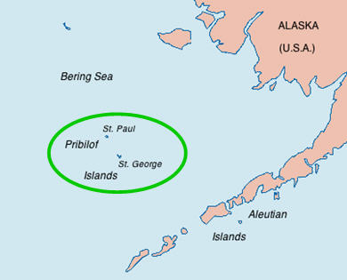
History: Where it Began (cont)
Done on Pribilof Islands Archipelago
St. Paul and St. George
70% of total Fur Seal Population globally

Slide 6
History: What it Looked Like
Track population composition:
Size
Age
Sex
Natural Mortality
Performed Observations
Summer months
Process needs to be accurate
Used for statistics

Slide 7
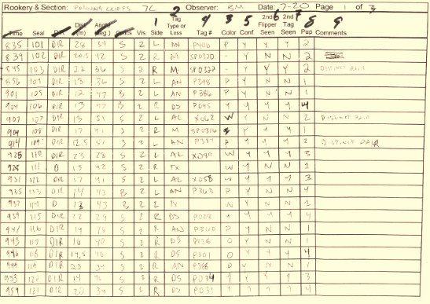
History: What it Looked Like (cont)

Slide 8
History: What it Looked Like (cont)
Codes are important
Visibility ( 1 - 3
Pup (0 – 5)
Age (P, J, A)
Loss (0 – 6)
Used for easy reference and writing
Cheat sheet on back of printed form
Used in Excel Sheet
Statistics and entry

Slide 9
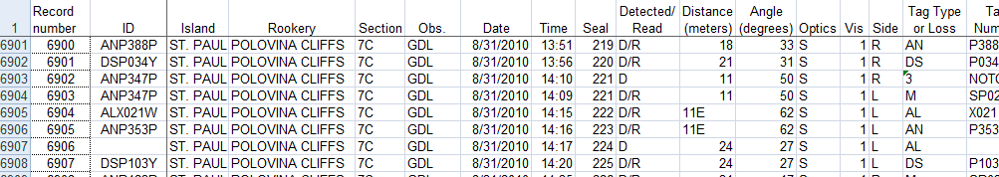
History: What it Looked Like (cont)
Entered into an Excel Spreadsheet
Used to create statistical data

Slide 10
History: What it Looked Like (cont)
Also done by performing “Counts”
Summer months
Pad and Paper
Entered into Excel Spreadsheet

Slide 11
Project Growth
From birth to adulthood…

Slide 12
The Growth of a Project
Birth
Initial Specifications
Toddler
Design
Pre-Teen
Finalizing Design
Teenager
Problems and Refactoring
Adult
Final Touches

Slide 13
Birth
Initial Specifications…

Slide 14
Birth: Initial Specifications
Client Specifications: Observations
Check IDLookup table for consistency
Tag Side, color, type, and number
Insert new record, or Edit previous record
Check plausibility of Tag Type / Color combo
Check plausibility of Island / Rookery / Section combo

Slide 15
Birth: Initial Specifications (cont)
Additional Specifications: Observations
Lookup table of all observations for that day
Dynamic Island, Rookery, Section, Tag Types, Tag Colors, and all codes
I.e. they can’t be hardcoded
There must be a centralized place to manage and transfer data to phone
Transfer IDLookup spreadsheet to Phone

Slide 16
Birth: Initial Specifications (cont)
Client Specifications: Counts
Counters for Females, pups, harem bulls, territorial bulls, and lone bulls
Harem Bulls must have females
Additional Specifications: Counts
Counters for dead adults, bulls, females and pups
Lookup table of all previous counts for that day
Ability to enter “negative” counts

Slide 17
Birth: Initial Specifications (cont)
Client Specifications: General
Export counts, observations to CSV
Move CSV from phone to computer
Additional Specifications: General
Export count totals in a separate CSV

Slide 18
Birth: Initial Specifications (cont)
Design Environment
Started with MotoDev for Eclipse
Switched to NBAndroid for Netbeans
Schedule
Planned for 8 hours a week
Spent much more

Slide 19
Toddler
Initial Design…

Slide 20
Toddler: Design
Prototyping
Convenient for working on Android
First large scale project
First Design Ideas
Based on initial specifications
Changed drastically by the end

Slide 21
Toddler: Design (cont)

Slide 22
Toddler: Design (cont)

Slide 23
Pre-teen
Finalizing Design…

Slide 24
Pre-Teen: Finalizing Design
Lots of refactoring
Project size grew quickly,
Needed easier way to add new elements without repeated code
i.e. a more Object Oriented design pattern
Produced
New design pattern
New database setup

Slide 25
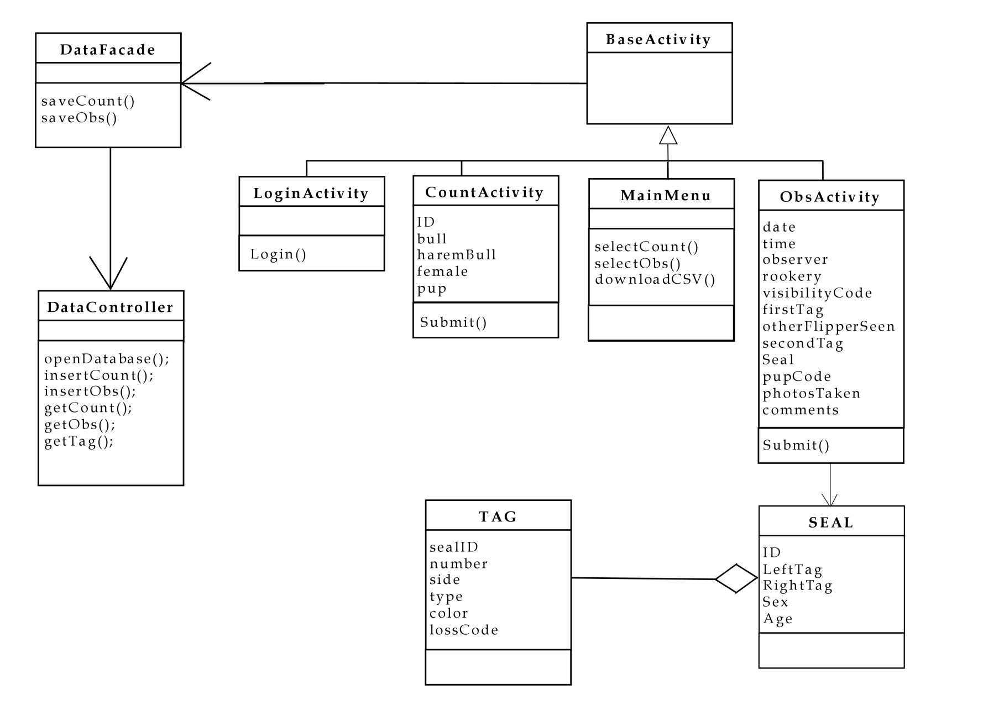
Pre-Teen: Finalizing Design (cont)

Slide 26
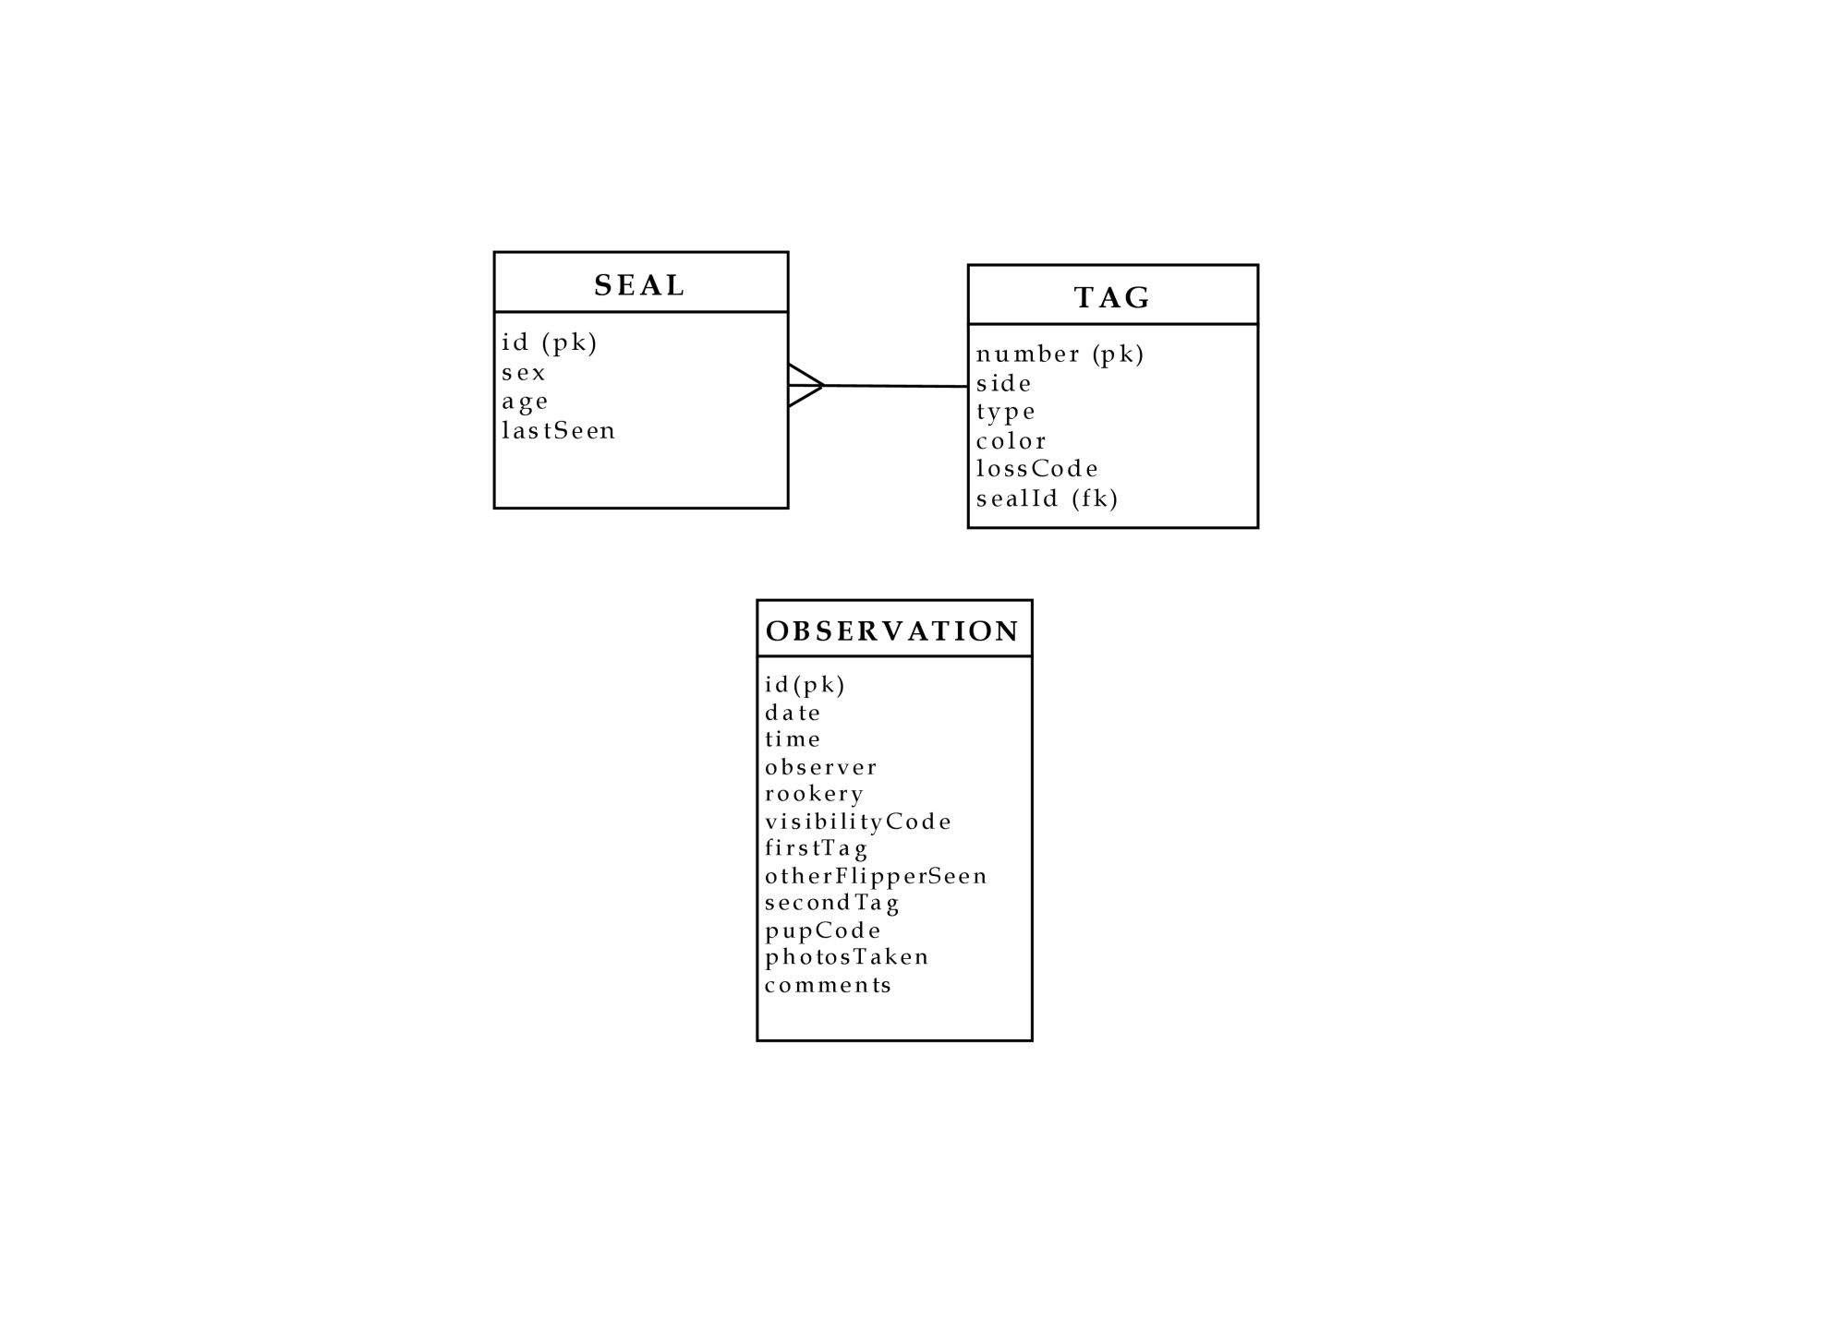
Pre-Teen: Finalizing Design (cont)

Slide 27
Pre-Teen: Finalizing Design (cont)
Not the end
Design changed one last time
Found classes were getting too large to be manageable
Wanted to separate functionality
Needed addition of classes to handle:
Database access
Xml Parsing
Export of CSV

Slide 28
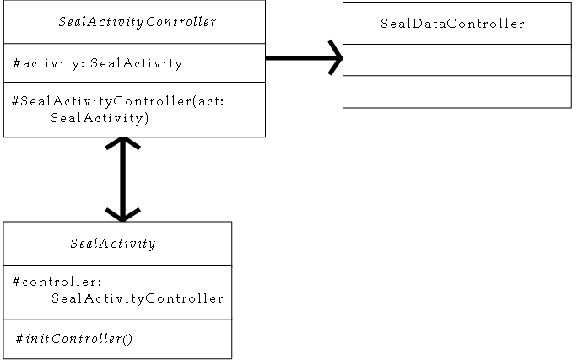
Pre-Teen: Finalizing Design (cont)

Slide 29
Pre-Teen: Finalizing Design (cont)
Each Activity activates its controller
Android Activity Management workaround
Slave wakes up the master….
Controller handles data validation, insertion, etc…
Activity handles all visuals
Model-View-Controller Pattern
A parallel class hierarchy
Also used Singleton and Adapter patterns
dataController
databaseController

Slide 30
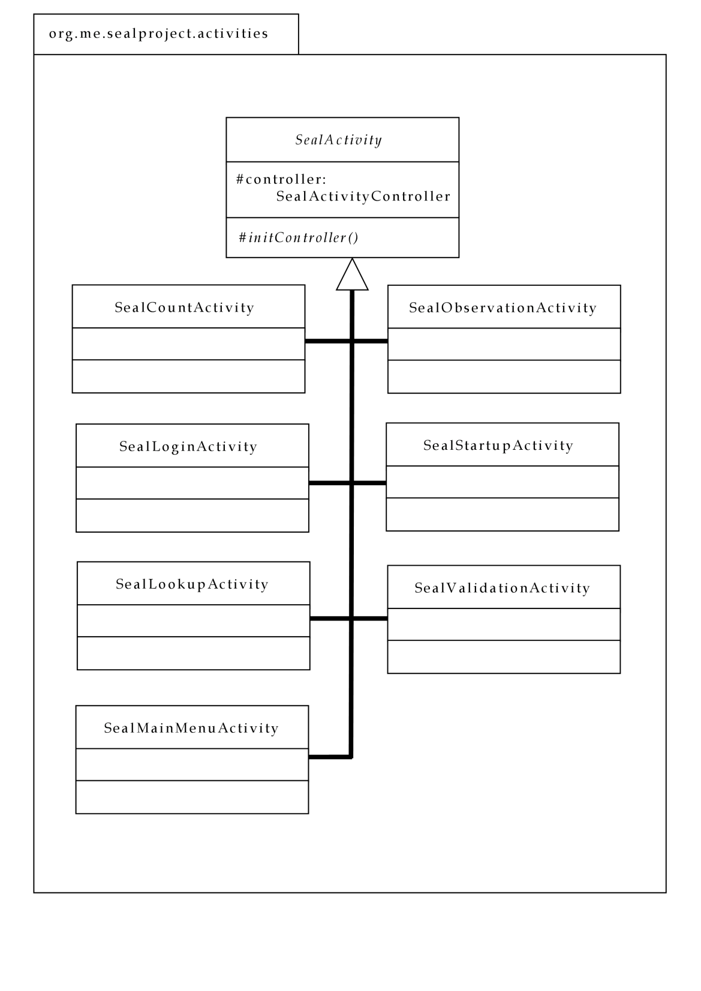
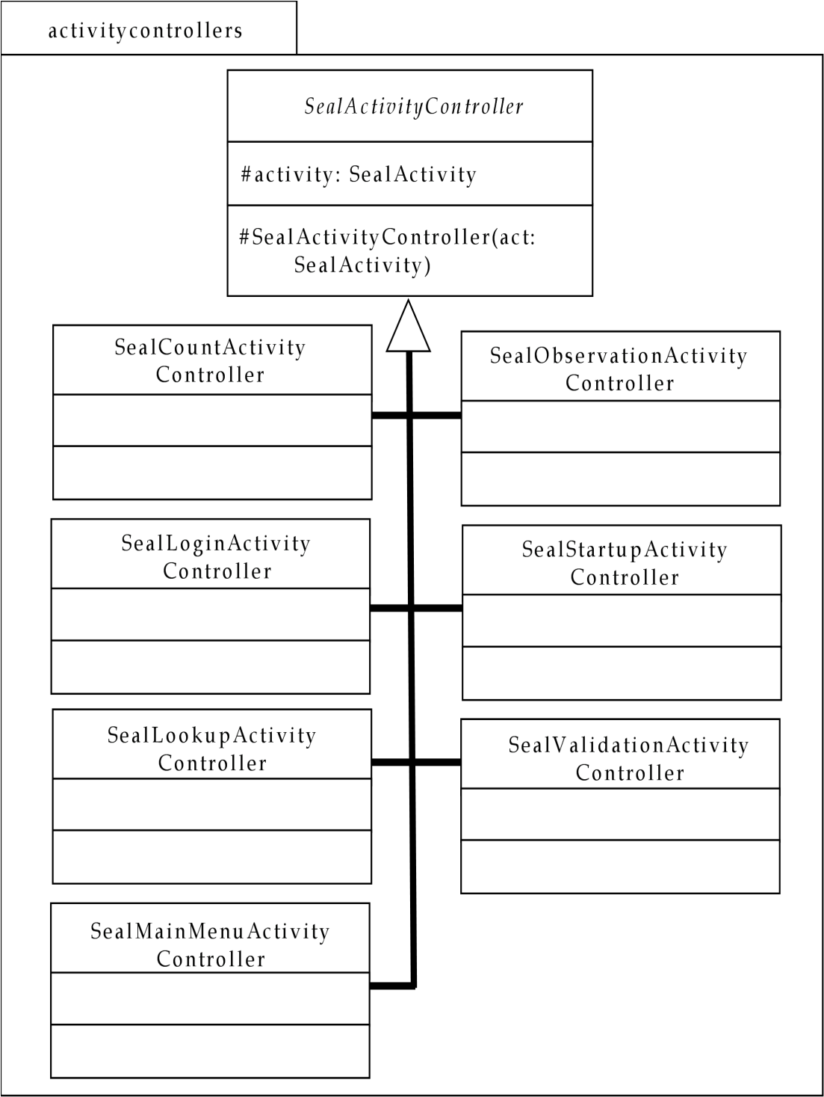
Final UML

Slide 31
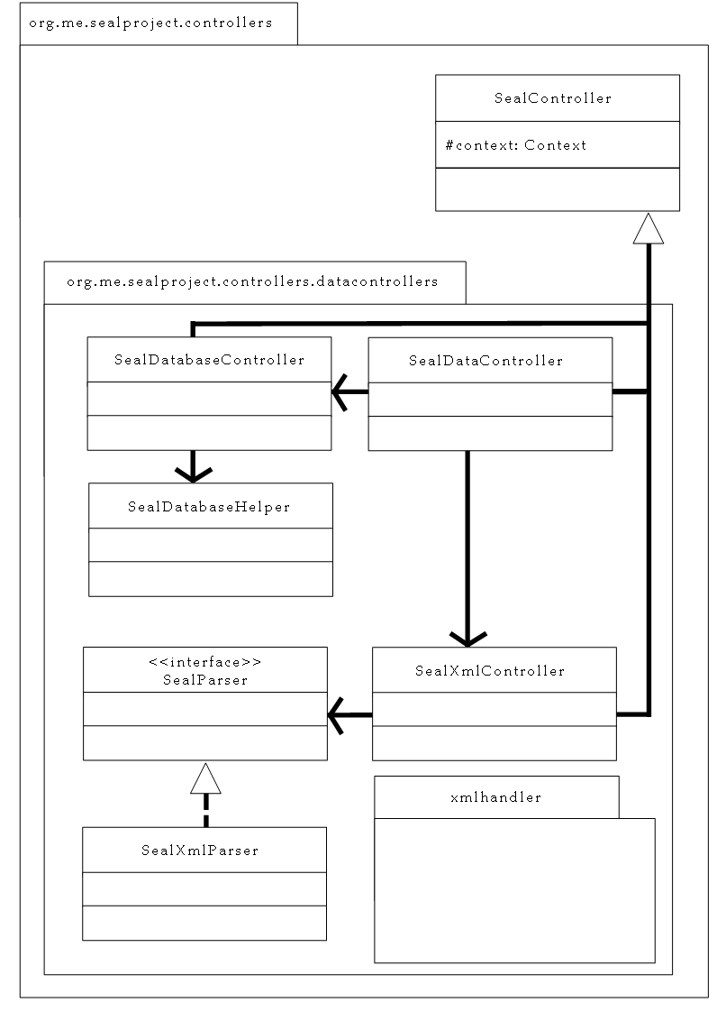
Final UML

Slide 32
Pre-Teen: Finalizing Design (cont)
More to do
Still needed to transfer files to phone
Transfer of Data to Phone
Mini program ran on computer
Needed to be compatible with Mac or Windows platform
Parsed Excel Document, put into XML format, transferred to phone SD card

Slide 33
Pre-Teen: Finalizing Design (cont)
Done with design
Easier to add components
More to figure out
Algorithms for parsing Excel, Xml and insertion to database
Now just needed to implement!
Lots of custom widgets for special functionality

Slide 34
Teenager
Problems and Refactoring…

Slide 35
Teenager: Problems / Refactoring
Learning Curve
First large scale project
Fairly new to Android
Never used SQLite
Debugging proved really difficult
Not always clear on error

Slide 36
Teenager: Problems / Refactoring
Misunderstandings
Several, all on my side of the street
Tag Creation and Management
Required a change to the database design
Seal Code Management
Additional Excel Parsing and insertion
Regular meetings helped, A LOT!

Slide 37

adult
Review…

Slide 38
Adult: Review
Planned 8 hours per week
Actual roughly 20 - 22 per week
Still working on bugs
Dr. Testa is working with phone

Slide 39
Adult: Review (cont)

Slide 40
Conclusion
To Conclude…

Slide 41
Conclusion
Learned Much
First Project with a Client
First Large Scale project
New to Android
App contained all major features needed
Took longer than expected
Hopefully will be used in the field
Work was hard but well worth it

