Slide 1
SEA-4
Ken Kelley
University of Alaska, Anchorage

Slide 2
The 4th Chapter
Everyone remembers the ground breaking epic game, known as “Sea”
Haven’t heard of it? Came out just before your earliest memories…
So popular that parts 2 and 3 quickly followed
A successful board game version was also made available, called Battleship.
Sea 4 aims to recapture the magic found in the original

Slide 3
The Goal
Design and Implement an interactive “Battleship” type game.
Language/IDE: C#, Visual Studio
User friendly GUI
Interactive Input
Immersive Output
Embedded videos
Logical AI Opponent
Features – Saving/Loading, Various Options
Increase experience with C#, and Visual Studio

Slide 4
The Essentials
Game Logic
Detect Valid Moves *especially important with ship placement, by both computer and player*
Fewer moves as game progresses
Win/Loss
Game Data
Need a way to represent a game state
Load/Save that state
AI opponent should make smart moves
Look for ships
Continue to sink a ship if found
Eventually opted to have several difficulty settings

Slide 5
The Essentials
And of course…. A GUI!
The workhorse of the program
Interactive component
Respond to player’s choices
Provide updates to game state, based on player’s actions
Be prepared to handle anything - especially incorrect responses.

Slide 6
The GUI
Menu
Load/save/new game
Options (extra features)
Text Box and Ship Counter
Inform player of win/loss
Game Messages
Action Window – Embedded Video/Interactive
2 Sea Grids (Array of Buttons)
Firing Grid
Ship Placement Grid

Slide 7
Firing Grid
Used to attack computer’s ships
Indicates hit/miss
Red: hit
White: miss
Blue: potential targets
Player can select a position, which is highlighted, and then click the “Fire!” Button
*Note* Clicking twice allows users the freedom to change their minds if a mistake is made.

Slide 8
Ship Placement Grid
Used initially to place ships…
Three Stages (Ship Placement)
User selects position
Possible layouts displayed, user chooses one
User confirms ship placement, may cancel anytime during the process
Player can view the status of their fleet
targeted by the computer, indicates computers hits/misses

Slide 9
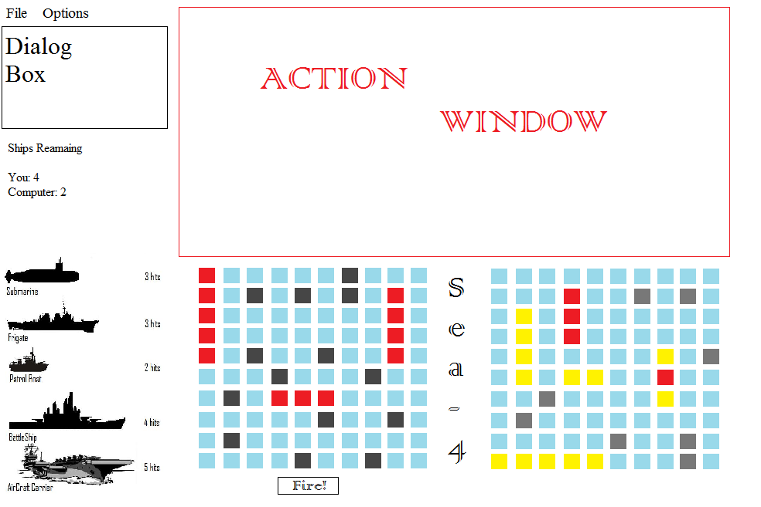
The Conceptual GUI

Slide 10
The Illusion of Control
One issue remains
Handling user interactions
Expecting the unexpected
Users need to feel like they are in control, and in fact, they are driving the application
We need a way to limit this control, to maintain stability of the program
How do we accomplish this?
The answer is relatively simple… if you have had the opportunity to enjoy CS351

Slide 11
The Solution
Phase System (Finite State Automata)
Certain parts of the application only respond when program is in a certain phase
Users interactions determine what phase its in
4 phases
Start : Number of Ships, AI difficulty, start ends
Ship: 3 phases of its own, create game state ends
Game: firing grid active, AI alternates, movies
Game Over: gameover() checked after each move
New Game, Play Again – restore start state

Slide 12
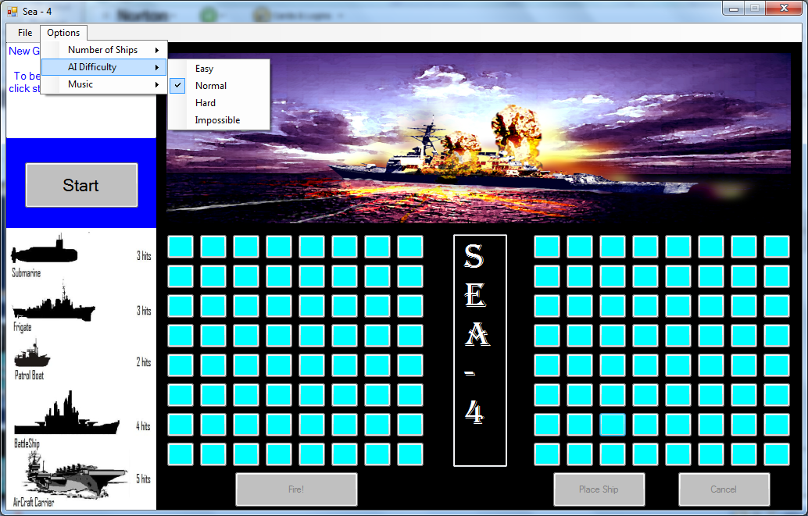
GUI - Start

Slide 13
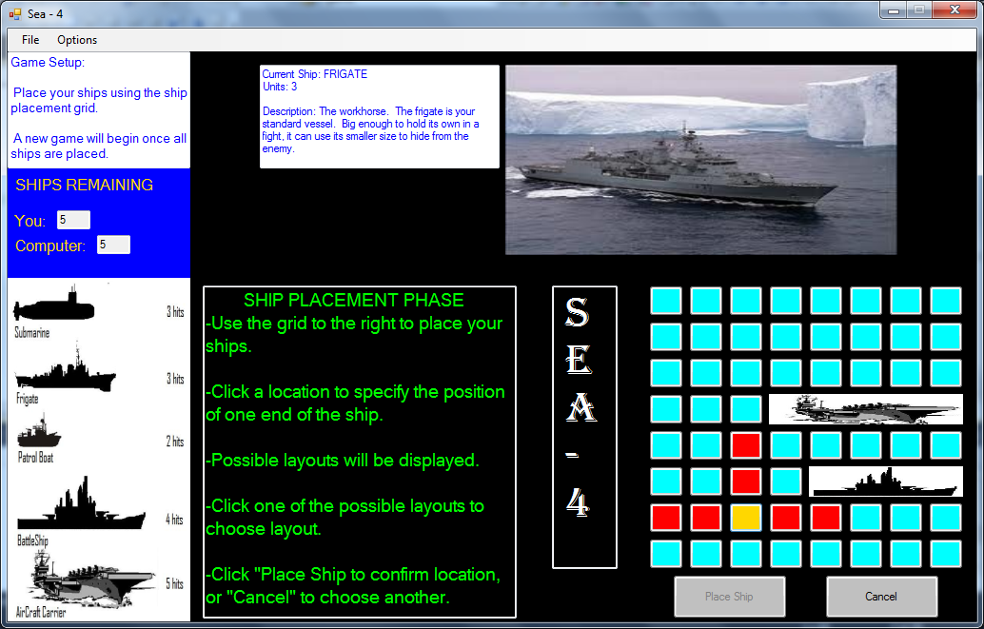
GUI - Ship

Slide 14
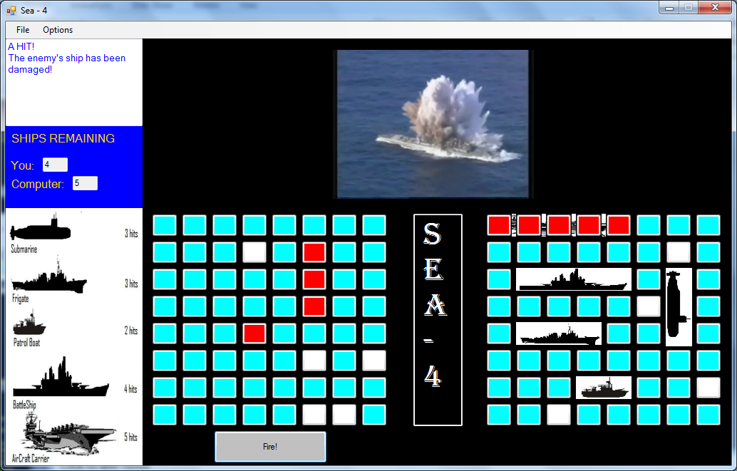
GUI - Game

Slide 15
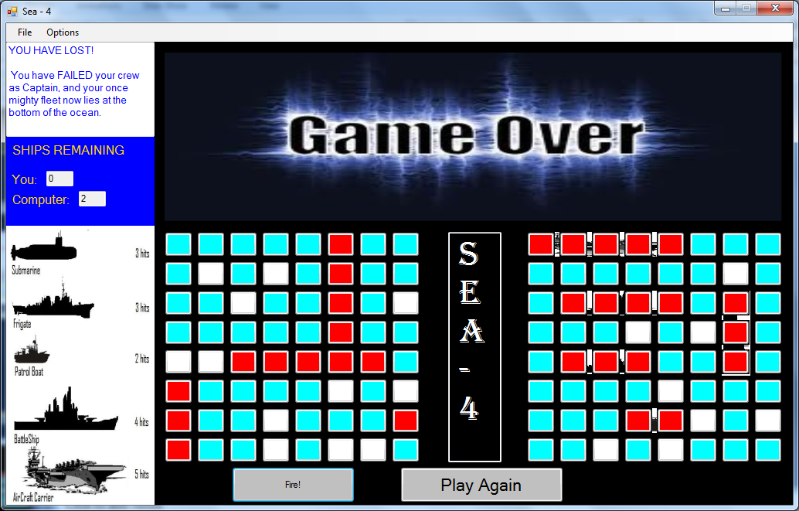
GUI – Game Over

Slide 16
Data Files
Two Important Files
.txt
.avi
Text files will contain game states, so that a game may be saved and loaded at a later time.
Video files will be used to enhance the user experience. Embedded videos will respond to the user’s actions.

Slide 17
It sounded good at the time…
This portion of the program had some major redesigns….
Problems
Game state was not sufficient to store data
Opted to scrap DirectX in favor of a player that was built into visual studio
Added visual instruction walkthrough, and images instead of colored blocks for ships (needed jpgs)
*increases immersion and is user friendly*

Slide 18
A Game State
0 0 0 0 0 X 0 0 0 0
0 0 0 0 0 0 1 0 0 0
0 0 0 0 0 0 1 0 0 0
0 0 0 0 0 0 1 0 0 0
0 0 0 0 X 0 1 0 0 0
0 0 0 0 0 0 1 1 1 0
0 0 X 0 0 0 0 1 1 0
0 0 0 0 0 0 X 1 1 0
0 0 0 0 0 0 0 1 0 0
00 0 0 0 0 0 0 0 0
(player)
H H H H H 0 0 0 0 0
0 0 0 0 0 0 0 0 1 0
0 0 0 0 0 0 0 0 1 0
0 X 0 0 0 X 0 0 0 0
0 0 0 0 0 0 0 0 0 0
0 0 0 0 1 0 0 0 0 0
0 0 0 0 1 0 0 0 0 0
0 X 0 0 1 0 0 X 0 0
0 0 0 0 0 0 0 0 0 0
0 0 0 0 0 0 0 0 0 0
(computer)
Two Arrays
Player
Computer
Four Variables
0: Open Water
1: Ship Placed
H: Hit by opponent
X: Miss by opponent

Slide 19
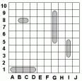
Game State - Redesign
4 3
XX XX XX XX XX XX XX HH HH HH
XX XX XX XX MM XX A1 XX XX XX
XX P1 P1 XX XX XX A1 XX XX XX
XX XX XX XX XX XX A1 XX XX XX
XX XX XX XX XX XX A1 XX XX XX
XX XX XX MM XX XX A1 XX S1 XX
XX XX XX XX XX XX XX XX S1 XX
XX XX XX XX XX XX XX XX S1 XX
XX XX XX XX XX XX XX XX XX XX
HH HH HH B1 XX XX XX XX MM XX

Slide 20
Embedded Video
Scrapped DirectX
Visual Studio has many hidden features
You can add controls (buttons and panels) to the application from the toolbox
Apparently, you can also add more tools to the toolbox
Windows Media Player is a built in tool, that can be added to the toolbox, extra control.
Windows Media Video (.wmv) replaced .avi

Slide 21
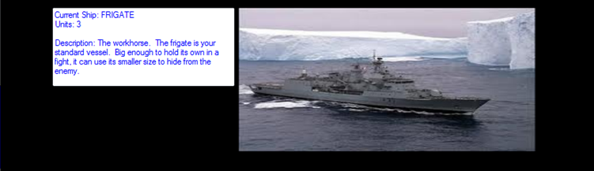
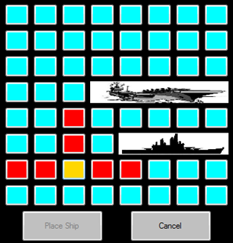
An image says a 1000 words
Ship phase walkthrough
Ship grid…
now with actual ships!

Slide 22
System Design
Programming Language/IDE
C#
Visual Studio
Data Structures
2-dimensional arrays - initial states, game changes
Simple and efficient
Algorithms
Mostly concerned with AI (Attack, ship placement)
Also used to initialize the game (allow player to place ships in a controlled manner
Save/Load game state

Slide 23
Algorithm – Computer Placement
private void placeCompShips()
{
int units = 5;
int counter = 1;
Boolean done = false;
Boolean emptySpace = false;
int x = 0;
int y = 0;
while (counter <= compShipCount)
{
if (counter == 6)
{
units = 5;
}
while (!done)
{
while (!emptySpace)
{
x = random.Next(0, 8);
y = random.Next(0, 8);
if (computerShips[x, y] == "XX")
{
emptySpace = true;
}
}

Slide 24
Algorithm – Computer Placement
int direction = random.Next(0, 5);
int directioncount = 1;
while (directioncount <= 4)
{
if (direction > 4)
{
direction = 1;
}
if (direction == 1)
{
if (clearPath(x, y, 1, units))
{
markCompShips(x, y, 1, units, getLabel(counter));
done = true;
}
}
else if (direction == 2)
{
if (clearPath(x, y, 2, units))
{
markCompShips(x, y, 2, units, getLabel(counter));
done = true;
}
Notes:
int direction = random.Next(0, 5);
int directioncount = 1;
while (directioncount <= 4)
{
if (direction > 4)
{
direction = 1;
}
if (direction == 1)
{
if (clearPath(x, y, 1, units))
{
markCompShips(x, y, 1, units, getLabel(counter));
done = true;
}
}
else if (direction == 2)
{
if (clearPath(x, y, 2, units))
{
markCompShips(x, y, 2, units, getLabel(counter));
done = true;
}
}
else if (direction == 3)
{
if (clearPath(x, y, 3, units))
{
markCompShips(x, y, 3, units, getLabel(counter));
done = true;
}
}
else if (direction == 4)
{
if (clearPath(x, y, 4, units))
{
markCompShips(x, y, 4, units, getLabel(counter));
done = true;
}
}
direction++;
directioncount++;
}
emptySpace = false;
}
if (counter != 3 && counter != 8)
{
units--;
}
counter++;
done = false;
}

Slide 25
Algorithm – Computer Placement
else if (direction == 3)
{
if (clearPath(x, y, 3, units))
{
markCompShips(x, y, 3, units, getLabel(counter));
done = true;
}
}
else if (direction == 4)
{
if (clearPath(x, y, 4, units))
{
markCompShips(x, y, 4, units, getLabel(counter));
done = true;
}
}
direction++;
directioncount++;
}
emptySpace = false;
}
if (counter != 3 && counter != 8)
{
units--;
}
counter++;
done = false;
}
Notes:
int direction = random.Next(0, 5);
int directioncount = 1;
while (directioncount <= 4)
{
if (direction > 4)
{
direction = 1;
}
if (direction == 1)
{
if (clearPath(x, y, 1, units))
{
markCompShips(x, y, 1, units, getLabel(counter));
done = true;
}
}
else if (direction == 2)
{
if (clearPath(x, y, 2, units))
{
markCompShips(x, y, 2, units, getLabel(counter));
done = true;
}
}
else if (direction == 3)
{
if (clearPath(x, y, 3, units))
{
markCompShips(x, y, 3, units, getLabel(counter));
done = true;
}
}
else if (direction == 4)
{
if (clearPath(x, y, 4, units))
{
markCompShips(x, y, 4, units, getLabel(counter));
done = true;
}
}
direction++;
directioncount++;
}
emptySpace = false;
}
if (counter != 3 && counter != 8)
{
units--;
}
counter++;
done = false;
}

Slide 26
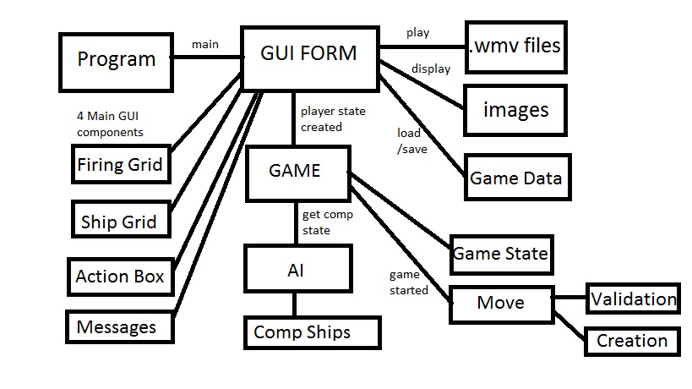
System Architecture

Slide 27
The Estimate
144 hours in the semester
8-12 hours a week

Slide 28
The Schedule

Slide 29
The Reality
8 – 12 hours a week…
Beginning was a little less than 8 hours
End was exceeded 12
Averaged out, but less pressure at start
Schedule ran into problems almost immediately
Priority of tasks
Video - kind of useless without hit s and misses
game state – need a state to display, need a game
Ship placement = highest priority.
Design changes (extra features, windows media player)

Slide 30
Conclusion
Sea 4 (Interactive Battleship)
A user friendly GUI, incorporates a phase system
Many Features
Music
Game variations
Number of Ships
Difficulty settings
Visual feedback - ship placement, videos
Load/Save …. And More!
It was a fun project, that I enjoyed, and I am happy with the outcome.

Slide 31
Conclusion
Provided programming experience
embedded videos
IO, Data Structures, GUI design, AI
experience with C# and Visual Studio
Provided software development experience
Design -> proposals -> implementation -> even distribution, this covered it all
Learned to accept/incorporate peer feedback through heuristic evaluations
Flexibility, as design can change, and problems arise

Slide 32
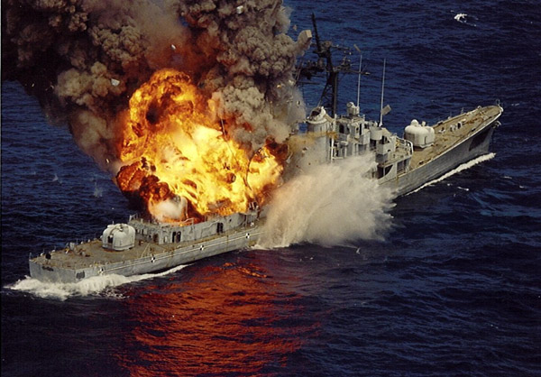
Questions?

