Slide 1
Online Roleplaying Game System
Ben Hall
CS 470
4/14/2011

Slide 2
Overview
Goal
Create a system to be used in an online roleplaying game
Requirements
Must run in a web browser
Using Silverlight with C#
Project is still a work in progress

Slide 3
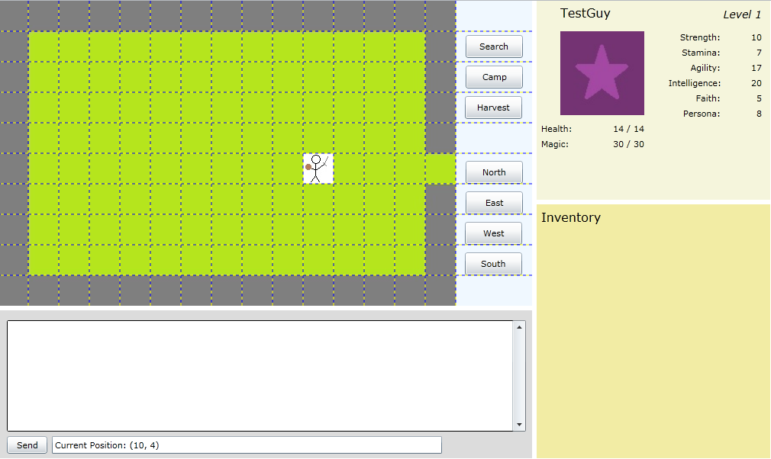
Interface

Slide 4
Map and Movement
Movement is currently done with buttons
Still wanting to implement click-to-move
Represented by GameMap objects
Uses arrays to determine which cells are movable and which contain Events
Events can trigger transitions to other maps
Movement in a map can trigger combat

Slide 5
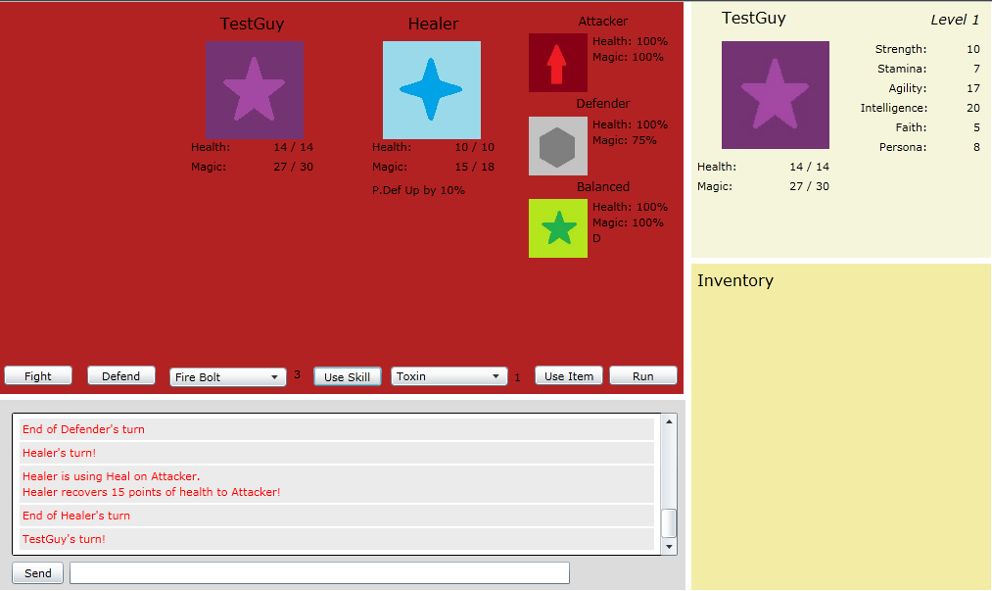
Combat

Slide 6
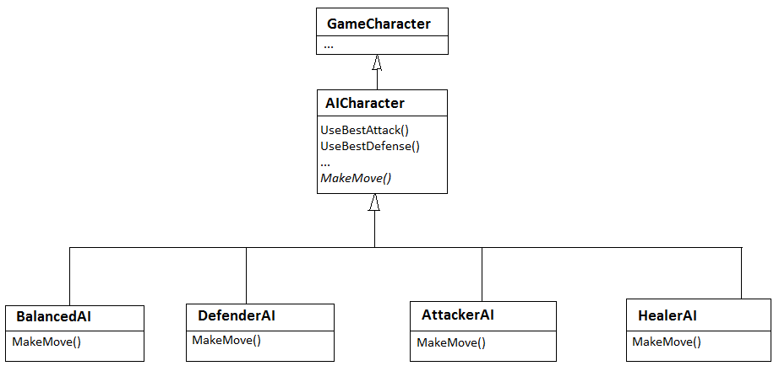
Combat
Turn-based
AIs use decision trees and random numbers
Currently 4 different styles of AI

Slide 7
Item Creation
Players would have crafting skills that allow them to create custom items and equipment
Item recipes would require some materials and allow others for different results
Not currently implemented

Slide 8
Player Interaction
Adventuring groups
Multiplayer combat, group-specific areas
Chat system
Various channels (Area, Party, Private, Global)
Specific types can be filtered

Slide 9
System Development
Most data currently stored as resource files included the application
May need to change in the future
Database use needed for login and permanent character storage

Slide 10
Schedule
Obviously behind schedule
Underestimated time needed for implementation
More difficulties from Silverlight than originally expected

