Slide 1
Hook – A First Person Shooter
Wes Rathburn
CS 470 - Applied Software Development

Slide 2
Project Overview
Goal - Develop a 3D Multiplayer First Person Shooter Game using Microsoft’s XNA Game Studio.
Introduce a new element to the traditional FPS gameplay.

Slide 3
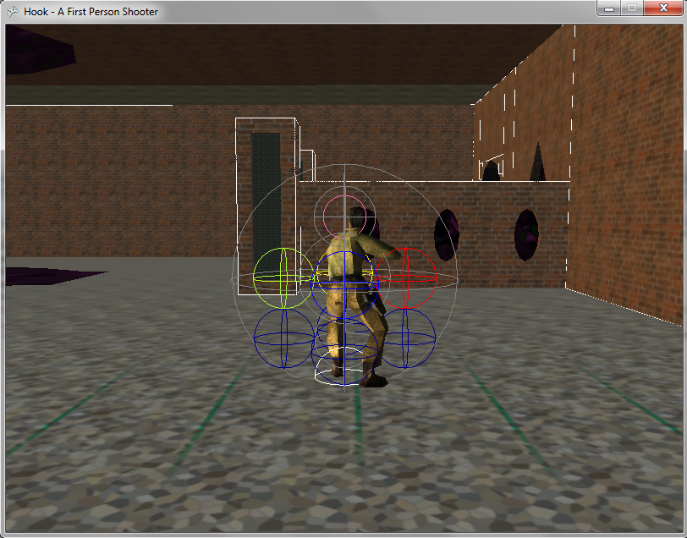
Traditional Gravity

Slide 4
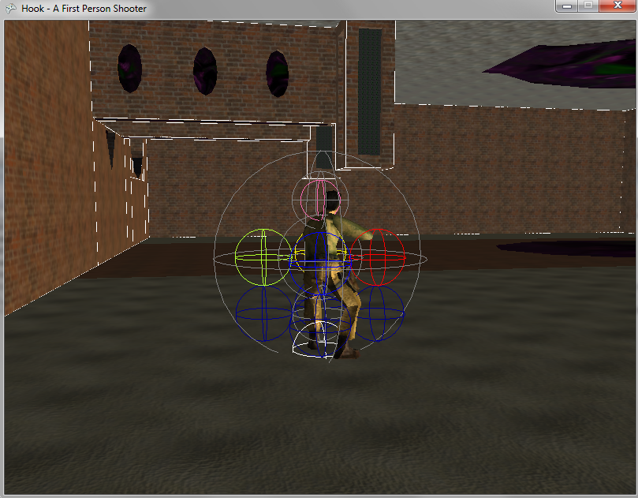
Hook Gravity

Slide 5
Hook Gravity
Player controlled gravity orientation
Limited to the 6 axis vectors
Allows for every surface of the map to be navigable. *(map determinant)

Slide 6
Controls
Standard First Person Shooter Controls
WASD
Spacebar
Shift to walk
Mouse to look around
Left mouse button to fire weapon.

Slide 7
Hook Controls
Many schemes were tested.
Press Spacebar to Jump and then while in the air press
Q – Rotate Gravity Vector Left
E – Rotate Gravity Vector Right
2 or 3 – Rotate Gravity Vector Forward
Gravity Planes that are visible to the player.

Slide 8
Gameplay
Team Deathmatch or Team Match Play
Each Team can have up to 8 players.
Death Limits or Round Limits can be adjusted by the player who hosts the game.
Any player can host a game.

Slide 9
More Gameplay
Laser Projectiles are fired in a semi-automatic fashion
Limited amount of rounds that can be shot
Weapon recharge areas in the map. (out in the open)
Damage can be either directed to the body or the head of another player. (Headshot = instant death)
Friendly Fire is OFF.

Slide 10
Player Stats / Game Stats
Individual player statistics limited to kills and deaths.
Game statistics are simply running tallies of each team’s collective player stats.(kills/deaths)
For Team Match Play, a third game statistic is added – Round Wins

Slide 11
Hook Gravity in the Game
There is no distance limit from a surface at which you can orient gravity.
Max Gravity Velocity = Max Movement Velocity.
There is no limit on how many times you can change gravity, but you can only change gravity once per jump.

Slide 12
Map and Model
The player character model is an imported Half-Life Model.
6 Animations imported
Two different textures files for the different teams.
One Map. Downloaded from TurboSquid.com
Provided Free to the XNA community.

Slide 13
Title Screen
Still under construction but will display the options for starting a new networked game or connecting to an existing networked game.

Slide 14
Prototyping the Game
New to game programming so releasing incremental prototypes helped me to better define the limitations for this game.
Hook gravity controls. Finding an ideal schema.

Slide 15
Game Design
Object Oriented
Player
Map
MapAsset
ModelAsset
CameraAsset
Bullet

Slide 17
Summary
Created and still prototyping a First Person Shooter game using Microsoft’s XNA Game Studio.
I learned a great deal more about the C# language.
Increase my use knowledge of Visual Studio
Underestimated the extensive work required for dealing with 3D models, but learned a great deal from my experience.

Slide 18
Questions?
Hook – A First Person Shooter
Wes Rathburn

