Slide 1
Providence Hospital Nurse Scheduling
Richard Patrick Greer

Slide 2
Introduction
The Neonatal ICU in Providence Alaska Medical Center would like a scheduling system to assign nurses to babies based on numerous constraints.
Several constraints make it difficult for a human to find a solution.

Slide 3
Excel sheets hold data in regards to infants, staff, psycho social classification of infants, and biomedical classification of infants that are used to determine schedules.

Slide 4
Currently, a member of staff has to assign nurse preferences based on a nurse’s training and schedule.
Then a staff member pairs babies to each nurse as close as possible to their preferences. However, some babies depending on their biomedical risks may be assigned to one, two, or three nurses.

Slide 5
The variation of preferences and the number of babies assigned to a particular nurse presents a problem that is not easy for a human to solve optimally or quickly.

Slide 6
Data Overview
The data of interest is listed below:
Nurses
Preference1
Preference2
Preference3
Babies
Medical Risk
Staff

Slide 7
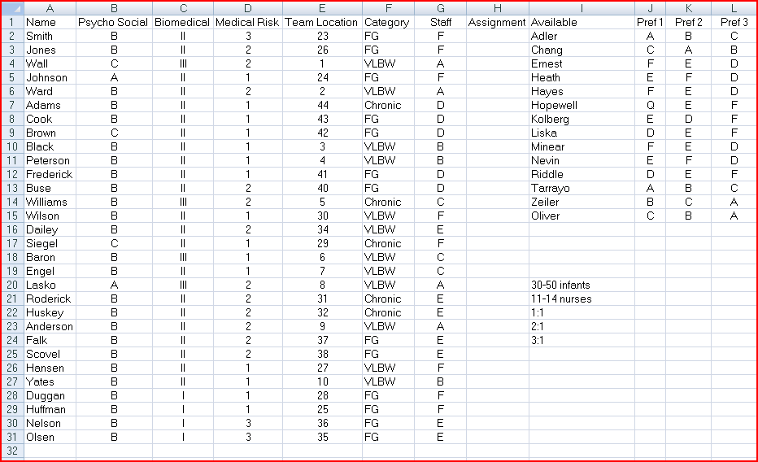

Slide 8
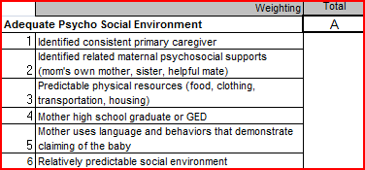
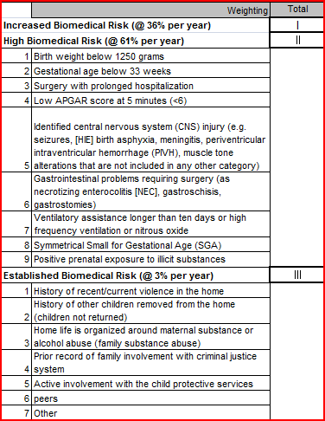
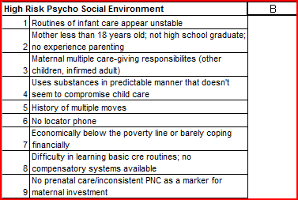
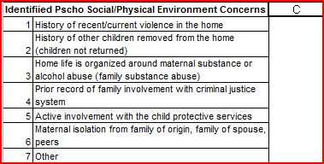

Slide 9
Large Problem Space
In an ideal situation every baby would be paired with one nurse and every nurse would be paired with one baby
If there are 14 babies and 14 nurses.
The number of possibilities to pair babies with nurses is equal to 14 factorial(14!).

Slide 10
14!= 14*13*12*11*10*9*8*7*6*5*4*3*2*1
= 87,178,291,200
However, in most situations there will be about 30-50 babies with 0-3 babies assigned to a nurse.

Slide 11
The problem space will change depending on the number of nurses, babies, and the medical risk of the babies.
Still the problem space will be very large.

Slide 12
Genetic Algorithm
Since the problem space is so large a genetic algorithm is used.

Slide 13

Chromosome
A chromosome will be represented as an array
The index of the array will correspond to a particular baby and the row will hold the nurse.

Slide 14
Mutation
A random point or points in the chromosome will be chosen for mutation.
A nurse or nurses will be changed to a new valid choice that still meets the constraints by switching one nurse from a different point in the chromosome with another.
if(isValid(mutant))
pop[x] = mutant;

Slide 15
Crossover
Partially mapped cross over is used
After crossover is completed a function is used to check whether or not the new chromosome is valid
If it is valid the new chromosome is added to the population.
if(isValid(offspring1))
parent1 = offspring1;
if(isValid(offspring2))
parent2 = offspring2;

Slide 16
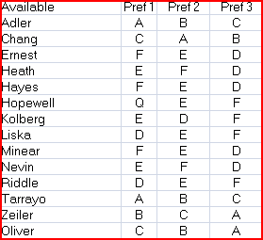
Fitness
int best = 100; // first pref
int second = 50; // second pick
int third = 25; // third pick
int notPref = -100; // not a pref

Slide 17
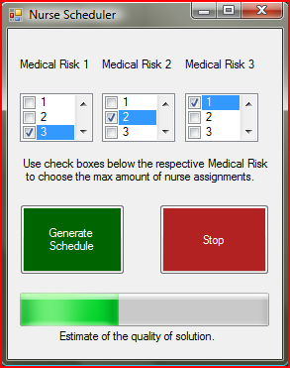
GUI!
The progress bar is incremented for every new generation of solutions that is created by the genetic algorithm.

Slide 18



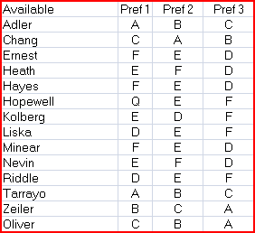
Sample Results

Slide 19
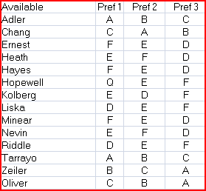



Sample Results
The genetic algorithm does optimize partial schedule. However, the Medical Risk constraints are not broken.
Only minor changes are needed to handle partial schedules. I will have this finished in the next few days.

Slide 20
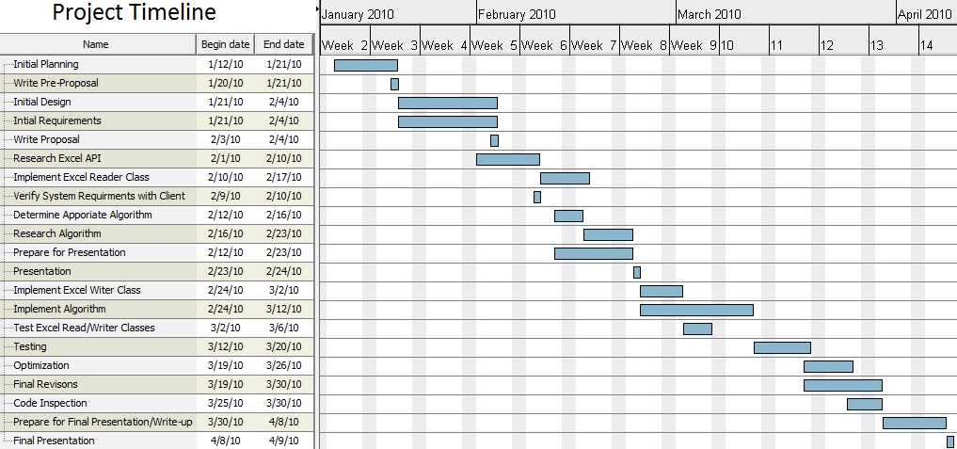
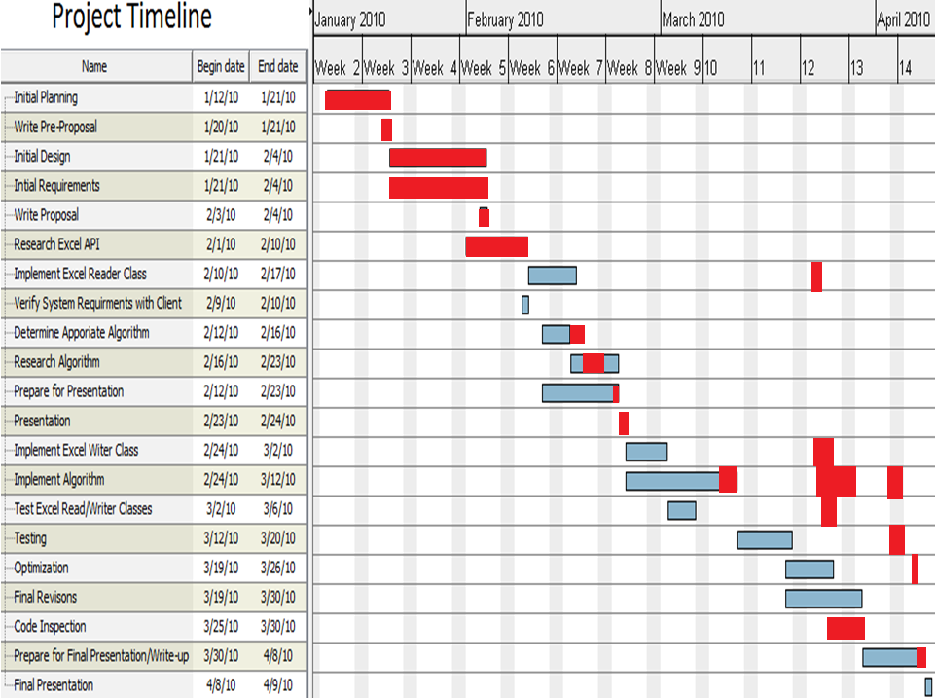

Slide 21
Conclusion
Data is from spread sheet and stored in objects and arrays.
A genetic algorithm returns a solution when it is terminated either by the user or by a time limit.
The new data is outputted to the spreadsheet.

