Slide 1
A New World
Or
People Keep Telling Me This is Ambitious
By Jeremiah Lewis

Slide 2
Overview
Create a FPS (First-Person Shooter)
Use a modular weapon system, providing different modes of attack and defense from the same ‘weapon’
Instead of using multiple types of enemies to challenge the players, use only a few types of enemies that ‘evolve’ as the player plays the game

Slide 3
Data Files
Data Files
<map name>.map
  120x40 grid, representing the floor, wall and ceilings of the terrain
  The starting position of the player
<map name>.objects
  Data to create the lights and the pathing tree used by the AI
<map name>.data
  Player data and data representing the ‘pool’ used by the Evolutionary Strategy to create new AIs

Slide 4
How was this created?
Load the name.map file into an array, creating the static objects based off of the array
Load the namd.objects file, creating all the objects that need to change over time, sometimes creating threads for them
While the program is playing, not only is the AI over-mind creating children to be placed in the game, but it is also writing the data those children will have into the name.data file.

Slide 5
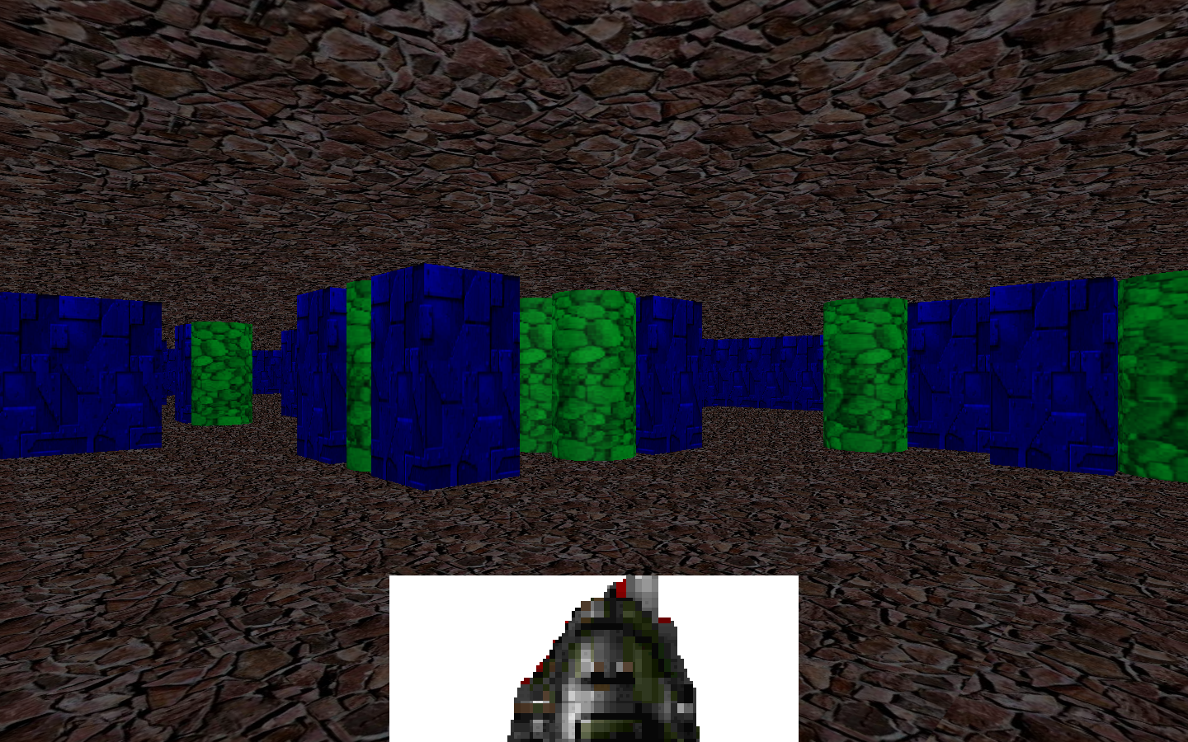
Final Product

Slide 6
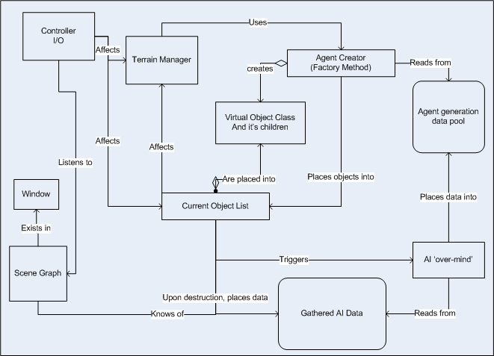
System Architecture

Slide 7
Algorithms: Evolutionary Strategy
Uncorrelated mutation with n-step sizes
  <x₁,…,x_{n},sigma₁,…,sigma_{n}> where n = 5
Mu (number of parents chosen) = 3
Lambda (number of children created)= 9
Tau (rate of learning, usually 1/sqrt(2n) ) = 2
Survivor selection is (mu, lambda)
Fitness selection is based on time the AI was ‘alive’, and how much damage the AI dealt
Fitness weighted by linear normalization

Slide 8
Algorithms: AI Finite-state Machine
Spawn
Walk nearest path
If see opponent, decide what to do:
  Attack with ranged attack
  Cast spell on self and attack with close-ranged attack
  Run away and cast trap spell on floor
Repeat #3 until opponent is dead or you are
Go to nearest path and do #2

Slide 9

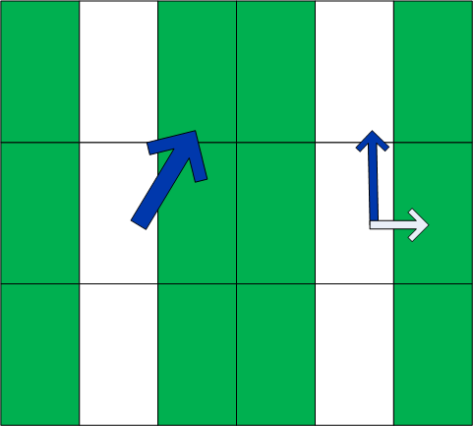
Algorithms: Collision Detection

Slide 10
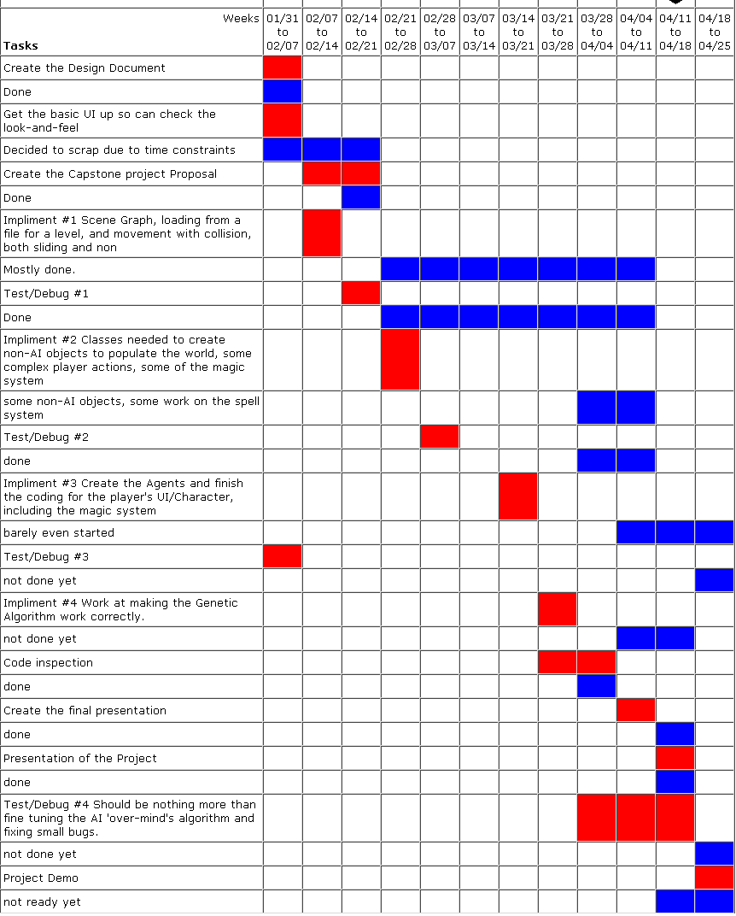
Timeline

Slide 11
Conclusion
I will be able to provide a playable demo in time, but it will not have the full functionality that I wanted
I learned:
  More about graphics programming than I thought possible
  More about AI design
  That learning several very different APIs at the same time makes my brain hurt
  That when the game companies have to push a game back by a year, they have excellent reasons
  There are more ways to apply evolutionary computing techniques than I thought

