Slide 1
An Automated Scheduler for Specials at Creekside Park Elementary School
Bruce Templeton
CS 470

Slide 2
System Overview
Goal
Develop a program to assist in the scheduling of times for students to be in ‘Specials’.
The client is the Creekside Park Title One department.
Why?
The Title One department is currently doing this scheduling completely by hand.
This program will significantly reduce the time it takes to schedule the ‘Specials’ for the classrooms each year.

Slide 3
What is a Special?
A Special is a scheduled time which students are required to be performing a specific task.
Examples
PE
Music
Lunch
Reading
Math
Science

Slide 4
Special Requirements
May be assigned to the entire grade.
May be a daily item.
Special may be in a different classroom.
Only one special at a time per classroom.
Lengths must be in multiples of 5 minutes.

Slide 5
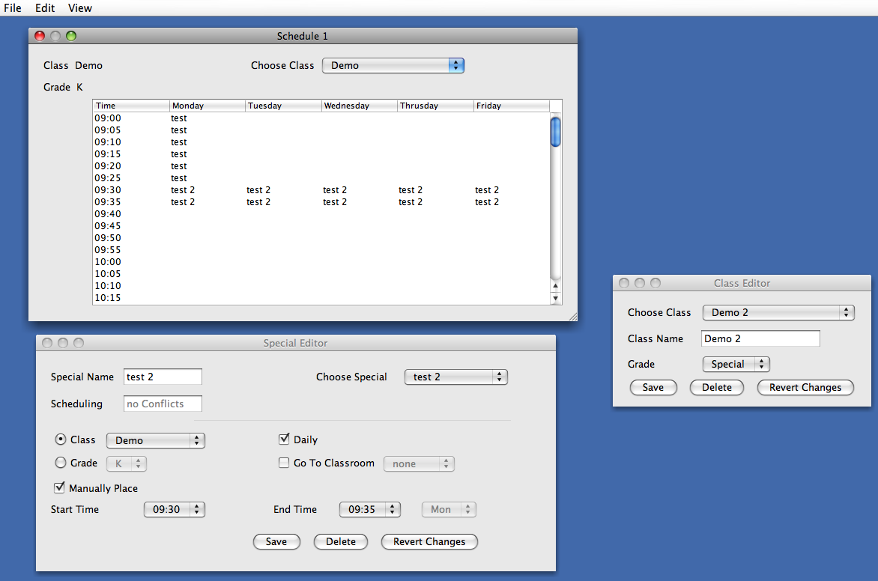
Current GUI

Slide 6
How as this Created?
The entire program is written in Java
The GUI was designed in NetBeans

Slide 7
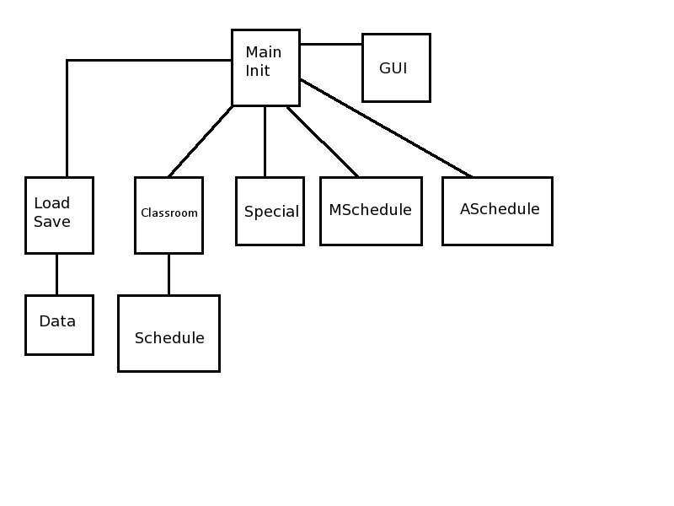
System Architecture

Slide 8
Classes
Schedule
Stores the schedule for each classroom
This is done with a 2D array
Classroom
This class represents each classroom
Does all conflict checking when adding or removing a special from the schedule

Slide 9
Classes
Special
This class hold all the information for each special
MSchedule
This is the manual scheduler
All specials are stored in an array
All Classrooms are stored in an array
LoadSave
Saves and load the classrooms and specials
The option to import specials from a previous year

Slide 10
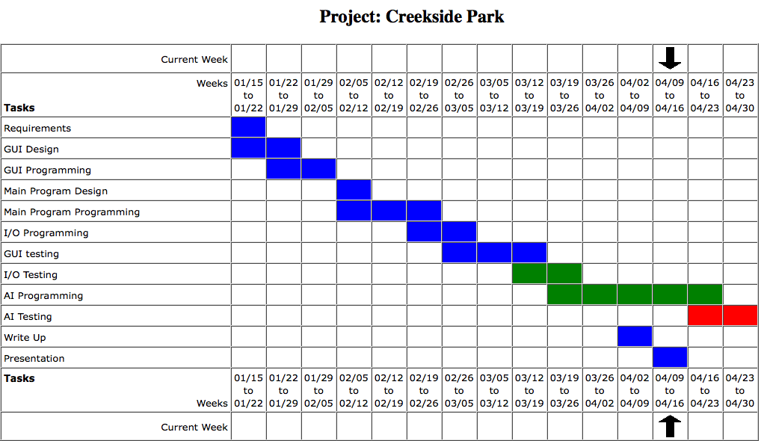
Schedule

Slide 11
Conclusion
Goal
Created a program that will significantly reduce the time it takes to schedule specials.
Challenges
Dealing with a client who is not sure what they want. The UI has changed quite a bit from the initial design.
Staying on schedule with all the changes

