Slide 1
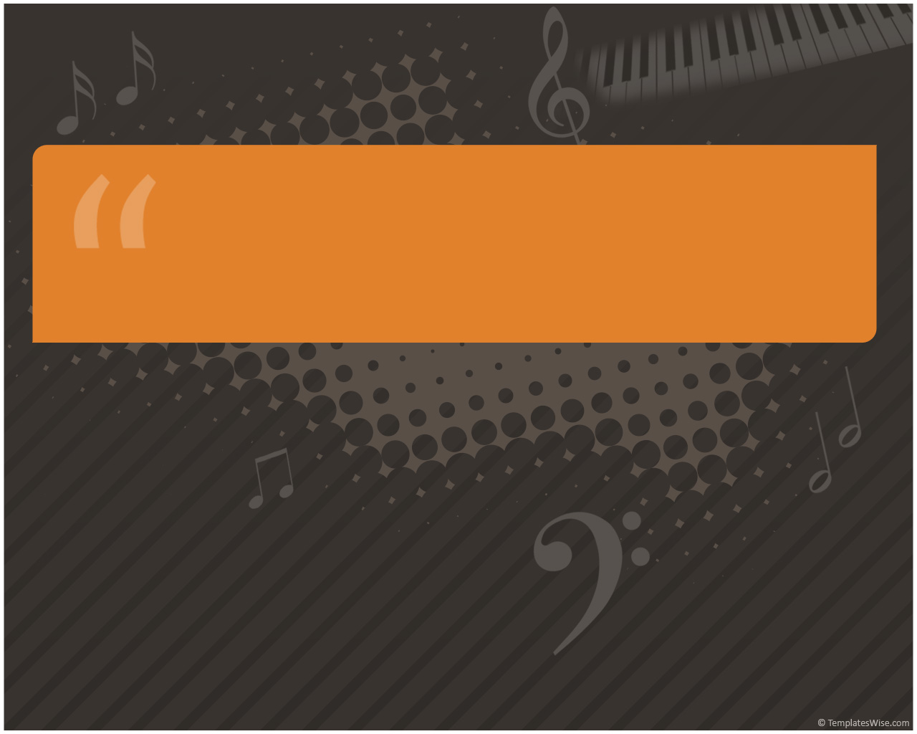
Guitar Trainer
Adam Janke
CS 470
Final Presentation

Slide 2

Project Overview
Goal
  Create an application that will assist guitar players in learning new songs
Purpose
  As a guitar player in training, creating an application that will help better myself and any others is a worthwhile project
  Better myself in Windows Form applications and 2D graphics drawing

Slide 3
Feature List
Read a specific binary file type named Guitar Pro (specifically, version 4)
Use the information read from the file to draw music tablature for each of the tracks defined (guitar, drums, bass, etc)
Allow the user to search and view YouTube videos for assistance
Written in C#

Slide 4
Why Guitar Pro Files?
A professionally defined standard
Large user base and already has tablature written for just about any song
Contains several aspects of my project (such as lyrics, tempo, notes, etc) into one place

Slide 5
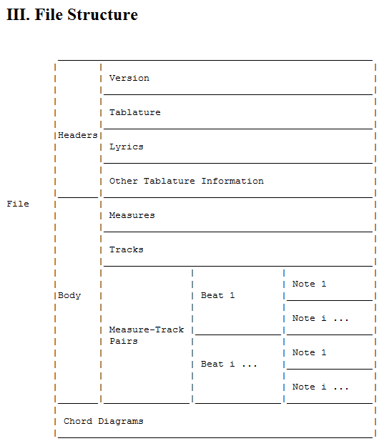
Guitar Pro File
The file is laid out as such:

Slide 6
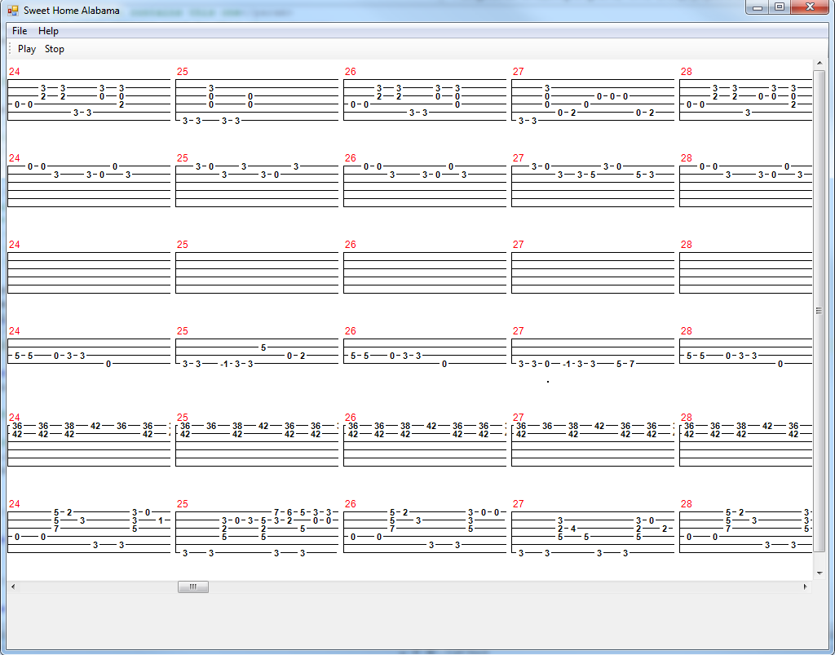
What it looks like

Slide 7
How is it drawn?
Read in the Guitar Pro file sequentially since most sections of the file have no maximum or minimum length
Save each part of the file in a particular class. A song is read in, which has tracks, each of which have measures, each of which have notes or rests, which have durations and effects (bends, hammer-on/pull-offs, vibrato, etc)
Measures must belong to tracks and each track must account for different instrument types
Songs have keys and tempos
There is a lot to account for!

Slide 8
How is it drawn continued
Similar to saving all the song information, drawing window requires a lot of depth.
The frame main window is drawn
On top of the main window a panel is drawn that contains all the tracks
Each track is drawn on top of that and each measure over the track it belongs to
Further, each note, note effect, and rest is drawn on top of its measure
Care must be taken to ensure elements are drawn in the proper order else something may be drawn on top of

Slide 9
Real-time playing
The measure that the song is currently on will have a red line drawn below it and will follow the song, measure by measure, sing-a-long style
The tracks will automatically scroll along with the song for hands-free play

Slide 10
Sound
The capabilities for MIDI playback are there (MIDI information is in the file)
I would like to have this implemented by demo time
Currently, the song plays with no audio accompaniment
Might have to concede to time and just have it play back an MP3 which is much easier
Less dynamic since user would have to provide MP3

Slide 11
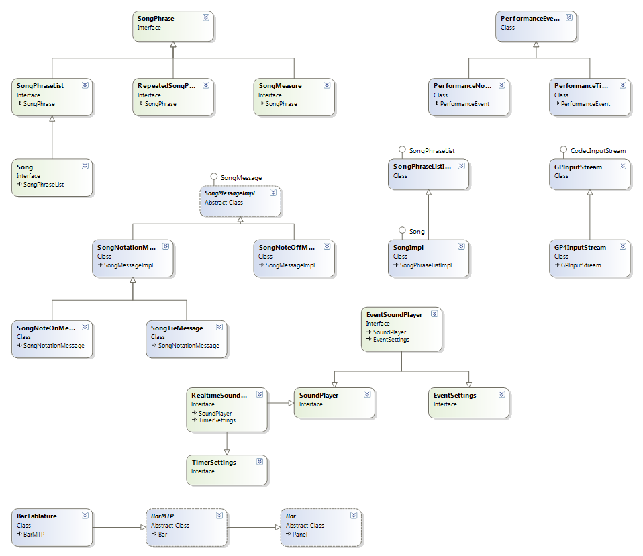
Class Diagram

Slide 12
Prototyping
I used prototyping since I had a feeling my own requirements would change slightly over time (and I was right!)
  Scrapped standard-less guitar tab file reading in favor of the Guitar Pro format. Implementing a reader for this took much longer than anticipated
    Allowed for much more dynamic of a program, however
  Guitar Pro format allowed for departure from visual chord diagrams
    “Real” style sheet music results in same benefit

Slide 13
Planning & Scheduling
In proposal guessed 12 hours/week
  I was pretty much on par with this
  Since requirements changed, however, my total time estimate was not as good

Slide 14
Planning & Scheduling

Slide 15
Conclusion
Implemented a much harder project than I anticipated
Gained experience in various aspects I had not worked much with
  Binary file reading
  Audio playback
  Play/stop
More C# experience
A non-toy project of significant scope

