Slide 1
Internship in Computing CS 395 Sunil Panthi

Slide 2
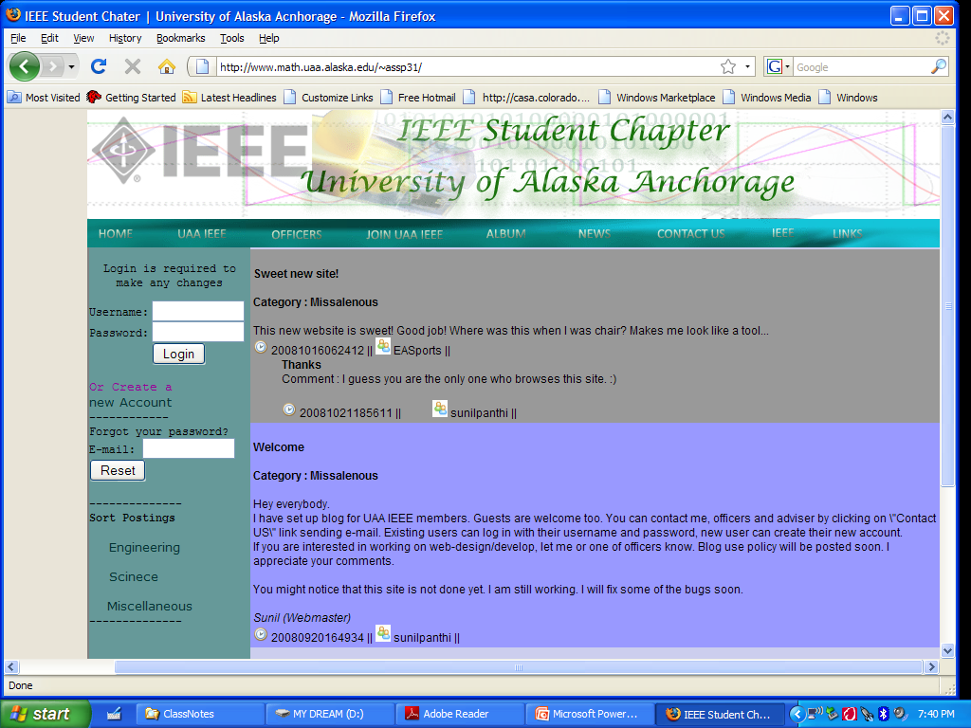
Goal Tools Implementation Database Architecture Summary Questions

Slide 3
GOAL
User Interactive Web Interface
Update Pages by Club Officers
Two Level of Authentication

Slide 4
TOOLS
Languages : PHP, JavaScript, HTML, CSS
Database: MySQL
Server: Apache
Browser: Firefox (Preferred)

Slide 5
IMPLEMENTATION
Blog Summary
Guest User
Navigate the page, Apply for Club Membership, Create Account
Authenticated User
Blog Function,
Create the content (3 MB file upload allowed)
Modify, Delete, Comment
Add Comment (others content)

Slide 6
IMPLEMENTATION
Administrator
Authenticated User Privilege
Delete Inappropriate Content
Update Web Page (Web Designing Skill not Needed)
Post News/Announcement
Access Membership Applications
Access to E-mail Sent via Site

Slide 7
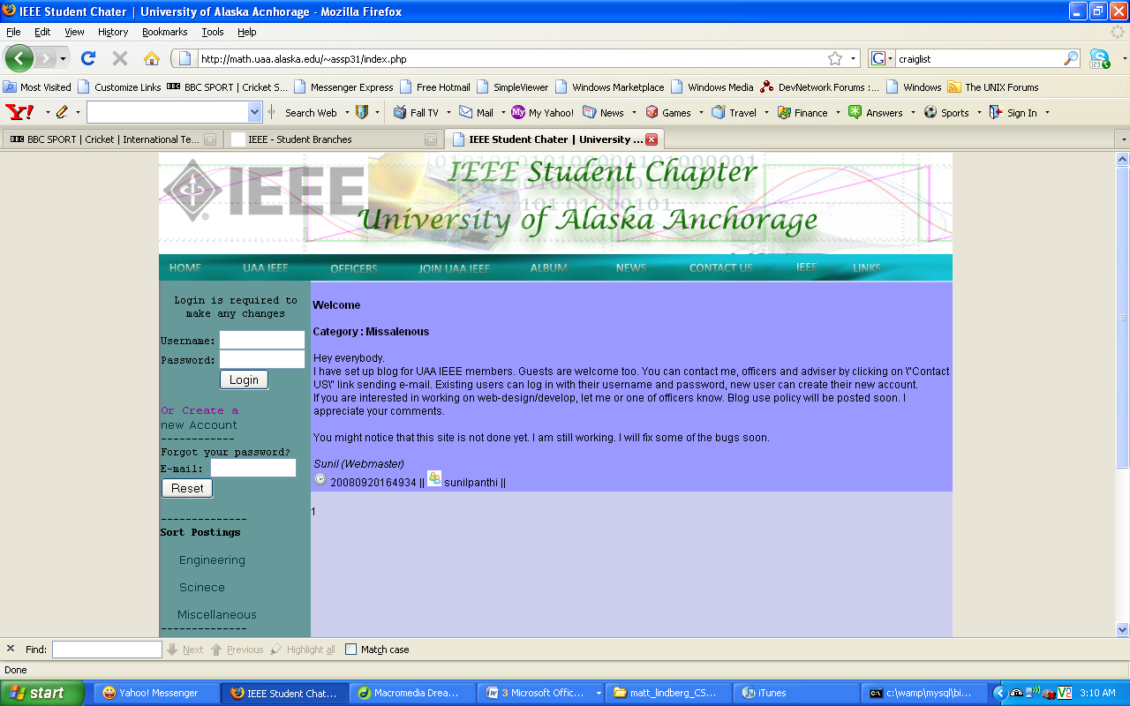
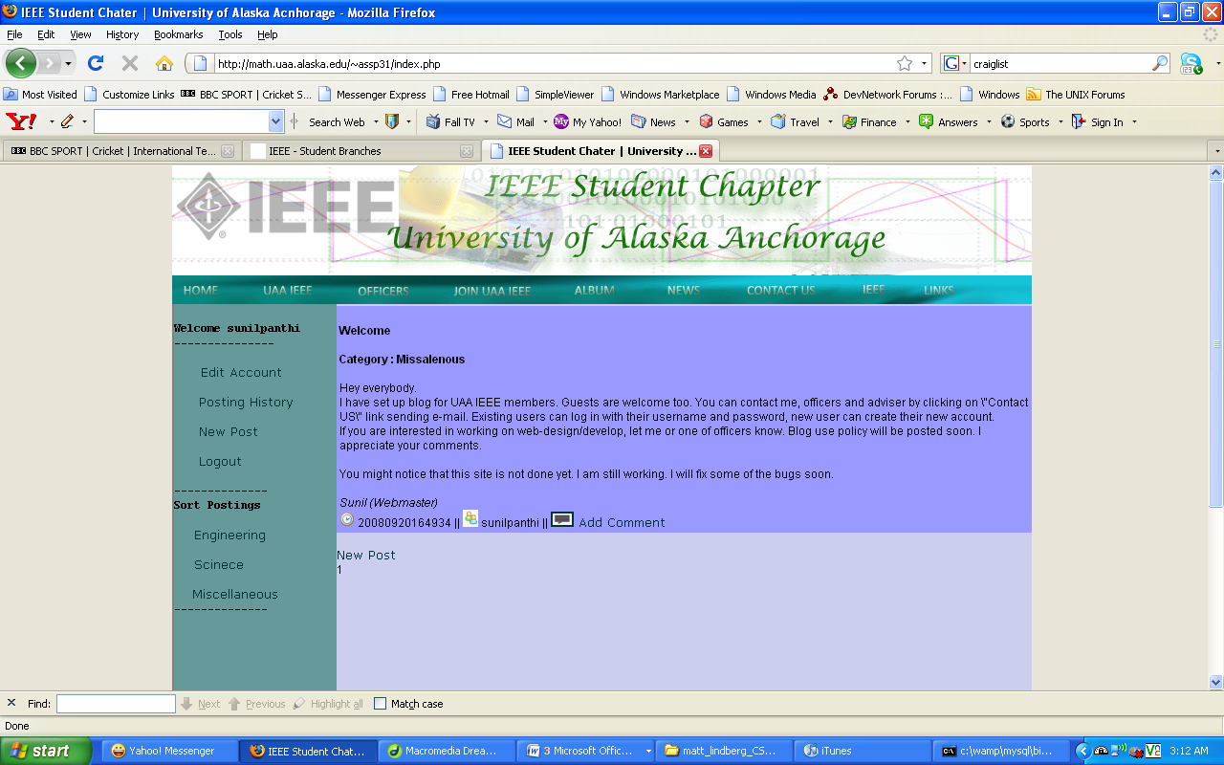
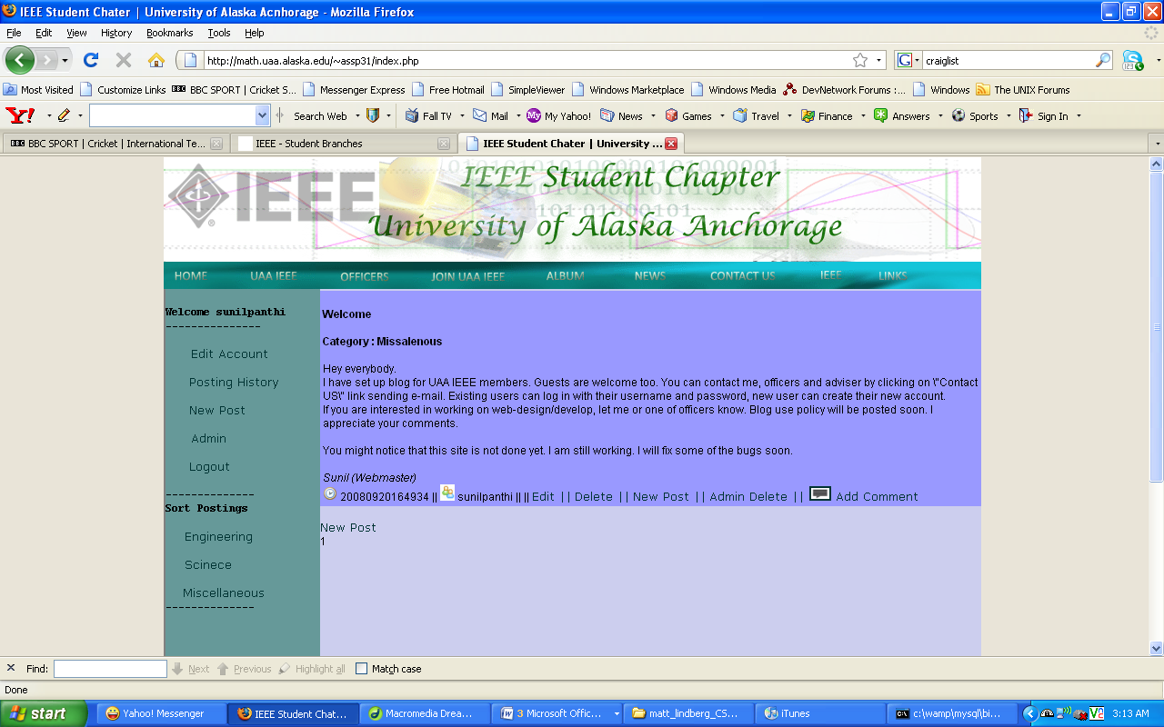
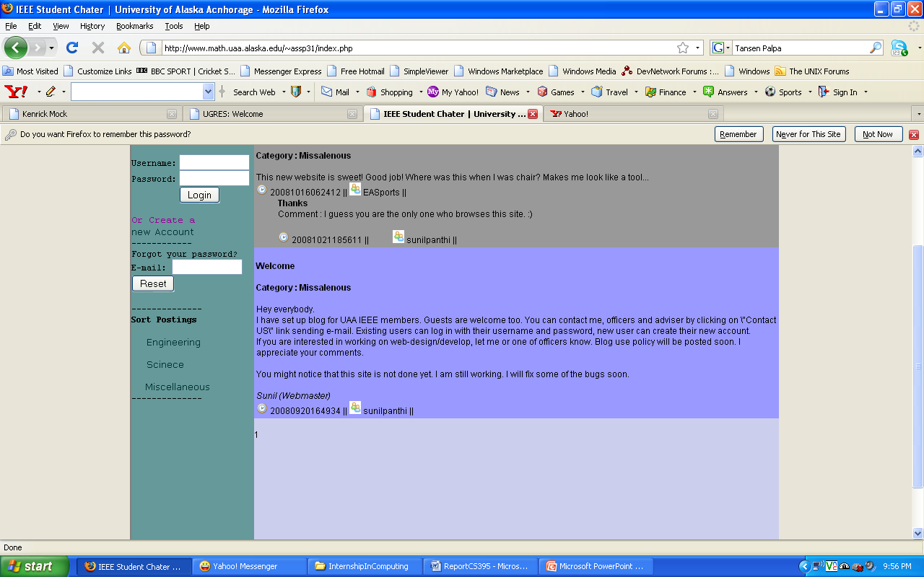
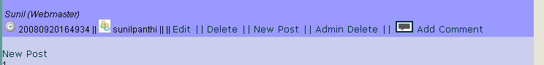
IMPLEMENTATION

Slide 8
IMPLEMENTATION
Create Account
Regular User
Update Personal Information
Logout
Admin
Login
Post
Update Pages
Add Comment
Reset Password
Delete Contents
Failed Login
Edit/Delete Content
Membership Application
Announcement
Postings
History
E-mails

Slide 9
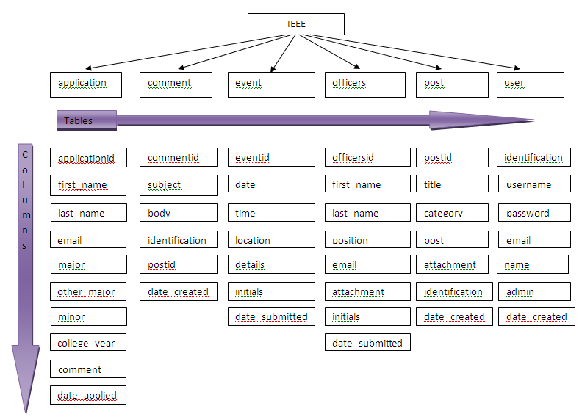
DATABASE ARCHITECTURE

Slide 10
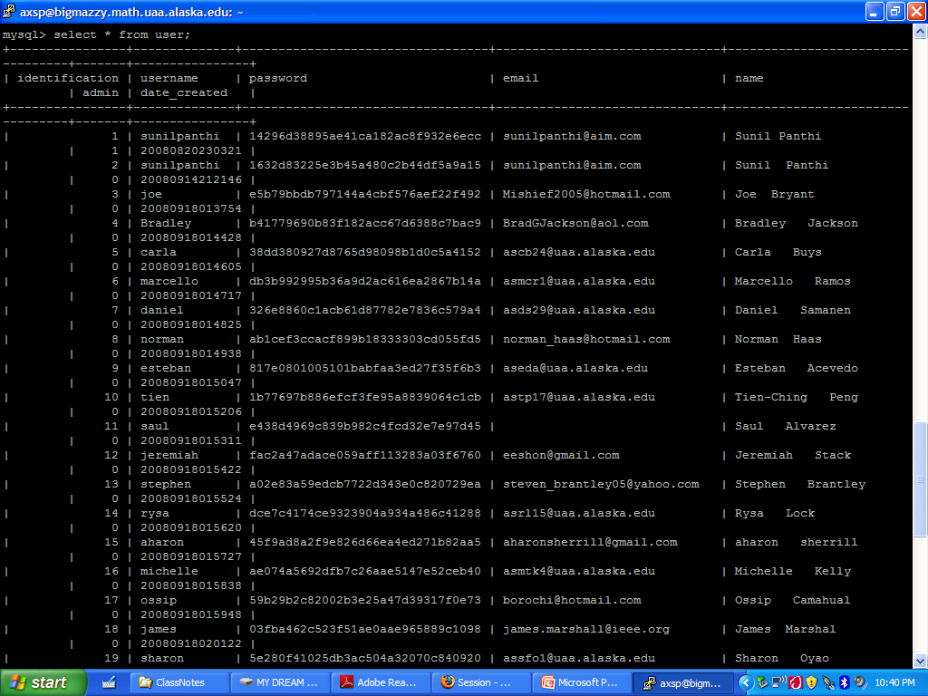
DATABASE ARCHITECTURE
1 - database, 6 - tables, 45 - columns
Column “identification” works as a signature
Password is encrypted
Store filename ONLY for the file upload
Validate user input before storing
Notes:
Here is the brief summary. User’s identification is secured, passwords are encrypted to 32 characters.
I have set to store the file name of any uploads. But file will be uploaded in a directory. All the information are validated before storing on the database. This screen shot shows the sample of user’s information (myself). You can see my password here.

Slide 11
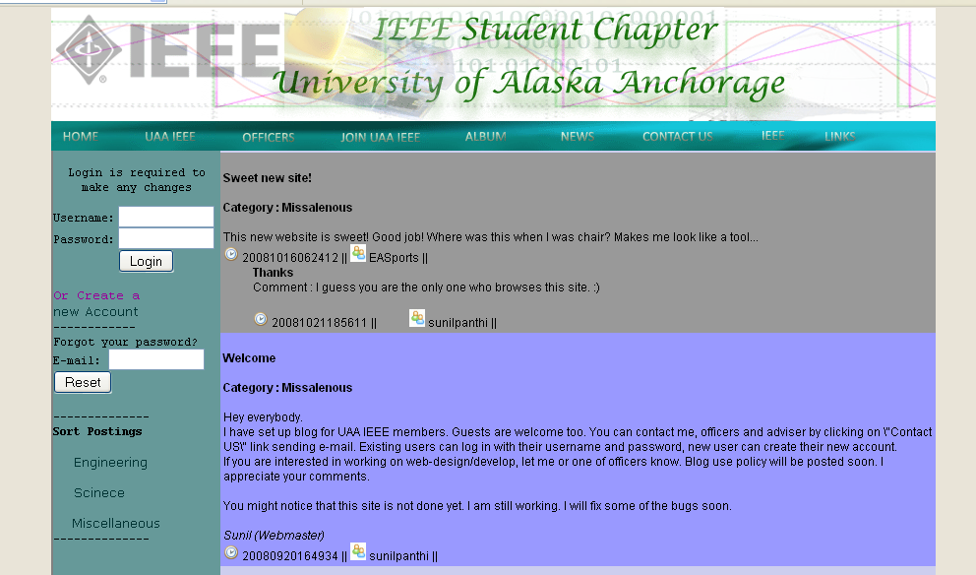
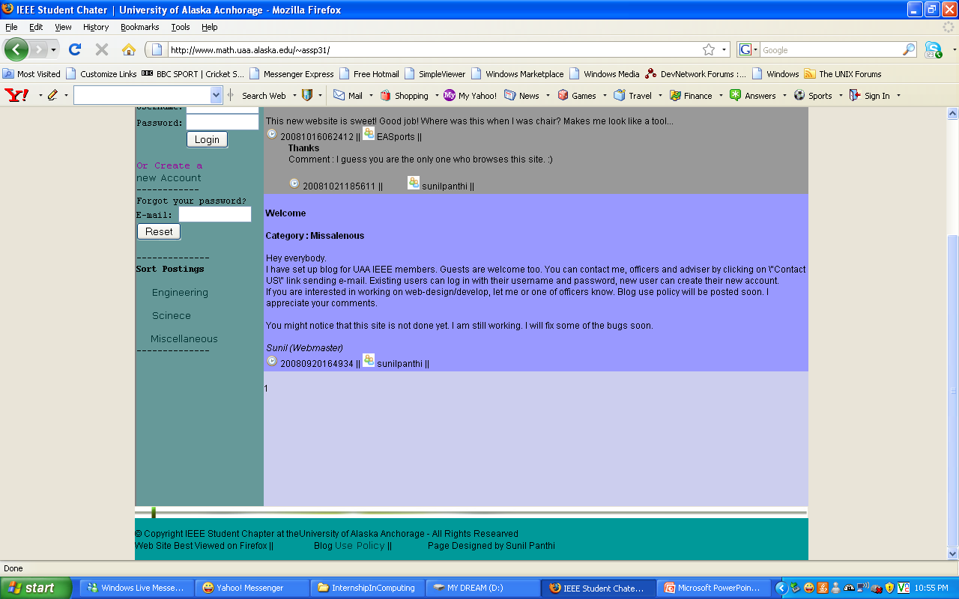

Slide 12
TIME SPENT

Slide 13
SUMMARY
Successful Implementation
More server side less client side
Timestamp not supported on old version of MySQL
Web page with poor navigation

Slide 14
QUESTIONS?

