Slide 1

DNR Business Reporting System, Version 2.0
Shawn Rivera and Matt Rykaczewski
CS 470

Slide 2
Project Background
Collaborated on the development of a web-based reporting system for the Department of Natural Resources (DNR)
  Projected started in August 2007
  DNR Business Reporting System (DBRS), Version 1.0 released in May 2008
Users have been asking for new features since the development of version 1.0
Notes:
Shawn

Slide 3
Project Overview
Goal
  Develop a new version of DBRS that incorporates most of the features requested by users
Client
  Primary client: Frank Wallis, GIS Manager
  Secondary client: Employees of DNR and other government agencies
Notes:
Shawn

Slide 4
Modifications
Implemented security (restricted access to the system and reports available to users outside DNR)
Replaced outdated DatabaseTools library with DBServices
Added “Please Wait” message to inform users when the system is processing a request or transferring control between DBRS and Alaska Mapper
Increased category/sub-category functionality on the available reports page
Notes:
Matt

Slide 5
Modifications
Added control to toggle if report descriptions are displayed on the available reports page
Implemented validation of user-entered values for “MTR” text fields
Added tooltip descriptions to report column headings (if they require further explanation)
Implemented ability to specify which report columns users can sort on
Notes:
Matt

Slide 6
User Interface
The five main pages of the UI include:
  Index page
  Login page
  Available reports page
  Report parameter page
  Report display page
Notes:
Shawn

Slide 7
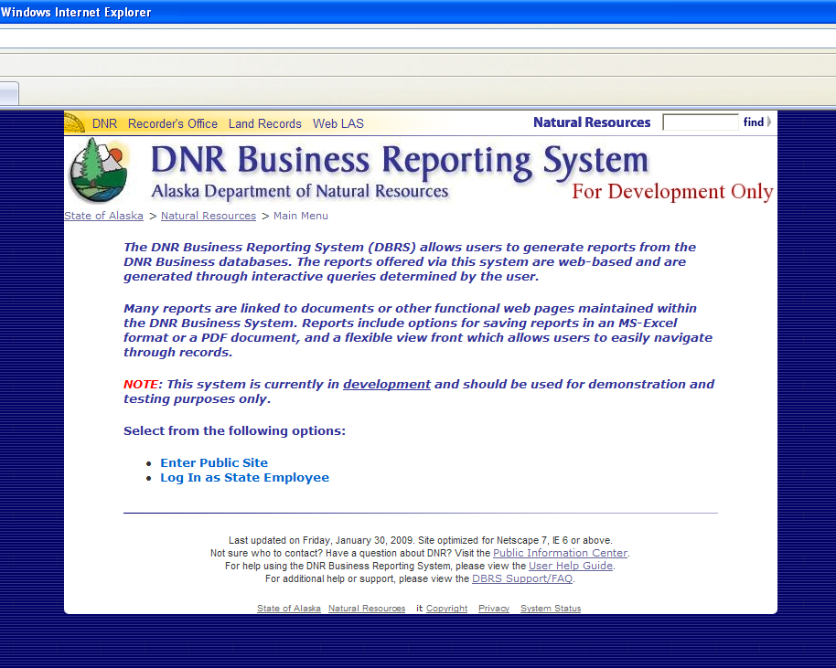
Index Page
Notes:
Shawn

Slide 8
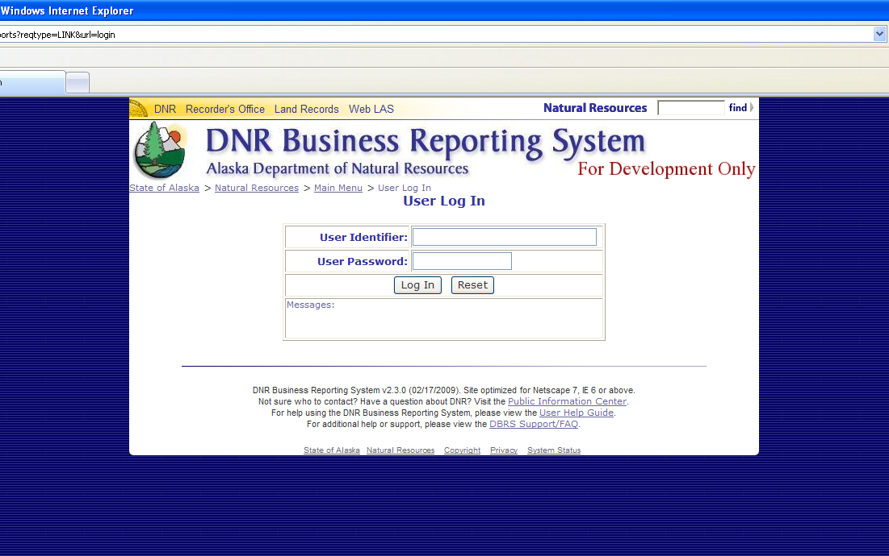
Login Page
Notes:
Shawn

Slide 9
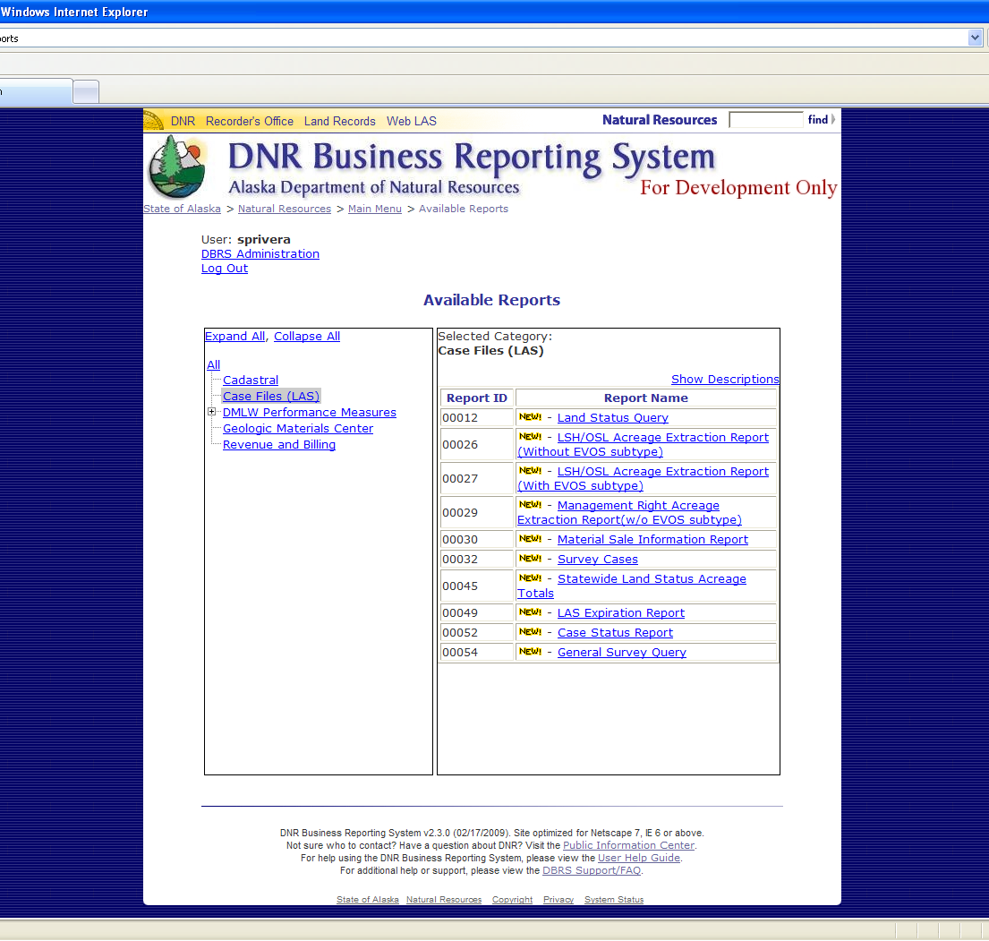
Available Reports Page
Notes:
Shawn

Slide 10
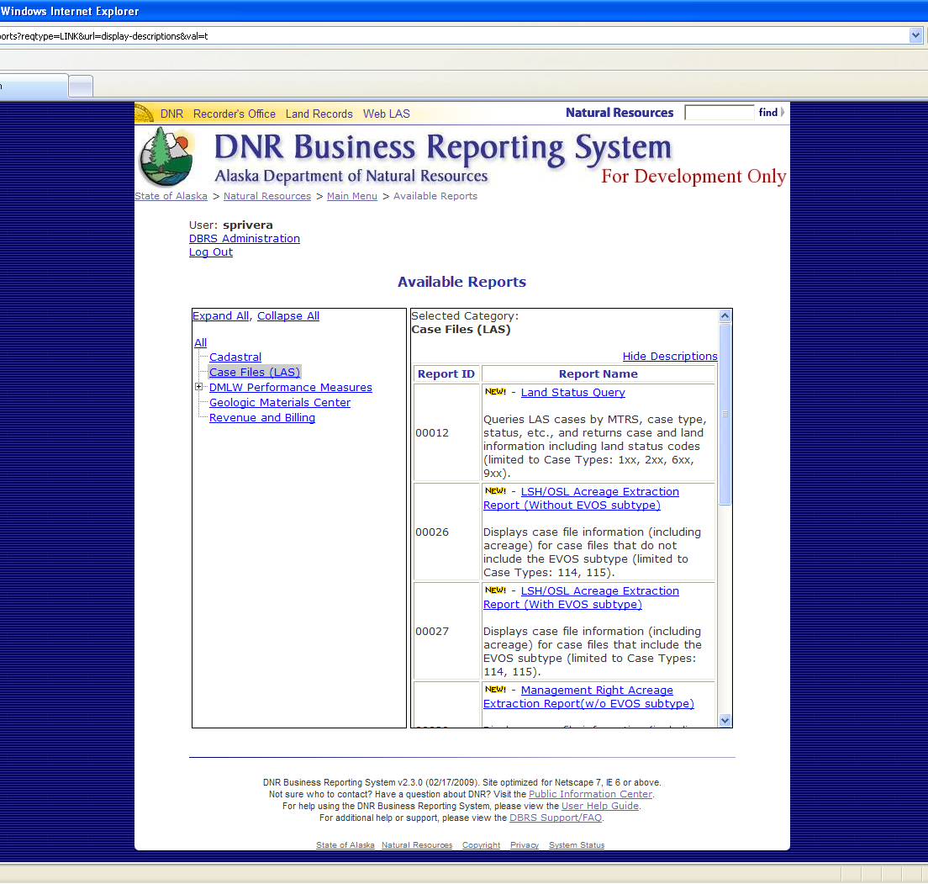
Available Reports Page
Notes:
Shawn

Slide 11
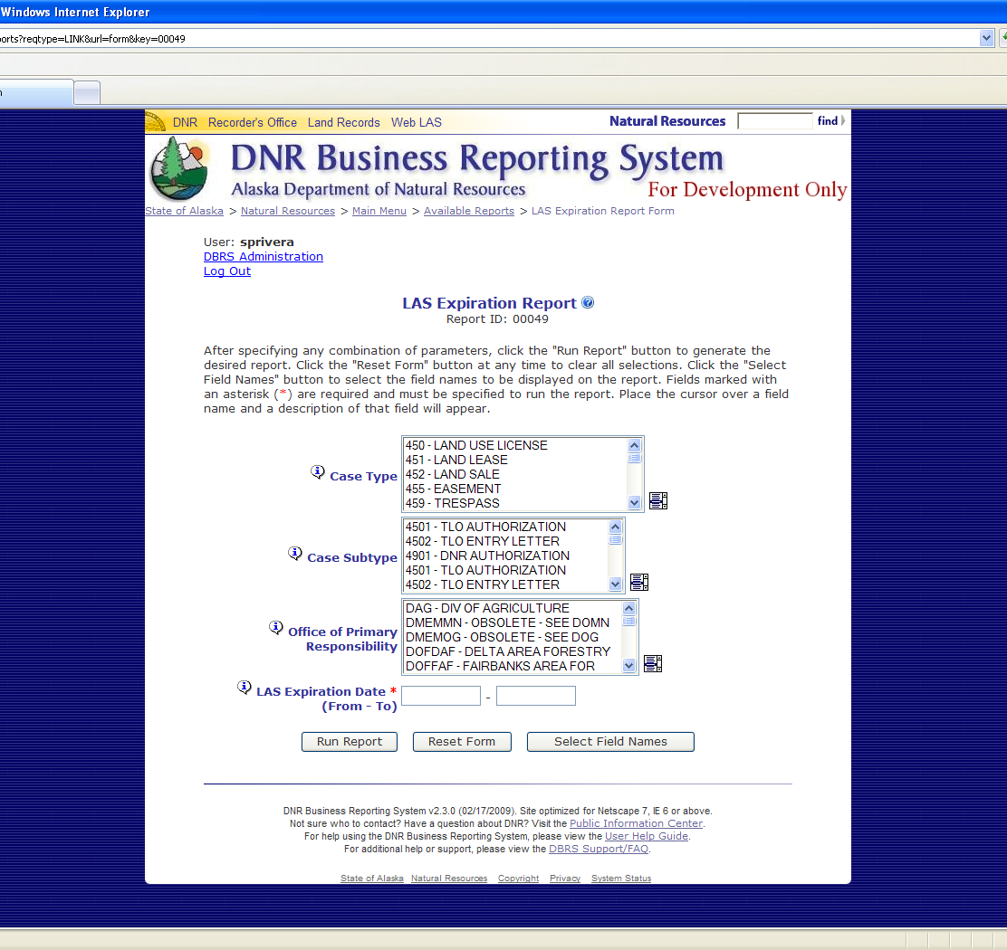
Report Parameter Page
Notes:
Shawn

Slide 12
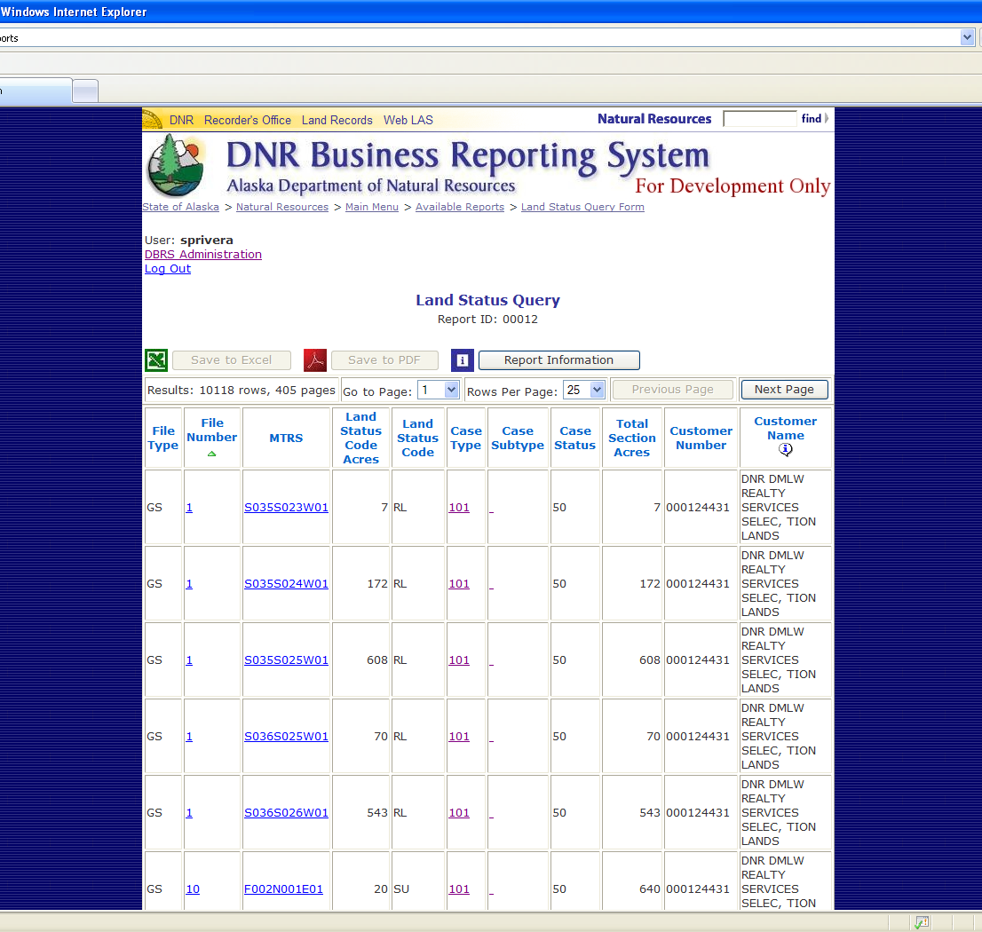
Report Display Page
Notes:
Shawn

Slide 13
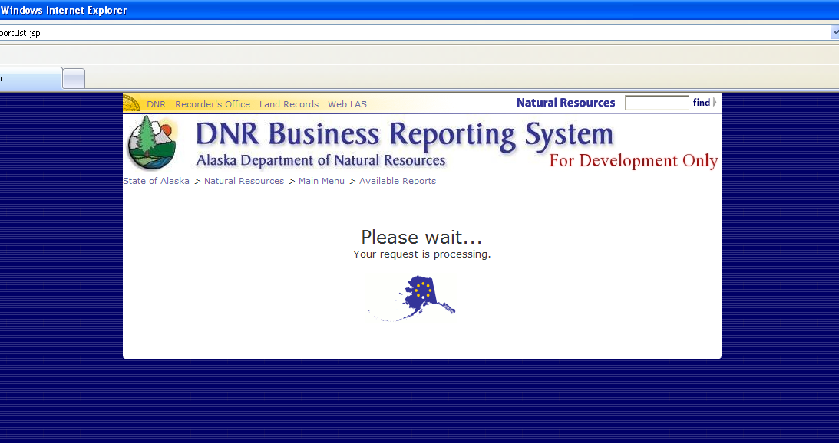
“Please Wait” Message
Notes:
Shawn

Slide 14
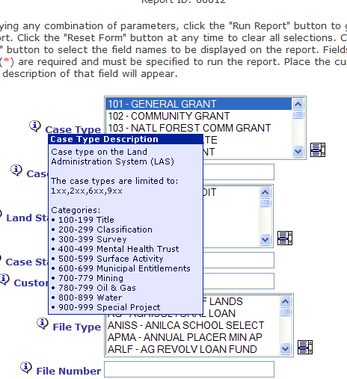
Parameter Description
Notes:
Shawn

Slide 15
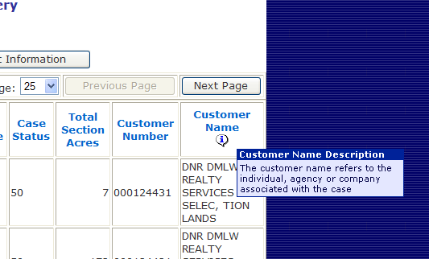
Field Description
Notes:
Shawn

Slide 16
System Design
Programming done in Java
  Servlets
  JavaServer Pages (JSP)
Data Structures
  New objects: Category and ReportField
  Modified objects: JSPRS and ReportDriver
Notes:
Matt

Slide 17
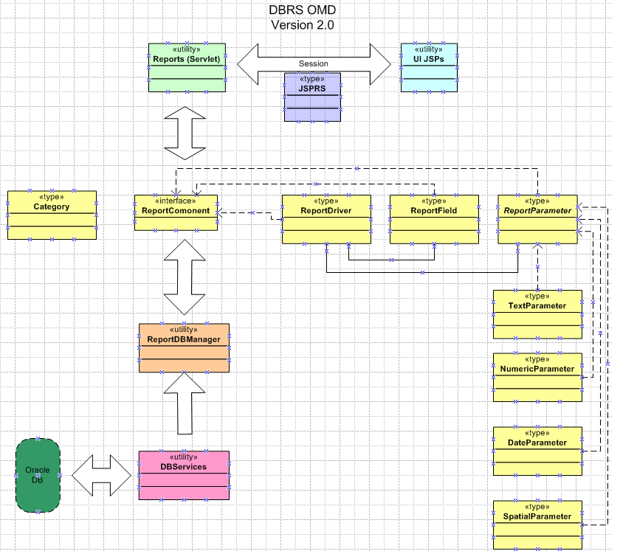
System Architecture
Notes:
Matt

Slide 18
System Architecture
Notes:
Matt

Slide 19
System Architecture
Notes:
Matt

Slide 20
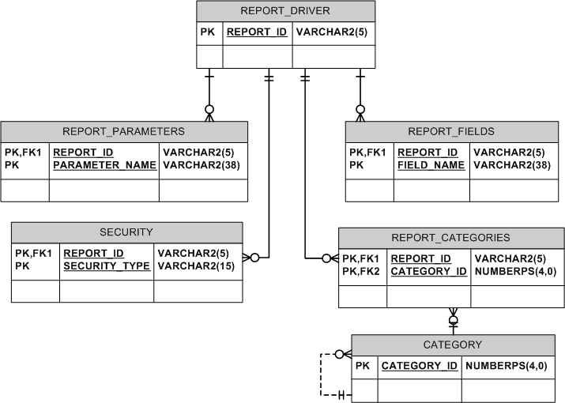
Database Structure
Notes:
Matt

Slide 21
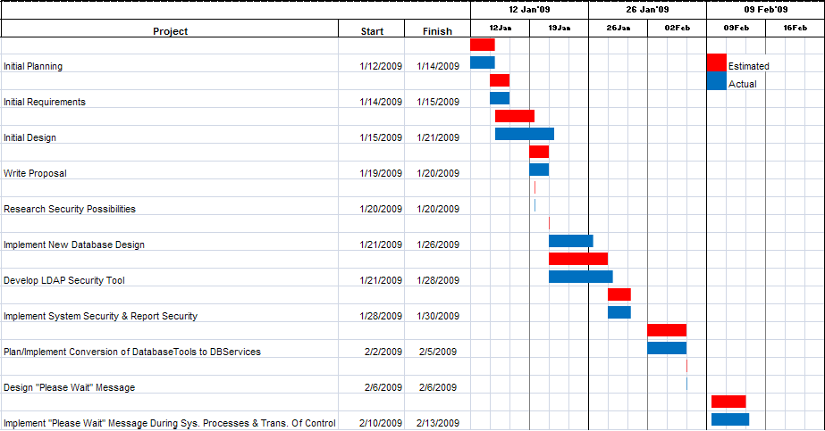
Schedule
Notes:
Matt

Slide 22
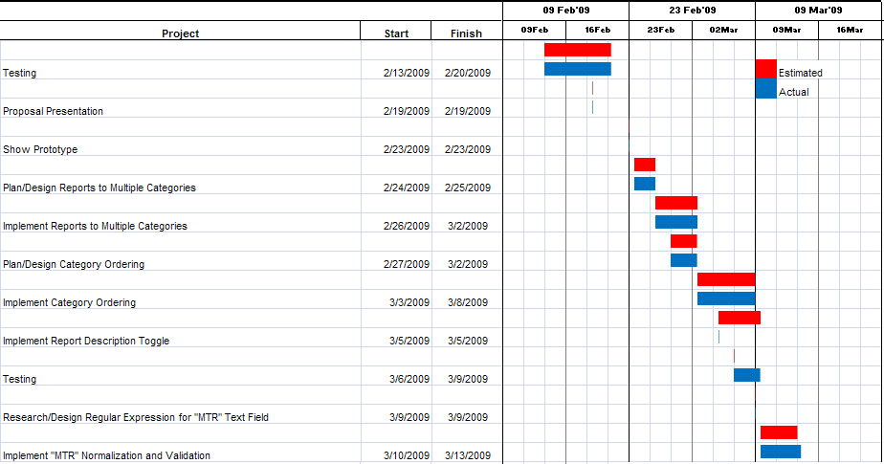
Schedule
Notes:
Matt

Slide 23
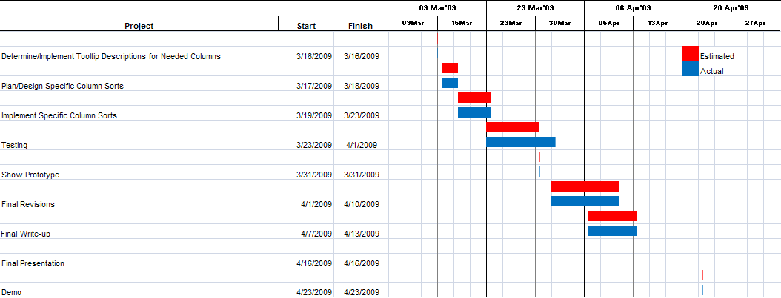
Schedule
Notes:
Matt

Slide 24
Conclusion
Successfully developed a version of DBRS that incorporates features requested by users
Prototyping methodology helped ensure the new version would meet the needs of the users
Underestimated time to complete some tasks, but no major deviations from schedule
Learned new aspects of Java, JavaScript and SQL and gained experience implementing security within applications
Notes:
Matt & Shawn

