Slide 1
GUI Bloopers
Graphic Design, Layout, and Web Page/Style Design

Slide 2
Graphic Design and Layout Bloopers
Once you have GUI controls appropriate for your software you have to decide on:
Layout
Colors
Fonts
The following bloopers diminish software’s perceived quality – it only takes a few to look amateurish and untrustworthy
Poor graphic design and layout can also decrease user’s ability and motivation to absorb the software’s content

Slide 3
Blooper 32 : Easily missed information
Software developers often assume that if information is displayed users will see it. Not so!
Common flaw: not focusing user’s attention
People scan for information, left to right, top to bottom
Should design for how human perception works
Examples users can miss:
Status or mode indicators
Prompts for input
Results
Error or status messages
Controls

Slide 4
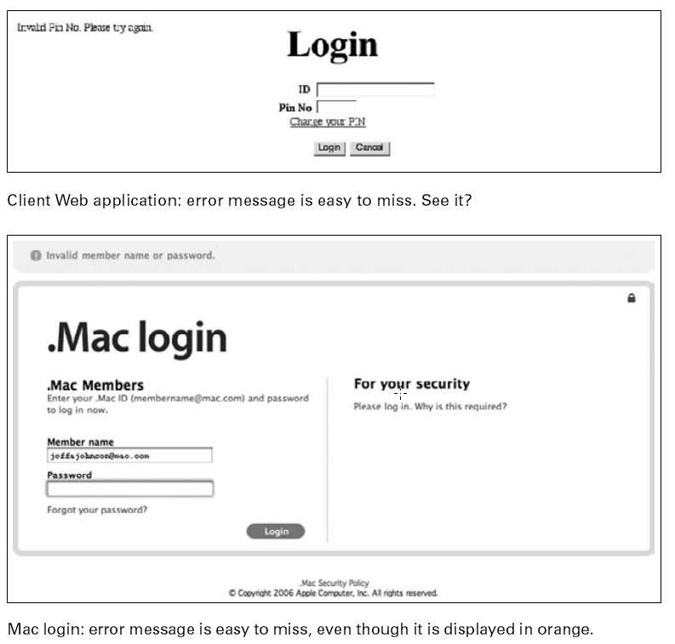
Blooper 32 Examples
Information too small or not where the user is looking

Slide 5
Avoiding Blooper 32
Construct a visual hierarchy
Organize information displays in hierarchical chunks; users ignore irrelevant chunks and find what they want much faster
Make important information bigger
Put important information where the user is looking
Center of field, not periphery
Use color to highlight

Slide 6
Avoiding Blooper 32
If necessary, use heavy artillery
Dialog boxes and pop-ups
Impossible to ignore, but it better be important
Sound
Simple beeps usually sufficient
Vibration and animation
Peripheral vision for stationary objects is poor, but is very good at noticing movement or changes
Distracting if too much; have been abused by web advertisers
Make sure animation stops quickly and can be stopped

Slide 7
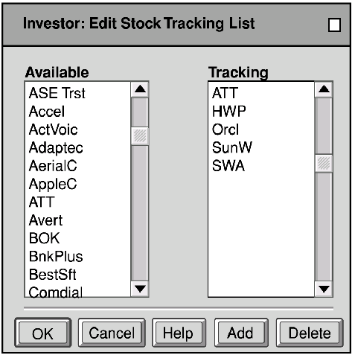
Blooper 33 : Mixing dialog box control buttons with content control buttons
This happens when you add new buttons to the standard “OK”, “Apply”, “Close”, “Cancel” buttons
Everything OK here?

Slide 8
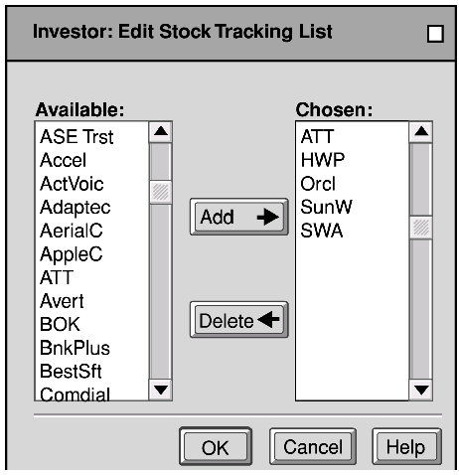
Align Buttons To Controls
It can be hard to see the connection between the new buttons and data
Make functions clear by separating content control buttons from window control buttons

Slide 9
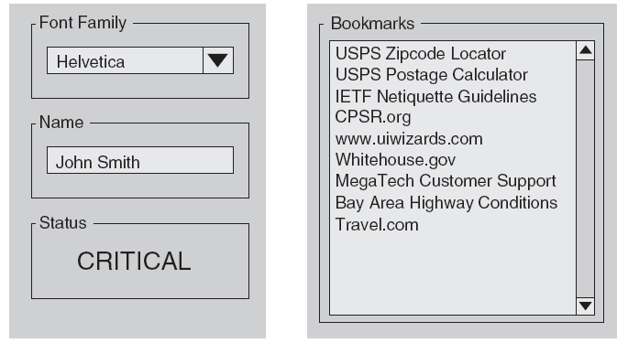
Blooper 34 : Misusing Group Boxes
Group boxes put a visible border around related controls and have a slot for a label
Serve no purpose around one setting; in this case a simple label is better.

Slide 10
Blooper 35: Radio Buttons too far apart
Related radio buttons should be grouped closely together

Slide 11
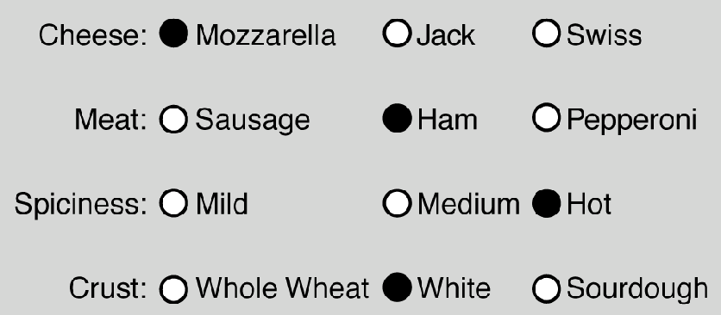
Improved Spacing

Slide 12
Blooper 35 Examples

Slide 13
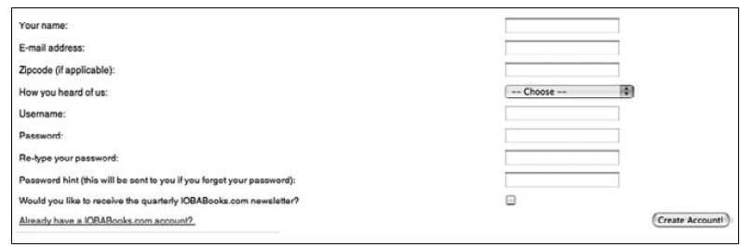
Blooper 36 : Labels too far from data fields
Sometimes GUI’s are developed where the label is placed too far from the control it describes
Common in automatic layouts where size is dictated by the largest field or screen width

Slide 14
Blooper 36 Example

Slide 15
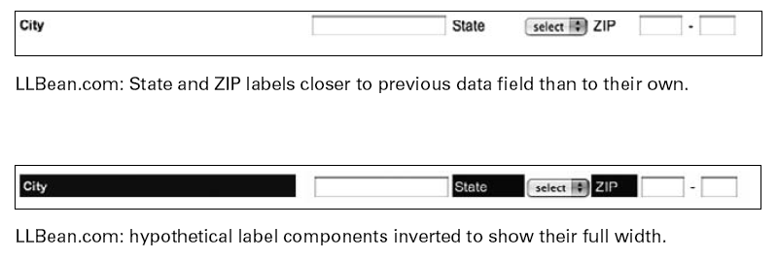
Blooper 36 Example
Variation: labels closer to other settings than their own

Slide 16
Avoiding Blooper 36
Don’t attach labels and data fields to opposite edges of a form or control panel
Don’t allow a few long labels to dictate the alignment of the entire form
Labels should be closer to their own field than to other fields
Put labels above fields

Slide 17
Avoiding Blooper 36

Slide 18
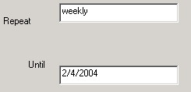
Blooper 37 : Inconsistent Label Alignment
Labels should be consistent in where they are placed throughout the application
Extreme case:

Slide 19
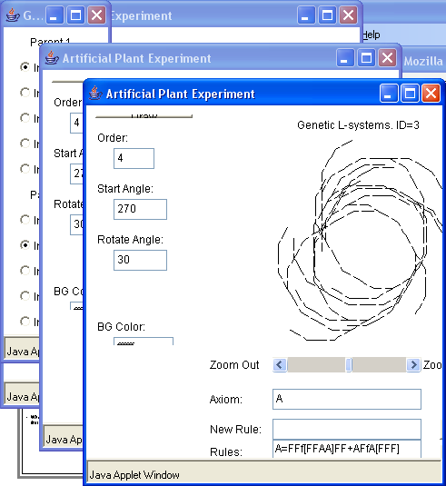
Blooper 38: Poor Window Location
Where should an application’s windows first appear?
Heuristics:
On-screen
Staggered
No occlusion

Slide 20
Blooper 39: Tiny fonts
Lots of people with impaired vision can’t read small fonts
Includes old folks over 45

Slide 21
Blooper 39 Example

Slide 22
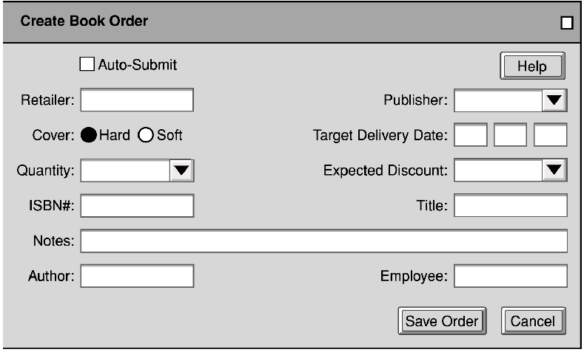
Blooper Bonus: Un-Natural Order
Avoid the “random” layout
Add proper tab stops, but also reorganize layout

Slide 23
Website Interface Design Tips
Build Navigational aids.
Navigation bars, frames
Critical for giving user a sense of where they are
Must provide context, e.g. bar with page headers
User shouldn’t have to go “back” to figure this out
Avoid dead-end pages
Keep download time short
Frustration after 10 seconds
Consistency!
E.g., keep “home” button in the same place, don’t change link colors
Simplicity often appreciated
Offer feedback
Design for the disabled
ALT tags
E.g., modem user might disable graphics
Use elements as designed
E.g. don’t use blank GIF as a spacer

Slide 24
Top Ten Mistakes
Jakob Nielsen’s top design mistakes
Using Frames
Gratuitous use of bleeding-edge technology
Scrolling text, marquees, and constantly running animations
Complex URLs
Orphan pages
Long, scrolling pages
Lack of navigation support
Non-standard link colors
Outdated information
Overly long download times

Slide 25
GUI Bloopers
Interaction Bloopers

Slide 26
Interaction Bloopers
More important than GUI control, navigation, text, and graphic design/layout bloopers:
Larger in scope, often generalizations of specific look-and-feel bloopers
Harder to identify
Harder to avoid
Often a result of decisions made in the bowels of implementation
Harder to correct

Slide 27
Blooper 40: Exposing implementation to users
Users should not be subjected to internal implementation details when they are contrary to their working model
Examples:
Speed in a game a setting from 1 to 10
Expect 10 to be fast and 1 to be slow, but it was the opposite
Delay loop for the setting’s number of times
Limits on data sizes to “weird” numbers
16, 32, 64, 128, etc.
Most people would prefer 10, 100, 1000, etc.
Design for the convenience of users, not developers

Slide 28
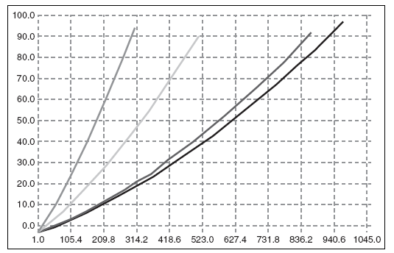
Blooper 40 Example
X values of graphs convenient for developers (intervals of max/10) but not for users

Slide 29
Avoiding Blooper 40
Focus the user interface strictly on the tasks
Design the UI according to a conceptual model that includes only objects, actions, and attributes from the app’s target tasks
Design for the convenience of users, not developers
Requires extra work for the developers, but hopefully they take pride in making software that is easy to use!

Slide 30
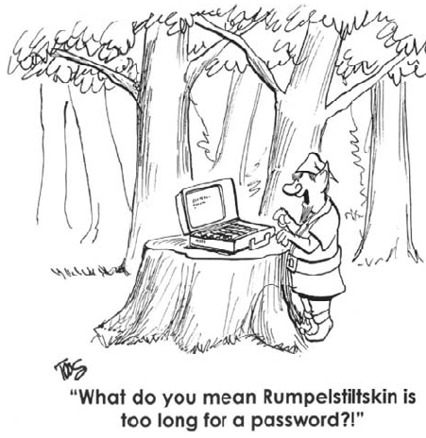
Blooper 41: Needless restrictions
Needless restrictions, like unnatural actions, are hard to learn, easy to forget, and annoying
Why is Rumpelstiltskin too long? Probably some arbitrary database limitation, perhaps set to 10 characters.
More common limitations would be some power of 2; e.g. 32 or 64 char limit

Slide 31
Blooper 41 Examples

Slide 32
Avoiding Blooper 41
Don’t impose numerical limits, if possible
Use dynamic allocation of storage
Use powers of 10 not powers of 2

Slide 33
Blooper 42: Confusable Concepts
One way an app’s conceptual model can be confusing is to include concepts that overlap in meaning or function
E.g. website that allows people to look for a home by: (a) town (b) location on a map
Users had to choose one or the other but users missed the artificial distinction since both are “by location”

Slide 34
Blooper 42 Example

Slide 35
Blooper 43 : Asking users for unneeded data
This is a sure way to annoy users
Variations:
We forgot, tell us again
Unnecessary questions
Requiring data that should be optional
Requiring repeated logins in a session

Slide 36
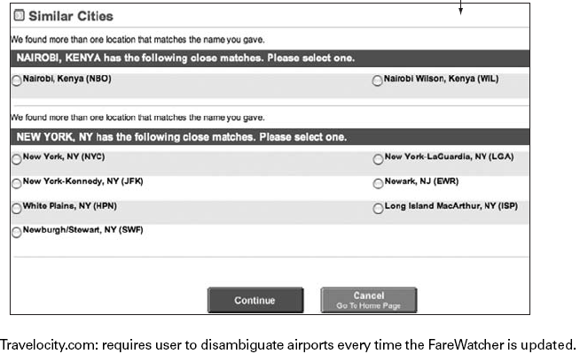
Blooper 43 Example

Slide 37
Blooper 43 Example

Slide 38
Blooper 43 Example

Slide 39
Avoiding Blooper 43
Make it a high priority NOT to require users to enter data repeatedly.
Ask only for data you really need
Stick to the current transaction
Don’t make any data “required” unless you really can’t proceed without it
Don’t require data some customers won’t have
Deduce as much as you can from information given to you instead of adding additional fields

Slide 40
Blooper 44: Asking users for random seeds
Programs shouldn’t ask the user to seed the random number generator
One exception: generating secure keys (require lots of random typing, mouse motion, etc.)
Meaningless to most users
People don’t give good random numbers
Avoiding the blooper: Incorporate random intervals/timers, if date/time not good enough, something like random.org

Slide 41
Blooper 45 : Pointless choice
A second special case of requiring users to enter unnecessary data is presenting data with unnecessary choices
No difference between choices
Users don’t know which to pick
Obvious answer
False choice

Slide 42
Blooper 45 Example

Slide 43
Blooper 45 Example

Slide 44
Blooper 45 Example

Slide 45
Avoiding Blooper 45
If the choice makes no difference, don’t offer it
How do you know? Test it!
Watch people using your software
If users won’t understand the question, don’t ask
If there is an obvious option, choose it
Don’t offer false choices

Slide 46
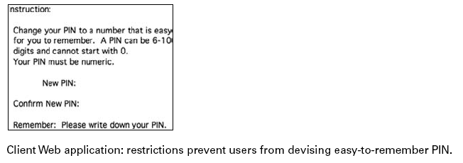
Blooper 46: Hard to remember ID
The most obvious way to burden users’ memory is to require authentication identification they cannot remember
Assigned, non-changeable passwords
Unreasonable password restrictions

Slide 47
Blooper 47 : Mission Impossible Instructions
Instructions that go away too soon
Detailed instructions should remain on the screen while the user is carrying them out
Latest Office apps display help in right hand pane

Slide 48
Blooper 47 Example

Slide 49
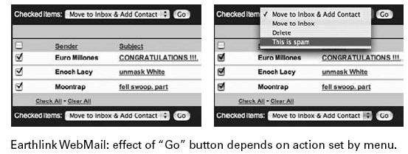
Blooper 48: Unnecessary or poorly marked modes
If your software has modes, users may not know which mode they are in and enter a command meant for the inactive mode
Examples:
Try to drag a rectangle to select objects but end up drawing a line instead
Printer outputs in landscape instead of portrait

Slide 50
Many harmless modes
Word is teeming with modes
View: Normal, outline, page layout
Auto correct: on, off
Insert or overwrite text
Auto save: on, off
Smart cut-and-paste: on, off
Etc.
Most of these modes don’t cause errors because they are rarely changed from defaults
Many users may not even know of these modes

Slide 51
Toasters have modes
The “darkness” control on a toaster is a mode that sometimes results in burnt toast when the last time you put in a frozen waffle
How could you make a modeless toaster?

Slide 52
Avoiding Blooper 48
Remove or minimize mode settings
E.g. for a photo application instead of a mode for “browse” and a mode for “edit” there might be separate windows for each
Minimize the use of modal dialog boxes unless it is crucial the users not interact with things on the display
Make modes visible and difficult to miss

Slide 53
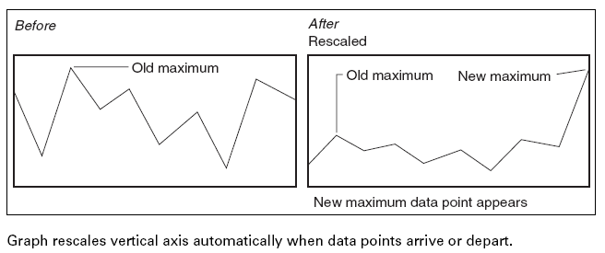
Blooper 49: Unexpected Rearrangement of Display
What if the OS constantly rearranged your icons for you?
Example

Slide 54
Blooper 49 Example

Slide 55
Blooper 50: Dialog Boxes that Trap Users
Dialog boxes sometimes provide no way out other than a direction that users don’t want to go.
No cancel
All paths are wrong
Required button is inactive
Unclear choices
No, not OK

Slide 56
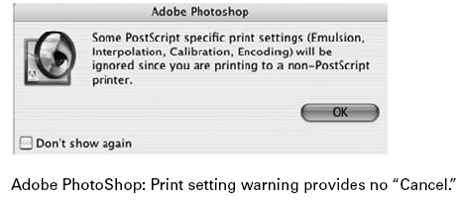
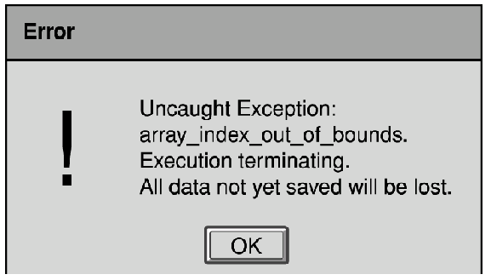
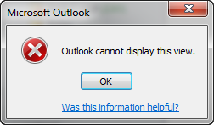
Blooper 50 Example
No Cancel
No, Not OK!

Slide 57
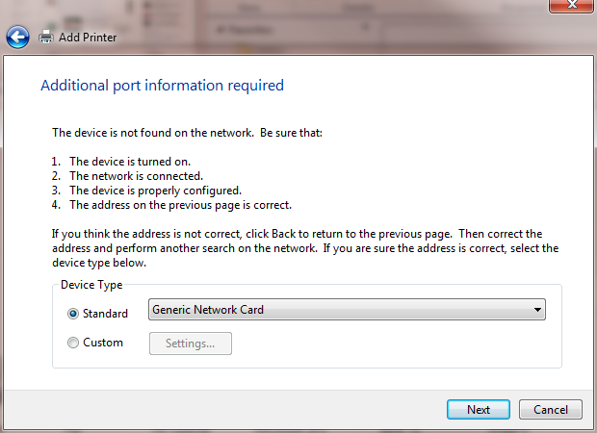
Click Back

Slide 58
Wrong paths in the dialog box
Required button is inactive

Slide 59
Avoiding Blooper 50
Provide users with alternatives so they don’t feel trapped
Analyze goals users could have when the dialog box appears so you can provide the right options
Test dialog boxes with users
Don’t use “OK” for bad messages
“Acknowledged”, “Understood”, “Sigh…not again”

Slide 60
Blooper 51: Ok and Cancel do the same thing
OK should mean “Yes do this” and Cancel should mean “No, I don’t want to do this”
Other variations where cancel doesn’t cancel
E.g. action already done and software doesn’t support undoing it

