Slide 1
Hardware-Based Speculation

Slide 2
Exploiting More ILP
Branch prediction reduces stalls but may not be sufficient to generate the desired amount of ILP
One way to overcome control dependencies is with speculation
Make a guess and execute program as if our guess is correct
Need mechanisms to handle the case when the speculation is incorrect
Can do some speculation in the compiler
We saw this previously with reordered / duplicated instructions around branches

Slide 3
Hardware-Based Speculation
Extends the idea of dynamic scheduling with three key ideas:
Dynamic branch prediction
Speculation to allow the execution of instructions before control dependencies are resolved
Dynamic scheduling to deal with scheduling different combinations of basic blocks
What we saw earlier was within a basic block
Modern processors started using speculation around the introduction of the PowerPC 603, Intel Pentium II and extend Tomasulo’s approach to support speculation

Slide 4
Speculating with Tomasulo
Separate execution from completion
Allow instructions to execute speculatively but do not let instructions update registers or memory until they are no longer speculative
Instruction Commit
After an instruction is no longer speculative it is allowed to make register and memory updates
Allow instructions to execute and complete out of order but force them to commit in order
Add a hardware buffer, called the reorder buffer (ROB), with registers to hold the result of an instruction between completion and commit
Acts as a FIFO queue in order issued

Slide 5
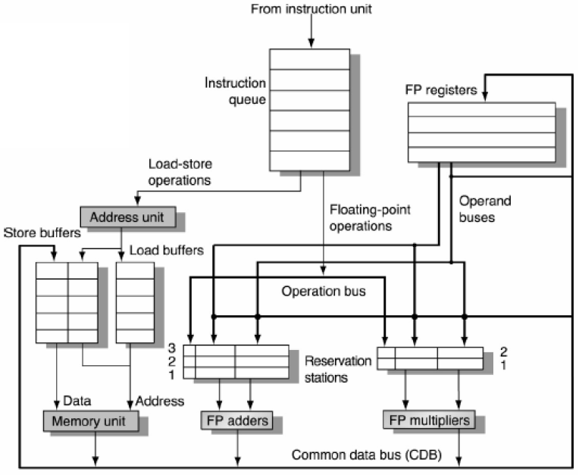
Original Tomasulo Architecture

Slide 6
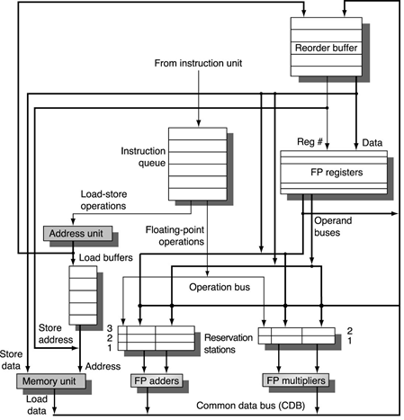
Tomasulo and Reorder Buffer
Sits between Execution and Register File
Source of operands
In this case integrated with Store buffer
Reservation stations use ROB slot as a tag
Instructions commit at head of ROB FIFO queue
Easy to undo speculated instructions on mispredicted branches or on exceptions

Slide 7
ROB Data Structure
Instruction Type Field
Indicates whether the instruction is a branch, store, or register operation
Destination Field
Register number for loads, ALU ops, or memory address for stores
Value Field
Holds the value of the instruction result until instruction commits
Ready Field
Indicates if instruction has completed execution and the value is ready

Slide 8
Instruction Execution
Issue: Get an instruction from the Instruction Queue
If the reservation station and the ROB has a free slot (no structural hazard), issue the instruction to the reservation station and the ROB, send operands to the reservation station if available in the register file or the ROB. The allocated ROB slot number is sent to the reservation station to use as a tag when placing data on the CDB.
Execution: Operate on operands (EX)
When both operands ready then execute; if not ready, watch CDB for result
Write result: Finish execution (WB)
Write on CDB to all awaiting units and to the ROB using the tag; mark reservation station available
Commit: Update register or memory with the ROB result
When an instruction reaches the head of the ROB and results are present, update the register with the result or store to memory and remove the instruction from the ROB
If an incorrectly predicted branch reaches the head of the ROB, flush the ROB, and restart at the correct successor of the branch
Blue text = Change from Tomasulo

Slide 9
Tomasulo With ROB
State
FP Op
Queue
 |  |  |  | ROB7
 |  |  |  | ROB6
 |  |  |  | ROB5
 |  |  |  | ROB4
 |  |  |  | ROB3
 |  |  |  | ROB2
F0 |  | LD F0, 10(R2) | I | ROB1
Newest
Reorder Buffer
Oldest
Registers
To
Memory
Dest
Dest
From
Memory
Dest
Reservation
Stations
1 | 10+R2
FP adders
FP multipliers
Notes:
Resolve RAW memory conflict? (address in memory buffers)
Integer unit executes in parallel

Slide 10
Tomasulo With ROB
State
FP Op
Queue
 |  |  |  | ROB7
 |  |  |  | ROB6
 |  |  |  | ROB5
 |  |  |  | ROB4
 |  |  |  | ROB3
 |  |  |  | ROB2
F0 |  | LD F0, 10(R2) | E | ROB1
Newest
Reorder Buffer
Oldest
Registers
To
Memory
Dest
Dest
From
Memory
Dest
Reservation
Stations
1 | 10+R2
FP adders
FP multipliers
Notes:
Cache miss on Load, long execution time

Slide 11
Tomasulo With ROB
State
FP Op
Queue
 |  |  |  | ROB7
 |  |  |  | ROB6
 |  |  |  | ROB5
 |  |  |  | ROB4
 |  |  |  | ROB3
F10 |  | ADDD F10,F4,F0 | I | ROB2
F0 |  | LD F0, 10(R2) | E | ROB1
Newest
Reorder Buffer
Oldest
Registers
To
Memory
Dest
Dest
From
Memory
2 | ADDD | R(F4),1
Dest
Reservation
Stations
1 | 10+R2
FP adders
FP multipliers
Notes:
Resolve RAW memory conflict? (address in memory buffers)
Integer unit executes in parallel

Slide 12
Tomasulo With ROB
State
FP Op
Queue
 |  |  |  | ROB7
 |  |  |  | ROB6
 |  |  |  | ROB5
 |  |  |  | ROB4
F2 |  | MULD F2,F10,F6 | I | ROB3
F10 |  | ADDD F10,F4,F0 | I | ROB2
F0 |  | LD F0, 10(R2) | E | ROB1
Newest
Reorder Buffer
Oldest
Registers
To
Memory
Dest
Dest
From
Memory
2 | ADDD | R(F4),1
3 | MULD | 2,R(F6)
Dest
Reservation
Stations
1 | 10+R2
FP adders
FP multipliers
Notes:
Resolve RAW memory conflict? (address in memory buffers)
Integer unit executes in parallel

Slide 13
Tomasulo With ROB
State
FP Op
Queue
 |  |  |  | ROB7
F0 |  | ADDD F0,F4,F6 | I | ROB6
F4 |  | LD F4,0(R3) | E | ROB5
-- |  | BNE F0, 0, L | I | ROB4
F2 |  | MULD F2,F10,F6 | I | ROB3
F10 |  | ADDD F10,F4,F0 | I | ROB2
F0 |  | LD F0, 10(R2) | E | ROB1
Newest
Reorder Buffer
Oldest
Registers
To
Memory
Dest
Dest
From
Memory
2 | ADDD | R(F4),1
6 | ADDD | 5,R(F6)
3 | MULD | 2,R(F6)
Dest
Reservation
Stations
1 | 10+R2
5 | 0+R3
FP adders
FP multipliers
Notes:
Suppose BNE issues but is stalled waiting for operands
Resolve RAW memory conflict? (address in memory buffers)
Integer unit executes in parallel

Slide 14
Tomasulo With ROB
State
FP Op
Queue
[R3] | ROB5 | ST F4, 0(R3) | I | ROB7
F0 |  | ADDD F0,F4,F6 | I | ROB6
F4 |  | LD F4,0(R3) | E | ROB5
-- |  | BNE F0, 0, L | I | ROB4
F2 |  | MULD F2,F10,F6 | I | ROB3
F10 |  | ADDD F10,F4,F0 | I | ROB2
F0 |  | LD F0, 10(R2) | E | ROB1
Newest
Reorder Buffer
Oldest
Registers
To
Memory
Dest
Dest
From
Memory
2 | ADDD | R(F4),1
6 | ADDD | 5,R(F6)
3 | MULD | 2,R(F6)
Dest
Reservation
Stations
1 | 10+R2
5 | 0+R3
FP adders
FP multipliers
Notes:
Resolve RAW memory conflict? (address in memory buffers)
Integer unit executes in parallel

Slide 15
Tomasulo With ROB
State
FP Op
Queue
[R3] | V1 | ST F4, 0(R3) | W | ROB7
F0 |  | ADDD F0,F4,F6 | I | ROB6
F4 | V1 | LD F4,0(R3) | W | ROB5
-- |  | BNE F0, 0, L | I | ROB4
F2 |  | MULD F2,F10,F6 | I | ROB3
F10 |  | ADDD F10,F4,F0 | I | ROB2
F0 |  | LD F0, 10(R2) | E | ROB1
Newest
Reorder Buffer
Oldest
Registers
To
Memory
Dest
Dest
From
Memory
2 | ADDD | R(F4),1
6 | ADDD | V1,R(F6)
3 | MULD | 2,R(F6)
Dest
Reservation
Stations
1 | 10+R2
FP adders
FP multipliers
Notes:
Resolve RAW memory conflict? (address in memory buffers)
Integer unit executes in parallel

Slide 16
Tomasulo With ROB
State
FP Op
Queue
[R3] | V1 | ST F4, 0(R3) | W | ROB7
F0 |  | ADDD F0,F4,F6 | E | ROB6
F4 | V1 | LD F4,0(R3) | W | ROB5
-- |  | BNE F0, 0, L | I | ROB4
F2 |  | MULD F2,F10,F6 | I | ROB3
F10 |  | ADDD F10,F4,F0 | I | ROB2
F0 |  | LD F0, 10(R2) | E | ROB1
Newest
Reorder Buffer
Oldest
Registers
To
Memory
Dest
Dest
From
Memory
2 | ADDD | R(F4),1
3 | MULD | 2,R(F6)
Dest
Reservation
Stations
1 | 10+R2
FP adders
FP multipliers
Notes:
Resolve RAW memory conflict? (address in memory buffers)
Integer unit executes in parallel

Slide 17
Tomasulo With ROB
State
FP Op
Queue
[R3] | V1 | ST F4, 0(R3) | W | ROB7
F0 | V2 | ADDD F0,F4,F6 | W | ROB6
F4 | V1 | LD F4,0(R3) | W | ROB5
-- |  | BNE F0, 0, L | I | ROB4
F2 |  | MULD F2,F10,F6 | I | ROB3
F10 |  | ADDD F10,F4,F0 | I | ROB2
F0 |  | LD F0, 10(R2) | E | ROB1
Newest
Reorder Buffer
Oldest
Registers
To
Memory
Dest
Dest
From
Memory
2 | ADDD | R(F4),1
3 | MULD | 2,R(F6)
Dest
Reservation
Stations
1 | 10+R2
FP adders
FP multipliers
Notes:
Resolve RAW memory conflict? (address in memory buffers)
Integer unit executes in parallel

Slide 18
Tomasulo With ROB
State
FP Op
Queue
[R3] | V1 | ST F4, 0(R3) | W | ROB7
F0 | V2 | ADDD F0,F4,F6 | W | ROB6
F4 | V1 | LD F4,0(R3) | W | ROB5
-- |  | BNE F0, 0, L | I | ROB4
F2 |  | MULD F2,F10,F6 | I | ROB3
F10 |  | ADDD F10,F4,F0 | I | ROB2
F0 | V3 | LD F0, 10(R2) | W | ROB1
Newest
Reorder Buffer
Oldest
Registers
To
Memory
Dest
Dest
From
Memory
2 | ADDD | R(F4),V3
3 | MULD | 2,R(F6)
Dest
Reservation
Stations
FP adders
FP multipliers
Notes:
Resolve RAW memory conflict? (address in memory buffers)
Integer unit executes in parallel

Slide 19
Tomasulo With ROB
State
FP Op
Queue
[R3] | V1 | ST F4, 0(R3) | W | ROB7
F0 | V2 | ADDD F0,F4,F6 | W | ROB6
F4 | V1 | LD F4,0(R3) | W | ROB5
-- |  | BNE F0, 0, L | E | ROB4
F2 |  | MULD F2,F10,F6 | I | ROB3
F10 |  | ADDD F10,F4,F0 | E | ROB2
F0 | V3 | LD F0, 10(R2) | C | ROB1
Newest
Reorder Buffer
Oldest
Registers
F0=V3
To
Memory
Dest
Dest
From
Memory
3 | MULD | 2,R(F6)
Dest
Reservation
Stations
FP adders
FP multipliers

Slide 20
Tomasulo With ROB
State
FP Op
Queue
[R3] | V1 | ST F4, 0(R3) | W | ROB7
F0 | V2 | ADDD F0,F4,F6 | W | ROB6
F4 | V1 | LD F4,0(R3) | W | ROB5
-- |  | BNE F0, 0, L | W | ROB4
F2 |  | MULD F2,F10,F6 | I | ROB3
F10 | V4 | ADDD F10,F4,F0 | W | ROB2
F0 | V3 | LD F0, 10(R2) | C | ROB1
Newest
Reorder Buffer
Oldest
Registers
F0=V3
To
Memory
Dest
Dest
From
Memory
3 | MULD | V4,R(F6)
Dest
Reservation
Stations
FP adders
FP multipliers
Notes:
Resolve RAW memory conflict? (address in memory buffers)
Integer unit executes in parallel

Slide 21
Tomasulo With ROB
State
FP Op
Queue
[R3] | V1 | ST F4, 0(R3) | W | ROB7
F0 | V2 | ADDD F0,F4,F6 | W | ROB6
F4 | V1 | LD F4,0(R3) | W | ROB5
-- |  | BNE F0, 0, L | W | ROB4
F2 |  | MULD F2,F10,F6 | E | ROB3
F10 | V4 | ADDD F10,F4,F0 | C | ROB2
F0 | V3 | LD F0, 10(R2) | C | ROB1
Newest
Reorder Buffer
Oldest
Registers
F0=V3
F10=V4
To
Memory
Dest
Dest
From
Memory
Dest
Reservation
Stations
FP adders
FP multipliers
Notes:
Resolve RAW memory conflict? (address in memory buffers)
Integer unit executes in parallel

Slide 22
Tomasulo With ROB
State
FP Op
Queue
[R3] | V1 | ST F4, 0(R3) | W | ROB7
F0 | V2 | ADDD F0,F4,F6 | W | ROB6
F4 | V1 | LD F4,0(R3) | W | ROB5
-- |  | BNE F0, 0, L | W | ROB4
F2 | V5 | MULD F2,F10,F6 | W | ROB3
F10 | V4 | ADDD F10,F4,F0 | C | ROB2
F0 | V3 | LD F0, 10(R2) | C | ROB1
Newest
Reorder Buffer
Oldest
Registers
F0=V3
F10=V4
To
Memory
Dest
Dest
From
Memory
Dest
Reservation
Stations
FP adders
FP multipliers
Notes:
Resolve RAW memory conflict? (address in memory buffers)
Integer unit executes in parallel

Slide 23
Tomasulo With ROB
State
FP Op
Queue
[R3] | V1 | ST F4, 0(R3) | W | ROB7
F0 | V2 | ADDD F0,F4,F6 | W | ROB6
F4 | V1 | LD F4,0(R3) | W | ROB5
-- |  | BNE F0, 0, L | W | ROB4
F2 | V5 | MULD F2,F10,F6 | C | ROB3
F10 | V4 | ADDD F10,F4,F0 | C | ROB2
F0 | V3 | LD F0, 10(R2) | C | ROB1
Newest
Reorder Buffer
Oldest
Registers
F0=V3
F10=V4
To
Memory
F2=V5
Dest
Dest
From
Memory
Dest
Reservation
Stations
FP adders
FP multipliers
Notes:
Resolve RAW memory conflict? (address in memory buffers)
Integer unit executes in parallel

Slide 24
Tomasulo With ROB
State
FP Op
Queue
[R3] | V1 | ST F4, 0(R3) | W | ROB7
F0 | V2 | ADDD F0,F4,F6 | W | ROB6
F4 | V1 | LD F4,0(R3) | W | ROB5
-- |  | BNE F0, 0, L | C | ROB4
F2 | V5 | MULD F2,F10,F6 | C | ROB3
F10 | V4 | ADDD F10,F4,F0 | C | ROB2
F0 | V3 | LD F0, 10(R2) | C | ROB1
Newest
Reorder Buffer
Oldest
Registers
F0=V3
F10=V4
To
Memory
F2=V5
Dest
Dest
From
Memory
Dest
Reservation
Stations
FP adders
FP multipliers
Notes:
Resolve RAW memory conflict? (address in memory buffers)
Integer unit executes in parallel

Slide 25
Avoiding Memory Hazards
A store only updates memory when it reaches the head of the ROB
Otherwise WAW and WAR hazards are possible
By waiting to reach the head memory is updated in order and no earlier loads or stores can still be pending
If a load accesses a memory location written to by an earlier store then it cannot perform the memory access until the store has written the data
Prevents RAW hazard through memory

Slide 26
Reorder Buffer Implementation
In practice
Try to recover as early as possible after a branch is mispredicted rather than wait until branch reaches the head
Performance in speculative processors more sensitive to branch prediction
Higher cost of misprediction
Exceptions
Don’t recognize the exception until it is ready to commit
Could try to handle exceptions as they arise and earlier branches resolved, but more challenging

