Slide 1
Multiprocessor Cache Coherency
CS448

Slide 2
What is Cache Coherence?
Two processors can have two different values for the same memory location
Write Through Cache

Slide 3
Terminology
Coherence
Defines what values can be returned by a read
Coherent if:
If P writes to X then reads X, with no writes to X by other processors, then the value read should be that written by P
If P writes to X and then another processor reads from X, if read/write sufficiently separated then the value read should be that written by P
Writes to the same location are serialized; two writes to the same location by any two processors are seen in the same order by all processors
Consistency
Determines when a written value will be returned by a read, we’ll need to define a memory consistency model
For now assume all processors see effect of all writes before a write completes

Slide 4
Techniques to Enforce Coherence
Directory-based
Centralized Directory holds the status of sharing a block of physical memory
Used with DSM machines; scales to larger processor counts but higher overhead than snooping
Snooping
No centralized directory
Each cache “snoops” or listens to maintain coherency among caches
Used with CSM machines using a bus

Slide 5
Snooping Protocols for Coherency
Write Invalidate: When one processor writes, invalidate all copies of this data that may be in other caches – Write Back Cache
Write Broadcast: When one processor writes, broadcast the value and update any copies that may be in other caches

Slide 6
Performance Differences
Multiple writes to the same word
Multiple broadcasts using update protocol
Only one initial invalidation using invalidate protocol
Multiword Cache Bocks
Invalidation works on cache blocks
Update must work on individual bytes
Delay between writing a word and reading it
Less in write update, data immediately into reader’s cache
Higher in invalidate, reader must cache miss and go to memory to fetch the data
Usually Write Invalidate is used; less bandwidth

Slide 7
Implementing Invalidation
Bus-based scheme
Processor to invalidate acquires the bus
Broadcasts the address to invalidate
All other processors continuously snoop on the bus watching the addresses
If an address is invalidated that matches an address in its cache, then the corresponding data is invalidated
Serialization of the bus forces serialization of access automatically

Slide 8
Implementing Invalidation
Write-through cache
To locate a data item when a cache miss occurs, just go to memory (since memory will contain the most up-to-date value in a write-through cache)
Write-back cache
What problem do we have reading in data on a cache miss when all processors use write-back caches?

Slide 9
Implementing Invalidation
Write-Back Cache
May need to find the most recent value of a data item in some other processor’s cache, not in memory
We can do this using the same snooping scheme for cache misses and writes
Each processor snoops every address placed on the bus when a read is requested from memory
If a processor has a dirty copy of the requested cache block (i.e. one we wrote to and is hence updated), provide that cache block to the requestor and abort the memory access
Since write-back caches generate lower memory requirements, they are preferred in multiprocessors despite increased complexity

Slide 10
Invalidation with Write-Back Cache
Snooping
Can use normal cache valid, dirty bits to invalidate or determine if we have the most updated copy
Add an extra state bit to indicate if a block is shared
Write to a block in the shared state generates an invalidation on the bus, marks the block as private
Writes to a block in the private state don’t generate invalidations since it should already be invalidated elsewhere
Move to the shared state when another processor has a read miss (tries to read this block from memory)
Example protocol
Each cache uses a finite-state transition diagram to determine the proper state and action

Slide 11
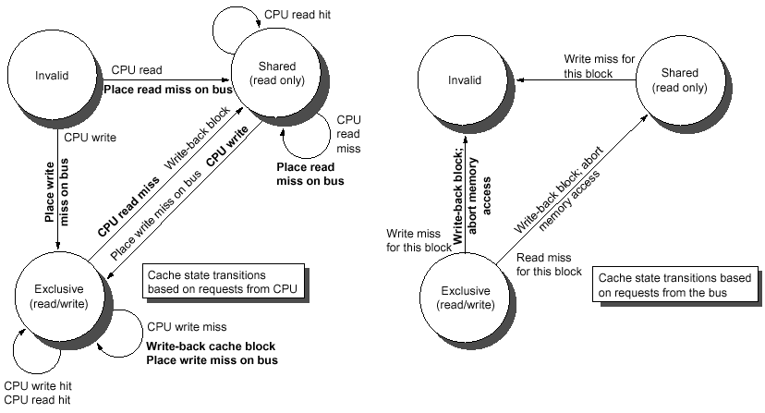
Write-Invalidate Write-Back Cache Coherence Protocol
Normal font = stimulus
Bold font = action
Action by CPU owner of cache Action from Bus

Slide 12
Explanation of Previous Slide
Left side: state transitions based on actions of the CPU associated with the cache
Right side: state transitions based on actions of other CPU’s placed on the bus
Example
CPU 1 starts in invalid; places read miss, reads block X, goes to shared state
CPU 1 re-reads block X, these are read hits
CPU 2 reads block X, places read miss, reads block X, goes to shared state
CPU 1 writes block X, always places write miss, moves to exclusive state
CPU 2 using right side reads write-miss and moves to Invalid state
CPU 1 writes or reads block X, stays in exclusive state
CPU 2 reads block X, places read miss
CPU 1 using right side gets read miss and moves to shared mode, supplies correct memory block to CPU 2
CPU 2 moves to shared mode

Slide 13
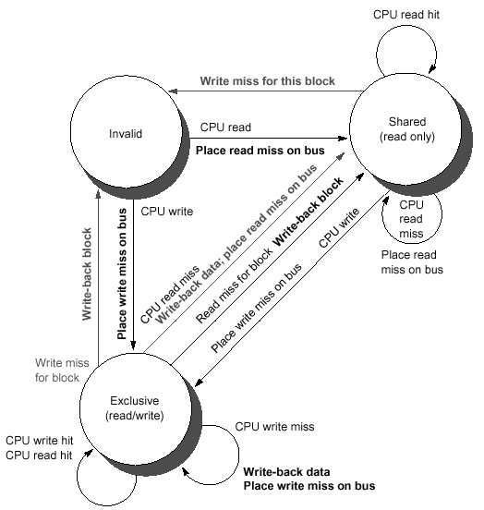
Merged State Transition Diagram
In practice, we’ll have a single state transition diagram with both types of stimulus merged together
Functionally the same as the split diagram on the previous slide
Protocol somewhat simplified from those in use today

Slide 14
Performance of Snooping Coherence Protocols
Use the four parallel programs described earlier as a benchmark
Split cache misses into two sets
Coherence Misses – misses due to cache invalidation
Capacity Misses – actually capacity, compulsory and conflict misses, but most of these are capacity. “Normal” cache misses from a uniprocessor

Slide 15
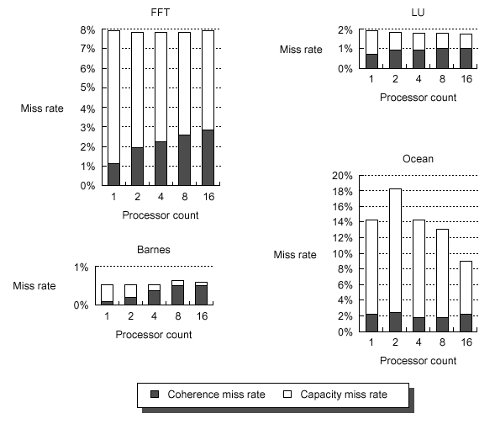
Miss Rate vs. Processor Count
Coherence Miss Rate goes up with processor count, more communication
Overall miss rate slightly down, due to more cache as we add more processors
High-communication app would be bad

Slide 16
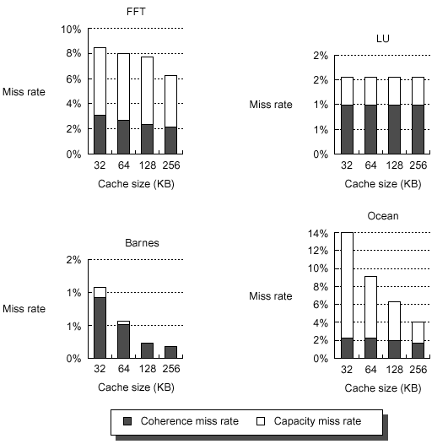
Miss Rate vs. Cache Size
Fixed processor count = 16
Miss rate drops as cache size increased, but varies on the application
Other variations possible: block size, set-associative cache, etc. Behaves similarly to the uniprocessor case

Slide 17
Distributed Shared Memory Architectures
Snooping protocol not so efficient on most DSM machines
Snooping requires a broadcast mechanism, which is easy to do on a bus
Most DSM systems don’t have a bus but a more complex system interconnect (LAN, mesh, hypercube, etc.) so broadcast becomes a much more expensive operation
One solution:
Prevent coherency by marking shared data as uncacheable
Private data can still be cached
For shared data, we must always access through memory
Simple to implement, but can slow things down if programs are not written with this model in mind
Access to remote memory can be quite slow

Slide 18
DSM Coherency
Another solution: software-based coherency
Possible but slow and conservative, every block that might be shared treated as if it is shared
Most popular alternative: Directory Protocol
Directory keeps the state of every block that may be cached
Information in the directory includes which caches have copies of the block, whether it is dirty, shared, etc.
Centralized version of snooping – this directory is always in the same location
Memory requirements for the directory are proportional to the number of memory blocks * number of processors

Slide 19
Directory Protocol
Each directory must track the following states for its cache blocks
Shared?
If shared, what processors are sharing this block?
This prevents broadcast if we need to invalidate those blocks, instead we can send a message to only these specific processors
Uncached?
Set if no processor has a copy of the cache block
Exclusive?
Exactly one processor has a copy of the cache block and has written to it, so memory copy is out of date
The processor of the exclusive block is called the owner of the block
Very similar to the snooping protocol, but the directory tracks of who has what data

Slide 20
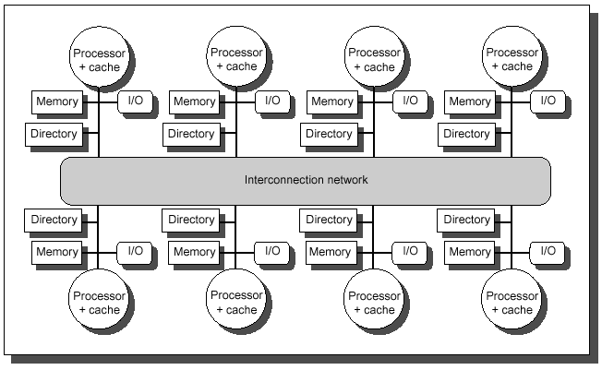
Directory Protocol for DSM
Directory added to each node to implement cache coherence
Each directory tracks caching for memory in its node
Notes:
Assuming address space is statically distributed so the node containing the memory and directory for a given physical address is known

Slide 21
Directory Protocol Terminology
Local node
Node where a request originates
Home node
Node where the memory location and directory entry reside
Could be the local node as well
Remote node
Node that has a copy of a cache block
Might be exclusive or shared
Nodes will pass messages to one another; messages will move a directory between states in a transition diagram, just like with the snooping protocol

Slide 22
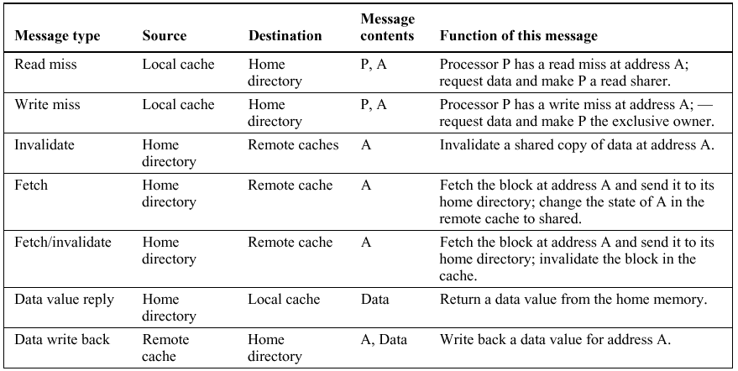
Directory Protocol Messages
1-2 : Miss requests by local cache to home
3-5 : Home sends to remote cache when home needs to satisfy request
6 : Home sends requested data to local cache
7 : Block replaced, needs to be written back to home or fetch requested

Slide 23
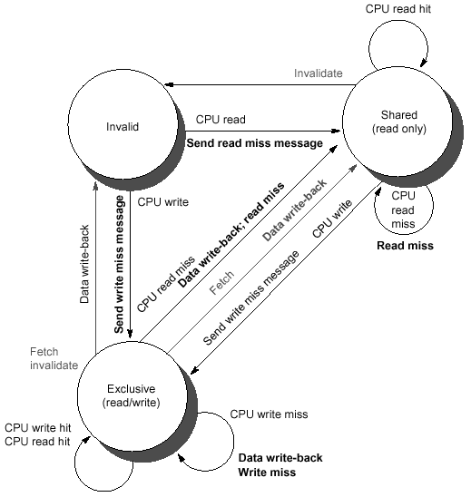
Directory-Based State Transition Diagram
Same as the snooping protocol diagram, except we are sending explicit messages instead of putting data on a common bus

Slide 24
Directory-Based Performance
Use same parallel programs as for the snooping protocol for our benchmark
Miss rate broken into two categories
Local misses
Remote misses
Remote misses are much more expensive than local misses
Longer read latencies to traverse interconnect
Will want to have bigger caches to avoid the latencies
Mostly will be coherence misses

Slide 25
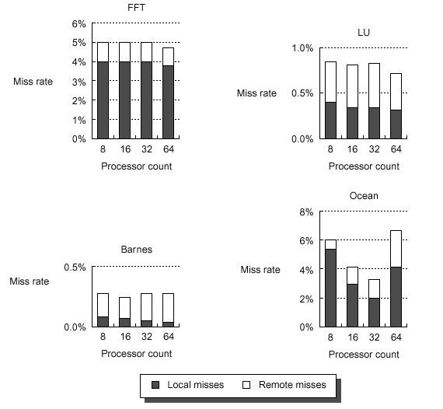
Miss Rate vs. Num Processors
As with snooping caches, remote misses increases somewhat as processor count increases
Anomaly here

Slide 26
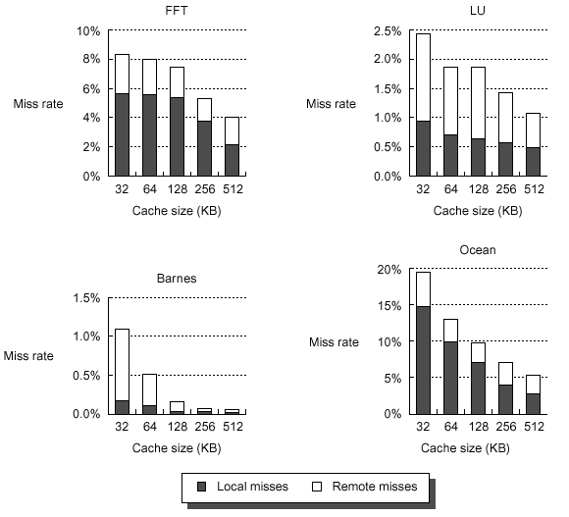
Miss Rate vs. Cache Size
P fixed at 64
Miss rates decrease as cache size grows, as you would expect!
Plateau varies with the application

Slide 27
Summary
Coherence protocols may be needed for correct program behavior
Most common protocol is write-back cache, write invalidation
Can use snooping or directory based mechanism to implement coherence
Coherence requests become more important in programs that are less optimized
Optimized programs will access most data locally and have fewer requests
Exactly how the cache miss rates affect CPU performance depends on the memory system, interconnect, latency, bandwidth, etc.

