Slide 1
Multiprocessors and
Thread Level Parallelism
Chapter 4, Appendix H
CS448

Slide 2
The Greed for Speed
Two general approaches to making computers faster
Faster uniprocessor
  All the techniques we’ve been looking at so far, plus others…
  Nice since existing programs still work without changing them, except may need to be re-compiled with optimizations
  But diminishing returns with higher cost, as with Amdahl’s law
Parallel processor
  Typically a collection general purpose uniprocessors today
  Large variation in memory access
  Required for high-end computer systems, e.g. supercomputing, DOE ASCI (Accelerated Strategic Computing Initiative) program

Slide 3
Parallel Processing
Advantages
  Performance gains possible
  Can be relatively inexpensive today with commodity processors
Disadvantages
  Software must now be changed radically to take advantage of the parallel machine
  Hardware challenges
  New types of overhead and organizational problems await the parallel machine

Slide 4
Types of Parallelism
We’ve already seen some sorts of parallelism…
  lookahead and pipelining
  data and control parallelism
  vectorization
  concurrency
  interleaving physical subsystems (e.g. memory)
  multiplicity and replication (e.g. multiple functional units)
  time and space sharing
  multitasking and multiprogramming
  multithreading
  distributed computing
We’ll focus primarily on multiprocessing here

Slide 5
Rise of the MIMD Processor
MIMDs offer flexibility
  Can function as a single-user multiprocessor for high performance on one application or as multiprogrammed multiprocessors running separate tasks
MIMDs can use COTS processors
  Nearly all multiprocessors today use the same microprocessors found in workstations or single processor machines

Slide 6
Terms
Multicore
  Multiple processors on a chip, typically share the same bus to memory and L2 cache
Cluster
  Standard components and networking technology to leverage commodity technology
    Often blades or rack-mounted servers
  Custom clusters may include specialized interconnect design
Thread/Process
  Program with its own address space

Slide 7
Multiprocessing
A few issues that stand out from uniprocessing
  Communication
    Interprocessor communication now comes into play
    Can treat similarly to I/O
    Issues of latency and bandwidth
  Resource allocation
    Allocated by programmer, compiler, hardware?

Slide 8
Communication among Multiple Processors
Software perspective
  Shared memory
    E.g. one processor writes to memory location X, second processor reads from memory location X
    Gets complicated with local vs. remote memory
    Sharing and access model
    Issues of speed, contention
  Explicitly send messages to specific processors via send and receive
    Similar to how computers operate on a network
    Usually seen as message passing
Hardware perspective
  Software and hardware models should not conflict for efficiency
    E.g. software treats “broadcast to all” as a cheap operation, when processor hardware does not support broadcast efficiently

Slide 9
MIMD Architecture
Two general classes of MIMD machines
  Centralized Shared-Memory (CSM) Architectures
    Typically used with a small number of processors
    Connected to a single centralized memory somehow, typically via a bus
    Sometimes called Uniform Memory Access (UMA) machines or Symmetric (shared-memory) Multiprocessors (SMP)
    Scalability issues with larger number of processors
  Distributed Shared Memory (DSM) Architecture
    Individual nodes contain memory, interconnected by some type of network
    Easy to scale up memory, good if most accesses are to local memory
    Latency and bandwidth issues between processors becomes key
    Sometimes called Non-Uniform Memory Access (NUMA) machines
Hybrid machines incorporating features of both are also possible

Slide 10
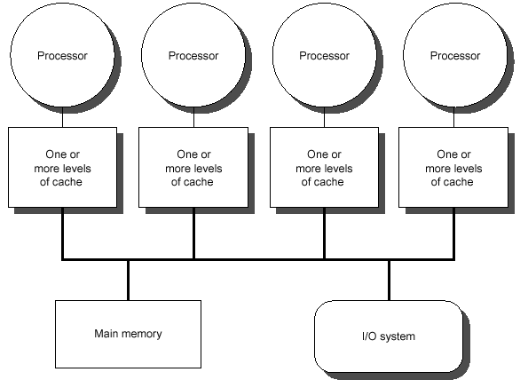
Centralized Shared Memory
Note: cache coherency problem

Slide 11
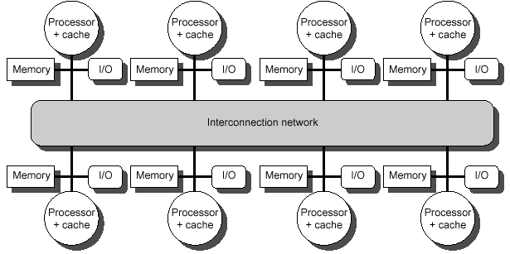
Distributed Shared Memory

Slide 12
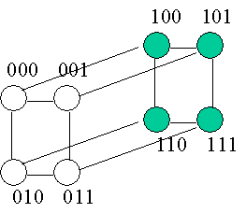


Example Interconnection Networks
Bus
2D Mesh
Hypercube

Slide 13
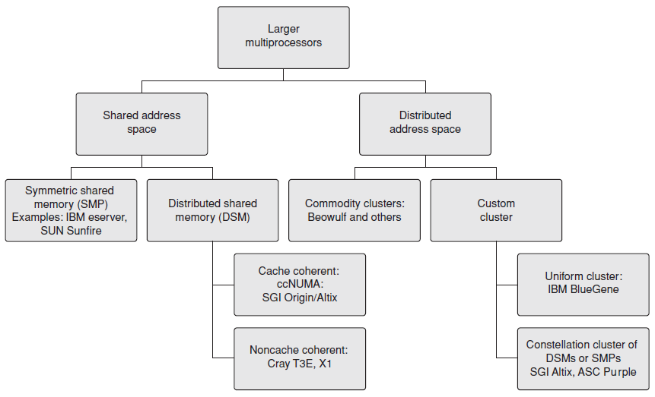
Classes of Large Scale Multiprocessors

Slide 14
Models for Memory, Communications
Shared Memory
  Does not mean there is a single centralized memory, but the address space is shared (same physical address on two processors refers to the same location in memory)
Address Space
  May consist of multiple private address spaces logically disjoint in addition to shared memory
  Essentially separate computers; sometimes called a multicomputer machine
  For machines with multiple private address spaces, communication of data performed by explicitly passing data between processors
    Called Message Passing Machines

Slide 15
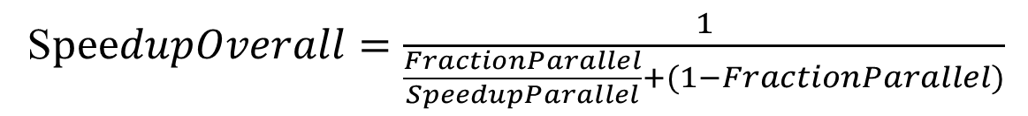
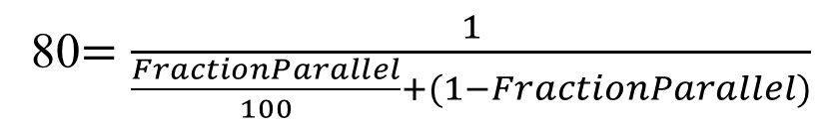
Challenges of Parallel Processing
Suppose you want to achieve a speedup of 80 with 100 processors. What fraction of the original computation can be sequential?
FractionParallel = 0.9975
S$peedupOverall=\frac{1}{\frac{FractionParallel}{SpeedupParallel}+(1−FractionParallel)}$
Assume parallel with all processors fully used
80$=\frac{1}{\frac{FractionParallel}{100}+(1−FractionParallel)}$
Notes:
Problem: many problems have insufficient parallelism

Slide 16
Message Passing Machines
Data transmitted through interconnect similar to sending over a LAN
For processor A to access or operate on data in processor B
  A sends message to request data or operation to B
  Message considered a Remote Procedure Call (RPC)
  B performs operation or access on behalf of A and returns the result with a reply message
Synchronous when A waits for reply before continuing
Asynchronous when A continues operating while waiting for reply from B
Program libraries exist to make RPC and message passing easier, e.g. MPI

Slide 17
Comparison of Communication Mechanisms
Shared Memory Communication
  Compatibility with well-understood mechanisms
  Ease of programming, similar to uniprocessor
  Low overhead for communicating small items
    Memory mapping in hardware, not through OS
  Can use hardware-controlled caching to reduce frequency of remote communication
Message Passing Communication
  Hardware can be simplified in some cases (we’ll see coherent caching problems shortly)
  Communication is explicit, forcing programmers to pay attention and optimize (like delayed branch)
    Could be a disadvantage as well!

Slide 18
Should Match SW to HW
Message Passing model on shared memory architecture
  Not too difficult, could “send” data by copying from one portion of the address space to another
Shared Memory on Message Passing architecture
  More difficult, without hw support for shared memory, the OS will need to handle things
  High overhead for sending small loads and stores
In either case, the resulting system will be slower than if the natural mapping from SW to HW is used

Slide 19
Communication Performance
Communication Bandwidth
  Data rate we can transmit data
  Determined by communication hardware, mechanism
  Slowest node for a data path can determine the communication bandwidth
Communication Latency
  Propagation time
  Latency = Sender overhead + Time of Flight + Transmission time + Receiver overhead
  Crucial metric to performance!
Latency Hiding
  Methods to hide latency by overlapping operations
  But puts additional burden on software system and the programmer in many cases

Slide 20
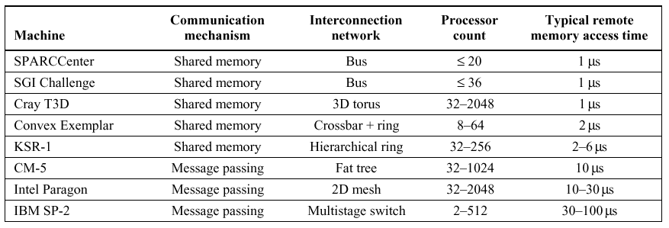
Sample Remote Access Times
Large latency of remote access can significantly impact performance
Must take into account in designing algorithms!
Load time for shared memory, Reply time for Message Passing

Slide 21
Performance Example
Unfortunately, stringing together N processors with performance P does not give us N*P as the new performance
  Factors coming into play
    Amount of parallelism
    Conventional factors (TLB miss, cache miss, etc.)
    Shared memory overhead
    Message passing overhead
Can modify uniprocessor performance model:
  CPUTime = IC * CPI * Parallel_Overhead * CycleTime

Slide 22
Communications Cost Example
Multiprocessor with:
  2000ns to handle remote memory reference
  All other references hit in local cache
  Cycle time is 10ns
  Base CPI is 1.0
  How much faster if there is no communication vs. 0.5% of instructions involve remote communications?
New effective CPI:
  CPI(new) = Base_CPI + RemoteRequestRate * RemoteRequestCost
  RemoteRequestCost = 2000ns / 10ns = 200 cycles
  CPI(new) = 1.0 + (0.05)(200) = 2.0
All local machine is twice as fast as the new machine
  Means we’d like to limit communications as much as possible (e.g. cache)
  Of course this doesn’t include the work done by other processors in parallelizing an application!

Slide 23
Sample Machines
Central Shared Memory
  Sequent Symmetry S-81
    Bus interconnect, thirty 386 CPU’s with separate FPU
  IBM ES/9000
    Crossbar interconnect, 6 ES/9000 CPU’s
  BBN TC- 2000
    Butterfly switch interconnect, 512 Motorola 68000 CPU’s, hybrid NUMA architecture with preferred memory module
  Modern multicore Intel/AMD processor
Distributed Shared Memory
  IBM Blue Gene
    Custom cluster, 64K nodes, 2 PowerPC 440’s per node, 3D Torus
  nCube
    Hypercube, custom CISC CPU, 64Mb per node, up to 8196 nodes

Slide 24
Application Domain
Multiprocessing performance is closely related to the application
  Much more care must be taken in construction a parallel algorithm to take advantage of the hardware than for a uniprocessor machine
    With uniprocessor, could rely on compiler techniques, hardware such as pipelining, etc. to help us out
    Not so much of this help available for parallel machines, more of a burden on the programmer
  Performance can vary significantly from one application to another, e.g.
    Matrix multiplication – lots of places for parallelism
    Computing a checksum – less room for parallelism, lots of dependencies on previous calculations

Slide 25
Example Problems
Fast Fourier Transform
  Convert signal from time to frequency domain
LU Kernel
  Solve linear algebra computations
Barnes
Ocean

Slide 26
Barnes
  Galaxy evolution, N-bodies with gravitational forces acting on them
  To reduce computational time required
    Gravity drops off as square of the distance
    Takes advantage of this property by treating “far away” bodies as a single point of combined mass at the centroid of the bodies, reducing N items to a single item
    Each node represents an octree, or eight children representing eight cubes in space; recursively divide a cube into eight smaller cubes
    Tree created to represent density of objects in space
  Challenges for parallelism
    Each processor given some subtree to work on
    Distribution of bodies is non-uniform and changes over time
    So we must re-partition work among the processes to maintain balance
    Requires communicating small amounts of data, implying shared-memory architecture may be most efficient

Slide 27
Ocean
  Ocean simulation, influence of eddy and currents on large-scale flow in the ocean
  To reduce computational time required
    Ocean is broken up into grids, more grids gives more resolution and increases accuracy but requires more processing
    Processing a grid cell requires data from neighboring cells
  Challenges for parallelism
    Each processor given a grid cell to work on
    Processors must communicate with their neighbors in a synchronized fashion before proceeding to the next step
    Implies a DSM machine laid out in a mesh format would match nicely to this problem

Slide 28
Computation vs. Communication
A key factor in the performance of parallel programs is the ratio of computation to communication
  High implies lots of computation for each datum communicated (good since communication is expensive)
Analysis of computation vs. communication varies on the problem and algorithm
  Results shown on next slide for the four sample apps
  We won’t show how we arose at these figures (work like this left for the Algorithms class)
  P = number of processors
  N = data set size

Slide 29
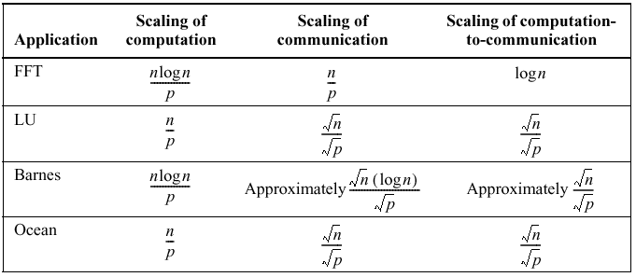
Computation vs. Communication
Scaling on a per-processor basis
Computation: As P increases, computation goes down
Communication: As P increases, comm. goes down but less slowly than computation
Ratio: As P increases, computation-to-comm ratio goes down, which is bad. If data size the same, more inefficiencies in comm.
Equation tells us how to balance N with P to maintain
any desired amount of work spent in computation or comm

Slide 30
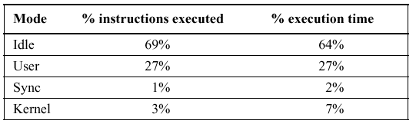
OS Workload
There is also overhead with the OS
  Just as we have with a uniprocessor
Example on eight-processor system running “make”
  Distribution of execution time:
  Most time actually spent idle waiting on the disk!
Bottom line: Application behavior a key factor on performance with a parallel machine, thought must be given into the algorithm and performance-related issues

