Slide 1
Intro to GPU’s for Parallel Computing

Slide 2
Goals for Rest of Course
Learn how to program massively parallel processors and achieve
high performance
functionality and maintainability
scalability across future generations
Acquire technical knowledge required to achieve the above goals
principles and patterns of parallel programming
processor architecture features and constraints
programming API, tools and techniques
Overview of architecture first, then introduce architecture as we go

Slide 3
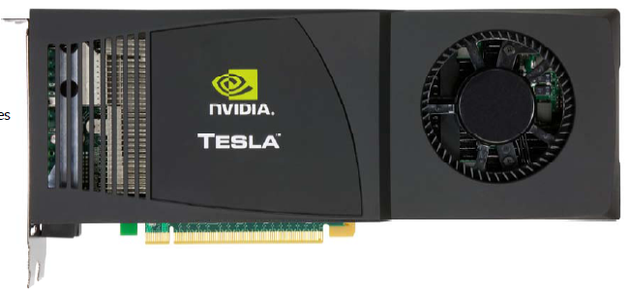
Equipment
Your own, if CUDA-enabled; will use CUDA SDK in C
Compute Unified Device Architecture
NVIDIA G80 or newer
G80 emulator won’t quite work
Lab machine – Tesla
Ubuntu
Quad core Xeon, 2 Ghz
16 Gb memory
Two Tesla C1060 “Tesla C1060 Computing Processor Board”
240 Cores
1.3 Ghz Clock
4 Gb memory
MD5 test
Average 363.67 Mhash/s
2x 3.2 Ghz Xeon: 42 Mhash/s

Slide 4
Equipment
May use our Beowulf cluster for MPI, beancounter.math.uaa.alaska.edu
13 custom-built boxes each containing a dual processor 1 Ghz Pentium III, 768 Mb of shared memory
Total of 27 nodes, including the master.
NetBSD 2.0F
Connected through a 100Mbps switch.

Slide 5
Why Massively Parallel Processors
A quiet revolution and potential build-up
2006 Calculation: 367 GFLOPS vs. 32 GFLOPS
G80 Memory Bandwidth: 86.4 GB/s vs. 8.4 GB/s
Until recently, programmed through graphics API
GPU in every PC and workstation – massive volume and potential impact
Notes:
CPU driven by sequential code performance; extracting ILP, branch prediction, ROB, out of order execution, etc.
Graphics focused on pixel-based processing, parallelism - now on every workstation, no longer just supercomputer
Size a factor for many fields, e.g. medical MRI; supercomputer in a workstation sized package

Slide 6
CPUs and GPUs have fundamentally different design philosophies
Control
ALU
ALU
ALU
ALU
CPU
GPU
Cache
DRAM
DRAM

Slide 7
Architecture of a CUDA-capable GPU
Streaming
Multiprocessor
(SM)
Building
Block
Host
Streaming
Processor
(SP)
Input Assembler
Thread Execution Manager
Parallel Data Cache
Parallel Data Cache
Parallel Data Cache
Parallel Data Cache
Parallel Data Cache
Parallel Data Cache
Parallel Data Cache
Parallel Data Cache
Texture
Texture
Texture
Texture
Texture
Texture
Texture
Texture
Texture
Load/store
Load/store
Load/store
Load/store
Load/store
Load/store
Global Memory
30 SM’s each with 8 SP’s on the C1060
Notes:
Joint CPU/GPU operation
Each SP can process a FP multiply and a FP multiply/add

Slide 8
GT200 Characteristics
1 TFLOPS peak performance (25-50 times of current high-end microprocessors)
265 GFLOPS sustained for apps such as Visual Molecular Dynamics (VMD)
Massively parallel, 128 cores, 90W
Massively threaded, sustains 1000s of threads per app
30-100 times speedup over high-end microprocessors on scientific and media applications: medical imaging, molecular dynamics
“I think they're right on the money, but the huge performance differential (currently 3 GPUs ~= 300 SGI Altix Itanium2s) will invite close scrutiny so I have to be careful what I say publically until I triple check those numbers.”
-John Stone, VMD group, Physics UIUC

Slide 9
Future Apps Reflect a Concurrent World
Exciting applications in future mass computing market have been traditionally considered “supercomputing applications”
Molecular dynamics simulation, Video and audio coding and manipulation, 3D imaging and visualization, Consumer game physics, and virtual reality products
These “Super-apps” represent and model physical, concurrent world
Various granularities of parallelism exist, but…
programming model must not hinder parallel implementation
data delivery needs careful management
Notes:
Do not go over all of the different applications. Let them read them instead.

Slide 10
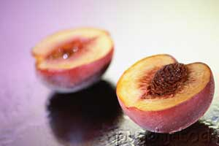
Stretching Traditional Architectures
Traditional parallel architectures cover some super-applications
DSP, GPU, network apps, Scientific
The game is to grow mainstream architectures “out” or domain-specific architectures “in”
CUDA is latter
Notes:
This leads to memory wall: Why we can’t transparently extend out the current model to the future application space: memory wall. How does the meaning of the memory wall change as we transition into architectures that target the super-application space.
Lessons learned from Itanium

Slide 11
Sample of Previous GPU Projects
Application | Description | Source | Kernel | % time
H.264 | SPEC ‘06 version, change in guess vector | 34,811 | 194 | 35%
LBM | SPEC ‘06 version, change to single precision and print fewer reports | 1,481 | 285 | >99%
RC5-72 | Distributed.net RC5-72 challenge client code | 1,979 | 218 | >99%
FEM | Finite element modeling, simulation of 3D graded materials | 1,874 | 146 | 99%
RPES | Rye Polynomial Equation Solver, quantum chem, 2-electron repulsion | 1,104 | 281 | 99%
PNS | Petri Net simulation of a distributed system | 322 | 160 | >99%
SAXPY | Single-precision implementation of saxpy, used in Linpack’s Gaussian elim. routine | 952 | 31 | >99%
TRACF | Two Point Angular Correlation Function | 536 | 98 | 96%
FDTD | Finite-Difference Time Domain analysis of 2D electromagnetic wave propagation | 1,365 | 93 | 16%
MRI-Q | Computing a matrix Q, a scanner’s configuration in MRI reconstruction | 490 | 33 | >99%
Notes:
LBM: Fluid simulation
About 20 versions were tried for each app.
Amdahl’s Law

Slide 12
Speedup of Applications
GeForce 8800 GTX vs. 2.2GHz Opteron 248
10× speedup in a kernel is typical, as long as the kernel can occupy enough parallel threads
25× to 400× speedup if the function’s data requirements and control flow suit the GPU and the application is optimized
Notes:
All kernels have large numbers of simultaneously executing threads
Most of the 10X kernels saturate memory bandwidth
Can get better quality as well as being faster; e.g. solve instead of approximate

