Slide 1
Review of the MIPS
Instruction Set Architecture

Slide 2
RISC Instruction Set Basics
All operations on data apply to data in registers and typically change the entire register
The only operations that affect memory are load and store operations
The instruction formats are few in number with all instructions typically one size
Text uses MIPS64
  Instructions generally have a D at the start or end of the mnemonic, e.g. DADD is 64 bit ADD

Slide 3
MIPS ISA
32 registers
  Register 0 always has the value 0
Three classes of instructions
  ALU instructions
    Register to register or immediate to register
    Signed or unsigned
    Floating point or Integer
    NOT to memory
  Load/Store instructions
    Base register added to signed offset to get an effective address
  Branches and Jumps
    Branch based on condition bit or comparison between pair of registers

Slide 4
MIPS arithmetic
Most instructions have 3 operands
Operand order is fixed (destination first)
Example:
HLL code: A = B + C;
MIPS code: DADD $s0, $s1, $s2
($s0, $s1 and $s2 are associated with variables by compiler)

Slide 5
MIPS arithmetic
HLL code: A = B + C + D;
E = F - A;
MIPS code: DADD $t0, $s1, $s2
DADD $s0, $t0, $s3
DSUB $s4, $s5, $s0
Operands must be registers
  Compiler tries to keep as many variables in registers as possible
  Some variables can not be allocated
    large arrays
    aliased variables (variables accessible through pointers)
    dynamically allocated variables on the heap or stack
  Compiler may run out of registers; this is called spilling

Slide 6
Memory layout: Alignment
31
23
15
7
0
0
this word is aligned; the others are not
4
8
12
address
16
Words are aligned (32 bit in this example)
Big-endian or Little-endian depending on the OS

Slide 7
Instructions: load and store
Example:
HLL code: A[3] = h + A[3];
MIPS code: LW $t0, 24($s3)
DADD $t0, $s2, $t0
SW $t0, 24($s3)
8 bytes per word → offset to 3rd word → 24 byte displacement
h already in register $s2
Store word operation has no destination (reg) operand

Slide 8
Swap example
C MIPS32
swap(int v[], int k)
{
int temp;
temp = v[k]
v[k] = v[k+1];
v[k+1] = temp;
}
swap:
MULI $2, $5, 4
ADD $2, $4, $2
LW $15, 0($2)
LW $16, 4($2)
SW $16, 0($2)
SW $15, 4($2)
JR $31
Explanation:
index k : $5
base address of v: $4
address of v[k] is $4 + 4*$5

Slide 9
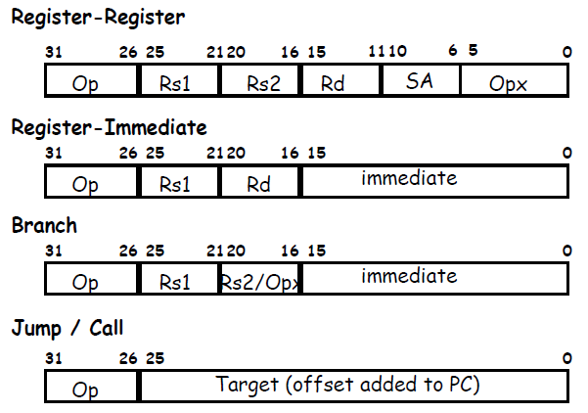
MIPS32 Instruction Formats

Slide 10
Control
Decision making instructions
  alter the control flow,
  i.e., change the "next" instruction to be executed
MIPS unconditional branch
J Label
MIPS conditional branch instructions:
BNE $t0, $t1, Label
BEQ $t0, $t1, Label
Example: if (X==Y)
A = B + C;
BNE $s4, $s5, Label
DADD $s3, $s0, $s1
Label: ....
Assembler calculates offset amount for us

Slide 11
Control Flow
We have: BEQ, BNE, what about Branch-if-less-than?
New instruction:
meaning:
if $s1 < $s2 then
$t0 = 1
SLT $t0, $s1, $s2 else
$t0 = 0
Can follow this with BNE $t0, $zero, Label
to get branch if less than

Slide 12
MIPS compiler conventions

Slide 13
What’s this do? 32 bits
LI $3, 4 # load immediate
Foo:
MULI $2, $3, 4
ADD $2, $1, $2
LW $15, 0($2)
ADDI $15, $15, 1
SW $15, 0($2)
ADDI $3, $3, -1
BNE $3, $zero, Foo

Slide 14
Brief look at the 80x86
Textbook appendix has more details
Complexity:
  Instructions from 1 to 17 bytes long
  one operand must act as both a source and destination
  one operand can come from memory
  complex addressing modes
  e.g., “base or scaled index with 8 or 32 bit displacement”
Saving grace:
  the most frequently used instructions are not too difficult to build
  compilers avoid the portions of the architecture that are slow
Implementation on later processors translates x86 instructions into RISC-like instructions internally, allowing it to adopt many of the RISC innovations

