Slide 1
Limits on ILP

Slide 2
Achieving Parallelism
Techniques
Scoreboarding / Tomasulo’s Algorithm
Pipelining
Speculation
Branch Prediction
But how much more performance could we theoretically get? How much ILP exists?
How much more performance could we realistically get?

Slide 3
Methodology
Assume an ideal (and impractical) processor
Add limitations one at a time to measure individual impact
Consider ILP limits on a hypothetically practical processor
Analysis performed on benchmark programs with varying characteristics

Slide 4
Hardware Model – Ideal Machine
Remove all limitations on ILP
Register renaming
Infinite number of registers available, eliminating all WAW and WAR hazards
Branch prediction
Perfect, including targets for jumps
Memory address alias analysis
All addresses known exactly, a load can be moved before a store provided that the addresses are not identical
Perfect caches
All memory accesses take 1 clock cycle
Infinite resources
No limit on number of functional units, buses, etc.

Slide 5
Ideal Machine
All control dependencies removed by perfect branch prediction
All structural hazards removed by infinite resources
All that remains are true data dependencies (RAW) hazards
All functional unit latencies: one clock cycle
Any dynamic instruction can execute in the cycle after its predecessor executes
Initially we assume the processor can issue an unlimited number of instructions at once looking arbitrarily far ahead in the computation

Slide 6
Experimental Method
Programs compiled and optimized with standard MIPS optimizing compiler
The programs were instrumented to produce a trace of instruction and data references over the entire execution
Each instruction was subsequently re-scheduled as early as the true data dependencies would allow
No control dependence

Slide 7
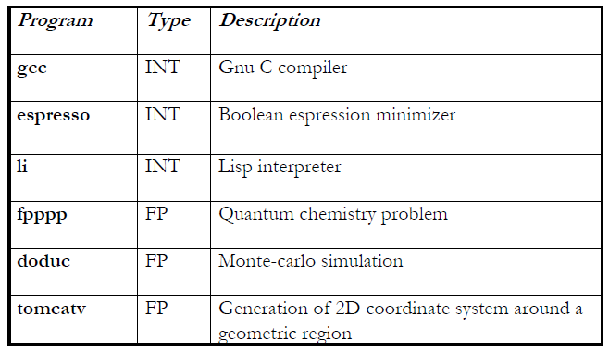
Benchmark Programs – SPECINT92

Slide 8
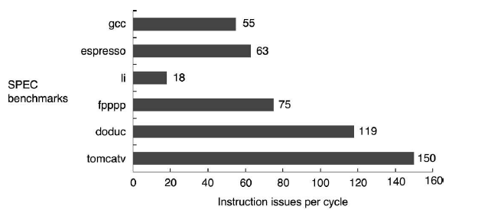
ILP on the Ideal Processor

Slide 9
How close could we get to the ideal?
The perfect processor must do the following:
Look arbitrarily far ahead to find a set of instructions to issue, predicting all branches perfectly
Rename all registers to avoid WAR and WAW hazards
Resolve data dependencies
Resolve memory dependencies
Have enough functional units for all ready instructions

Slide 10
Limiting the Instruction Window
Limit window size to n (no longer arbitrary)
Window = number of instructions that are candidates for concurrent execution in a cycle
Window size determines
Instruction storage needed within the pipeline
Maximum issue rate
Number of operand comparisons needed for dependence checking is O(n²)
To try and detect dependences among 2000 instructions would require some 4 million comparisons
Issuing 50 instructions requires 2450 comparisons

Slide 11
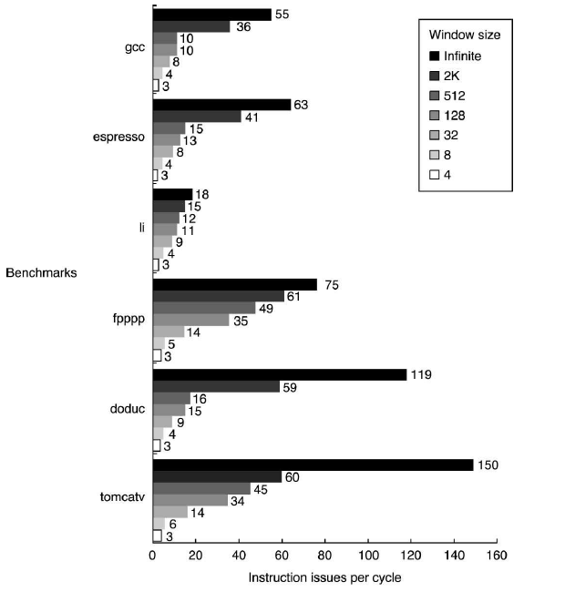
Effect of Reduced Window Size
Notes:
Best window size today around 200

Slide 12
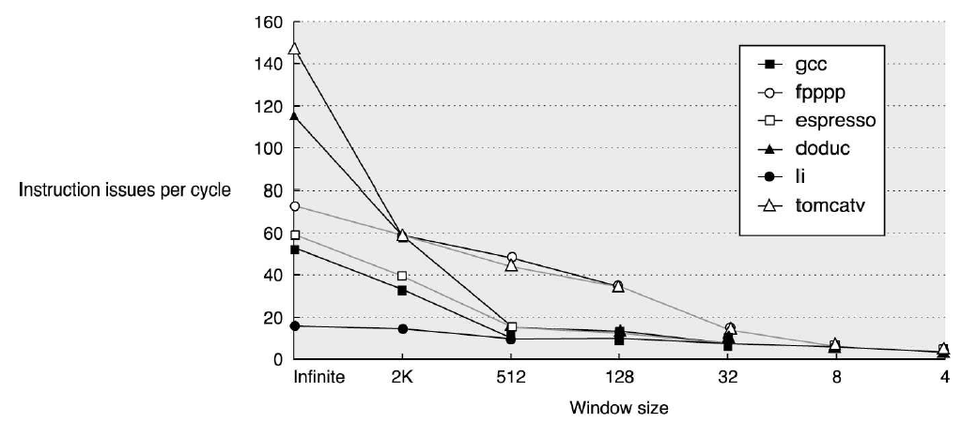
Effect of Reduced Window Size

Slide 13
Effect of Reduced Window Size
Integer programs do not have as much parallelism as floating point programs
Scientific nature of the program
Highly dependent on loop-level parallelism
Instructions that can execute in parallel across loop iterations cannot be found with small window sizes without compiler help
From now on, assume:
Window size of 2000
Maximum of 64 instructions issued per cycle

Slide 14
Effects of Branch Prediction
So far, all branch outcomes are known before the first instruction executes
This is difficult to achieve in hardware or software
Consider 5 alternatives
Perfect
Tournament predictor
(2,2) prediction scheme with 8K entries
Standard (non-correlating) 2-bit predictor
Static (profile-based)
None (parallelism limited to within current basic block)
No penalty for mispredicted branches except for unseen parallelism

Slide 15
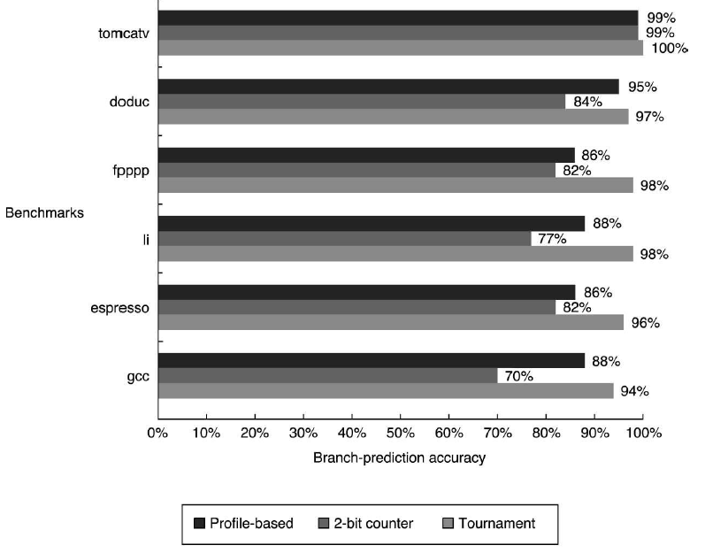
Branch Prediction Accuracy
Notes:
I think not really 100% on tomcatv

Slide 16
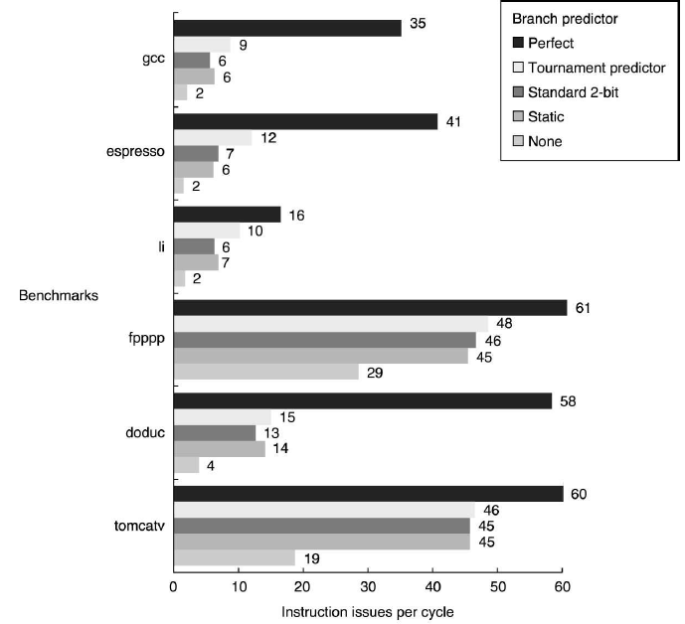
Effects of Branch Prediction

Slide 17
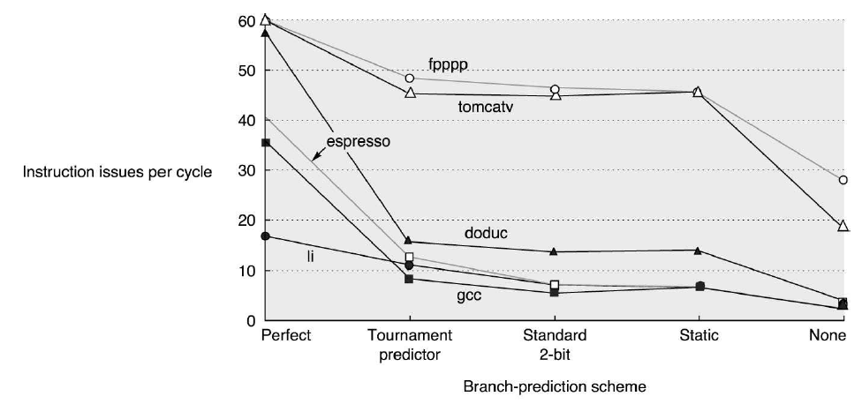
Effects of Branch Prediction

Slide 18
Branch Prediction
Accurate prediction is critical to finding ILP
Loops are easy to predict
Independent instructions are separated by many branches in the integer programs and doduc
From now on, assume tournament predictor
Also assume 2K jump and return predictors

Slide 19
Effect of Finite Registers
What if we no longer have infinite registers? Might have WAW or WAR hazards
Alpha 21264 had 41 gp and integer renaming registers
IBM Power5 has 88 fp and integer renaming registers

Slide 20
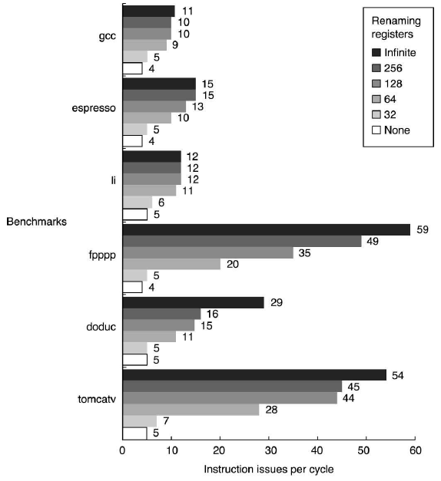
Effect of Renaming Registers

Slide 21
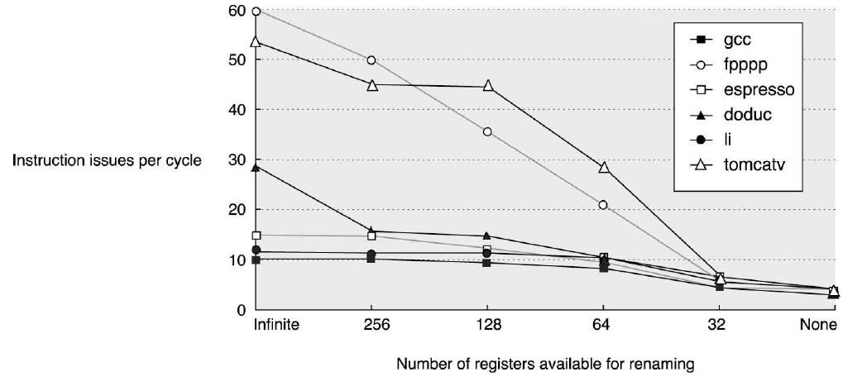
Effects of Renaming Registers

Slide 22
Renaming Registers
Not a big difference in integer programs
Already limited by branch prediction and window size, not that many speculative paths where we run into renaming problems
Many registers needed to hold live variables for the more predictable floating point programs
Significant jump at 64
We will assume 256 integer and FP registers available for renaming

Slide 23
Imperfect Alias Analysis
Memory can have dependencies too, so far assumed they can be eliminated
So far, memory alias analysis has been perfect
Consider 3 models
Global/stack perfect: idealized static program analysis (heap references are assumed to conflict)
Inspection: a simpler, realizable compiler technique limited to inspecting base registers and constant offsets
None: all memory references are assumed to conflict

Slide 24
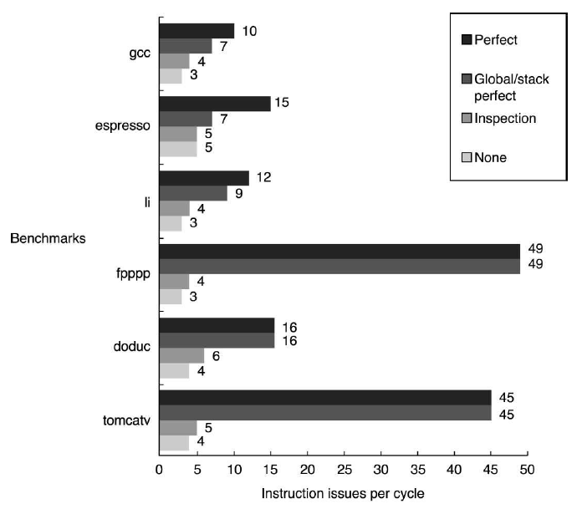
Effects of Imperfect Alias Analysis
Notes:
No heap references for fpppp and tomcatv

Slide 25
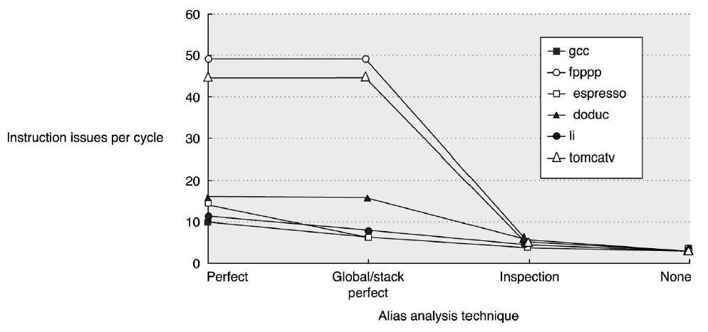
Effects of Imperfect Alias Analysis

Slide 26
Memory Disambiguation
Fpppp and tomcatv use no heap so perfect with global/stack perfect assumption
Perfect analysis here better by a factor of 2, implies there are compiler analysis or dynamic analysis to obtain more parallelism
Has big impact on amount of parallelism
Dynamic memory disambiguation constrained by
Each load address must be compared with all in-flight stores
The number of references that can be analyzed each clock cycle
The amount of load/store buffering determines how far a load/store instruction can be moved

Slide 27
What is realizable?
If our hardware improves, what may be realizable in the near future?
Up to 64 instruction issues per clock (roughly 10 times the issue width in 2005)
A tournament predictor with 1K entries and a 16 entry return predictor
Perfect disambiguation of memory references done dynamically (ambitious but possible if window size is small)
Register renaming with 64 int and 64 fp registers

Slide 28
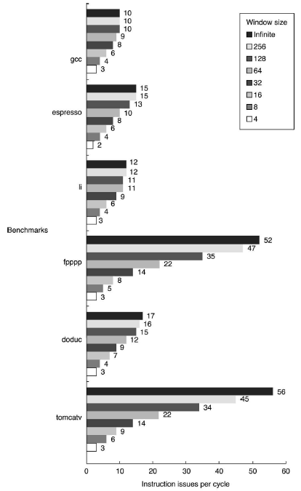
Performance on Hypothetical CPU

Slide 29
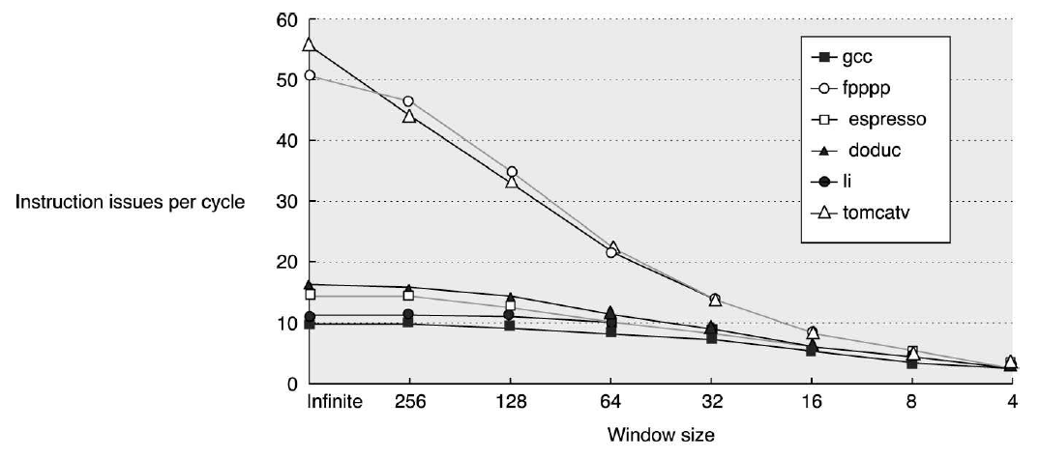
Performance on Hypothetical CPU

Slide 30
Hypothetical CPU
Ambitious/impractical hardware assumptions
Unrestricted issue (particularly memory ops)
Single cycle operations
Perfect caches
Other directions
Data value prediction and speculation
Address value prediction and speculation
Speculation on multiple paths
Simpler processor with larger cache and higher clock rate vs. more emphasis on ILP with a slower clock and smaller cache

