Slide 1
Fundamentals of Computer Design

Slide 2
Rapid Pace of Development
IBM 7094 released in 1965
  Featured interrupts
  Could add floating point numbers at 350,000 instructions per second
  Standard 32K of core memory in 36 bit words
  Occupied an entire air conditioned room
  System cost of about $3.5 million

Slide 3
This laptop
Fujitsu Lifebook T4220 purchased in 2008
  16 GFLOPS (we’ll see later this is not a particularly good benchmark)
  Standard 2GB of core memory in 64 bit words
  Occupies 12” by 9” by 1.5” space
  System cost of about $2,000

Slide 4
Moore’s Law
Transistors per inch square
  Twice as many after ~1.5-2 years
Related trends
  Processor performance
  Twice as fast after ~18 months
  Memory capacity
  Twice as much in <2 years
Not a true law but an observation
  We’re getting close to hitting the physical limits

Slide 5
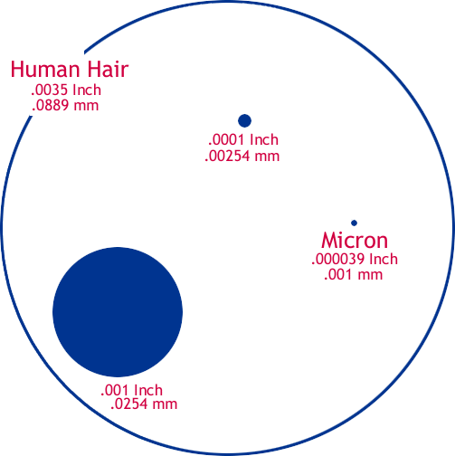
The Shrinking Chip
Human Hair: 100 microns wide
  1 micron is 1 millionth of a meter
Bacterium: 5 microns
Virus: 0.8 microns
Early microprocessors: 10-15 micron technology
1997: 0.35 Micron
1998: 0.25 Micron
1999: 0.18 Micron
2001: 0.13 Micron
2003: 0.09 Micron
2007: 0.065 Micron
2009: 0.045 Micron
Physical limits believed to be around 0.016 Microns, should reach it around 2018
Notes:
Smaller process technology means we can generate less heat, pack more transistors into the same area as before

Slide 6
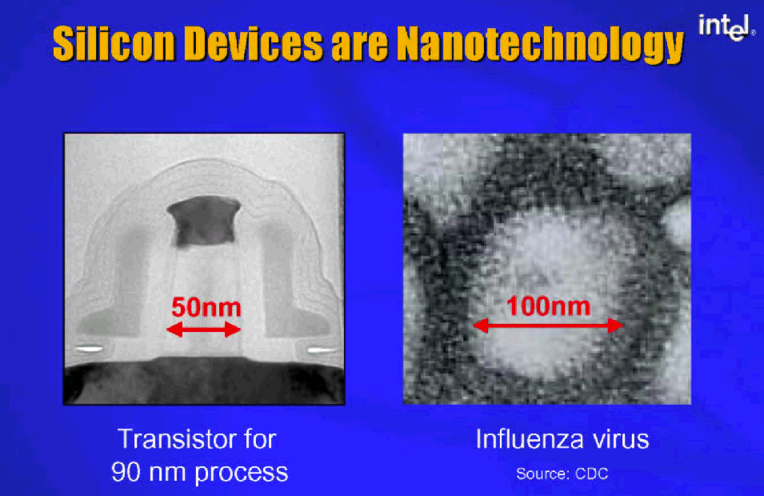
Size

Slide 7
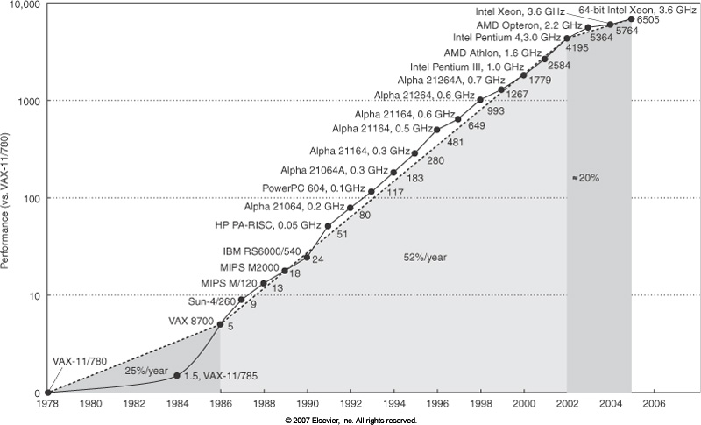
Performance Trend
Notes:
Doubling the number of people on a project doesn’t speed it up by 2x
Similarly, 2x transistors does not automatically get you 2x performance
Possible because of continued advances in computer architecture.
Much of computer architecture is about how do you organize these resources to get more done
20% since 2002 ; little ILP to exploit efficiently

Slide 8
RISC vs. CISC
Big debate in the 80’s
Ideas from RISC won
  Although you don’t think of it as RISC, today’s Intel Architecture adopted many RISC ideas internally
Notes:
RISC focuses on the common case and makes it really fast,
Which simplifies the design and everything else is fast
Instead of complex logic for rare cases and that slows everything down

Slide 9
Terms for a Computer Designer
Instruction Set Architecture – The assembly instructions visible to a programmer
Organization – Mostly transparent to the programmer, but high-level design aspects such as how much cache, replacement policies, cache mapping algorithm, bus structure, internal CPU design.
Computer Architecture – We’ll refer to this as instruction set design, organization of the hardware design, and the actual hardware itself.

Slide 10
ISA for this class
Mostly a MIPS-like ISA
  32 general purpose and 32 floating point registers
  Load-store architecture
Memory Addressing
  Byte addressing
  Objects in MIPS must be byte aligned
Addressing Modes
  Register, Immediate, Displacement
Notes:
Byte aligned if an object of size s bytes at address A is aligned if A mod s = 0

Slide 11
ISA for this class
Types and sizes of operands
  8-bit ASCII to 64 it double precision
Operations
  Data transfer, arithmetic, logical, control, floating point
Control Flow instructions
Encoding on an ISA
  Fixed length vs. Variable length
Notes:
Will do a brief MIPS review later

Slide 12
Other Design Factors
Notes:
Some examples:
Apps sucked into OS
Interconnect redesigned for new Apps (e.g. graphics bandwidth)
Instruction Set & hardware designed for new Apps (e.g. MMX, MMX2)
Power, CPU, ISA designed for mobile users (Transmeta, Atom)
The interactions among all these components form a huge constraint satisfaction problem, which is in the class of NP hard problems!

Slide 13
Conflicting Requirements
To minimize cost implies a simple design
To maximize performance implies complex design or sophisticated technology
Time to market matters! Implies simple design and great secrecy
Time to productivity! Implies need complete vertical solutions in place
Don’t mess up – requires simulation, QA, quantification
Notes:
Throughout this course we’ll focus mostly on the CPU, Memory, and Instruction Set. However, one should not lose sight of the bigger picture.

Slide 14
Technology Trends
In 1943, Thomas Watson predicted “I think there is a world market for maybe five computers."
  (The IBM PC was an “undercover” project and saved the company)
In the 70’s and 80’s IBM pursued the high-speed Josephson Junction, spending $2 billion, before scrapping it and using CMOS like everyone else.
Notes:
Don’t have to be perfect prognosticators to survive but it can cost a lot of money (around $7 billion to IBM)

Slide 15
Current Trends
Memory use by programs growing by a factor of 1.5 to 2 per year.
  Lesson: don’t make your word size or address space too small!
Replacement of assembly by HLL’s
  Lesson: compilers are critical!
Growing demand on multimedia
  Lesson: Design for high-speed graphic interfaces.
Growing demand for networking.
  Lesson: Also design for high-speed I/O
Growing demand for simplicity in attaching I/O devices
  Lesson: Rise of USB, perhaps Firewire next?
Growing demand for mobile computing
  Lesson: Need ability to adapt to low power scenarios

Slide 16
Implementation Trends
IC density is increasing at close to 35% per year, while the die size is also increasing at close to 15% per year. This results in transistor count increasing at 40-55% per year. Factors into a lower future cost for developing the same chip!
Semiconductor DRAM density increasing around 40% per year, bandwidth and latency also improving.
Disk technology increasing at an astounding rate, about 30-100% per year

Slide 17
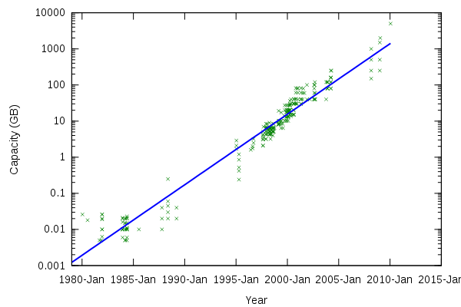
PC Hard Drive Capacity

Slide 18
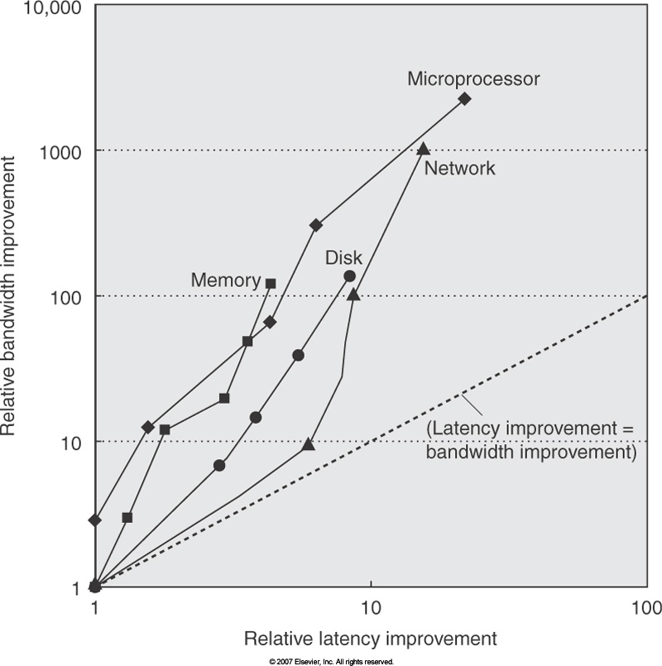
Bandwidth vs. Latency
Notes:
Rule of thumb: bandwidth grows by at least the square of the improvement in latency
Can see memory wall: CPU high, memory low

Slide 19
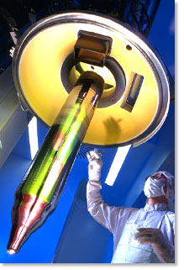
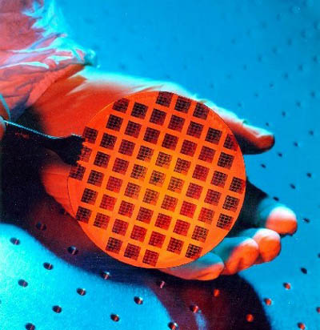
Chip Production
Ingot of purified silicon – 1 meter long, sliced into thin wafers
Chips are etched – much like photography
  UV light through multiple masks
  Circuits laid down through mask
Process takes about 3 months
View of
Cross-Section
Notes:
Sliced using diamond saws
Yield is the % of usable chips per wafer

Slide 20
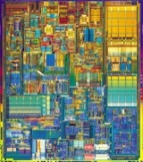

Yield
Manufacturing
Defects
✗
✗
✗
✗
✗
✗
✗
✗
13/16 working chips
81.25% yield
1/4 working chips
25.0% yield
Size Matters! (of the die, anyway)

Slide 21
Costs
Wafers completely bad so no testing. Assume 100%
0.4/cm² in 2006
Complexity of manufacturing; a typical α = 4
Notes:
The maximum number of dies per wafer is basically the area of the wafer divided by the area of the die. We must subtract off a correction factor since dies are currently square, while wafers are round.
The maximum number of dies per wafer is unrealistic today due to imperfections in the manufacturing process.

Slide 22
Some Sizes
0.25u Pentium II = 105 mm²
0.25u PPC 604e = 47.3 mm²
0.18u Pentium 4: 217 mm²
0.18u Transmeta TM5600 88 mm²
0.90u VIA C7M 30mm²
0.065u Athlon X2 (Brisbane) 118 mm²
0.065u Core 2 Due (Conroe) 143 mm²
0.045u Atom 230: 26 mm²
The diameter of wafers has increased from 200mm (8 inch) in 1993 to 300mm today (12 inch) with some resistance going to 450 mm

Slide 23
Cost per die
The book has some examples of computing the die yield for various wafer and die sizes.
For a designer, the wafer yield, cost, and defects are all determined by the manufacturing process.
The designer has control over the die area.
  If alpha is typically 4, then this means that the die_yield is proportional to (Die_Area)⁻⁴. Plugging this in to the equation for die cost gives us:
Size matters!

Slide 24
Optimization Problem
Optimize price/performance ratio
Conflicting goals due to interactions between components
  If adding a new feature, die size goes up, number of defects goes up and fewer dies per wafer, may need more testing, power usage may increase requiring larger battery or heat sink, etc…

Slide 25
Measuring Performance
What does it mean to say one computer is faster than another?
  Historically, advertisers and consumers have used clock speed. 2Ghz vs. 1Ghz means the first is twice as fast as the second?
  Pentium 4E in 2004
    Whopping 3.6 Ghz!
    31 stage integer pipeline!
  Core i5 750 in 2010
    Only 2.66 Ghz

Slide 26
Execution Time – A Better Metric
Compare two machines, X and Y, on the same task:
Another metric sometimes used is performance, which is just the reciprocal of execution time:

Slide 27
Measuring Execution Time
More difficult than it seems to measure execution time
  Wall-clock time, response time, or elapsed time - Total time to complete a task. Note the system might be waiting on I/O, performing multiple tasks, OS activities, etc.
  CPU time – Only the time spent computing in the CPU, not waiting for I/O. This includes time spent in the OS and time spent in user processes.
  System CPU Time – Portion of CPU time spent performing OS related tasks.
  User CPU Time – Portion of CPU time spent performing user related tasks.

Slide 28
What programs should we run?
Real Programs – Run the programs users will use. Examples are compilers, office tools, etc.
  Unfortunately there is a porting problem among different architectures, so it might not be a fair comparison if the same software is coded differently.
Kernels – These are small, intensive, key pieces from real programs that are run repeatedly to evaluate performance.
  Examples include Livermore Loops and Linpack. Here is a code fragment from Livermore Loops:
for (l=1; l<=loop; l++) {
for (k=0; k<n; k++) {
x[k] = q + y[k] * (r*z[k+10]+t*z[k+11]);
}
}
Notes:
A big problem of these kernels is they’re not real programs, so no user really uses them and therefore it may be misleading in actual tasks.

Slide 29
Benchmarks
Toy benchmarks - this includes small problems like quicksort, sieve of eratosthenes, etc.
  They are best saved for CS201 programming assignments!
Synthetic benchmarks - These are similar to kernels, but try to match the average frequency of operations and operands of a large set or programs.
  Examples: Whetstone and Dhrystone
  The problem is no user really runs these either. Programs typically reside entirely in cache and don’t test the entire system performance!

Slide 30
Benchmarks
Benchmark Suites - These are a collection of benchmarks together in an attempt to measure the performance of processors with a variety of applications.
  Suffers from problems of OS support, compiler quality, system components, etc.
  Suites such as CrystalMark or the SPEC (www.spec.org) benchmark seem to be required for the industry today, even if the results may be somewhat meaningless.
  http://www.spec.org/cpu2006/results/cpu2006.html

Slide 31
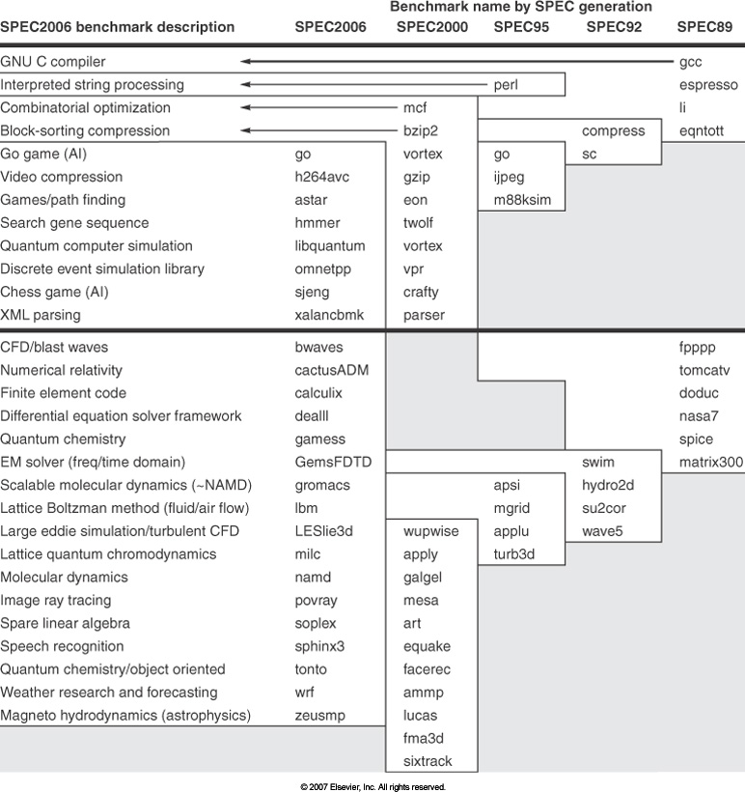

Slide 32
Programs in SPECint92 and SPECfp92
Benchmark | Source | Lines of Code | Description
Espresso | C | 13500 | Minimize Boolean functions.
Li | C | 7413 | Lisp interpreter that solves 8 queens problem
Compress | C | 1503 | LZ compression on a 1Mb file
Gcc | C | 83589 | GNU C Compiler
Benchmark | Source | Lines of Code | Description
Spice2g6 | FORTRAN | 18476 | Circuit simulation
Alvinn | C | 272 | Neural network training simulation
Ear | C | 4483 | Inner ear model that filters and detects various sounds
Su2cor | FORTRAN | 2514 | Compute masses of elementary particles from Quark-Gluon theory
Notes:
How many of these algorithms do you know? Do you actually run these types of things yourself? (maybe, probably not)

Slide 33
Benchmark Problems
Benchmark mistakes
  Only average behavior represented in test workload
  Loading level controlled inappropriately
  Caching effects ignored
  Ignoring monitoring overhead
  Not ensuring same initial conditions
  Collecting too much data but doing too little analysis
Benchmark tricks
  Compiler (soft)wired to optimize the workload
  Very small benchmarks used
  Benchmarks manually translated to optimize performance

Slide 34
Benchmark Trick Example
Certain flags during compilation can have a huge effect on final execution time for some tests
  The Whetstone loop contains the following expression:
    SQRT(EXP(X))
  A brief analysis yields:
It would be surprising to see such an optimization automatically performed by a compiler due to the expected rarity of encountering SQRT(EXP(X)). Nevertheless, several compilers did perform this optimization!

Slide 35
Comparing Performance
The table lists the time in seconds that each computer requires to run a particular program.
 | Computer A | Computer B | Computer C
Program P1 | 1 | 10 | 20
Program P2 | 1000 | 100 | 20
Total Time | 1001 | 110 | 40
Which computer is better? For P1, A is 10 times faster than B, but for P2 B is 10 times faster than A.

Slide 36
Total Execution Time
A consistent summary measure
Simplest approach: compare relative performance in total execution time
So then B is 9.1 times faster than A (1001/110), while C is 2.75 times faster than B. Of course this is all relative to the programs that are selected.

Slide 37
Other Total Execution Time Metrics
Arithmetic mean
Weighted arithmetic mean
Normalize the execution time with respect to some reference machine.
  Geometric mean

Slide 38
Geometric Mean
For the previous example referenced to A:
For A
For B
For C
This says that the execution time of these programs on C is 0.63 of A and B.
Notes:
Drawbacks to using geometric means include:
Don’t predict actual execution time
Danger of designers working to do better on benchmarks, not overall, e.g. a 2 to 1 second improvement will reward the system as much as a 500 to 250 second improvement

Slide 39
Quantitative Principles of Computer Design
Take Advantage of Parallelism
  Instruction level, application level, system level
Principle of Locality
  Temporal and spatial
Focus on the Common Case
  In design, favor the frequent case over the infrequent case
    E.g. if adding two numbers rarely results in overflow, can improve performance by optimizing the more common case of no overflow
      Will be slower when overflow occurs, but rare so overall performance will be improved

Slide 40
Amdahl’s Law
The performance improvement to be gained from using some faster mode of execution is limited by the fraction of time the faster mode can be used.
Speedup = (Performance for entire task using enhancement) / (Performance for entire task without enhancement)
Another variant is based on the ratio of Execution times, where Execution time = 1/speedup.

Slide 41
Speedup
Fraction(enhanced) is just the fraction of time the enhancement can be used. For example, if a new enhancement is 20 times faster but can only be used 5% of the time:
Notes:
If this new enhancement is expensive, it is probably not worth the effort unless every last bit of speed is critical, or there is some application that can use this enhancement more often. This illustrates the law of diminishing returns: The incremental improvement in speedup gained by an additional improvement of just a portion of the computation diminishes as improvements are added.

Slide 42
Example
Consider a critical benchmark. Floating Point Square Root is responsible for 20% of the execution time. You could increase this operation by a factor of 10 via hardware. Or at the same cost, you could make all FP instructions run 2 times faster, which accounts for 50% of the execution time. Which is better?

Slide 43
CPU Performance
All commercial computers are synchronous – they have a clock that “ticks” once per cycle.
  Usually the cycle time is a constant, but it may vary (e.g. SpeedStep).
  Duration is usually on the order of nanoseconds, or more commonly the rate is expressed instead , e.g. 100 Mhz.
CPU time for a program can then be expressed two ways:
  CPU Time = CPU clock cycles for a program * Clock cycle time
or
  CPU Time = CPU clock cycles for a program / Clock Rate

Slide 44
Cycles Per Instruction
We can count the number of instructions executed – the instruction path length or Instruction Count (IC). Given IC and the number of clock cycles we can calculate the average number of clock cycles per instruction, or CPI:
  CPI (Ave # clock cycles per instr) = CPU clock cycles for a program / IC
With a little algebraic manipulation we can use CPI to compute CPU Time:
  CPU clock cycles for a program = CPI * IC
Substitute this in for CPU Time..
  CPU Time = CPI * IC * Clock Cycle Time
Or
  CPU Time = CPI * IC / ClockRate

Slide 45
CPI
Unfortunately, CPI, IC, and the Clock Cycle Time are all subtly inter-related.
  CPI and cycle time depend on the instruction set
  The instruction set depends on the hardware
  The hardware impacts the cycle time, etc.
Sometimes CPI is more useful to deal with in terms of all individual instructions. We can denote this by:
  CPU Time =
  and
  CPI Total=
Notes:
Here, i varies over each instruction, and we must sum the results for each instruction to get the total CPU Time. CPI_{i} should be measured since reference manuals won’t include the effects of cache misses, branch predictions, etc.

Slide 46
CPI Example
CPI is useful because it is measurable, unlike the nebulous “fraction of execution” in Amdahl’s equation. Consider the previous example to compute the speedup of Floating Point Square Root:
Suppose you run your program and as it runs collect the following data:
  100 total instructions
  25 of these instructions are floating point instructions
  2 of these instructions are floating point square root
  100 clock cycles were spent on floating point instructions
    40 of these 100 cycles were spent on floating point square root
    100 clock cycles were spent on non-floating point instructions

Slide 47
CPI Example
Frequency of FP operations = 25/100 = 0.25
Frequency of FPSQ operations = 2/100 = 0.02
Ave CPI of FP operations = 100 / 25 = 4
Ave CPI of FPSQ operations = 40 / 2 = 20
Ave CPI of non-FP operations = 100 / 75 = 1.33
If we could reduce the CPI of FPSQ by 10 (down to 2), or reduce the CPI of all FP operations by 2, which is better?
  Will calculate in class

Slide 48
Measuring Components of CPU Performance
Cycle Time is easy to measure for an existing CPU (whatever frequency it is running at).
Cycle Time is hard to measure for a CPU in design! The logic design, VLSI process, simulations, and timing analysis need to be done.
IC – This is one thing that is relatively easy to measure, just count up the instructions. This can be done with instruction trace, logging, or simulation tools.
CPI – This can be difficult to measure exactly because it depends on the processor organization as well as the instruction stream. Pipelining and caching will affect the CPI, but it is possible to simulate the system in design and estimate the CPI.

Slide 49
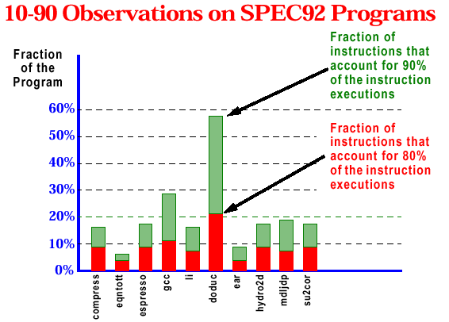
Example on effect of locality

Slide 50
Common Fallacies, Pitfalls
Falling prey to Amdahl’s Law
  Should measure speedup before spending effort to enhance it
Single point of failure
  E.g. single fan may limit reliability of the disk subsystem
Fallacy: The cost of the processor dominates the cost of the system

Slide 51
Common Fallacies, Pitfalls
Fallacy: Benchmarks remain valid indefinitely
  Benchmark reverse engineering in compilers
Fallacy: The rated mean time to failure of X is 1,200,000 hours or almost 140 years, so X will practically never fail
  More useful measure would be % of disks that fail
Fallacy: Peak performance tracks observed performance
  Example: Alpha in 1994 announced as being capable of executing 1.2 billion instructions per second at its 300 Mhz clock rate.
Notes:
How can this be? The answer lies in the superscalar ideas – executing multiple instructions at once. To achieve this feat, the processor would have to execute two integer instructions and two floating point instructions on each clock cycle. This is virtually impossible except for very specific cases!

Slide 52
Common Fallacies, Pitfalls
Fault detection can lower availability
  Hardware has a lot of state that is not always critical to proper operation
    E.g. if cache prefetch fails, program will still work, but a fault detection mechanism could crash the program or raise errors that take time to process
    Less than 30% of operations on the critical path for Itanium 2

Slide 53
Common Fallacies, Pitfalls
Fallacy: MIPS is a useful benchmark
Example: Say multiply FP instruction requires 4 clock cycles. However, instead of executing the FP multiply instruction, we could instead use a software floating point routine that used only Integer instructions.
Since the integer instructions are simpler, they will require fewer clock cycles. For simplicity say that each integer instruction requires 2 clock cycles and it takes 20 of them to implement the FP multiply. Then for a 1 Mhz machine:
  FP Multiply has a CPI of 4
  MIPS = 1 / 4 = 0.25
The software FP Multiply using integer instructions has a CPI of 2
  MIPS = 1 / 2 = 0.50
The software version has higher MIPS! Lost in the analysis is that it takes many more integer instructions than floating point instructions to do the same thing.

