Slide 1
Unit Testing
Test First, Code Second

Slide 2
Understanding Why We Test First
This seems backwards, if you test first there is nothing to test
Testing first requires you to think differently
  Some claim the most important piece of the agile development process
  Can be difficult to embrace
  How can this even be done with nothing to test?

Slide 3
Tests before Code
Cooking recipes have been compared to software programs/algorithms
  How do you know when the turkey is done?
  Without a test you’ll just be guessing at when you’re done (and risk salmonella)
Building inspector does the same thing
  Set of criteria for the building to pass, even if the building doesn’t exist yet
Programming
  Write the test case first
  Forces you into a simple, bottom-up design as you test individual cases first and then later the integration of those cases

Slide 4
Writing a Test Case
First, decide on subtask to accomplish
  Should be small and require a simple test case (or cases)
Simple example
  Need to write code to find the largest of three integers
  Write test case first to indicate success or failure of the code you will write

Slide 5
Simple Test Case
public void testMaxOfThreeInts()
{
if (maxOfThreeInts(1,7,3) == 7)
{
System.out.println("Passed MaxOfThreeInts Test");
}
else
{
System.out.println("Failed maxOfThreeInts Test");
}
}

Slide 6
Simple Test Case, Expanded
If desired, we can add more tests for the code, to test more conditions.
public void testMaxOfThreeInts()
{
if (maxOfThreeInts(1,7,3) == 7)
{
    if (maxOfThreeInts(6,1,4) == 6)
    {
    System.out.println("Passed MaxOfThreeInts Test");
    }
    else
    {
    System.out.println("Failed maxOfThreeInts Test");
    }
}
else
{
System.out.println("Failed maxOfThreeInts Test");
}
}
Don’t add too many or the test case can become too complex. “Smoke test”.

Slide 7
Better Version
Use assert which throws an exception if the expression in parenthesis is not true
  Appropriate for internal invariants
  NOT appropriate to take the place of argument checking, work your app would do for correct operation
  For Java, must run with –ea flag
public void testMaxOfThreeInts()
{
assert(maxOfThreeInts(1,7,3) == 7) : "Failed for 1,7,3";
assert(maxOfThreeInts(7,1,3) == 7) : "Failed for 7,1,3";
}

Slide 8
Writing Code Being Tested
Next we would fill in the code to be tested. If desired we could start with a stub to allow the test case to run:
Then we fill in the code and test it:
public int maxOfThreeInts(int num1, int num2, int num3)
{
return num1;
}
public int maxOfThreeInts(int num1, int num2, int num3)
{
int max = num1;
if ((num2 >= num1)) && (num2 >= num3)) max = num2;
if ((num3 >= num1)) && (num3 >= num2)) max = num3;
return max;
}

Slide 9

Slightly More Complex Example
Test to see if entered password matches that of the stored password for a graphical password scheme

Slide 10
Graphical Password Test
Already defined:
class Point
{
private int x,y;
public Point(int x, int y) { ... }
public double distance(Point otherPoint) { ... }
}
Header:
private boolean passwordMatch(ArrayList<Point> actual,
ArrayList<Point> entered)
What tests to write?
Notes:
Some sample tests:
ArrayList<Point> actualPW = new ArrayList<Point>();
ArrayList<Point> enteredPW = new ArrayList<Point>();
actualPW.add(new Point(10,10));
actualPW.add(new Point(20,20));
enteredPW.add(new Point(10,10));
assert(!passwordMatch(actualPW, enteredPW)) : "Failed passwordMatch 1";
enteredPW.add(new Point(20,20));
assert(passwordMatch(actualPW, enteredPW)) : "Failed passwordMatch 2";

Slide 11
Graphical Password Test
private boolean passwordMatch(ArrayList<Point> actual,
ArrayList<Point> entered)

Slide 12
Next we write the code
private boolean passwordMatch(ArrayList<Point> actual,
ArrayList<Point> entered) {
if (actual.size() != entered.size()) {
return false;
}
for (int i=0; i<actual.size(); i++) {
Point p1 = actual.get(i);
Point p2 = entered.get(i);
double d = p1.distance(p2);
if (d > CIRCLEDIAMETER/2) {
return false;
}
}
return true;
}
Tests can help drive the creation of the code;
e.g. if wrote test for different sized ArrayLists

Slide 13
Exhaustive Testing
This would be if we wrote test cases to handle all input scenarios
  Not feasible in most cases
  Too many input combinations, tests become too complicated and difficult, too time consuming
Practical alternative is representative testing
  Pick cases that are representative of a segment of the code
  Pick cases on the boundary conditions and outside boundary conditions (i.e. should cause errors)
  We’ll say more about choosing test conditions for good coverage later

Slide 14
Testing First is Hard!
You may “reinterpret” the process by writing the code first and then immediately afterwards write the test
  Not OK
If you find code without a test, stop, write the test, and continue
  Work harder to think of testing as the first step when tackling a subtask
  The act of writing the test case will drive the design and force you to focus on the immediate subtask, eliminate ancillary issues, and give a different perspective on writing the code

Slide 15
Developing a Test Suite
The collection of all tests is called the Test Suite
Immediately provides a system status report
  Use as a roadmap to locate problems
  If testing is not done first, it is easy to have gaps in the system
Test suite grows naturally and incrementally using the test-first methodology
The test suite can grow to be quite large
  Must be automated

Slide 16
Automated Testing
Tests must be automated so they can be re-run in case new code breaks old code
Must be
  Fully automated (click a button to run them all)
  Interpret Results (visual feedback)
  Descriptive Error Messages (so you know where it failed)
  Fast
Testing frameworks like JUnit (Java), NUnit (.NET), or XUnit (C++) can help
Will walk through JUnit briefly in class
Can google for JUnit/NUnit tutorials online

Slide 17
Rationale Behind Testing First
Forces programmers to think about code before writing it
  By extension, guides design of the overall system
If you wrote the code first and it seems to work, would you bother writing a test for it?
Gives immediate, useful feedback
Test suite becomes an invaluable, custom tool to gauge the health and progress of the system

Slide 18
Testing First Forces Simplicity
Writing test phase
  State test cases as simply as possible
  Find enough representative test cases to cover the code
Writing code
  Goal becomes making the test pass
  Perform least amount of work to reasonably make the test pass
    Might be ugly code at first, but if it works it can be refactored later

Slide 19
Simplicity drives the Design
Simple bottom-up development leads to a good high-level design
Doesn’t dismiss system design, but promotes designing and building the system in tandem
Argument: cumulative effect of making lots of good, small local decisions leads to a good overall, global design
  Emergent behavior; we get an emergent design that can be robust

Slide 20
Testing First Clarifies the Task
A test is a small, self-contained action
It becomes an example to help understand what the code needs to do
Also acts as a checkpoint; if you don’t understand the problem well enough to write a test case, you aren’t ready to write the code
Might grapple on how to write the test, but the time also helps you write the code

Slide 21
Testing First Frees You from On-the-fly Editing
On-the-fly editing: You’re coding along then see a different way of implementing the code.
  Scrap approach or keep it?
  Hit on productivity either way
Testing first eliminates distraction
  Aim for simplest, correct solution
  Later, the code can be re-examined
  No immediate worry about readability, efficiency, maintainability, speed, size, cleverness, etc. The focus is on making simple code to pass the test.
After code is written it is fair game for change

Slide 22
Test Suites and Refactoring
A major refactoring could involve changing code in lots of classes and methods
  Potential for everything to horribly break
Test Suite provides a safety net and provide confidence in large, complex changes
Can experimentally probe the structure and dependencies by making tentative changes

Slide 23
Testing First Provides Documentation
Test cases provide useful documentation
  Encapsulates the developer’s intent while writing the code
Future maintainers get chronology of the development and useful diagnostic tool to guide future changes

Slide 24
Fixing Broken Test Cases
You modify code or introduce a bug and as a result, tests don’t run correctly. What now?
Goal is to make the tests pass
  Might require refactoring the test cases themselves to match new code signatures
  Might require searching through the code to find out why the test case fails

Slide 25
Adding Missing Tests
If you ever find a bug that the test suite doesn’t catch, then you must write a test that exposes the deficiency before fixing the code
  Causes the tests to reflect the error condition
  Prevents missing the problem in the future if it creeps back in somehow

Slide 26
Tests Suites and Sanity
Test suites psychologically help the team’s frame of mind
  Successful passing of tests strokes your inner programmer
  Stronger boost when you see a new/better/more efficient way to write your code, and can see that all of the tests still pass

Slide 27

JUnit and NetBeans Demo
Integrated into NetBeans
  Slightly different process if not using an IDE; have to import Junit, make a test class, extend TestCase
  Also integrated with Eclipse and other IDE’s
Create project
Create class for code that will be tested
  Can make a test case with no corresponding class, but I think it’s a bit easier to make the class first
Select the class in the project view and under T)ools select Create JUnit Tests

Slide 28
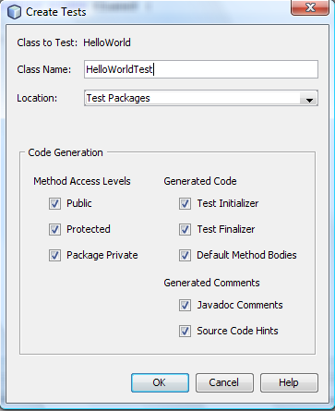
JUnit
Creating a JUnit Test
Class has “Test” at end to distinguish it as a test
Can leave default code generation
If there are methods in the class, JUnit will create tests for each one
  Can be useful to write an empty method to be tested first, with just the header, to make it easier to generate the test

Slide 29
Test Class
@BeforeClass
public static void setUpClass() throws Exception {
}
@AfterClass
public static void tearDownClass() throws Exception {
}
@Before
public void setUp() {
}
@After
public void tearDown() {
}
/**
* Test of main method, of class HelloWorld.
*/
@Test
public void testMain() {
System.out.println("main");
String[] args = null;
HelloWorld.main(args);
// TODO review the generated test code and remove the default call to fail.
fail("The test case is a prototype.");
}
Run once for the test class
Run for every test
Test; Add multiple test methods with @Test

Slide 30

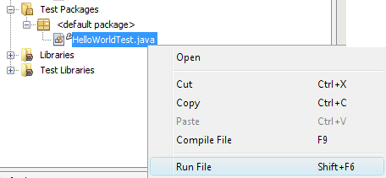
Running Tests
Select “Test <project>” under the “R)un” menu
Or right-click the test class and select “Run”

Slide 31
Determining Success or Failure
The Assert class has the following methods:
  assertEquals: Overloaded to test if an actual value matches the expected one. First parameter can be a String with a message.
    assertEquals(“Number mismatch”, 3, 3); // Passes if 3 == 3
  assertFalse: Use this if you know the function will always return false (fails if it receives true)
  assertNotNull: If your method return null in the event of failure use this to check to see if it succeeds
  assertNotSame: If your method is supposed to return an element from a list you can use this to check if the element returned is the one from the actual list
  assertNull: If your method return null in the event of failure use this to check to see if it fails
  fail: Will fail the test, use this in conjunction with conditionals
  failNotEquals: Essentially the same as assertEquals but will fail the test if they arent equal instead of causing an error
  failNotSame: Essentially the same as assertNotSame except instead of causing an error it will cause a failure

Slide 32
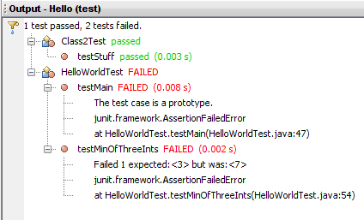
Running Tests
IDE displays results of each test; click on a test to get more details and jump straight to the failed case

Slide 33
Happy Testing!
JUnit makes it easy to create, maintain, run tests
Tests are kept separate from the actual project so they don’t interfere with the “real” code
If you don’t want to use a test framework you could make your own with a little extra work
  Separate class with a main() that invokes all the methods for the tests, outputs or asserts errors, etc.

