Slide 1

Agile Samurai Principles

Slide 2
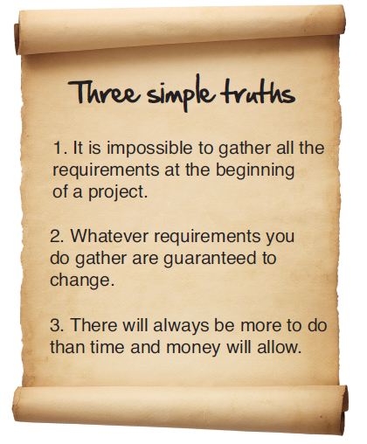
Agile Development

Slide 3
Deliver Value Every Iteration
Break big problems into smaller ones
Focus on most important issues
Deliver something that works
Lots of customer feedback
Change course when necessary
You are accountable

Slide 4
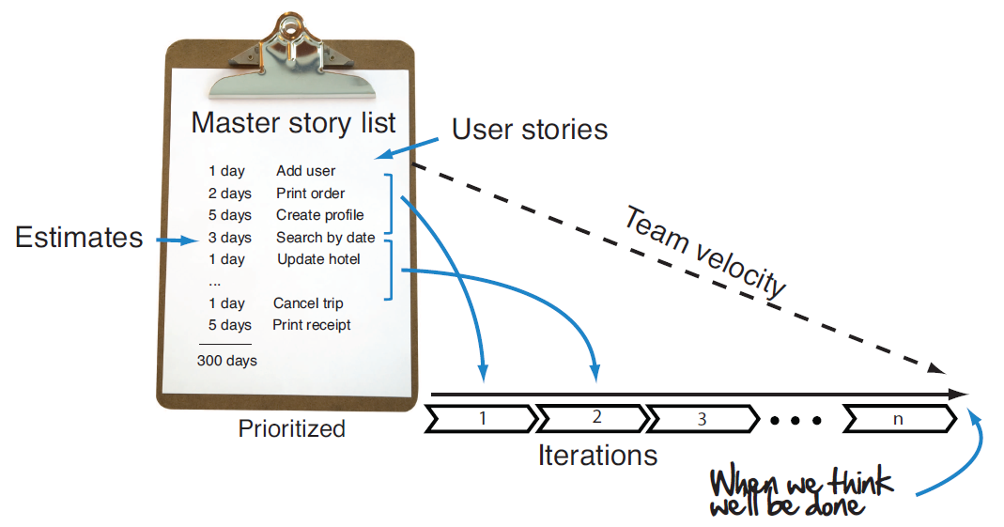
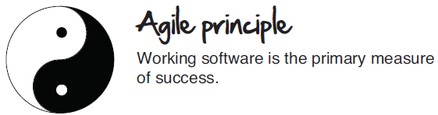
Agile Planning

Slide 5
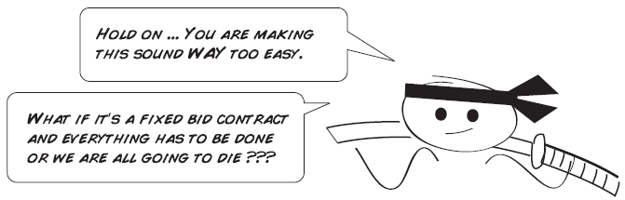
Agile Planning

Slide 6
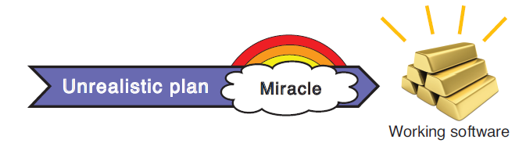
Agile Planning

Slide 7
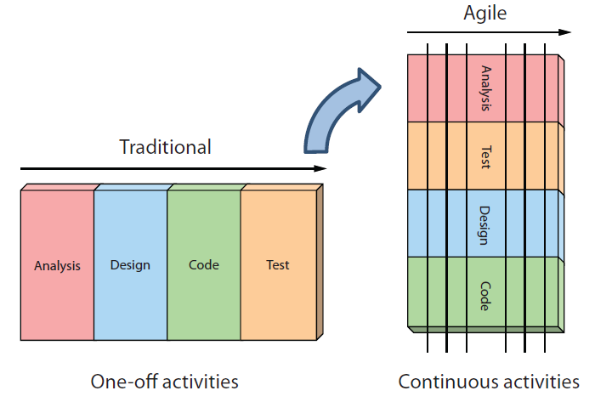
Agile Lifecycle

Slide 8
Agile Team
Blurred instead of fixed roles
Characteristics of successful teams
  Co-located, at least for initial meetings
  Engaged customer
  Self-organizing instead of top-down
  Accountable and empowered
  Cross-functional

Slide 9

What if I don’t have an engaged customer?
Build credibility
  Find a problem and make it go away
  Show you are a fierce executor that will get things done and can help them
  Might take a few iterations but they will see your value

Slide 10
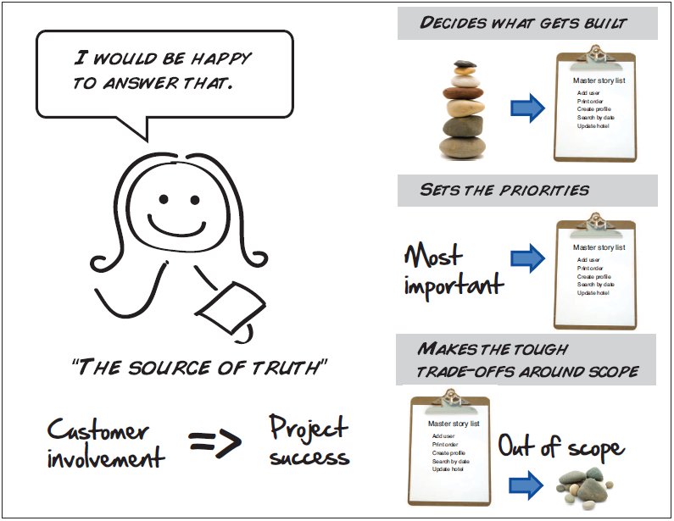
The Agile Customer

Slide 11
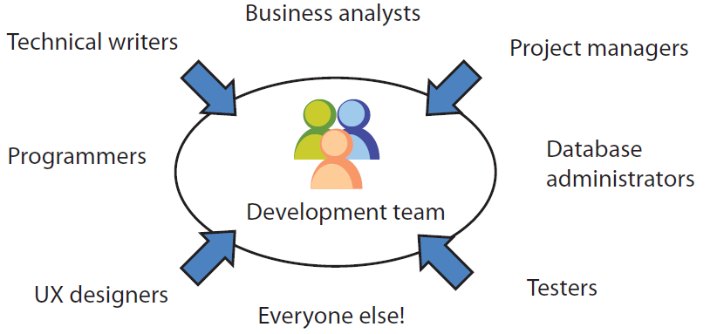
Agile Development Team

Slide 12
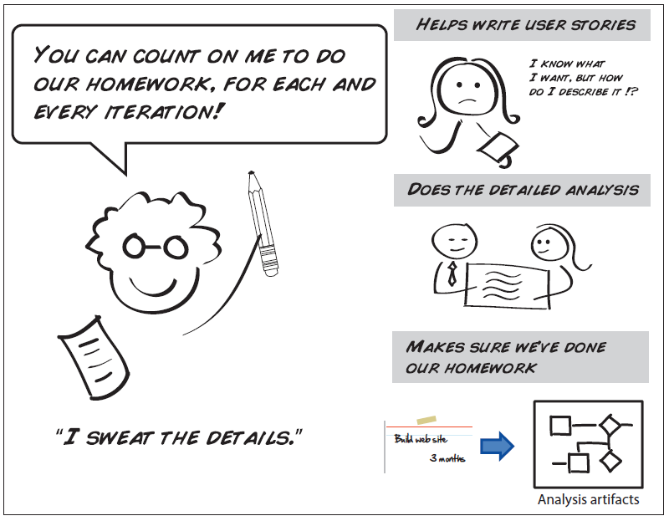
Agile Analyst

Slide 13
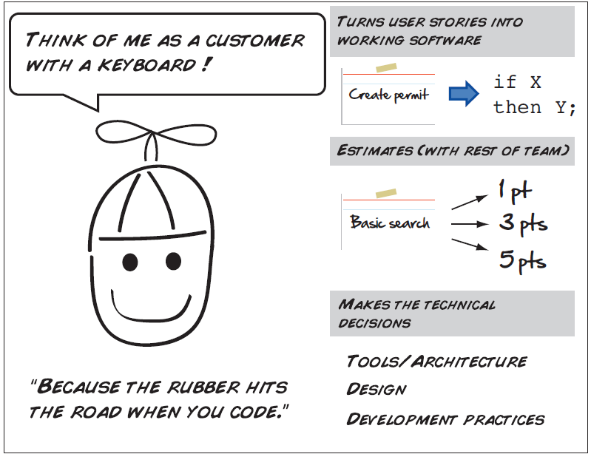
Agile Programmer

Slide 14
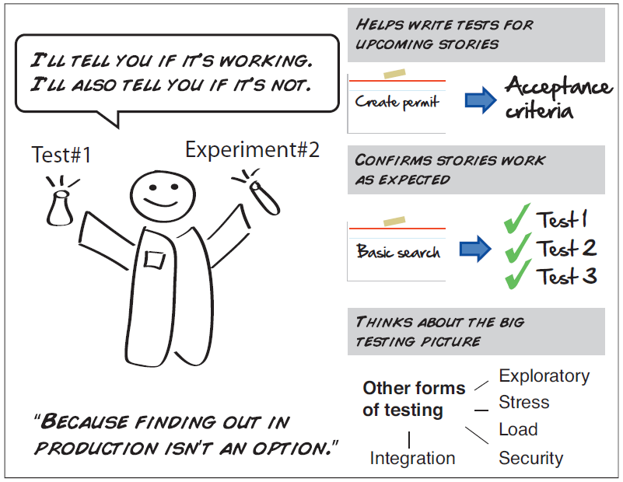
Agile Tester

Slide 15
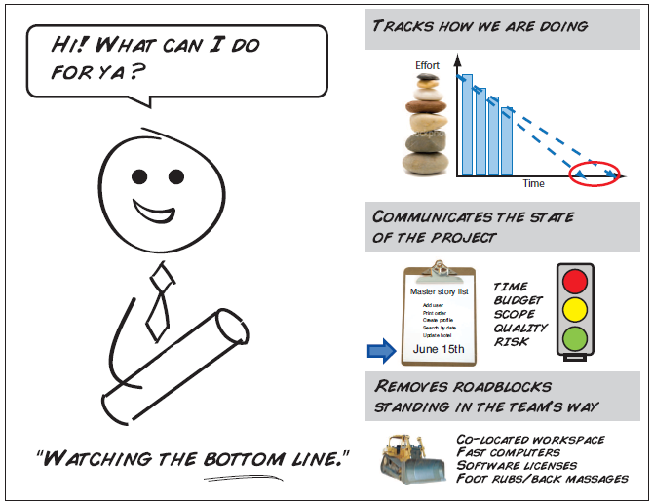
Agile Manager

Slide 16
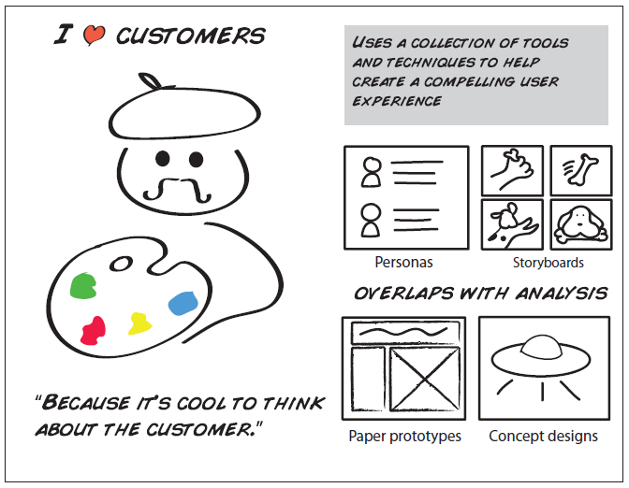
Agile Usability Designer

Slide 17
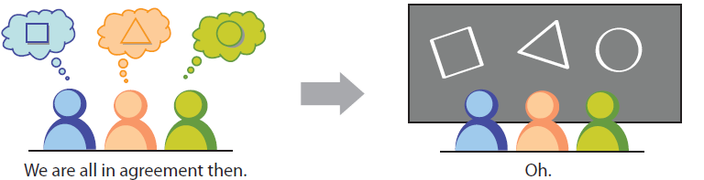
Kicking off a project
The Inception Deck
  Ten questions you’d be crazy not to ask before starting any software project
  Gets everyone pointing in the same direction
    Shared goals, vision, context

Slide 18
Inception Deck
Collectively fill out a slide on to get a pretty good idea about what the project is, what it isn’t, and what it’s going to take to deliver
Need to get customer/stakeholders involved
It’s a living document

Slide 19
<Your project name>
<Your sponsors>
Notes:
Project name – pick a cool sounding name for your project
Sponsors – list your project sponsors here (the people with the money)
Putting your sponsors name boldly out there for all to see is a great way to get their engagement and attention (necessary for any successful project).

Slide 20

Why are we here?
Important reason #1
Important reason #2
Important reason #3
<#1 reason for doing this project>
Notes:
Write down all the reasons why your company would want to spend money on this project in the first place.
Then pick and highlight the most important one.

Slide 21
The elevator pitch
For [target customer]
who [statement of need or opportunity]
the [project name]
is a [product category]
that [key benefit, compelling reason to buy].
Unlike [primary competitive alternative]
our project [statement of primary differentiation].

Slide 22
Product box
<product name>
fun picture
<slogan>
<benefit #1>
<benefit #2>
<benefit #3>
Notes:
If you could walk into a store, and buy the shrink wrapped version of your software, what the design of the box look like and what would it say?
Point here is to get your team looking at your project through the eyes of your end customer.

Slide 23
The NOT list
IN | OUT
UNRESOLVED
Notes:
List all the big ticket items you are (and are NOT) going to deliver within the scope of this project.
Before starting your project move all the UNRESOLVED ones to either IN or OUT.

Slide 24



Your project community
<community#3>
Your core team
<team#2>
<group#1>
Everyone else !
... is always bigger than you think!
Notes:
List everyone you are going to have to interact with at some point during the course of your project.
Goal is to start building relationships with these people and let them know we are coming down the tracks (before we actually get there).

Slide 25



Technical solution
Technologies:
<language>
<libraries>
<tools>
<technology>
Danger!
Out of scope
Notes:
This is about letting people know how we plan on building this thing.
If there are any tools or libraries assumptions you are making list them here.
Also if there are areas of the application architecture that are risky highlight those too.

Slide 26
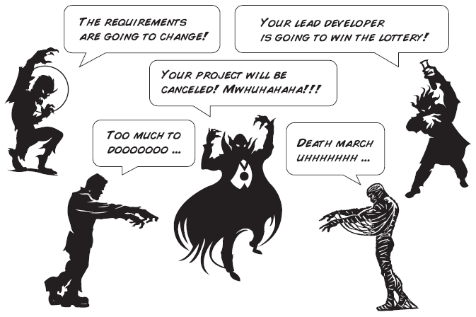
What keeps us up at night
<scary thing #1>
<scary thing #2>
<scary thing #3>
Notes:
This is your chance to call out any craziness you’ve heard while building the deck, and having a frank conversation with your sponsors and your team about how you are going to handle it.
This is perhaps on of the most powerful slides in the deck – it’s your chance to ask for whatever you need to be successful and the consequences if you don’t get it.
Use it!

Slide 27
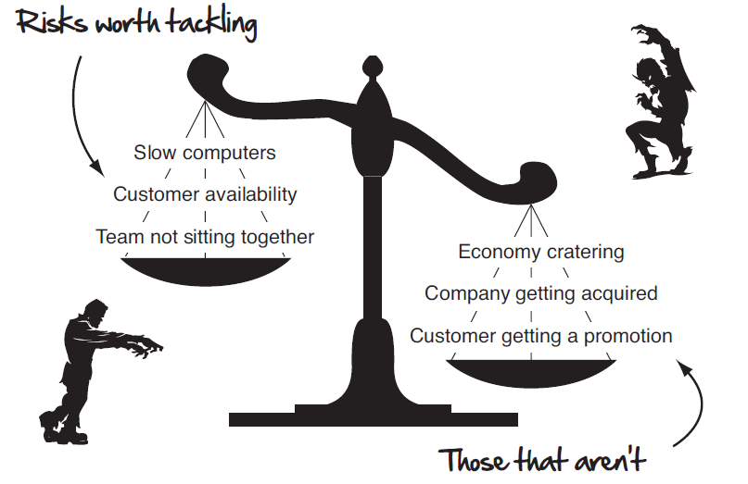
Don’t overdo it

Slide 28
The A-Team
# | Role | Competencies/Expectations
1 | Analyst | Comfortable with just-in-time analysis. Likes to test. Comfortable with rapid iterative development.
2 | Developers | C#, MVC.NET, jQuery, SQL Unit testing, refactoring, TDD, continuous integration
0.5 | Project manager | Responsible for outward facing communication Status reports, scope, budget, and reporting upwards
Notes:
Set expectations around who you are going to need and what kind of skills they will need to have to pull this off.
Use names if specific people are important (i.e. Billy is the only guy who can do X).

Slide 29

How big is this thing?
Ship it!
Construction
UAT
Training
~3months
1 wk
1 wk
This is a guess. Not a commitment.
Notes:
Give your sponsors some idea of how big this thing is (1, 3, or 6 monther).
Before you can complete this slide you and the team should create and estimate a high-level story list for the project.
This isn’t a commitment (too many unknowns). It’s just a really rough guess. Don’t treat it as anything else.

Slide 30
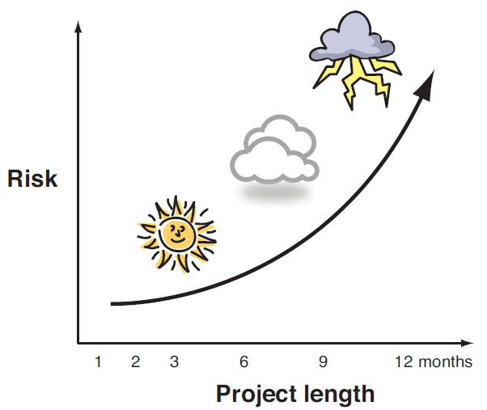
Risk vs. Time
The risk of project failure increases over time – think small

Slide 31
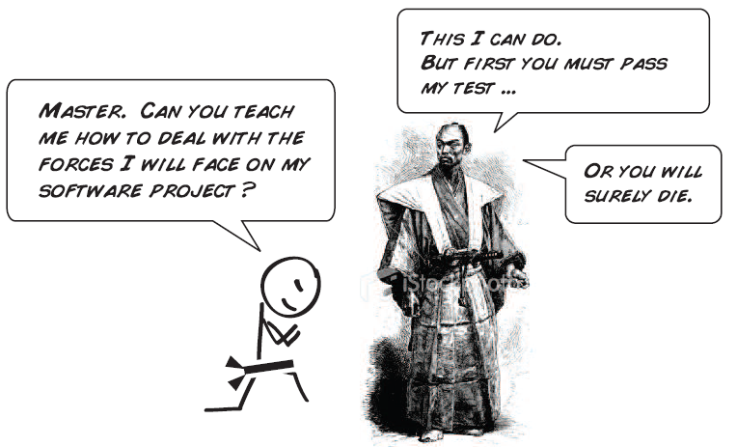
The Test

Slide 32
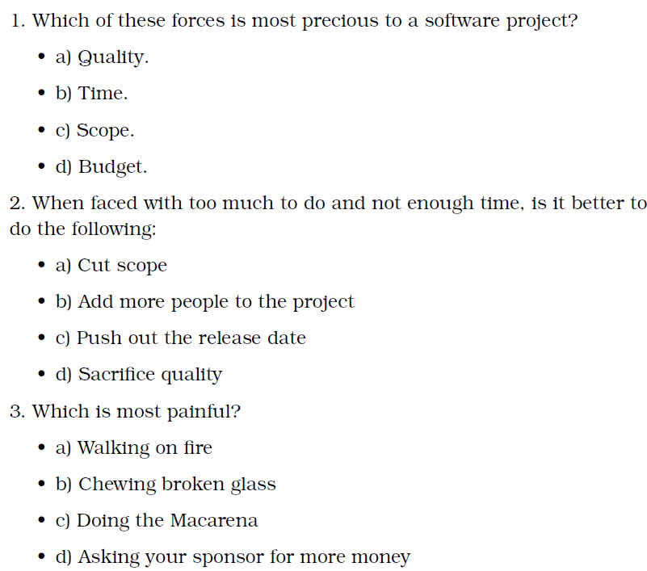
The Test

Slide 33
Trade-off sliders
 | The classic four
 | Feature completeness (scope)
 | Stay within budget (budget)
 | Deliver project on time (time)
 | High quality, low defects (quality)
ON
OFF
ON
OFF
ON
OFF
ON
OFF
 | Other important things
 | Ease of use
 | Community of users
 | Detailed audits (log everything)
 | <insert yours>
ON
OFF
ON
OFF
ON
OFF
ON
OFF
Notes:
When push comes to shove, something has to give. Here we want to be clear on what that is.
On agile projects we flex on scope. But there could be others factors at play here so get ready to listen as you customer tells you which forces can bend (scope) and which are written in stone (usually budget).
Slider rules:
1. No two sliders can occupy the same level.
2. List other important project factors down below.

Slide 34
The first release
Ship it!
Construction
UAT
Training
~3months
1 wk
1 wk
3 people, 3 ½ months, $250K
Notes:
Stakeholders are usually interested in two things:
How much is this going to cost.
When is it going to be done.
Here we do our best to answer those two questions so they can decide if the project is still worth doing by showing them what it’s going to take.

