Slide 1
Implementing a Graph
Implement a graph in three ways:
  Adjacency List
  Adjacency-Matrix
  Pointers/memory for each node (actually a form of adjacency list)

Slide 2
Adjacency List
List of pointers for each vertex

Slide 3
Undirected Adjacency List

Slide 4
Adjacency List
The sum of the lengths of the adjacency lists is 2|E| in an undirected graph, and |E| in a directed graph.
The amount of memory to store the array for the adjacency list is O(max(V,E))=O(V+E).

Slide 5
Adjacency Matrix
1 2 3 4 5
1 0 1 1 0 0
2 0 0 0 0 0
3 0 0 0 1 0
4 1 0 0 0 0
5 0 1 0 1 0

Slide 6
Undirected Adjacency Matrix
1 2 3 4 5
1 0 1 1 1 0
2 1 0 0 0 1
3 1 0 0 1 0
4 1 0 1 0 1
5 0 1 0 1 0

Slide 7
Adjacency Matrix vs. List?
The matrix always uses Θ(v²) memory. Usually easier to implement and perform lookup than an adjacency list.
Sparse graph: very few edges.
Dense graph: lots of edges. Up to O(v²) edges if fully connected.
The adjacency matrix is a good way to represent a weighted graph. In a weighted graph, the edges have weights associated with them. Update matrix entry to contain the weight. Weights could indicate distance, cost, etc.

Slide 8
Searching a Graph
Search: The goal is to methodically explore every vertex and every edge; perhaps to do some processing on each.
For the most part in our algorithms we will assume an adjacency-list representation of the input graph.

Slide 9
Breadth First Search
Example 1: Binary Tree. This is a special case of a graph.
  The order of search is across levels.
  The root is examined first; then both children of the root; then the children of those nodes, etc.
1
2
4
5
3
6
7

Slide 10
Breadth First Search
Example 2: Directed Graph
Pick a source vertex S to start.
Find (or discover) the vertices that are adjacent to S.
Pick each child of S in turn and discover their vertices adjacent to that child.
Done when all children have been discovered and examined.
This results in a tree that is rooted at the source vertex S.
The idea is to find the distance from some Source vertex by expanding the “frontier” of what we have visited.

Slide 11
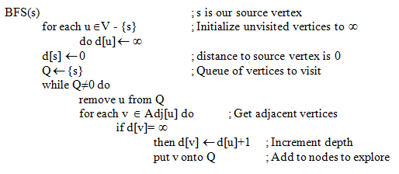
Breadth First Search Algorithm
Pseudocode: Uses FIFO Queue Q

Slide 12
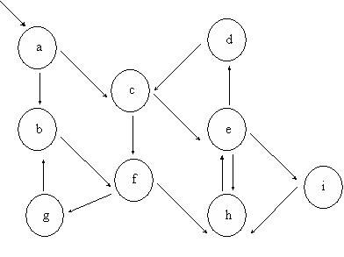

Slide 13
BFS Example
Final State shown
Can create tree out of
order we visit nodes

Slide 14
BFS Properties
Memory required: Need to maintain Q, which contains a list of all fringe vertices we need to explore, O(V)
Runtime: O(V+E) ; O(E) to scan through adjacency list and O(V) to visit each vertex. This is considered linear time in the size of G.
Claim: BFS always computes the shortest path distance in d[i] between S and vertex I. We will skip the proof.
What if some nodes are unreachable from the source? (reverse c-e,f-h edges). What values do these nodes get?

Slide 15
Depth First Search
Example 1: DFS on binary tree. Specialized case of more general graph. The order of the search is down paths and from left to right.
  The root is examined first; then the left child of the root; then the left child of this node, etc. until a leaf is found. At a leaf, backtrack to the lowest right child and repeat.
1
2
3
4
5
6
7

Slide 16
Depth First Search
Example 2: DFS on directed graph.
Start at some source vertex S.
Find (or explore) the first vertex that is adjacent to S.
Repeat with this vertex and explore the first vertex that is adjacent to it.
When a vertex is found that has no unexplored vertices adjacent to it then backtrack up one level
Done when all children have been discovered and examined.
Results in a forest of trees.

Slide 17
DFS Algorithm
Pseudocode

Slide 18
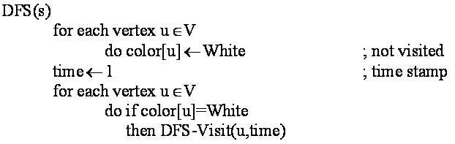
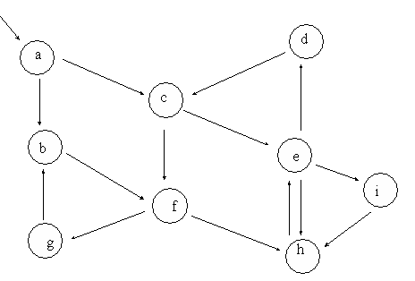
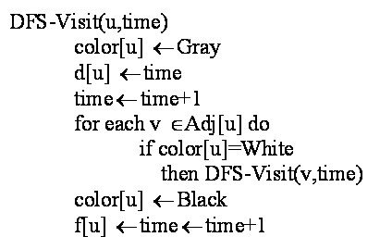

Slide 19
DFS Example
Tree:
Result (start/finish time):

Slide 20
DFS Example
What if some nodes are unreachable? We still visit those nodes in DFS. Consider if c-e, f-h links were reversed. Then we end up with two separate trees
  Still visit all vertices and get a forest: a set of unconnected graphs without cycles (a tree is a connected graph without cycles).

Slide 21
DFS Runtime
O(V²) - DFS loop goes O(V) times once for each vertex (can’t be more than once, because a vertex does not stay white), and the loop over Adj runs up to V times.
But…
  The for loop in DFS-Visit looks at every element in Adj once. It is charged once per edge for a directed graph, or twice if undirected. A small part of Adj is looked at during each recursive call but over the entire time the for loop is executed only the same number of times as the size of the adjacency list which is (E).
  Since the initial loop takes (V) time, the total runtime is (V+E).
Note: Don’t have to track the backtracking/fringe as in BFS since this is done for us in the recursive calls and the stack. The amount of storage needed is linear in terms of the depth of the tree.

Slide 22
DAG
Directed Acyclic Graph
  Nothing to do with sheep
  This is a directed graph that contains no cycles
A directed graph D is acyclic iff a DFS of G yields no back edges (an edge to a previously visited node).
  Proof: Trivial. Acyclic means no back edge because a back edge makes a cycle.

Slide 23
DAG
DAG’s are useful in various situations, e.g.:
  Detection of loops for reference counting / garbage collection
  Topological sort
Topological sort
  A topological sort of a dag is an ordering of all the vertices of G so that if (u,v) is an edge then u is listed (sorted) before v. This is a different notion of sorting than we are used to.
  a,b,f,e,d,c and f,a,e,b,d,c are both topological sorts of the dag below. There may be multiple sorts; this is okay since a is not related to f, either vertex can come first.

Slide 24
Topological Sort
Main use: Indicate order of events, what should happen first
Algorithm for Topological-Sort:
  Call DFS(G) to compute f(v), the finish time for each vertex.
  As each vertex is finished insert it onto the front of the list.
  Return the list.
Time is Θ(V+E), time for DFS.

Slide 25
Topological Sort Example
sauce
bake
Making Pizza
sausage
cheese
oregano
olives
crust
DFS: Start with sauce.
The numbers indicate start/finish time. We insert into the list in reverse order of finish time.
Why does this work? Because we don’t have any back edges in a dag, so we won’t return to process a parent until after processing the children. We can order by finish times because a vertex that finishes earlier will be dependent on a vertex that finishes later.

Slide 26
Greedy Algorithms
Spanning Trees
Chapter 16, 23

Slide 27
What makes a greedy algorithm?
Feasible
  Has to satisfy the problem’s constraints
Locally Optimal
  The greedy part
  Has to make the best local choice among all feasible choices available on that step
    If this local choice results in a global optimum then the problem has optimal substructure
Irrevocable
  Once a choice is made it can’t be un-done on subsequent steps of the algorithm
Simple examples:
  Playing chess by making best move without lookahead
  Giving fewest number of coins as change
Simple and appealing, but don’t always give the best solution

Slide 28
Simple Example of a Greedy Algorithm
Consider the 0-1 knapsack problem. A thief is robbing a store that has items 1..n. Each item is worth v[i] dollars and weighs w[i] pounds. The thief wants to take the most amount of loot but his knapsack can only hold weight W. What items should he take?
  Greedy algorithm: Take as much of the most valuable item first. Does not necessarily give optimal value!

Slide 29
Fractional Knapsack Problem
Consider the fractional knapsack problem. This time the thief can take any fraction of the objects. For example, the gold may be gold dust instead of gold bars. In this case, it will behoove the thief to take as much of the most valuable item per weight (value/weight) he can carry, then as much of the next valuable item, until he can carry no more weight.
Moral
  Greedy algorithm sometimes gives the optimal solution, sometimes not, depending on the problem.
  Dynamic programming, which we will cover later, will typically give optimal solutions, but are usually trickier to come up with and may take much longer to run

Slide 30
Spanning Tree
Definition
  A spanning tree of a graph G is a tree (acyclic) that connects all the vertices of G once
    i.e. the tree “spans” every vertex in G
  A Minimum Spanning Tree (MST) is a spanning tree on a weighted graph that has the minimum total weight
Where might this be useful? Can also be used to approximate some
NP-Complete problems

Slide 31
Sample MST
Which links to make this a MST?
Optimal substructure: A subtree of the MST must in turn be a MST of the
nodes that it spans.

Slide 32
MST Claim
Claim: Say that M is a MST
  If we remove any edge (u,v) from M then this results in two trees, T1 and T2.
  T1 is a MST of its subgraph while T2 is a MST of its subgraph.
  Then the MST of the entire graph is T1 + T2 + the smallest edge between T1 and T2
  If some other edge was used, we wouldn’t have the minimum spanning tree overall

Slide 33
Greedy Algorithm
We can use a greedy algorithm to find the MST.
  Two common algorithms
    Kruskal
    Prim

Slide 34
Kruskal’s MST Algorithm
Idea: Greedily construct the MST
  Go through the list of edges and make a forest that is a MST
  At each vertex, sort the edges
  Edges with smallest weights examined and possibly added to MST before edges with higher weights
  Edges added must be “safe edges” that do not ruin the tree property.

Slide 35
Kruskal’s Algorithm

Slide 36
Kruskal’s Example
A={ }, Make each element its own set. {a} {b} {c} {d} {e} {f} {g} {h}
Sort edges.
Look at smallest edge first: {c} and {f} not in same set, add it to A, union together.
Now get {a} {b} {c f} {d} {e} {g} {h}

Slide 37
Kruskal Example
Keep going, checking next smallest edge.
Had: {a} {b} {c f} {d} {e} {g} {h}
{e} ≠ {h}, add edge.
Now get {a} {b} {c f} {d} {e h} {g}

Slide 38
Kruskal Example
Keep going, checking next smallest edge.
Had: {a} {b} {c f} {d} {e h} {g}
{a} ≠ {c f}, add edge.
Now get {b} {a c f} {d} {e h} {g}

Slide 39
Kruskal’s Example
Keep going, checking next smallest edge.
Had {b} {a c f} {d} {e h} {g}
{b} ≠ {a c f}, add edge.
Now get {a b c f} {d} {e h} {g}

Slide 40
Kruskal’s Example
Keep going, checking next smallest edge.
Had {a b c f} {d} {e h} {g}
{a b c f} = {a b c f}, dont add it!

Slide 41
Kruskal’s Example
Keep going, checking next smallest edge.
Had {a b c f} {d} {e h} {g}
{a b c f} = {e h}, add it.
Now get {a b c f e h} {d}{g}

Slide 42
Kruskal’s Example
Keep going, checking next smallest edge.
Had {a b c f e h} {d} {g}
{d} ≠ {a b c e f h}, add it.
Now get {a b c d e f h} {g}

Slide 43
Kruskal’s Example
Keep going, check next two smallest edges.
Had {a b c d e f h} {g}
{a b c d e f h} = {a b c d e f h}, don’t add it.
a
6
4
5
9
b
c
d
14
2
10
e
f
g
15
3
8
h

Slide 44
Kruskal’s Example
Do add the last one:
Had {a b c d e f h} {g}

Slide 45
Runtime of Kruskal’s Algo
Runtime depends upon time to union set, find set, make set
Simple set implementation: number each vertex and use an array
  Use an array
    member[] : member[i] is a number j such that the ith vertex is a member of the jth set.
  Example
    member[1,4,1,2,2]
    indicates the sets S1={1,3}, S2={4,5} and S4={2};
    i.e. position in the array gives the set number. Idea similar to counting sort, up to number of edge members.

Slide 46
Set Operations
1
2
3
Given the Member array
Make-Set(v)
member[v] = v
Make-Set runs in constant running time for a single set.
Find-Set(v)
Return member[v]
Find-Set runs in constant time.
Union(u,v)
for i=1 to n
do if member[i] = u
then member[i]=member[v]
Scan through the member array and update old members to be the new set.
Running time O(n), length of member array.
member = [1,2,3] ; {1} {2} {3}
find-set(2) = 2
Union(2,3)
member = [1,3,3] ; {1} {2 3}

Slide 47
Overall Runtime
O(V)
O(ElgE) – using heapsort
O(E)
O(1)
O(V)
Total runtime: O(V)+O(ElgE)+O(E*(1+V)) = O(E*V)
Book describes a version using disjoint sets that runs in O(E*lgE) time

Slide 48
Prim’s MST Algorithm
Also greedy, like Kruskal’s
Will find a MST but may differ from Prim’s if multiple MST’s are possible

Slide 49
Prim’s Example

Slide 50
Prim’s Example

Slide 51
Prim’s Algorithm

Slide 52
Prim’s Algorithm

Slide 53
Prim’s Algorithm

Slide 54
Prim’s Algorithm
Get spanning tree by connecting nodes with their parents:

Slide 55
Runtime for Prim’s Algorithm
O(V) if using a heap
O(lgV) if using a heap
O(V)
O(E) over entire while(Q<>NIL) loop
O(lgV) to update if using a heap!
The inner loop takes O(E lg V) for the heap update inside the O(E) loop.
This is over all executions, so it is not multiplied by O(V) for the while loop
(this is included in the O(E) runtime through all edges.
The Extract-Min requires O(V lg V) time.
O(lg V) for the Extract-Min and O(V) for the while loop.
Total runtime is then O(V lg V) + O(E lg V) which is O(E lg V)
in a connected graph
(a connected graph will always have at least V-1 edges).

Slide 56
Prim’s Algorithm – Linear Array for Q
What if we use a simple linear array for the queue instead of a heap?
  Use the index as the vertex number
  Contents of array as the distance value
  E.g.
Val[10 5 8 3 … ]
Par[6 4 2 7 …]
Says that vertex 1 has key = 10, vertex 2 has key = 5, etc.
Use special value for infinity or if vertex removed from the queue
Says that vertex 1 has parent node 6, vertex 2 has parent node 4, etc.
Building Queue: O(n) time to create arrays
Extract min: O(n) time to scan through the array
Update key: O(1) time

Slide 57
Runtime for Prim’s Algorithm with Queue as Array
O(V) to initialize array
O(V) to search array
O(V)
O(E) over entire while(Q<>NIL) loop
O(1) direct access via array index
The inner loop takes O(E ) over all iterations of the outer loop.
It is not multiplied by O(V) for the while loop.
The Extract-Min requires O(V ) time.
This is O(V²) over the while loop.
Total runtime is then O(V²) + O(E) which is O(V²)
Using a heap our runtime was O(E lg V). Which is worse?
Which is worse for a fully connected graph?

