Slide 1
OOP and Dynamic Method Binding
Chapter 9

Slide 2
Object Oriented Programming
Skipping most of this chapter
Focus on 9.4, Dynamic method binding
Polymorphism or Subtype Polymorphism
One of three key factors in OOP
Encapsulation of data and methods (data hiding)
Inheritance
Dynamic method binding

Slide 3
Dynamic Method Binding
Ability to use a derived class in a context that expects its base class
Person
printLabel()
Student s = new Student()
Professor p = new Professor()
Person x = s;
Person y = p;
s.printLabel();
p.printLabel();
x.printLabel(); // Which one?
y.printLabel();
Student
printLabel()
Professor
printLabel()

Slide 4
Dynamic Method Binding
x.printLabel();
If we use Person’s printLabel() then this is using static binding
We say that Student’s printLabel() redefines Person’s printLabel()
If we use Student’s printLabel() this this is using dynamic binding
We say that Student’s printLabel() overrides Person’s printLabel()
This is what always happens in Java
C++ and C# let you do both

Slide 5
Virtual Methods
Methods that can be overridden are called virtual methods
You might never have seen this term before since it’s not used in Java because all methods are virtual
In C++:
Normally virtual methods are used
when the object doesn’t know what
implementation is to be used at
compile time
class person
{
public:
virtual void printLabel();

Slide 6
Abstract Classes
In most OOP languages we can omit the body of a virtual method in a base class
Java and C# use the keyword abstract
A class defined as abstract must have at least one abstract method on it
C++ uses assignment to 0
abstract class person {
public abstract void printLabel();
An interface is identical to an abstract class with all abstract methods
class person {
public:
virtual void printLabel() = 0;

Slide 7
Dynamic Method Binding
Non-virtual methods require no space at run time; the compiler just calls the appropriate version, based on type of variable
Member functions are passed an extra, hidden, initial parameter: this (called Me in VB and self in Smalltalk)
C++ philosophy is to avoid run-time overhead whenever possible(Sort of the legacy from C)
Languages like Smalltalk have (much) more run-time support

Slide 8
Dynamic Method Binding
Virtual functions are the only thing that requires any trickiness
They are implemented by creating a dispatch table (vtable) for the class and putting a pointer to that table in the data of the object
Objects of a derived class have a different dispatch table
In the dispatch table, functions defined in the parent come first, though some of the pointers point to overridden versions

Slide 9
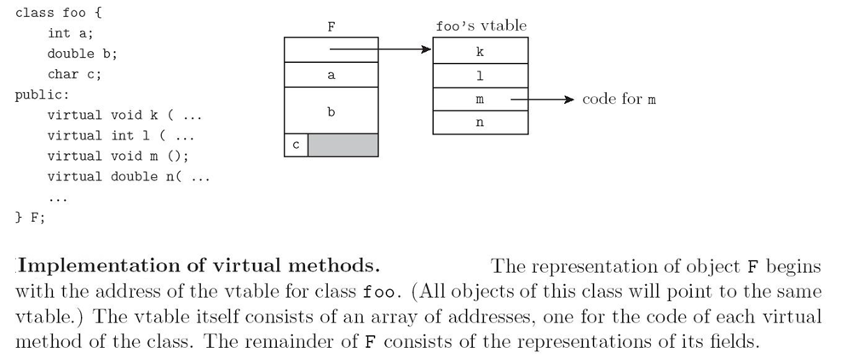
Implementation of Virtual Methods
vtable = virtual method table

Slide 10
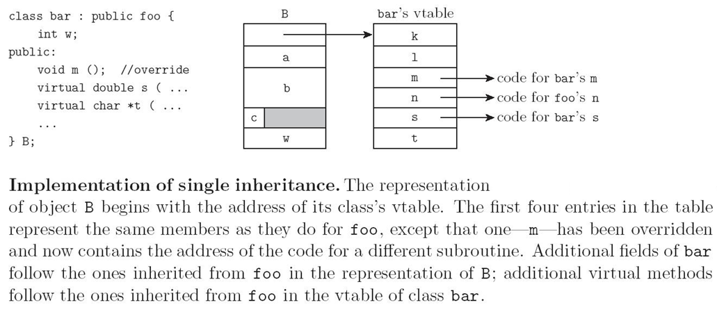
Implementation of Virtual Methods

Slide 11
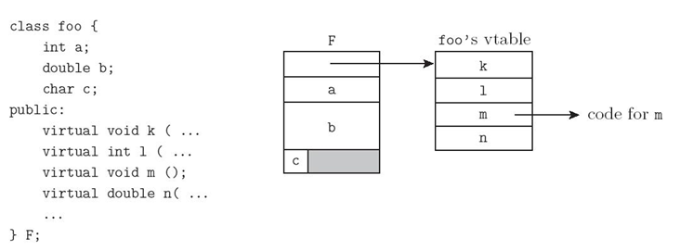
Different on Stack:
Foo *f = new Foo();
Bar *b = new Bar();
Foo *q = b;
Bar *s = f; // static semantic error
Foo f;
Bar b;
Foo q = b;
Bar s = f; // Error

Slide 12
Dynamic Type Binding
Note that if you can query the type of an object, then you need to be able to get from the object to run-time type info
The standard implementation technique is to put a pointer to the type info at the beginning of the vtable
Of course you only have a vtable in C++ if your class has virtual functions

