Slide 1
Data Types, Memory

Slide 2
Data Types
Values held in machine locations
Integers, reals, characters, Booleans are built into languages as primitive types
Machine location directly contains the value
Efficiently implemented, likely understood by the instruction set
Others built on top of them : structured types
Laid out in sequence of locations in the machine
Arrays, records, pointers.
Hopefully can be treated as first class citizens
A first class citizen can be passed as a parameter, returned from a subroutine, or assigned into a variable.

Slide 3
Data Types
What are types good for?
implicit context
checking - make sure that certain meaningless operations do not occur
type checking cannot prevent all meaningless operations
It catches enough of them to be useful
Polymorphism results when the compiler finds that it doesn't need to know certain things

Slide 4
Data Types
STRONG TYPING has become a popular buzz-word
like structured programming
informally, it means that the language prevents you from applying an operation to data on which it is not appropriate
STATIC TYPING means that the compiler can do all the checking at compile time

Slide 5
Type Systems
Examples
Common Lisp is strongly typed, but not statically typed
Ada is statically typed
Pascal is almost statically typed
Java is strongly typed, with a non-trivial mix of things that can be checked statically and things that have to be checked dynamically

Slide 6
Type Systems
Common terms:
discrete types – countable
integer
boolean
char
enumeration
subrange
Scalar types - one-dimensional
discrete
real

Slide 7
Type Systems
Composite or structured types:
records (unions)
arrays
strings
sets
pointers
lists
files

Slide 8
Variant Records and Unions
Back when memory was scarce…
Variant records allowed two or more different fields to share the same block of memory
Called Variant in Pascal, Union in C
union myUnion {
int i; // 32 bits of storage
float f; // Same 32 bits of storage
};
Union myUnion u;
u.i accesses storage as Integer
u.f accesses storage as float
How might we do something in
Java that allows accesses to a value
that might be of different types?

Slide 9
Records (Structures)
Memory layout and its impact (structures)
struct element {
char name[2];
int atomic_number;
double atomic_weight;
bool metallic;
}

Slide 10
Type Systems
ORTHOGONALITY is a useful goal in the design of a language, particularly its type system
A collection of features is orthogonal if there are no restrictions on the ways in which the features can be combined (analogy to vectors)
For example
Pascal is more orthogonal than Fortran, (because it allows arrays of anything, for instance), but it does not permit variant records as arbitrary fields of other records (for instance)
Orthogonality is nice primarily because it makes a language easy to understand, easy to use, and easy to reason about

Slide 11
Type Checking
A TYPE SYSTEM has rules for
type equivalence (when are the types of two values the same?)
type compatibility (when can a value of type A be used in a context that expects type B?)
type inference (what is the type of an expression, given the types of the operands?)
Type compatibility / type equivalence
Compatibility is the more useful concept, because it tells you what you can DO
The terms are often (incorrectly, but we do it too) used interchangeably.

Slide 12
Type Equivalence
Sometimes we need to know when two types are equivalent, but this can be trickier than it sounds
struct complex {
float re, im;
};
struct polar {
float x, y;
};
struct {
float re, im;
} a, b;
struct complex c, d;
struct polar e;
int f[5], g[10];
// which are equivalent types?

Slide 13
Type Checking
Two major approaches: structural equivalence and name equivalence
Name Equivalence
Two types are the same if they have the same name
Structural Equivalence
Two types are the same if they have the same structure
Structural equivalence depends on simple comparison of type descriptions substitute out all names
expand all the way to built-in types
Name equivalence is more fashionable these days

Slide 14
Type Checking
Coercion
When an expression of one type is used in a context where a different type is expected, one normally gets a type error
But what about var a : integer; b, c : real; ... c := a + b;

Slide 15
Type Checking
Coercion
Many languages allow things like this, and COERCE an expression to be of the proper type
Coercion can be based just on types of operands, or can take into account expected type from surrounding context as well
Fortran has lots of coercion, all based on operand type

Slide 16
Type Checking
C has lots of coercion, too, but with simpler rules:
all floats in expressions become doubles
short int and char become int in expressions
if necessary, precision is removed when assigning into LHS
In effect, coercion rules are a relaxation of type checking
Recent thought is that this is probably a bad idea
Languages such as Modula-2 and Ada do not permit coercions
C++, however, goes hog-wild with them
They're one of the hardest parts of the language to understand
Notes:
const long MAX_LEN = 0x7FFF;
short len = strlen(input);
if (len < MAX_LEN)
{
// Safe to do strcpy(input)?
}

Slide 17
Functions as Types
Some languages allow functions to behave as “first class citizens”
Function can be treated like a data type or variable
Can pass a function as an argument
Pascal example:
function newton(a, b: real; function f: real): real;
Know that f returns a real value, but the arguments to f are unspecified.

Slide 18
Java Example
public interface RootSolvable {
double valueAt(double x);
}
public class MySolver implements RootSolvable
{
double valueAt(double x)
{
…
}
}
public double Newton(double a, double b, RootSolvable f)
{
…
val = f.valueAt(x);
…
}
mysolver = new MySolver();
z = Newton(a,b,mysolver);
Not a true first-class citizen
since a function can’t be
constructed and returned
by another function

Slide 19
Arrays
A sequence of elements of the same type stored consecutively in memory
Element can be accesses quickly [O(1)]
Accessed via indexing
A[i] : i→ index
Index is often an integer but does not have to be
Must be efficiently computed
Here we are not including “associative” arrays that are really more like hash tables
When is array bound computed?
When is the space for the array allocated?
Where is the space for the array allocated?
Java: from the Heap

Slide 20
Array Initialization
Should the values in an array be pre-initialized?
Java initializes all values to 0 or null
C/C++ do no initialization, array contains whatever values happen to be sitting in memory
Issue of efficiency

Slide 21
Arrays in Pascal
May have any range of indices
array [21-30] of real
May have non integer indexes
array [(Mon,Tue, Wed,Thu,Fri)] of integer;
array [char] of token;
type token = (plus, minus, times, divide,number, lparen, rparen, semi);
These non-integer values really map to integer values internally for efficiency purposes
E.g. Mon=0,Tue=1, Wed=2, etc.

Slide 22
Arrays
Should array type include bounds?
Pascal did and it causes some problems
typeof(A[10] ) ≠ typeof(A[100])
Function arguments with arrays are problematic
Sort function with an array size of size 10 can’t take array of size 9
Instead must pass array bounds as parameters

Slide 23
Arrays Layout
Determines the machine address of the i’th element relative to the address of the first element
Different from allocation
Reserve actual machine memory for the array
The elements of the array appear in consecutive locations

Slide 24
Arrays Layout(C/Java-Like Language)
int[] A = new int[10];
γ(A[i]) = γ(A[0])+e*i
0 <= i < n
e=element size, i=index
Strongly typed language requires
checking type in dope vector

Slide 25
Arrays
var A : array [low .. high] of T
base
Starting address of the first element A[low]
width
size of an element of type T
The elements are stored at
base, base+width, base + 2*width ….
Address of A[i] computed in 2 parts
Compile time : offset from base
Run time : location of base

Slide 26
Arrays
Address of A[i]
= base +(i-low)*width
= i*width + (base-low*width)
(base-low*width) may be precomputed and stored
This is generally the value associated with an array variable
i*width : must be computed at runtime
If low = 0
Address of A[i] = i*width + base
Time to compute the address is independent of i
So we get O(1) or constant access time

Slide 27
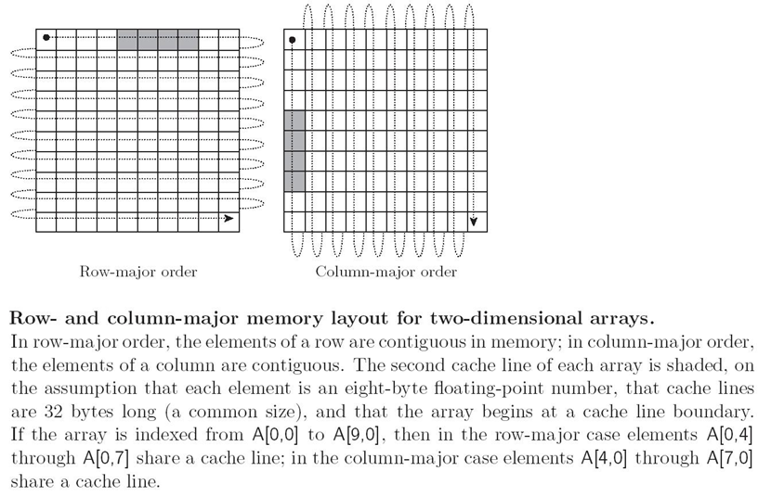
Arrays

Slide 28
Multidimensional Arrays
Common in all languages
C : A[200][200]
Allocated in linear fashion
Row major
Store by rows: row 1, row 2, row 3, ….
Column major
Store by columns

Slide 29
Multidimensional Arrays Layout(C/Java-Like)
Row major order
char[][] C = new char[4][3];
γ(C[i][j]) = γ(C[0][0])+e*(ni+j)
0 <= i < m and 0 <=j < n

Slide 30
Multidimensional Arrays
(j-low2)
b | b+1 | b+2
b+3 | b+4 | b+5
b+6 | b+7 | b+8
Address of M[i][j]
(i-low1)
Fixed part :
Variable part :

Slide 31
Multi-D Arrays(Java)
Java actually stores only 1D arrays; multi-dimensional arrays are references to other arrays
int[][] nums = new int[4][3];

Slide 32
Strings
Strings are typically just arrays of characters
They are often special-cased, to give them flexibility (like polymorphism or dynamic sizing) that is not available for arrays in general
It's easier to provide these things for strings than for arrays in general because strings are one-dimensional and (more important) non-circular

Slide 33
Dangling Pointers
Structures or Classes are often used as nodes within dynamic data structures, such as linked lists
Raises the possibility of the dangling pointer
A pointer to storage used for another purpose and the storage is subsequently deallocated
Garbage
Allocated but inaccessible memory locations
Programs that create garbage are said to have memory leaks

Slide 34
Dangling Pointer Example
class node {
int value, node next
};
node p, q;
p = new node();
q = new node();
q = p;
delete(p);
“dangling reference”
“orphan”

Slide 35
Memory Leak Terms
Dangling reference/Widow
A pointer to storage used for another purpose and the storage is subsequently deallocated
Garbage/Orphan
Allocated but inaccessible memory locations
Programs that create garbage are said to have memory leaks

Slide 36
Avoiding Garbage
Many languages ask the programmer to explicitly manage the heap, where memory is allocated
C, C++,…
User must make sure to destroy everything that is allocated
Memory management is generally not central to the problem the programmer is trying to solve
What if something is missed? Easy to do…
void foo()
{
p = new node();
if (b) return;
delete(p);
}
Interpreted and functional languages generally do automatic garbage collection
Java, C#, Lisp,…

Slide 37
Garbage Collection
Motivation from functional programming
Increased importance due to OOP
How do we reduce/eliminate the burden of memory management from the programmer?

Slide 38
Garbage Collection Algorithms
Reference counting
Mark-Sweep
Copy collection
In Java
The garbage collector runs as a low-priority thread. It is automatic but it can be explicitly called by: System.gc() (regardless of the state of the heap at the time of the call).

Slide 39
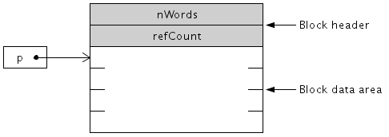
Garbage Collection Reference Counting
Free List
Heap is a continuous chain of nodes called the free list
Implemented various ways, we’ll skip implementation
Each node has an extra field to keep a count as well as a field to keep track of the node size
Reference Count
Number of pointers referencing that node
Initially set to 0

Slide 40
Garbage Collection Reference Counting
Node creation via new()
Get nodes from the free list
Set reference count to 1
Pointer Assignment
e.g. p=q;
Increment the reference count of q by 1
Decrement the reference count of p by 1
If zero, nothing references p so it is safe to delete
must also decrement reference count for any pointer in p’s data area by one. If one of these counts becomes zero, repeat for it’s descendants
Destroy p
Then perform the assignment

Slide 41
Garbage Collection Reference Counting
Pointer Deletion
e.g. delete p;
Decrement p’s reference count If refcount == 0 For every pointer q in p’s data area delete q Put p on the free list
Set p to null

Slide 42
Garbage Collection Reference Counting
The algorithm is activated dynamically on
new
Delete
assignment
Advantages
Very simple, fast, non-compacting garbage collection
Heap maintenance spread throughout program execution (instead of suspending the program when the garbage collector runs)
Must not forget to adjust reference counts on any pointer assignment (including passing pointers as subroutine arguments), or disaster can happen

Slide 43
Reference Counting Example
node p, q, t;
p = new node();
q = new node();
p.next = q;
t = new node();
p
1
q
1
p
1
if p.next pointed
to something, we’d
decrement the ref
q
2
p
1
t
1
q
2

Slide 44
Reference Counting Example
t.next = q;
delete q;
q = new node();
p
1
t
1
q
2
p
1
t
1
q
3
p
1
t
1
q
2
p
1
t
1
q
1
2

Slide 45
Reference Counting Example
q.next = p;
delete t;
p
1
t
1
q
1
2
p
2
t
1
q
1
2
p
2
t
0
q
1
2
p
2
t
q
1
1

Slide 46
Reference Counting Example
p
2
t
q
1
1
p
1
t
delete p;
delete q;
q
1
1
1
q
0
1
0
q
1
0

Slide 47
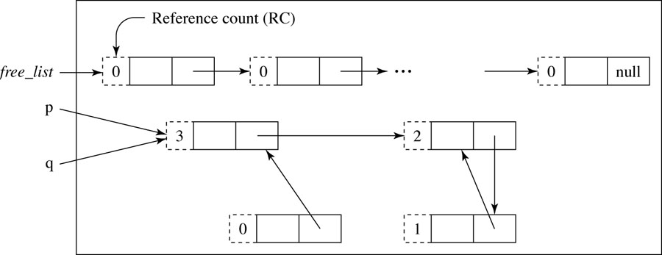
Garbage Collection Reference Counting

Slide 48
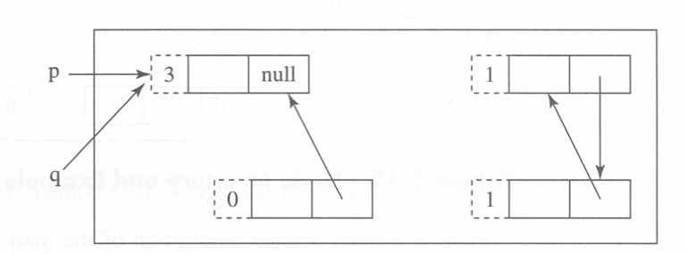
Reference Counting
Minor Problem – Storage overhead for reference count
Major Problem - Can’t handle circular chains of nodes
p.next=null;

Slide 49
Garbage Collection Mark-Sweep
Unlike reference counting, called when the heap becomes full
i.e. free list becomes empty
Orphans are reassigned to the free list
Possibly large number of nodes
May be time consuming
Advantage over reference counting is it reclaims all garbage, even those in circular chains
2 Pass algorithm
1st pass: Mark all the nodes if they are accessible
2nd pass: Reassign the orphans

Slide 50
Garbage Collection Mark-Sweep
Mark Phase
Start with the active variables
Follow the links and “mark” the nodes that can be accessed
All unmarked nodes are orphans
Sweep Phase
Follow all nodes in the heap
If the node is unmarked return to free list
Unmark all nodes that were not returned

Slide 51
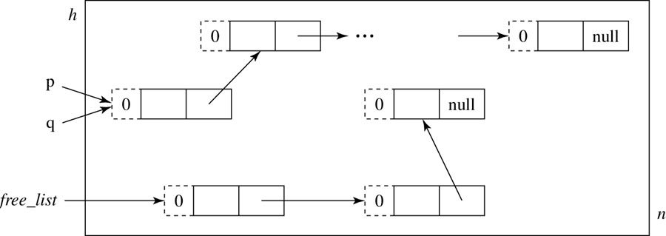
Garbage Collection Mark-Sweep
After Mark Phase
After Sweep Phase

Slide 52
Online Demo
Heap of Fish
http://www.artima.com/insidejvm/applets/HeapOfFish.html

Slide 53
Garbage Collection Mark-Sweep
Advantages
Not invoked unless needed
Small programs don’t need it
Typically perform a large number of new/delete before this is needed
Reclaims all garbage
No problem with circular chains
Reduced memory overhead
Integer vs. a bit
Disadvantages
Time consuming when used
2 pass algorithm

Slide 54
Garbage Collection Copy Collection aka Stop and Copy
Time-space compromise compared to Mark-Sweep
Also invoked only when heap becomes full
Significantly faster than Mark-Sweep
Only 1 pass over the heap
But heap size is effectively reduced by half
i.e. copy collection uses a lot more memory, (but this is not as bad as it sounds if using virtual memory, can still have data in all available physical memory)

Slide 55
Garbage Collection Copy Collection
Divide the heap into two equal halves
from_space: All active nodes are kept here.
to_space: Used as a copy buffer
When the from_space becomes full
All accessible nodes are copied into to_space
The descendents are copied as well
Copying to the to_space called Forwarding
Everything in the from_space is then added to the free list
Swap the roles of from_space and to_space
Eliminates the inaccessible nodes
Skipping some details here of allocating nodes from the free list of the to_space

Slide 56
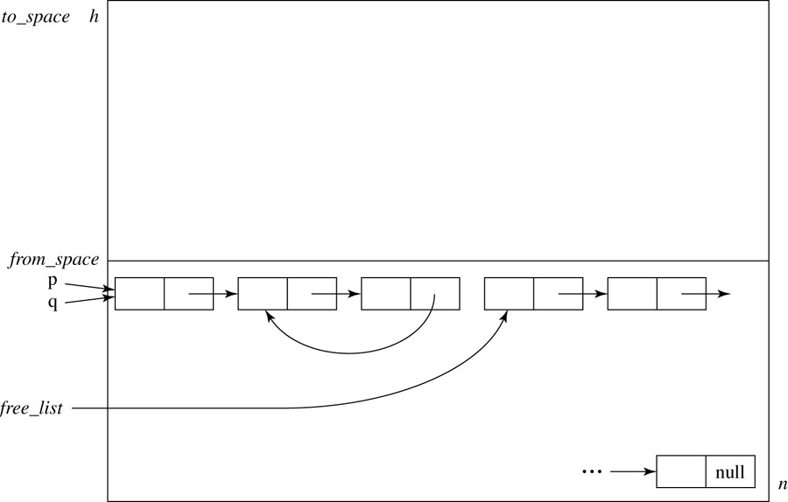
Garbage Collection Copy Collection
Initial Heap Organization
After Copy Collection Activation

Slide 57
Efficiency of Copy Collection vs. Mark Sweep
M = heap size
R = amount of live memory
r = R/M is the residency
m = amount of memory reclaimed
t = time needed for reclaiming memory
e =m/t is the efficiency of garbage collection (memory reclaimed per time)

Slide 58
Efficiency Continued
Comparison:
Since r < 1, copy collection
better for small r
As r increases, mark sweep
becomes more efficient
(as r approaches M/2)

Slide 59
Garbage Collection Today
Many newer, complex algorithms proposed
Active area of research
Incremental garbage collectors
Efficient garbage collectors (e.g., no recursion)
Generational garbage collectors
Separate objects that are in a young/old generation; older are more likely to survive, so might only scan younger generations, condemn older generations less frequently
Hard to judge algorithm in isolation
Often must consider hardware considerations such as paging, virtual memory

