Slide 1
Control Flow
Chapter 6

Slide 2
Control Flow
Skipping most of this chapter in class
  Skim it when reading
  We’ll just hit on a few topics that may be new
Basic paradigms for control flow:
  Sequencing
  Selection
  Iteration and Recursion
  Procedural Abstraction
  Concurrency
  Nondeterminacy

Slide 3
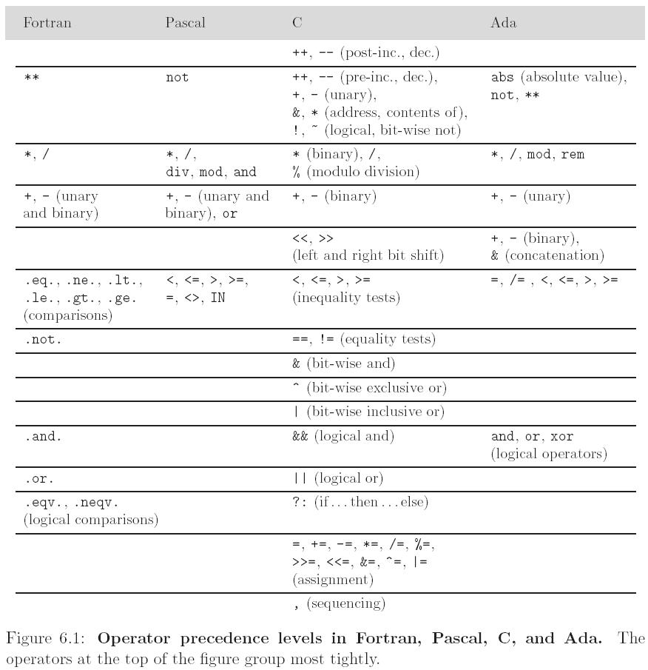
Precedence Rules
Varies from language to language; the smart programmer always uses parentheses where questionable to ensure proper precedence

Slide 4
Concepts in Expression Evaluation
Ordering of operand evaluation (generally none)
Application of arithmetic identities
  commutativity (assumed to be safe)
  associativity (known to be dangerous)
  (a + b) + c works if a~=maxint and b~=minint and c<0
  a + (b + c) does not
Short Circuit
Variables as values vs. variables as references
Orthogonality
  Features that can be used in any combination (Algol 68)
a:= if b < c then d else e; // “returns” a val
a:= begin f(b); g(c); end; // “returns” a val

Slide 5
Concepts in Expression Evaluation
Side Effects
  often discussed in the context of functions
  a side effect is some permanent state change caused by execution of function
    some noticeable effect of call other than return value
    in a more general sense, assignment statements provide the ultimate example of side effects
      they change the value of a variable
Side Effects are fundamental to the von Neumann computing model
In (pure) functional, logic, and dataflow languages, there are no such changes
  These languages are called SINGLE-ASSIGNMENT languages
  Expressions in a purely functional language are REFERENTIALLY TRANSPARENT

Slide 6
Concepts in Expression Evaluation
Boxing
  A drawback of using the primitive value model for built-in types is they can’t be passed to methods that expect references to objects
  Boxing is “wrapping” a primitive in an object
  Early Java: wrap explicitly using Integer, Double, etc.
  Later Java: Automatic boxing and unboxing
    Integer x = 6; //6 is boxed
    Integer y = 2*x + 3; //x is unboxed, 15 is boxed

Slide 7
Concepts in Expression Evaluation
Initialization
  Definite assignment: variable must have a value assigned before being used
Constructors
Combination assignment, multiway assignment

Slide 8
Structured Flow
Sequencing
  specifies a linear ordering on statements
    one statement follows another
  very imperative, Von-Neumann
Selection
  sequential if statements or switch/select statements
  if ... then ... else
  if ... then ... elsif ... else
  (cond
  (C1) (E1)
  (C2) (E2)
  ...
  (Cn) (En)
  (T) (Et)
  )

Slide 9
GOTO Statement
Once the primary means of control flow
Heavily discussed in the 60’s and 70’s
  Dijkstra – GOTO’s Considered Harmful
Mostly abandoned in favor of structured programming; some languages allow labels (can be useful for immediate exit)
  Not allowed at all in Java; can’t even use the keyword
A = 1
PRINT “HELLO”
A = A + 1
IF A < 100 GOTO 11
PRINT "DONE"

Slide 10
Iteration
Loops
  While, repeat, for
  foreach
Recursion
  Tail recursion
  No computation follows recursive call
  /* assume a, b > 0 */
  int gcd (int a, int b) {
  if (a == b) return a;
  else if (a > b) return gcd (a - b, b);
  else return gcd (a, b – a);
  }
Iterators
  In general we may wish to iterate over the elements of any well-defined set (container or collection)
    ArrayList, Set (maybe), HashTable, etc.

Slide 11
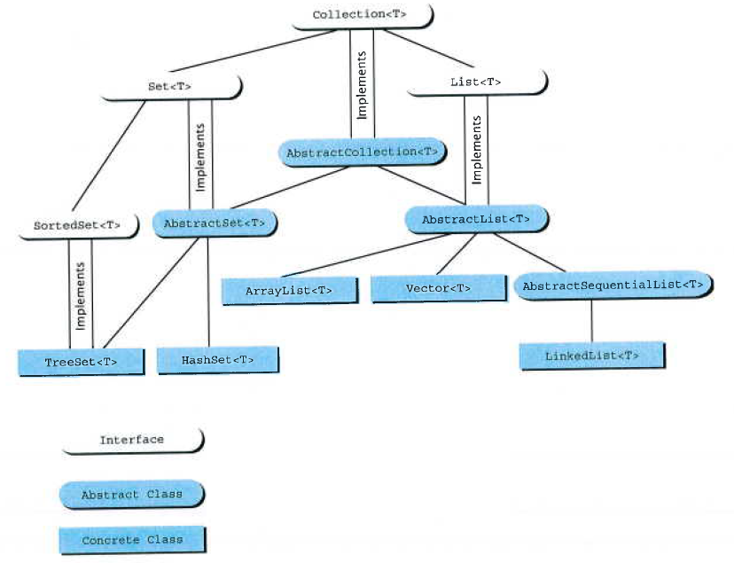
Java Collections

Slide 12
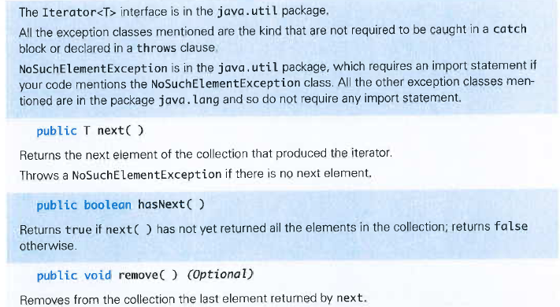
Java Iterators
Iterator used with a collection to provide sequential access to the elements in the collection
Methods in the Iterator<T> Interface

Slide 13
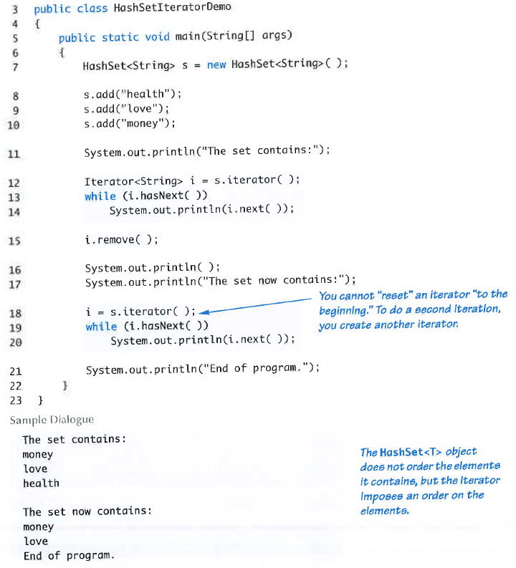

Slide 14
Applicative and Normal-Order Evaluation
We normally assume all arguments are evaluated before passing them to a subroutine
  Required for many languages so we know what to stick on the stack
  But this need not always be the case
Applicative Order Evaluation
  Evaluating all arguments before the call
Normal Order Evaluation
  Evaluating only when the value is actually needed
  Used in some functional languages

Slide 15
Normal Order Evaluation
Applicative Order is the norm
Normal Order can sometimes lead to faster code, code that works when applicative-order evaluation would cause a run-time error
  E.g. short circuit
Lazy Evaluation in Scheme
  Built-in functions delay and force
  Keeps track of expressions already evaluated so it can reuse their values if they are needed more than once
    Also called memoization
    E.g.: fib(n) { if (n<=2) return n else return fib(n-1)+fib(n-2) }

