Slide 1
Semantic Analysis
Chapter 4

Slide 2
Role of Semantic Analysis
Following parsing, the next two phases of the "typical" compiler are
  semantic analysis
  (intermediate) code generation
The principal job of the semantic analyzer is to enforce static semantic rules
  constructs a syntax tree (usually first)
  information gathered is needed by the code generator

Slide 3
Role of Semantic Analysis
There is considerable variety in the extent to which parsing, semantic analysis, and intermediate code generation are interleaved
A common approach interleaves construction of a syntax tree with parsing
(no explicit parse tree), and then follows with separate, sequential phases for semantic analysis and code generation

Slide 4
Attribute Grammars
Both semantic analysis and (intermediate) code generation can be described in terms of annotation, or "decoration" of a parse or syntax tree
ATTRIBUTE GRAMMARS provide a formal framework for decorating such a tree
Consider the following LR (bottom-up) grammar for arithmetic expressions
made of constants, with precedence and associativity:

Slide 5
Attribute Grammars
E → E + T
E → E – T
E → T
T → T * F
T → T / F
T → F
F → - F
F → (E)
F → const
This says nothing about what the program MEANS

Slide 6
Attribute Grammars
We can turn this into an attribute grammar as follows (similar to Figure 4.1):
E → E + T E1.val = Sum(E2.val,T.val)
E → E – T E1.val = Diff(E2.val,T.val)
E → T E.val = T.val
T → T * F T1.val = Prod(T2.val,F.val)
T → T / F T1.val = Div(T2.val,F.val)
T → F T.val = F.val
F → - F F1.val = Prod(F2.val,-1)
F → (E) F.val = E.val
F → const F.val = C.val

Slide 7
Attribute Grammars
The attribute grammar serves to define the semantics of the input program
Attribute rules are best thought of as definitions, not assignments
They are not necessarily meant to be evaluated at any particular time, or in any particular order, though they do define their left-hand side in terms of the right-hand side

Slide 8
Evaluating Attributes
The process of evaluating attributes is called annotation, or DECORATION, of the parse tree
  When a parse tree under this grammar is fully decorated, the value of the expression will be in the val attribute of the root
The code fragments for the rules are called SEMANTIC FUNCTIONS
  Strictly speaking, they should be cast as functions, e.g., E1.val = sum (E2.val, T.val) but often we will use the obvious E1.val = E2.val + T.val

Slide 9
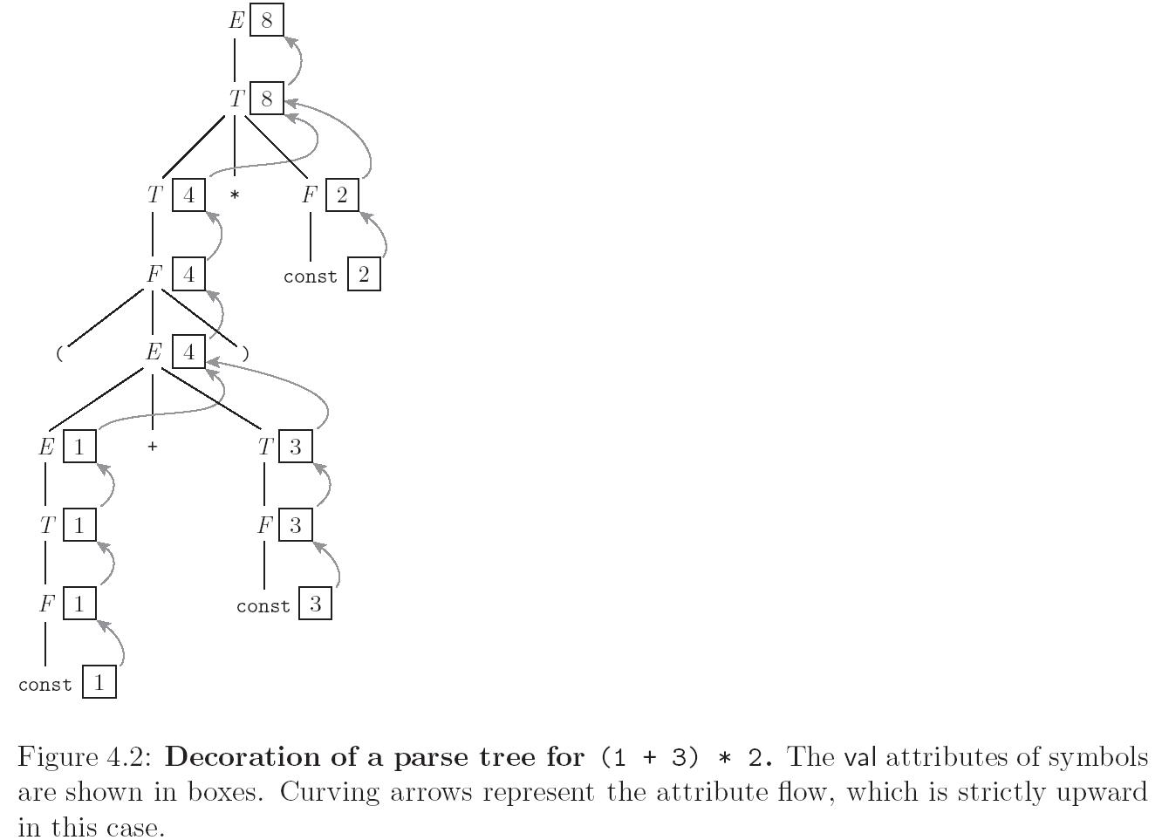
Evaluating Attributes
E → E + T E1.val = E2.val + T.val
E → E – T E1.val = E2.val - T.val
E → T E.val = T.val
T → T * F T1.val = T2.val * F.val
T → T / F T1.val = T2.val / F.val
T → F T.val = F.val
F → - F F1.val = - F2.val
F → (E) F.val = E.val
F → const F.val = C.val

Slide 10
Evaluating Attributes
This is a very simple attribute grammar:
  Each symbol has at most one
  attribute
    the punctuation marks have no attributes
These attributes are all so-called SYNTHESIZED attributes:
  They are calculated only from the attributes of things below them in the parse tree

Slide 11
Evaluating Attributes
In general, we are allowed both synthesized and INHERITED attributes:
  Inherited attributes may depend on things above or to the side of them in the parse tree
  Tokens have only synthesized attributes, initialized by the scanner (name of an identifier, value of a constant, etc.).
  Inherited attributes of the start symbol constitute run-time parameters of the compiler

Slide 12
Inherited Attributes
LL(1) grammar covering subtraction:
Expr → const Expr_Tail
Expr_Tail → - const Expr_Tail | ε
For the expression 9 – 4 – 3:
Expr
9 Expr_Tail
- 4 Expr_Tail
- 3 Expr_Tail
ε

Slide 13
Inherited Attributes
If we are allowed to pass attribute values not only bottom-up but also left-to-right then we can pass 9 into the Expr_Tail node for evaluation, and so on for each Expr_Tail
Expr
9 Expr_Tail
- 4 Expr_Tail
- 3 Expr_Tail
ε
Similar to recursion when the result is accumulated as recursive calls made
Notes:
Leftmost box: “subtotal”. Rightmost box: “Value” that is returned

Slide 14
Evaluating Attributes
The grammar for evaluating expressions is called S-ATTRIBUTED because it uses only synthesized attributes
Its ATTRIBUTE FLOW (attribute dependence graph) is purely bottom-up
  It is SLR(1), but not LL(1)
An equivalent LL(1) grammar requires inherited attributes:

Slide 15
Evaluating Attributes – Example
Attribute grammar in Figure 4.3:
E → T TT E.v = TT.v
TT.st = T.v
TT₁ → + T TT₂ TT₁.v = TT₂.v
TT₂.st = TT₁.st + T.v
TT₁ → - T TT₂ TT₁.v = TT₂.v
TT₂.st = TT₁.st - T.v
TT → ε TT.v = TT.st
T → F FT T.v = FT.v
FT.st = F.v
Notes:
st stands for “subtotal”; subscripts identify which TT we are interested in

Slide 16
Evaluating Attributes– Example
Attribute grammar in Figure 4.3 (continued):
FT₁ → * F FT₂ FT₁.v = FT₂.v
FT₂.st = FT₁.st * F.v
FT₁ → / F FT₂ FT₁.v = FT₂.v
FT₂.st = FT₁.st / F.v
FT → ε FT.v = FT.st
F₁ → - F₂ F₁.v = - F₂.v
F → ( E ) F.v = E.v
F → const F.v = C.v
Figure 4.4 – parse tree for (1+3)*2

Slide 17
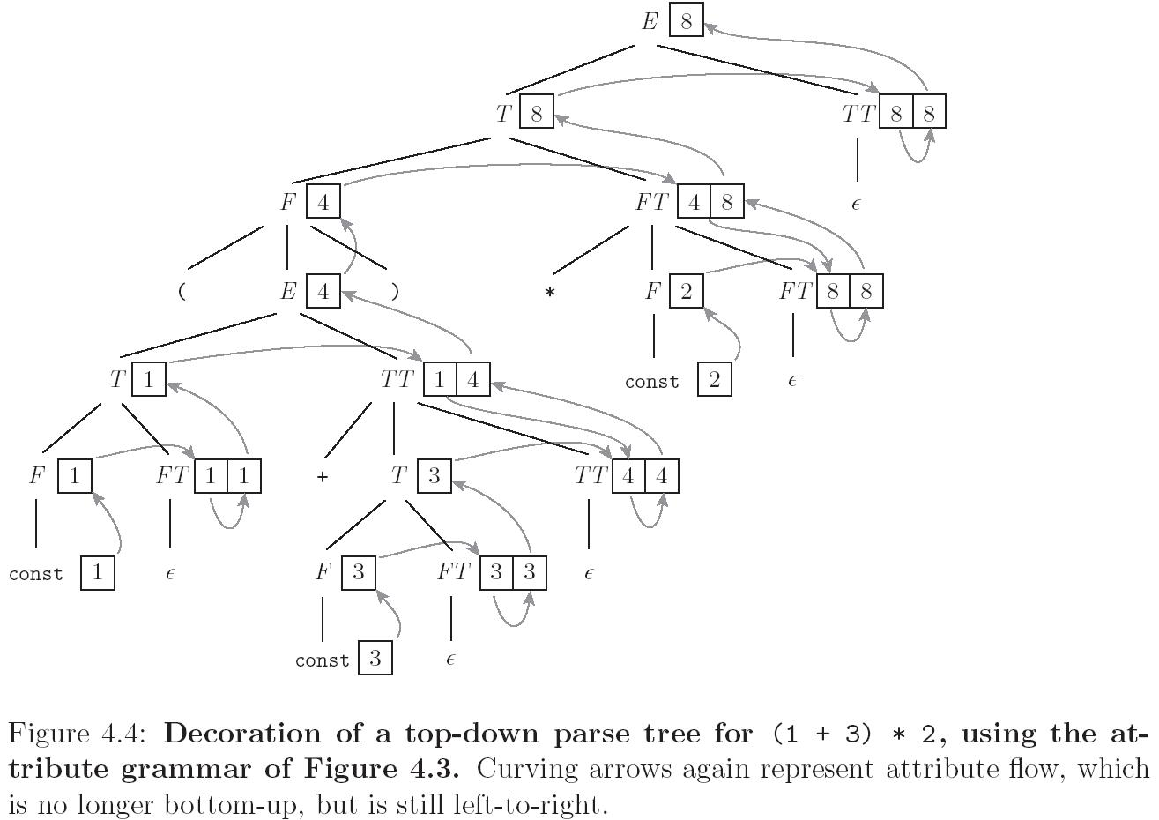
Evaluating Attributes– Example

Slide 18
Evaluating Attributes– Example
Attribute grammar in Figure 4.3:
  This attribute grammar is a good bit messier than the first one, but it is still L-ATTRIBUTED, which means that the attributes can be evaluated in a single left-to-right pass over the input
  In fact, they can be evaluated during an LL parse
  Each synthetic attribute of a LHS symbol (by definition of synthetic) depends only on attributes of its RHS symbols

Slide 19
Evaluating Attributes – Example
Attribute grammar in Figure 4.3:
  Each inherited attribute of a RHS symbol (by definition of L-attributed) depends only on
    inherited attributes of the LHS symbol, or
    synthetic or inherited attributes of symbols to its left in the RHS
  L-attributed grammars are the most general class of attribute grammars that can be evaluated during an LL parse

Slide 20
Evaluating Attributes
There are certain tasks, such as generation of code for short-circuit Boolean expression evaluation, that are easiest to express with non-L-attributed attribute grammars
Because of the potential cost of complex traversal schemes, however, most real-world compilers insist that the grammar be L-attributed

Slide 21
Evaluating Attributes - Abstract Syntax
The Abstract Syntax defines essential syntactic elements without describing how they are concretely constructed
Consider the following Pascal and C loops
  Pascal C
  while i<n do begin while (i<n) {
  i:=i+1 i=i+1;
  end }
Small differences in concrete syntax; identical abstract construct

Slide 22
Abstract Syntax Format
We can define an abstract syntax using rules of the form
  LHS = RHS
    LHS is the name of an abstract syntactic class
    RHS is a list of essential components that define the class
      Similar to defining a variable. Data type or abstract syntactic class, and name
Recursion naturally occurs among the definitions as with BNF
  Makes it fairly easy to construct programmatically, similar to what we did for the concrete syntax

Slide 23
Abstract Syntax Example
Loop
  Loop = Expression test ; Statement body
  The abstract class Loop has two components, a test which is a member of the abstract class Expression, and a body which is a member of an abstract class Statement
Nice by-product: If parsing abstract syntax in a language like Java, it makes sense to actually define a class for each abstract syntactic class, e.g.
  class Loop extends Statement {
  Expression test;
  Statement body;
  }

Slide 24
Abstract Syntax of a C-like Language
Program = Declarations decpart; Statements body;
Declarations = Declaration*
Declaration = VariableDecl | ArrayDecl
VariableDecl = Variable v; Type t
ArrayDecl = Variable v; Type t; Integer size
Type = int | bool | float | char
Statements = Statement*
Statement = Skip | Block | Assignment |
Conditional | Loop
Skip =
Block = Statements
Conditional = Expression test;
Statement thenbranch, elsebranch
Loop = Expression test; Statement body
Assignment = VariableRef target; Expression source
Expression = VariableRef | Value | Binary | Unary

Slide 25
Abstract Syntax of a C-like Language
VariableRef = Variable | ArrayRef
Binary = Operator op; Expression term1, term2
Unary = UnaryOp op; Expression term
Operator = BooleanOp | RelationalOp | ArithmeticOp
BooleanOp = && | ||
RelationalOp = = | ! | != | < | <= | > | >=
ArithmeticOp = + | - | * | /
UnaryOp = ! | -
Variable = String id
ArrayRef = String id; Expression index
Value = IntValue | BoolValue | FloatValue | CharValue
IntValue = Integer intValue
FloatValue = Float floatValue
BoolValue = Boolean boolValue
CharValue = Character charValue

Slide 26
Java Abstract Syntax for C-Like Language
class Loop extends Statement {
Expression test;
Statement body;
}
class Assignment extends Statement {
// Assignment = Variable target; Expression source
Variable target;
Expression source;
}
…

Slide 27
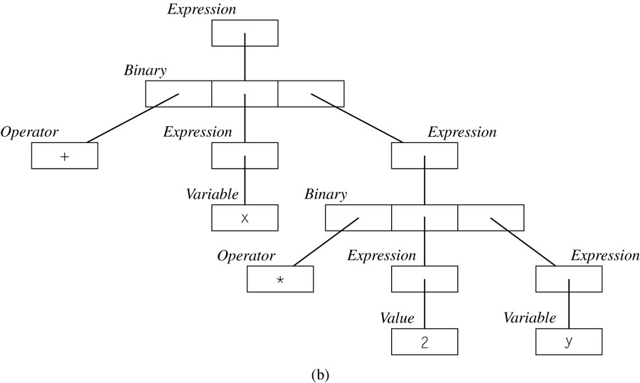
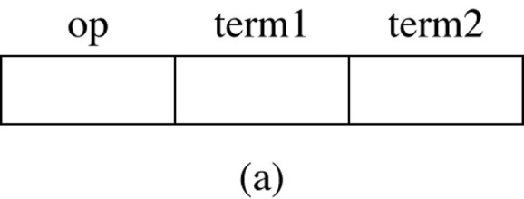
Abstract Syntax Tree
Just as we can build a parse tree from a BNF grammar, we can build an abstract syntax tree from an abstract syntax
Example for: x+2*y
Expression = Variable | Value | Binary
Binary = Operator op ; Expression term1, term2
Binary node
Expr

Slide 28
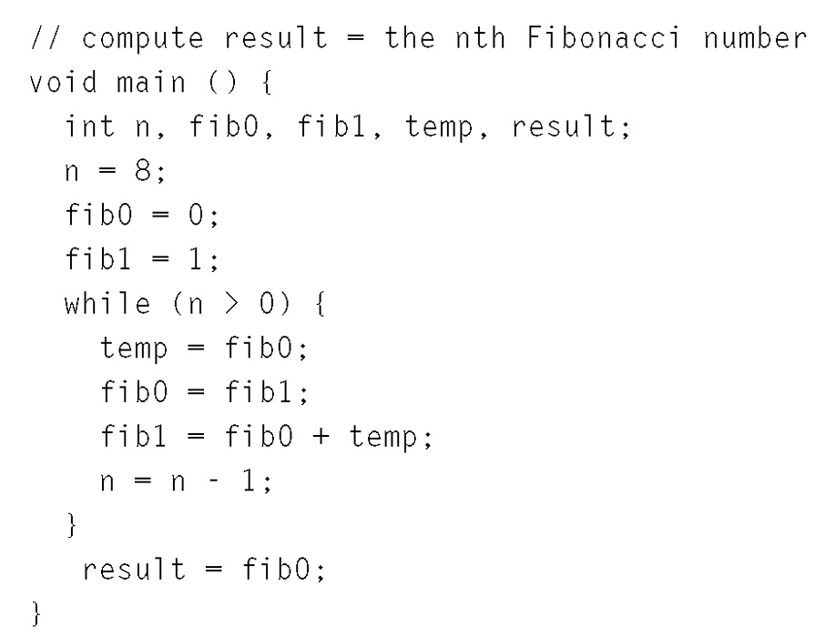
Sample C-Like Program
Compute nth fib number

Slide 29
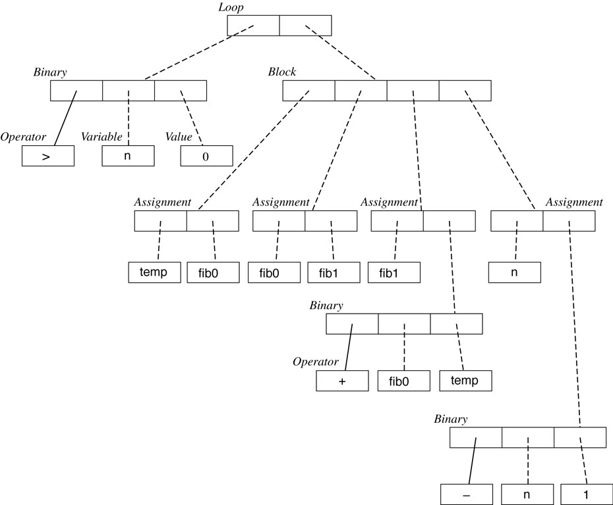
Abstract Syntax for Loop of C-Like Program

Slide 30
Concrete and Abstract Syntax
Aren’t the two redundant?
  A little bit
The concrete syntax tells the programmer exactly what to write to have a valid program
The abstract syntax allows valid programs in two different languages to share common abstract representations
  It is closer to semantics
  We need both!
To construct the abstract syntax tree a common approach is a bottom-up attribute grammar associated with the concrete syntax

Slide 31
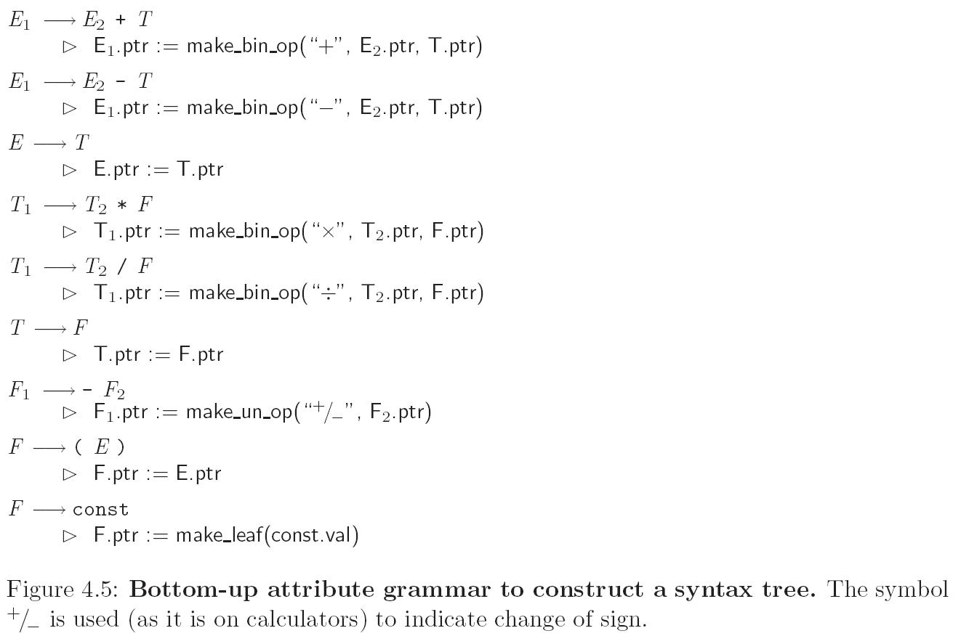
Evaluating Attributes – Syntax Trees
Skipping Top-Down, but
it exists too (with inherited
attributes)

Slide 32
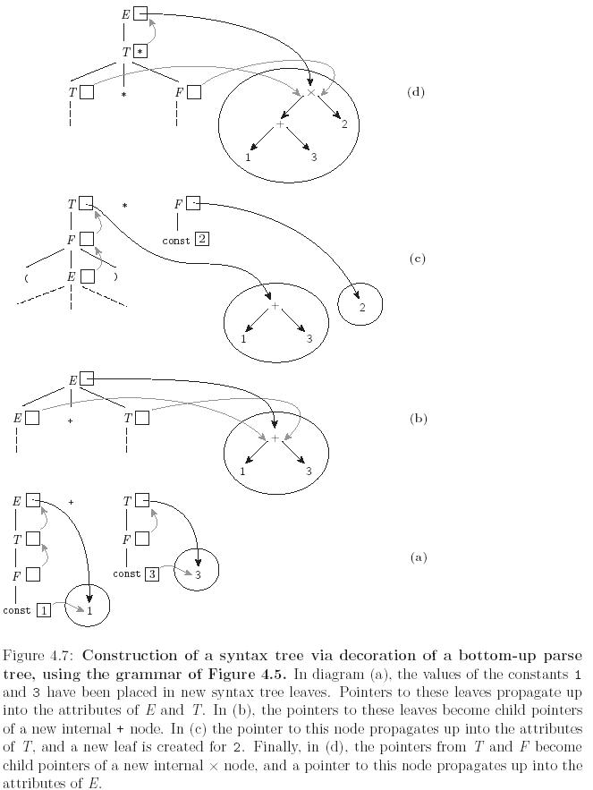
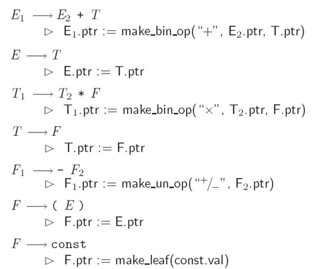
Evaluating Attributes – Syntax Trees
(1+3)*2

Slide 33
Action Routines
We can tie this discussion back into the earlier issue of separated phases v. on-the-fly semantic analysis and/or code generation
If semantic analysis and/or code generation are interleaved with parsing, then the TRANSLATION SCHEME we use to evaluate attributes MUST be L-attributed

Slide 34
Action Routines
If we break semantic analysis and code generation out into separate phase(s), then the code that builds the parse/syntax tree can still use a left-to-right (L-attributed) translation scheme
However, the later phases are free to use a fancier translation scheme if they want

Slide 35
Action Routines
There are automatic tools that generate translation schemes for context-free grammars or tree grammars (which describe the possible structure of a syntax tree)
  These tools are heavily used in syntax-based editors and incremental compilers
  Most ordinary compilers, however, use ad-hoc techniques

Slide 36
Action Routines
An ad-hoc translation scheme that is interleaved with parsing takes the
form of a set of ACTION ROUTINES:
  An action routine is a semantic function that we tell the compiler to execute at a particular point in the parse
  Same idea as the previous abstract syntax example (Fig 4.6, 4.7), except the action routines are embedded among the symbols of the right-hand sides; work performed is the same
For our LL(1) attribute grammar, we could put in explicit action routines as follows:

Slide 37
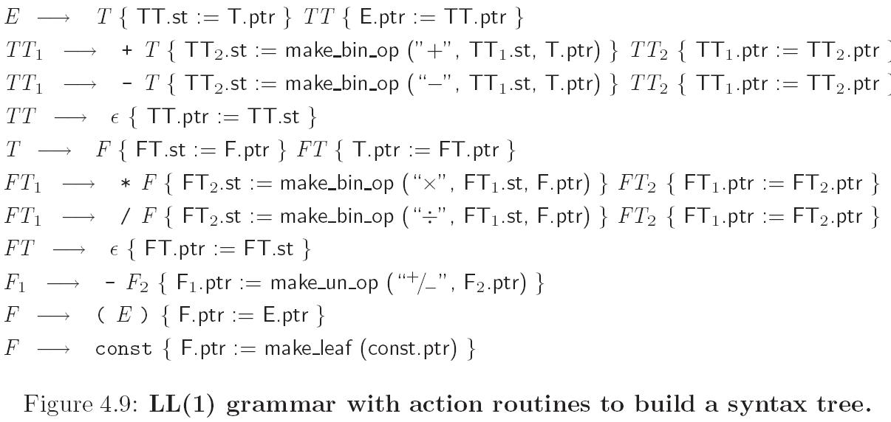
Action Routines - Example
Action routines (Figure 4.9)

Slide 38
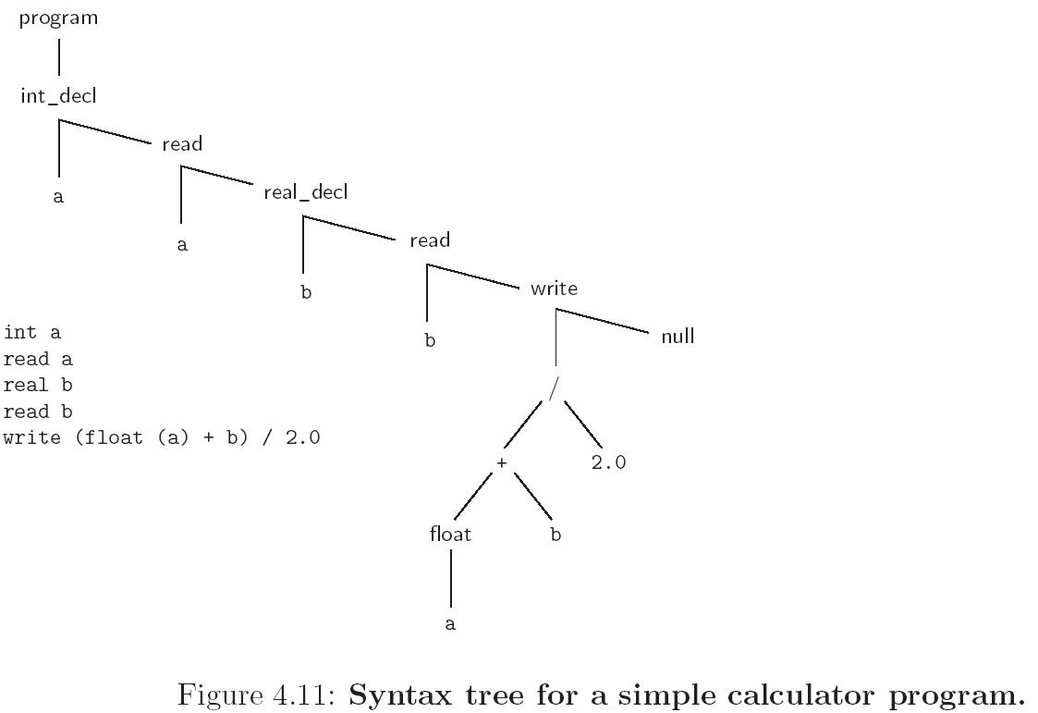
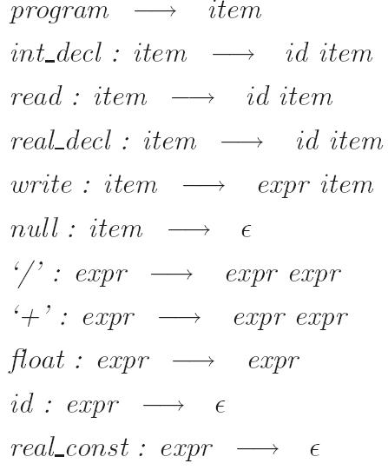
Decorating a Syntax Tree
Abstract syntax tree for a simple program to print an average of an integer and a real

Slide 39
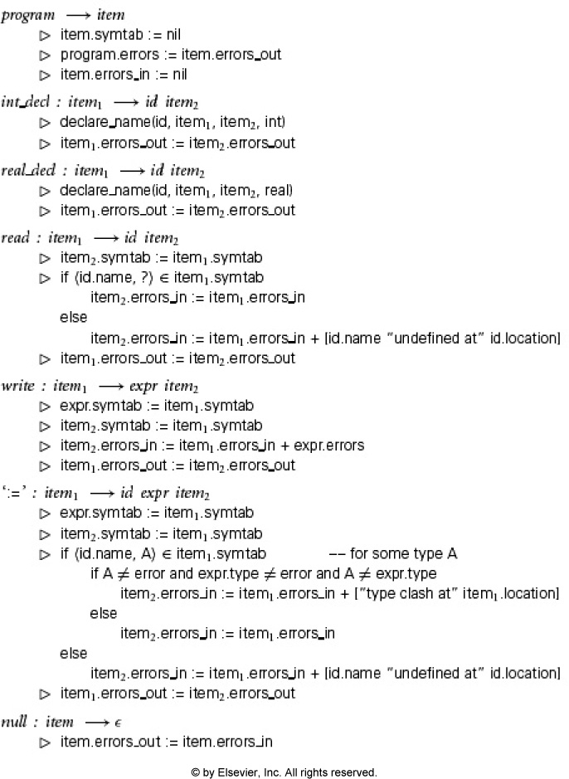
Complete Attribute
Grammar
Notes:
Figure 4-11

Slide 40
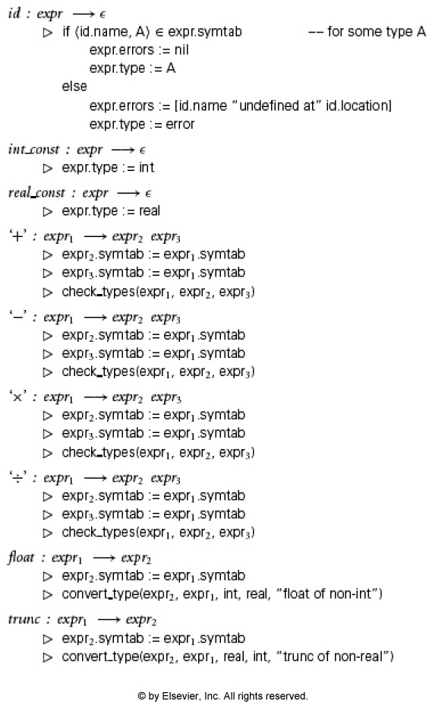
Notes:
Figure 4-11B

Slide 41
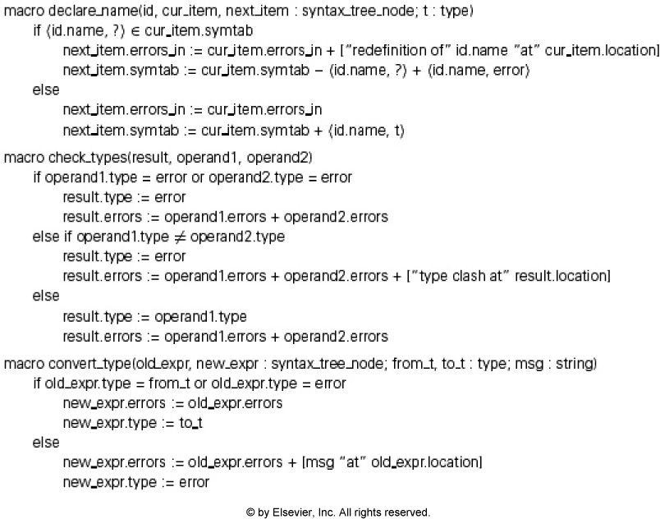
Notes:
Figure 4-11C

