Slide 1
Names, Scope, Memory, and Binding

Slide 2
Name, Scope, and Binding
A name is exactly what you think it is
  Usually think of identifiers but can be more general
  symbols (like '+' or '_') can also be names
A binding is an association between two things, such as a name and the thing it names
The scope of a binding is the part of the program (textually) in which the binding is active

Slide 3
Binding
Binding Time is the point at which a binding is created
  language design time
    program structure, possible type
  language implementation time
    I/O, arithmetic overflow, stack size, type equality (if unspecified in design)
  program writing time
    algorithms, names
  compile time
    plan for data layout
  link time
    layout of whole program in memory
  load time
    choice of physical addresses

Slide 4
Binding
Implementation decisions (continued):
  run time
    value/variable bindings, sizes of strings
    subsumes
      program start-up time
      module entry time
      elaboration time (point a which a declaration is first "seen")
      procedure entry time
      block entry time
      statement execution time

Slide 5
Binding
The terms STATIC and DYNAMIC are generally used to refer to things bound before run time and at run time, respectively
  “static” is a coarse term; so is "dynamic"
IT IS DIFFICULT TO OVERSTATE THE IMPORTANCE OF BINDING TIMES IN THE DESIGN AND IMPLEMENTATION OF PROGRAMMING LANGUAGES

Slide 6
Binding
In general, early binding times are associated with greater efficiency
Later binding times are associated with greater flexibility
Compiled languages tend to have early binding times
Interpreted languages tend to have later binding times
Today we talk about the binding of identifiers to the variables they name
  Not all data is named! For example, dynamic storage in C or Pascal is referenced by pointers, not names

Slide 7
Lifetime and Storage Management
Key events
  creation of objects
  creation of bindings
  references to variables (which use bindings)
  (temporary) deactivation of bindings
  reactivation of bindings
  destruction of bindings
  destruction of objects
The period of time from creation to destruction is called the LIFETIME of a binding
  If object outlives binding it's garbage
  If binding outlives object it's a dangling reference
The textual region of the program in which the binding is active is its scope

Slide 8
Lifetime and Storage Management
Storage Allocation mechanisms
  Static
  Stack
  Heap
Static allocation for
  code
  globals
  static or own variables
  explicit constants (including strings, sets, etc)
  scalars may be stored in the instructions

Slide 9
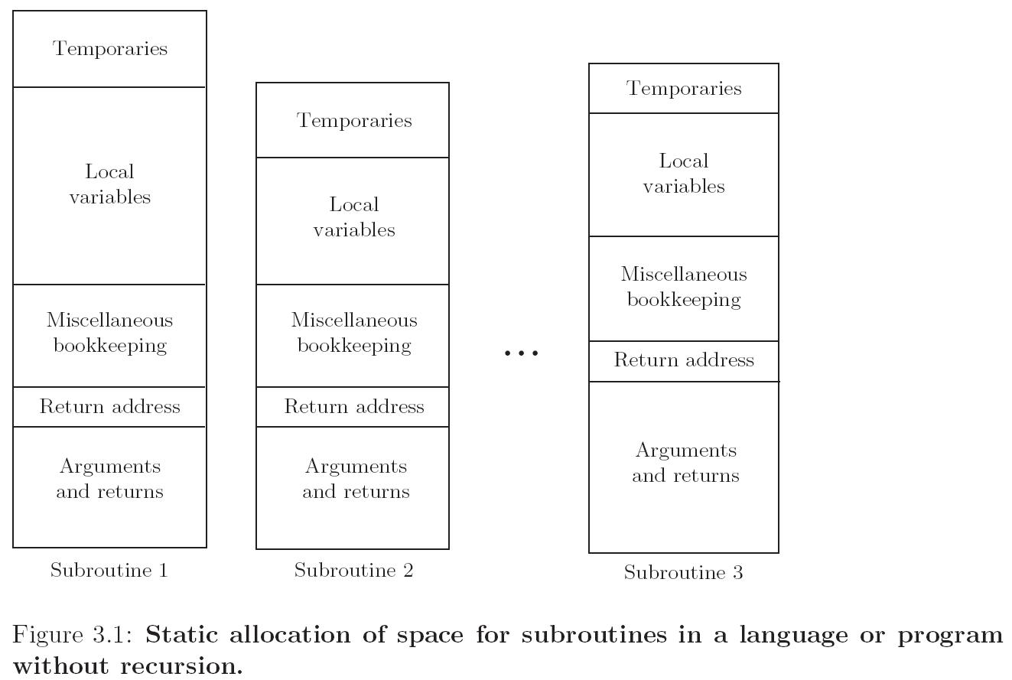
Lifetime and Storage Management

Slide 10
Lifetime and Storage Management
Central stack for
  parameters
  local variables
  temporaries
Why a stack?
  allocate space for recursive routines
  (not possible in old FORTRAN – no recursion)
  reuse space
  (in all programming languages)

Slide 11
Lifetime and Storage Management
Contents of a stack frame
  arguments and returns
  local variables
  temporaries
  bookkeeping (saved registers, line number static link, etc.)
Local variables and arguments are assigned fixed OFFSETS from the stack pointer or frame pointer at compile time

Slide 12
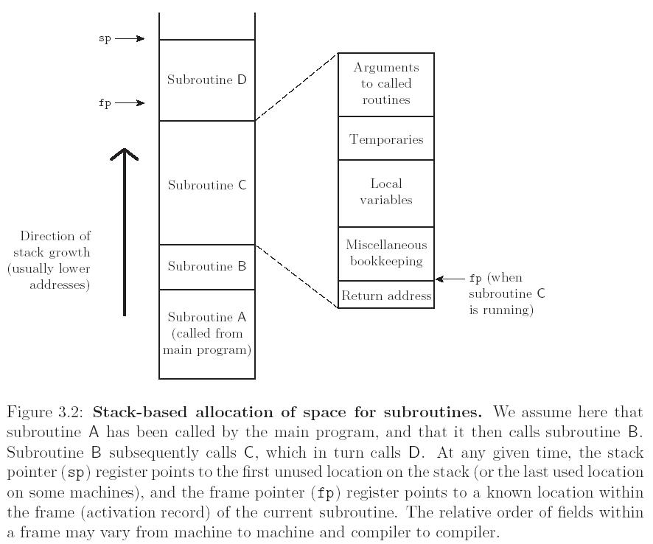
Lifetime and Storage Management

Slide 13
Example: Examine Stack for the C Program
int bar(int x)
{
int z=5;
return z;
}
int foo(int x)
{
int y=3;
x = x + y;
y = bar(x);
return x;
}
int main(int argc, char* argv[])
{
int a=1, b=2, c=3;
b = foo(a);
printf("%d %d %d\n",a,b,c);
return 0;
}

Slide 14
Memory Management
Heap
  Region of memory where subblocks are allocated and deallocated dynamically
More unstructured
Allocation and deallocation may happen in arbitrary order
  Memory may become fragmented
  Need for garbage collection
  We will describe garbage collection algorithms later
Heap Management
  Often managed with a single linked list – the free list – of blocks not in use
    First Fit?
    Best Fit? (smallest block large enough to handle request)

Slide 15
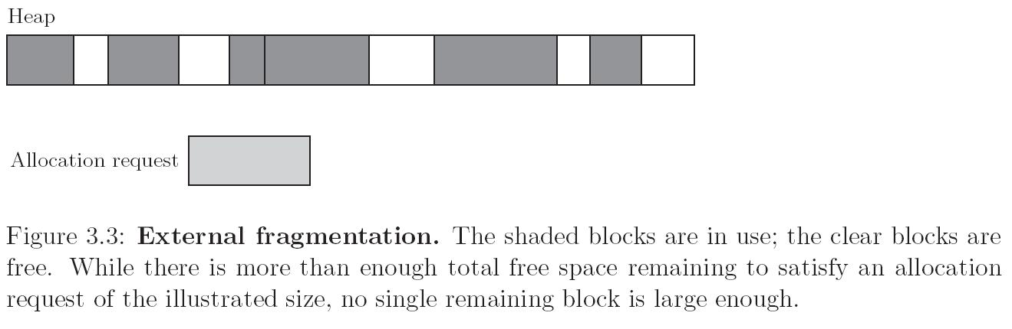
Lifetime and Storage Management
Heap for dynamic allocation

Slide 16
Scope Rules
A scope is a program section of maximal size in which no bindings change, or at least in which no re-declarations are permitted
In most languages with subroutines, we OPEN a new scope on subroutine entry:
  create bindings for new local variables,
  deactivate bindings for global variables that are re-declared (these variable are said to have a "hole" in their scope)
  make references to variables

Slide 17
Scope Rules
On subroutine exit:
  destroy bindings for local variables
  reactivate bindings for global variables that were deactivated
Algol 68:
  ELABORATION = process of creating bindings when entering a scope
Ada (re-popularized the term elaboration):
  storage may be allocated, tasks started, even exceptions propagated as a result of the elaboration of declarations

Slide 18
Scope Rules
With STATIC (LEXICAL) SCOPE RULES, a scope is defined in terms of the physical (lexical) structure of the program
  The determination of scopes can be made by the compiler
  All bindings for identifiers can be resolved by examining the program
  Typically, we choose the most recent, active binding made at compile time
  Most compiled languages, C++ and Java included, employ static scope rules

Slide 19
Scope Rules
The classical example of static scope rules is the most closely nested rule used in block structured languages such as Algol 60 and Pascal
  An identifier is known in the scope in which it is declared and in each enclosed scope, unless it is re-declared in an enclosed scope
  To resolve a reference to an identifier, we examine the local scope and statically enclosing scopes until a binding is found

Slide 20
Scope Rules
Note that the bindings created in a subroutine are destroyed at subroutine exit
Obvious consequence when you understand how stack frames are allocated and deallocated
The modules of Modula, Ada, etc., give you closed scopes without the limited lifetime
  Bindings to variables declared in a module are inactive outside the module, not destroyed
  The same sort of effect can be achieved in many languages with own (Algol term) or static (C term) variables

Slide 21
Scope Rules
Access to non-local variables STATIC LINKS
  Each frame points to the frame of the (correct instance of) the routine inside which it was declared
  In the absence of formal subroutines, correct means closest to the top of the stack
  You access a variable in a scope k levels out by following k static links and then using the known offset within the frame thus found
More details in Chapter 8

Slide 22
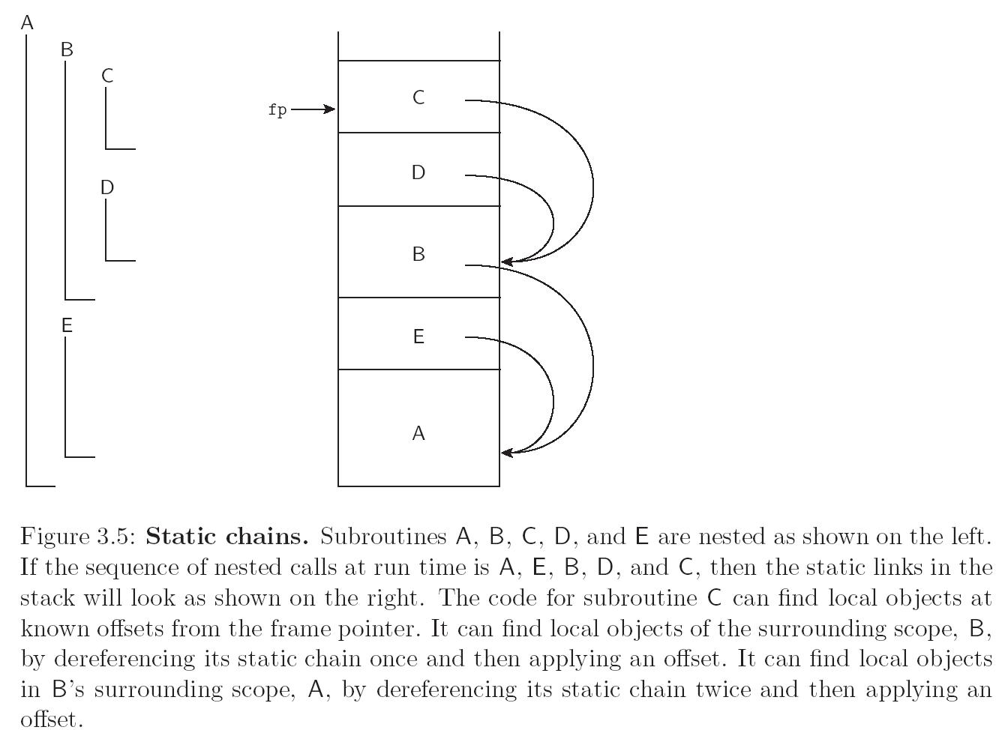
Scope Rules

Slide 23
Scope Rules
The key idea in static scope rules is that bindings are defined by the physical (lexical) structure of the program.
With dynamic scope rules, bindings depend on the current state of program execution
  They cannot always be resolved by examining the program because they are dependent on calling sequences
  To resolve a reference, we use the most recent, active binding made at run time

Slide 24
Binding of Referencing Environments
Accessing variables with dynamic scope:
  (1) keep a stack (association list) of all active variables
    When you need to find a variable, hunt down from top of stack
    This is equivalent to searching the activation records on the dynamic chain

Slide 25
Binding of Referencing Environments
Accessing variables with dynamic scope:
  (2) keep a central table with one slot for every variable name
    If names cannot be created at run time, the table layout (and the location of every slot) can be fixed at compile time
    Otherwise, you'll need a hash function or something to do lookup
    Every subroutine changes the table entries for its locals at entry and exit (push / pop on a stack).

Slide 26
Binding of Referencing Environments
(1) gives you slower access but fast calls
(2) gives you slower calls but fast access
In effect, variable lookup in a dynamically-scoped language corresponds to symbol table lookup in a statically-scoped language
Because static scope rules tend to be more complicated, however, the data structure and lookup algorithm also have to be more complicated

Slide 27
Scope Rules
Dynamic scope rules are usually encountered in interpreted languages
  early LISP dialects assumed dynamic scope rules.
Such languages do not normally have type checking at compile time because type determination isn't always possible when dynamic scope rules are in effect

Slide 28
Scope Rules
Example: Static vs. Dynamic
int a;
void first()
{
a = 1;
}
void second()
{
int a = 3;
first();
}
void main()
{
a = 2;
second;
printf("%d\n",a);
}

Slide 29
Scope Rules
Example: Static vs. Dynamic
If static scope rules are in effect (as would be the case in C), the program prints a 1
If dynamic scope rules are in effect, the program prints a 2
Why the difference? At issue is whether the assignment to the variable a in function first changes the variable a declared in the main program or the variable a declared in function second

Slide 30
Scope Rules
Example: Static vs. Dynamic
Static scope rules require that the reference resolve to the most recent, compile-time binding, namely the global variable a
Dynamic scope rules, on the other hand, require that we choose the most recent, active binding at run time
  Perhaps the most common use of dynamic scope rules is to provide implicit parameters to subroutines
    Begin
      Print_base: integer := 16 // use hex
      Print_integer(n)
  This is generally considered bad programming practice nowadays
    Alternative mechanisms exist, e.g. optional parameters

Slide 31
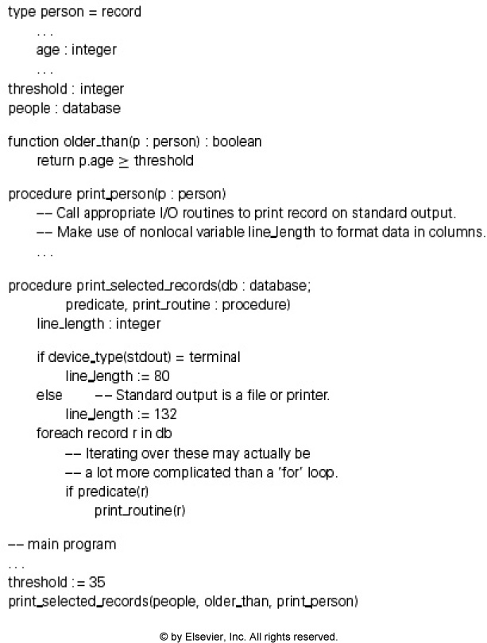
Static scoping or
Deep binding makes sense here
Dynamic scoping or
Shallow binding makes some sense here

Slide 32
Binding of Referencing Environments
REFERENCING ENVIRONMENT of a statement at run time is the set of active bindings
A referencing environment corresponds to a collection of scopes that are examined (in order) to find a binding
SCOPE RULES determine that collection and its order
First-class status: objects that can be passed as parameters or returned and assigned
Second-class status: objects that can be passed but not returned or assigned
Some programming languages allow subroutines to be first-class
  What binding rules to use for such a subroutine?

Slide 33
Binding within a Scope
Aliasing
  Two or more names that refer to a single object in a given scope are aliases
  What are aliases good for?
    space saving - modern data allocation methods are better
    multiple representations
    linked data structures - legit
  Also, aliases arise in parameter passing
    Sometimes desirable, sometimes not

Slide 34
Aliases
Java:
public static void foo(MyObject x)
{
x.val = 10;
}
public static void main(String[] args)
{
MyObject o = new MyObject(1);
foo(o);
}
Notes:
Discuss creation of object with reference to same object, then how it is created on the stack as a parameter

Slide 35
Aliases
C++:
public static void foo(int &x)
{
MyObject o;
x = 10;
}
public static void main(String[] args)
{
int y = 20;
foo(y);
}
Notes:
Discuss creation of object with reference to same object, then how it is created on the stack as a parameter

Slide 36
Binding within a Scope
Overloading
  some overloading happens in almost all languages
    integer + v. real +
  Handled with help from the symbol table
    Lookup a list of possible meanings for the requested name; the semantic analyzer chooses the most appropriate one based on the context
  some languages get into overloading in a big way
    Ada
    C++

Slide 37
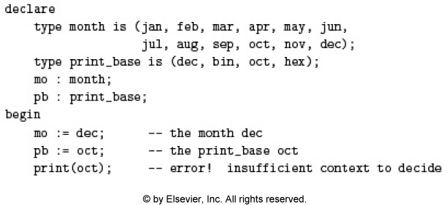
Ada Constant Overloading

Slide 38
C++ Operator Overloading
const Money operator +(const Money& amount1, const Money& amount2)
{
int allCents1 = amount1.cents + amount1.dollars*100;
int allCents2 = amount2.cents + amount2.dollars*100;
int sumAllCents = allCents1 + allCents2;
int absAllCents = abs(sumAllCents); //Money can be negative.
int finalDollars = absAllCents/100;
int finalCents = absAllCents%100;
if (sumAllCents < 0)
{
finalDollars = -finalDollars;
finalCents = -finalCents;
}
return Money(finalDollars, finalCents);
}
bool operator ==(const Money& amount1, const Money& amount2)
{
return ((amount1.dollars == amount2.dollars)
&& (amount1.cents == amount2.cents));
}

Slide 39
Binding within a Scope
It's worth distinguishing between some closely related concepts
  overloaded functions - two different things with the same name; in Ada
  function min(a, b : integer) return integer…
  function min(x, y : real) return real …
  In Fortran, these can be automatically coerced:
  real function min(x,y) real x,y ...
Fortran will convert int input to reals, find the min, then return the result back as a real

Slide 40
Binding within a Scope
generic functions (modules, etc.) - a syntactic template that can be instantiated in more than one way at compile time
  Also called explicit parametric polymorphism
  via macro processors in C++
  Templates in C++/Java
public class TwoTypePair<T1, T2>
{
private T1 first;
private T2 second;
public TwoTypePair(T1 firstItem, T2 secondItem)
{
first = firstItem;
second = secondItem;
}
public T1 getFirst()
{
return first;
}
...
TwoTypePair<String, Integer> rating = new TwoTypePair<String, Integer>("The Car Guys", 8);

Slide 41
Separate Compilation
Since most large programs are constructed and tested incrementally, and some programs can be very large, languages must support separate compilation
Compilation units usually a “module”
  Class in Java/C++
  Namespace in C++ can link separate classes
  More arbitrary in C
  Java and C# were the first to break from the standard of requiring a file with header information for all methods/classes

Slide 42
Conclusions
The morals of the story:
  language features can be surprisingly subtle
  Determining how issues like binding, naming, and memory are used have a huge impact on the design of the language
  Static vs. dynamic scoping is interesting, but all modern languages use static scoping
  most of the languages that are easy to understand are easy to compile, and vice versa

