Slide 1
Syntax

Slide 2
Syntax
Syntax defines what is grammatically valid in a programming language
  Set of grammatical rules
  E.g. in English, a sentence cannot begin with a period
  Must be formal and exact or there will be ambiguity in a programming language
We will study three levels of syntax
  Lexical
    Defines the rules for tokens: literals, identifiers, etc.
  Concrete Syntax or just “Syntax”
    Actual representation scheme down to every semicolon, i.e. every lexical token
  Abstract Syntax – will cover in Semantics
    Description of a program’s information without worrying about specific details such as where the parentheses or semicolons go

Slide 3
BNF or Context Free Grammar
BNF = Backus-Naur Form to specify a grammar
  Equivalent to a context free grammar
Set of rewriting rules (a rule that can be applied multiple times) also known as production rules defined on a set of nonterminal symbols, a set of terminal symbols, and a start symbol
  Terminals, ∑ : Basic alphabet from which programs are constructed. E.g., letters, digits, or keywords such as “int”, “main”, “{“, “}”
  Nonterminals, N : Identify grammatical categories
  Start Symbol: One of the nonterminals which identifies the principal category. E.g., “Sentence” for english, “Program” for a programming language

Slide 4
Rewriting Rules
Rewriting Rules, ρ
  Written using the symbols → and |
  | is a separator for alternative definitions, i.e. “OR”
  → is used to define a rule, i.e. “IS”
  Format
    LHS → RHS1 | RHS2 | RHS3 | …
    LHS is a single nonterminal
    RHS is any sequence of terminals and nonterminals

Slide 5
Sample Grammars
Grammar for subset of English
  Sentence → Noun Verb
  Noun → Jack | Jill
  Verb → eats | bites
Grammar for a digit
  Digit → 0 | 1 | 2 | 3 | 4 | 5 | 6 |7 |8 |9
Grammar for signed integers
  SignedInteger → Sign Integer
  Sign → + | -
  Integer → Digit | Digit Integer
Grammar for subset of Java
  Assignment → Variable = Expression
  Expression → Variable | Variable + Variable | Variable – Variable
  Variable → X | Y

Slide 6
Derivation
Process of parsing data using a grammar
  Apply rewrite rules to non-terminals on the RHS of an existing rule
  To match, the derivation must terminate and be composed of terminals only
Example
  Digit → 0 | 1 | 2 | 3 | 4 | 5 | 6 |7 |8 |9
  Integer → Digit | Digit Integer
  Is 352 an Integer?
  Integer → Digit Integer → 3 Integer →
  3 Digit Integer → 3 5 Integer →
  3 5 Digit → 3 5 2
Intermediate formats are called sentential forms
This was called a Leftmost Derivation since we replaced the leftmost nonterminal symbol each time (could also do Rightmost)

Slide 7
Derivation and Parse Trees
The derivation can be visualized as a parse tree
Integer
Digit
Integer
Digit
Integer
3
Digit
5
2

Slide 8
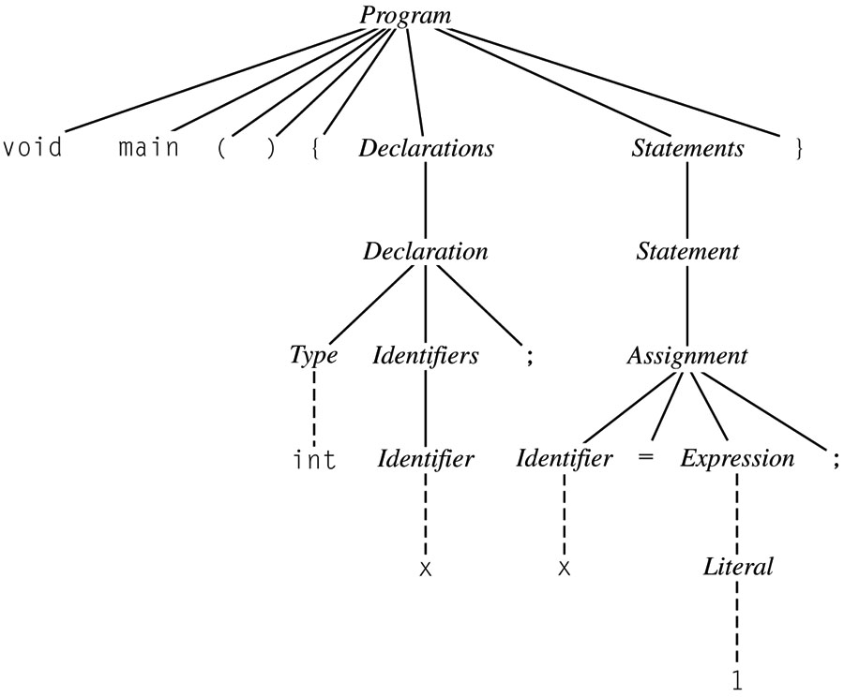
Parse Tree Sketch for Programs

Slide 9
BNF and Languages
The language defined by a BNF grammar is the set of all strings that can be derived
  Language can be infinite, e.g. case of integers
A language is ambiguous if it permits a string to be parsed into two separate parse trees
  Generally want to avoid ambiguous grammars
  Example:
    Expr → Integer | Expr + Expr | Expr * Expr | Expr - Expr
    Parse: 3*4+1
      Expr * Expr → Integer * Expr →
      3 * Expr → 3 * Expr+Expr → … 3 * 4 + 1
      Expr + Expr → Expr + Integer → Expr + 1
      Expr * Expr +1 → … 3 * 4 + 1

Slide 10
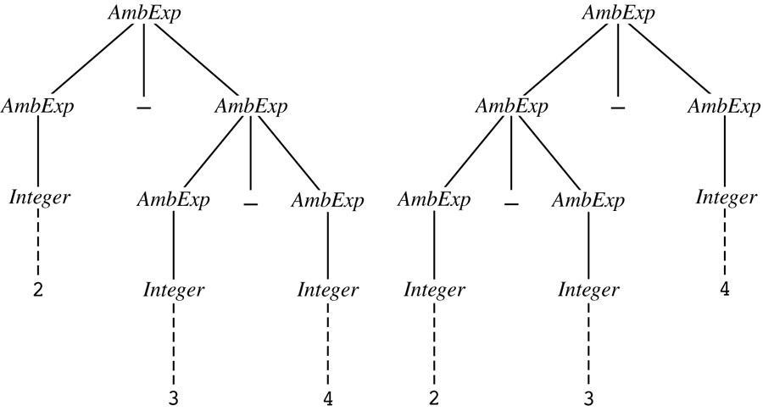
Ambiguity
Example for
  AmbExp → Integer | AmbExp – AmbExp
  2-3-4

Slide 11
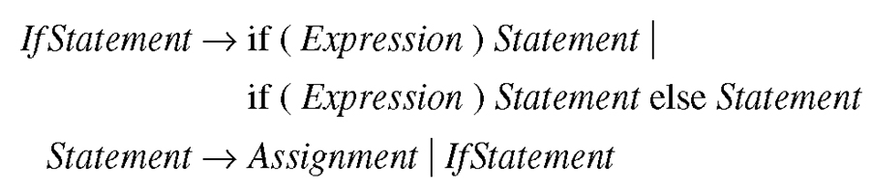
Ambiguous IF Statement
Dangling ELSE:
if (x<0)
if (y<0) { y=y-1 }
else { y=0 };
Does the else go with the first or second if?

Slide 12
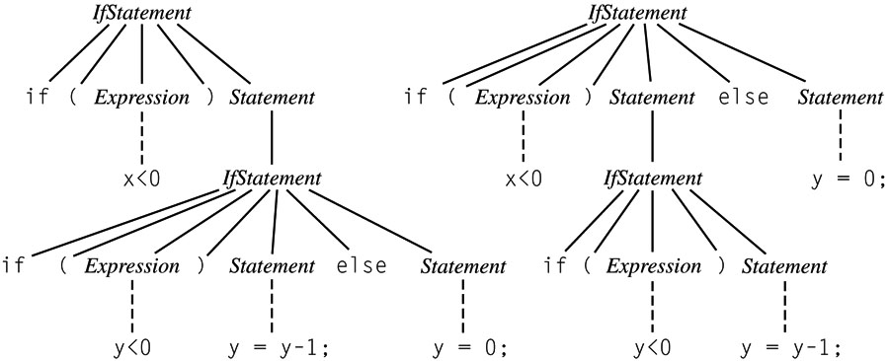
Dangling Else Ambiguity

Slide 13
How to fix ambiguity?
Use explicit grammar without ambiguity
  E.g., add an “ENDIF” for every “IF”
One problem with end markers is that they tend to bunch up. In Pascal you say
if A = B then …
else if A = C then …
else if A = D then …
else if A = E then …
else ...;
With end markers this becomes
  if A = B then …
  else if A = C then …
  else if A = D then …
  else if A = E then …
  else ...;
  end; end; end; end;

Slide 14
Ambiguity
Fixing Ambiguity
  Java makes a separate category for if-else vs. if:
    IfThenStatement → If (Expr) Statement
    IfThenElseStatement → If (Expr) StatementNoShortIf else Statement
    StatementNoShortIf contains everything except IfThenStatement, so the else always goes with the IfThenElse statement not the IfThenStatement
In general, we add new grammar rules that enforce precedence

Slide 15
Precedence Example
    Ambiguous
      Expr → Identifier | Integer | Expr + Expr | Expr * Expr | Expr – Expr
    Unambiguous
      Expr → Term | Expr + Term | Expr - Term
      Term → Factor | Term * Factor
      Factor → Integer | Identifier
    Parse: 3*4+1
  Expr + Term → Term + Term → Term * Factor + Term
  → Integer * Factor + Term → 3 * Factor + Term →
  3 * Integer + Term → 3 * 4 + Term → 3 * 4 + Factor →
  3 * 4 + Integer → 3 * 4 + 1
    What has precedence, + or *?

Slide 16
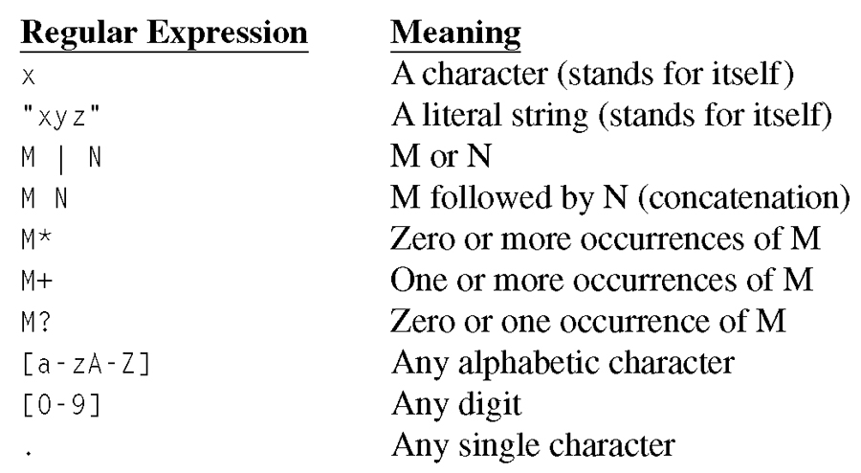
Alternative to BNF
The use of regular expressions is a common alternate way to express a language
Kleene Star
ε
The empty string
Notes:
RegExpr for CS A331, MM/DD/YY or MM/DD/YYYY

Slide 17
Regex to EBNF
Sometimes the following variations on “standard” regular expressions are used:
  { M } means zero or more occurrences of M
  ( M | N) means one of M or N must be chosen
  [ M ] means M is optional
  Use “{“ to mean the literal { not the regex {

Slide 18
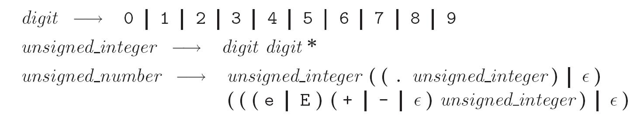
Regular Expressions
Numerical literals in Pascal may be generated by the following:

Slide 19
RegEx Examples
Booleans
  “true” | “false”
Integers
  (0-9)+
Identifiers
  (a-zA-Z)(a-zA-Z0-9)*
Comments (letters/space only)
  “//”(a-zA-Z)*(“\r” | “\n” | “\r\n”)
Simple Expressions
  Expr → Term ( (+|-) Term )*
  Term → Factor ( (* | / ) Factor) *
Regular expressions seem pretty powerful
  Can you write one for the language a^{n}b^{n}? (i.e. n a’s followed by n b’s)

Slide 20
Regular Expressions != Context Free Grammar
Regular expressions express a subset of context free grammars
  Regular Expressions ←→ Regular Languages ←→ Language of a Deterministic Finite State Automaton
  Context Free Grammars ←→ Context Free Languages ←→ Language of a Pushdown Automata

Slide 21
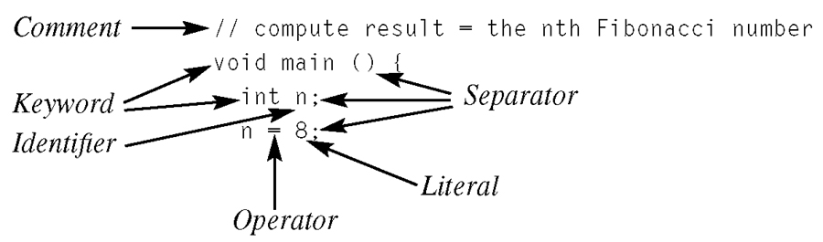
Lexical Analysis
Lexicon of a programming language – set of all nonterminals from which programs are written
Nonterminals – referred to as tokens
  Each token is described by its type (e.g. identifier, expression) and its value (the string it represents)
  Skipping whitespace or comments
or punctuation

Slide 22
Categories of Lexical Tokens
Identifiers
Literals
  Includes Integers, true, false, floats, chars
Keywords
  bool char else false float if int main true while
Operators
  = || && == != < <= > >= + - * / % ! [ ]
Punctuation
  ; . { } ( )
  Issues to consider: Ignoring comments, role of whitespace, distinguising the < operator from <=, distinguishing identifiers from keywords like “if”

Slide 23
A Simple Lexical Syntax for a Small C-Like Language
Primary → Identifier [ "["Expression"]" ] | Literal | "("Expression")"
| Type "("Expression")"
Identifier → Letter ( Letter | Digit )*
Letter → a | b | … | z | A | B | … Z
Digit → 0 | 1 | 2 | … | 9
Literal → Integer | Boolean | Float | Char
Integer → Digit ( Digit )*
Boolean → true | false
Float → Integer . Integer
Char → ‘ ASCIICHAR ‘

Slide 24
Scanning
Recall scanner is responsible for
  tokenizing source
  removing comments
  (often) dealing with pragmas (i.e., significant comments)
  saving text of identifiers, numbers, strings
  saving source locations (file, line, column) for error messages

Slide 25
Scanning
Suppose we are building an ad-hoc (hand-written) scanner for Pascal:
  We read the characters one at a time with look-ahead
If it is one of the one-character tokens
{ ( ) [ ] < > , ; = + - etc }
we announce that token
If it is a ., we look at the next character
  If that is a dot, we announce ..
  Otherwise, we announce . and reuse the look-ahead

Slide 26
Scanning
If it is a <, we look at the next character
  if that is a = we announce <=
  otherwise, we announce < and reuse the look-ahead, etc.
If it is a letter, we keep reading letters and digits and maybe underscores until we can't anymore
  then we check to see if it is a reserved word

Slide 27
Scanning
If it is a digit, we keep reading until we find a non-digit
  if that is not a . we announce an integer
  otherwise, we keep looking for a real number
  if the character after the . is not a digit we announce an integer and reuse the . and the look-ahead

Slide 28
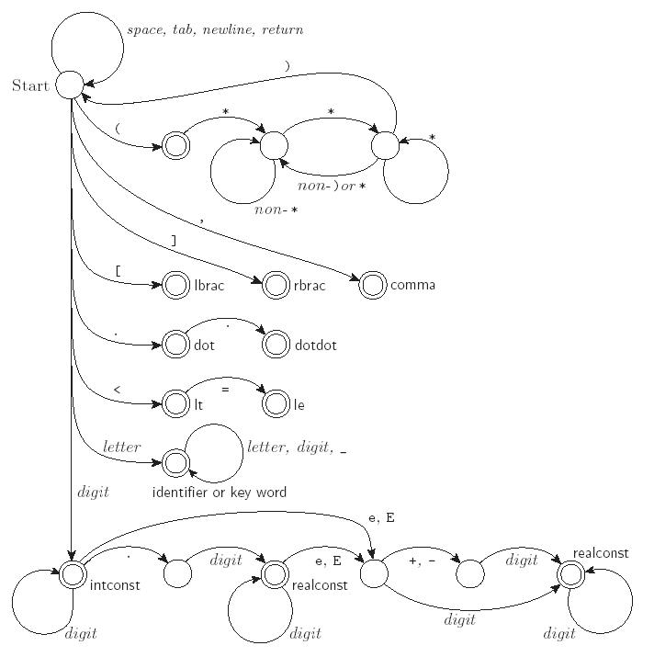
Scanning
Pictorial representation of a Pascal scanner as a finite automaton

Slide 29
Scanning
This is a deterministic finite automaton (DFA)
  Lex, scangen, etc. build these things automatically from a set of regular expressions
  Specifically, they construct a machine that accepts the language
  identifier | int const
  | real const | comment | symbol | ...
  This is the Lexical Syntax for the programming language

Slide 30
Scanning
We run the machine over and over to get one token after another
  Nearly universal rule:
    always take the longest possible token from the input
    thus foobar is foobar and never f or foo or foob
    more to the point, 3.14159 is a real const and never 3, ., and 14159
Regular expressions "generate" a regular language; DFAs "recognize" it

Slide 31
Scanning
Scanners tend to be built three ways
  ad-hoc
  semi-mechanical pure DFA
  (usually realized as nested case statements)
  table-driven DFA
Ad-hoc generally yields the fastest, most compact code by doing lots of special-purpose things, though good automatically-generated scanners come very close

Slide 32
Scanning
Writing a pure DFA as a set of nested case statements is a surprisingly useful programming technique
  though it's often easier to use perl, awk, sed
Table-driven DFA is what lex and scangen produce based on an input grammar
  lex (flex) in the form of C code
  scangen in the form of numeric tables and a separate driver (for details see Figure 2.11)

Slide 33
Scanning
Note that the rule about longest-possible tokens means you return only when the next character can't be used to continue the current token
  the next character will generally need to be saved for the next token
In some cases, you may need to peek at more than one character of look-ahead in order to know whether to proceed
  In Pascal, for example, when you have a 3 and you a see a dot
    do you proceed (in hopes of getting 3.14)?
    or
    do you stop (in fear of getting 3..5)?

Slide 34
Scanning
In messier cases, you may not be able to get by with any fixed amount of look-ahead. In Fortran, for example, we have
DO 5 I = 1,25 loop
DO 5 I = 1.25 assignment
Here, we need to remember we were in a potentially final state, and save enough information that we can back up to it, if we get stuck later

Slide 35
Parsing – From lexical to concrete syntax
Terminology:
  context-free grammar (CFG)
  symbols
    terminals (tokens)
    non-terminals
  production
  derivations (left-most and right-most - canonical)
  parse trees
  sentential form

Slide 36
Parsing
By analogy to RE and DFAs, a context-free grammar (CFG) is a generator for a context-free language (CFL)
  a parser is a language recognizer
There is an infinite number of grammars for every context-free language
  not all grammars are created equal, however

Slide 37
Parsing
It turns out that for any CFG we can create a parser that runs in O(n^3) time
There are two well-known parsing algorithms that permit this
  Early's algorithm
  Cooke-Younger-Kasami (CYK) algorithm
O(n^3) time is clearly unacceptable for a parser in a compiler - too slow

Slide 38
Parsing
Fortunately, there are large classes of grammars for which we can build parsers that run in linear time
  The two most important classes are called
  LL and LR
LL stands for
'Left-to-right, Leftmost derivation'.
LR stands for
'Left-to-right, Rightmost derivation’

Slide 39
Parsing
LL parsers are also called 'top-down', or 'predictive' parsers & LR parsers are also called 'bottom-up', or 'shift-reduce' parsers
There are several important sub-classes of LR parsers
  SLR
  LALR
We won't be going into detail on the differences between them

Slide 40
Parsing
Every LL(1) grammar is also LR(1), though right recursion in production tends to require very deep stacks and complicates semantic analysis
Every CFL that can be parsed deterministically has an SLR(1) grammar (which is LR(1))
Every deterministic CFL with the prefix property (no valid string is a prefix of another valid string) has an LR(0) grammar

Slide 41
Parsing
You commonly see LL or LR written with a number in parentheses after it
  This number indicates how many tokens of look-ahead are required in order to parse
  Almost all real compilers use one token of look-ahead
This grammar is LL(1)
  idlist → idlist id | id

Slide 42
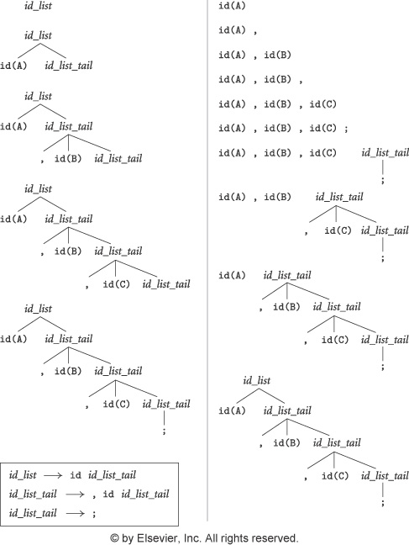
LL vs. LR
Input string: A, B, C;
Token list:
A
,
B
,
C
;

Slide 43
LL Parsing
Here is an LL(1) grammar for a calculator language (Fig 2.15):
program → stmt_list $$
stmt_list → stmt stmt_list
| ε
stmt → id := expr
| read id
| write expr
expr → term term_tail
term_tail → add_op term term_tail
| ε

Slide 44
LL Parsing
LL(1) grammar (continued)
10. term → factor fact_tail
11. fact_tail → mult_op fact fact_tail
| ε
factor → ( expr )
| id
| number
add_op → +
| -
mult_op → *
| /

Slide 45
LL Parsing
Example program
read A
read B
sum := A + B
write sum
write sum / 2
First we extract tokens and find identifiers
We start at the top and predict needed productions on the basis of the current left-most non-terminal in the tree and the current input token
  Called recursive descent

Slide 46
Recursive Descent Parser
void match(expected)
if input_token = expected
consume input_token
else parse_error
void program()
if input_token = ID, READ, WRITE, $$
stmt_list()
match($$)
else parse_error
void stmt_list()
if input_token = ID, READ, WRITE
stmt();
stmt_list();
if input_token = $$
skip
else parse_error
program → stmt_list $$
stmt_list → stmt stmt_list
| ε
Stmt → id := expr
| read id
| write expr

Slide 47
Recursive Descent Parser
void stmt()
if input_token = ID
match(id)
match(:=)
expr()
if input_token = READ
match(read)
match(id)
if input_token = WRITE
match(write)
expr()
else parse_error
void expr()
if input_token = ID, NUMBER, (
term();
term_tail()
else parse_error
Stmt → id := expr
| read id
| write expr
expr → term term_tail
term_tail → add_op term term_tail | ε
term → factor fact_tail
factor → ( expr )
| id
| number

Slide 48
Recursive Descent Parser
void term_tail()
if input_token = +, -
add_op()
term()
term_tail()
if input_token = ), ID, READ, WRITE, $$
skip
else parse_error
void term()
if input_token = ID, NUMBER, (
factor()
factor_tail()
else parse_error
term_tail → add_op term term_tail | ε
term → factor fact_tail
fact_tail → mult_op fact fact_tail | ε
factor → ( expr )
| id
| number
add_op → + | -
mult_op → * | /

Slide 49
Recursive Descent Parser
void factor_tail()
if input_token = *, /
mult_op()
factor()
factor_tail()
if input_token = +,-,), ID, READ, WRITE, $$
skip
else parse_error
void factor()
if input_token = ID
match(id)
if input_token = NUMBER
match(number)
if input_token = (
match (()
expr()
match())
else parse_error
term_tail → add_op term term_tail | ε
term → factor fact_tail
fact_tail → mult_op fact fact_tail | ε
factor → ( expr )
| id
| number
add_op → + | -
mult_op → * | /
void add_op()
if input_token = +
match(+)
if input_token = -
match(-)
else parse_error
void mult_op()
if input_token = *
match(*)
if input_token = /
match(/)
else parse_error

Slide 50
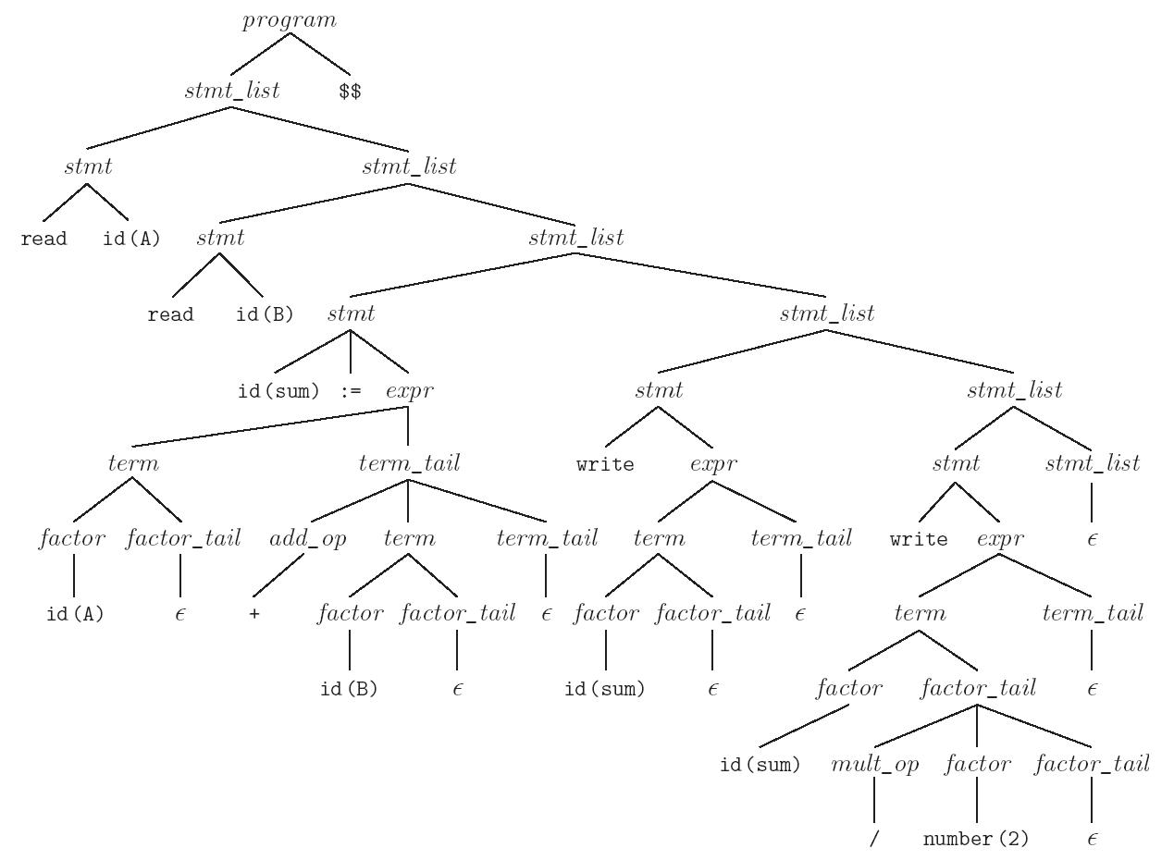
Parse Tree
read A
read B
sum := A + B
write sum
write sum / 2

Slide 51
LL Parsing
Table-driven LL parsing: you have a big loop in which you repeatedly look up an action in a two-dimensional table based on current leftmost non-terminal and current input token. The actions are
  (1) match a terminal
  (2) predict a production
  (3) announce a syntax error

Slide 52
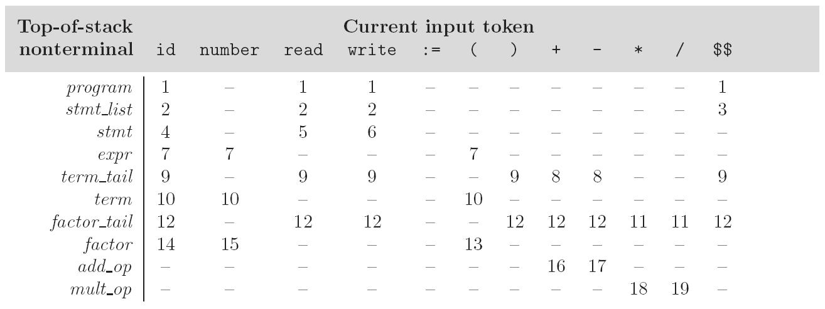
LL Parsing
LL(1) parse table for parsing for calculator language

Slide 53
LL Parsing
To keep track of the left-most non-terminal, you push the as-yet-unseen portions of productions onto a stack
  for details see Figure 2.20
The key thing to keep in mind is that the stack contains all the stuff you expect to see between now and the end of the program
  what you predict you will see

Slide 54
LL Parsing
Problems trying to make a grammar LL(1)
  left recursion
    example:
    id_list → id | id_list , id
    equivalently
    id_list → id id_list_tail
    id_list_tail → , id id_list_tail
    | ε
    we can get rid of all left recursion mechanically in any grammar

Slide 55
LL Parsing
Problems trying to make a grammar LL(1)
  common prefixes: another thing that LL parsers can't handle
    solved by "left-factoring”
    example:
    stmt → id := expr | id ( arg_list )
    equivalently
    stmt → id id_stmt_tail
    id_stmt_tail → := expr
    | ( arg_list)
    we can eliminate left-factor mechanically

Slide 56
LL Parsing
Note that eliminating left recursion and common prefixes does NOT make a grammar LL
  there are infinitely many non-LL LANGUAGES, and the mechanical transformations work on them just fine
  the few that arise in practice, however, can generally be handled with kludges

Slide 57
Bottom-Up and LR Parsing
Skipping this part in the text
  Almost always table-driven
The algorithm to build predict sets is tedious (for a "real" sized grammar), but relatively simple
It consists of three stages:
  (1) compute FIRST sets for symbols
  (2) compute FOLLOW sets for non-terminals
  (this requires computing FIRST sets for some strings)
  (3) compute predict sets or table for all productions

