Slide 1
Introduction to SQL, OleDB interface to Access from VB.NET

Slide 2
SQL
Structured Query Language, abbreviated SQL
  Usually pronounced “sequel” but also “ess-cue-ell”)
  The common language of client/server database management systems.
  Standardized – you can use a common set of SQL statements with all SQL-compliant systems.
  Defined by E.F. Codd at IBM research in 1970.
  Based on relational algebra and predicate logic

Slide 3
SQL Data Retrieval
Given an existing database, the SELECT statement is the basic statement for data retrieval.
  Both simple and complex, and it may be combined with other functions for greater flexibility.
SELECT data_element1 [, {data_element2 | function(..)} ] Or *
FROM table_1, [, table_2, …]
[ WHERE condition_1 [, {not, or, and} condition_2] ]
[ GROUP BY data_1, … ]
[ HAVING aggregate function(…)… ]
[ORDER BY data1, … ]

Slide 4
SELECT statement
Some sample aggregate functions:
  COUNT(*) SUM(item)
  AVG(item) MAX(item)
  MIN(item)
Conditional Operators
  = Equal
  < Less than
  > Greater than
  <>,!= Not equal to
  <= Less than or equal to
  >= Greater than or equal to

Slide 5
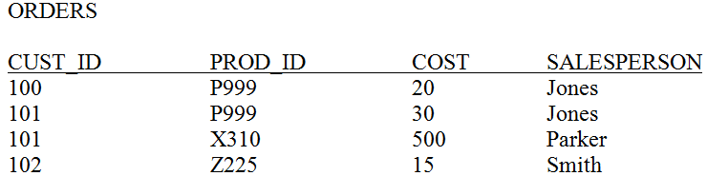
SELECT Examples
Select every row, column from the table:
  SELECT * FROM Orders;
  SELECT Orders.cust_id, Orders.prod_id, Orders.cost,
  Orders.salesperson
  FROM Orders;
Returns a set of all rows that match the query

Slide 6
SELECT
If a table has spaces or certain punctuation in it, then Access needs to have the items enclosed in square brackets []. The previous query is identical to the following:
  SELECT [orders].[cust_id], orders.prod_id, orders.cost, orders.[salesperson]
  FROM Orders;

Slide 7

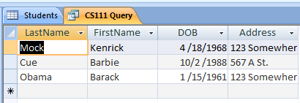
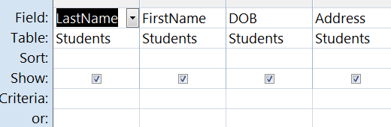
SELECT Query in Access
Can flip back and forth between SQL View, Run, and Design Mode
SQL
Run
Design

Slide 8
More SELECT Statements
Note that we can have duplicates as a result of the selection. If we want to remove duplicates, we can use the DISTINCT clause:
SELECT DISTINCT Orders.cust_id
FROM Orders;
We can combine a selection and a projection by using the WHERE clause:
SELECT Orders.cust_id
FROM Orders
WHERE Salesperson = “Jones”;
This could be used if we wanted to get all the customers that Jones has sold to, in this case, CUST_ID=101 and CUST_ID=100. By default, Access is not case-sensitive, so “jones” would also result in the same table.

Slide 9
More SELECT
We can further refine the query by adding AND , OR, or NOT conditions. If we want orders from Jones or from Smith then the query becomes:
SELECT Orders.cust_id
FROM Orders
WHERE Salesperson = “Jones” or Salesperson = “Smith”;
Another refinement is to use the BETWEEN operator. If we want only those orders between 10 and 100 then we could define this as:
SELECT Orders.cust_id, Orders.cost
FROM Orders
WHERE Orders.cost >10 and Orders.cost <100;
Or use the between operator:
SELECT Orders.cust_id, Orders.cost
FROM Orders
WHERE Orders.cost BETWEEN 10 and 100;

Slide 10
More SELECT
Finally, we might want to sort the data on some field. We can use the ORDER BY clause:
SELECT Orders.cust_id, Orders.cost
FROM Orders
WHERE Orders.cost >10 and Orders.cost <100
ORDER BY Orders.cost;
This sorts the data in ascending order of cost. An example is shown in the table:
CUST_ID COST
102 15
100 20
101 30
If we wanted to sort them in descending order, use the DESC keyword:
SELECT Orders.cust_id, Orders.cost
FROM Orders
WHERE Orders.cost >10 and Orders.cost <100
ORDER BY Orders.cost DESC;

Slide 11
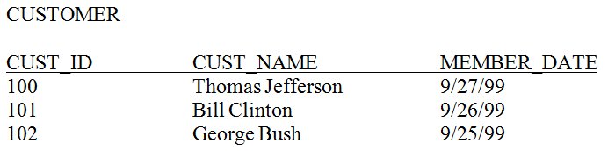
Joining Data from Multiple Tables
If our data is in multiple tables we can join them together in one query.
  Use a JOIN operator (Access default w/Design view)
  Add tables to the FROM, WHERE section (what we will use here)
Say we have the following table in addition to Orders:

Slide 12
Multiple Tables
SELECT Orders.cust_id, Customer.Cust_Name
FROM Orders, Customer
WHERE Orders.cost >10 and Orders.cost <100;
What do you expect from this query?
Result:
100 Thomas Jefferson
101 Thomas Jefferson
102 Thomas Jefferson
100 Bill Clinton
101 Bill Clinton
102 Bill Clinton
100 George Bush
101 George Bush
102 George Bush
PRODUCT of two tables!

Slide 13
Multiple Tables
Need to link the tables by their common field, the customer ID:
SELECT Orders.cust_id, Customer.Cust_Name
FROM Orders, Customer
WHERE Orders.cust_id = Customer.Cust_Id and
Orders.cost >10 and Orders.cost <100;
Result:
100 Thomas Jefferson
101 Bill Clinton
102 George Bush

Slide 14
INSERT command
Allows you to insert single or multiple rows of data into a table
INSERT INTO table [(column-list)] [VALUES (value-list) | sql-query]

Slide 15
INSERT examples
Given mytable(field1 as currency, field2 as text, field3 as integer):
INSERT INTO mytable (field1, field2, field3)
VALUES (12.10, “bah”,20);
Adds a new row to the table mytable
If you don’t specify every field then fields left out get the default:
INSERT INTO mytable (field1, field2) VALUES(24.2, “zot”);
Adds only for field1 and field2.

Slide 16
INSERT Examples
INSERT INTO ORDERS (CUST_ID, PROD_ID, COST, SALESPESON)
VALUES (103, ‘Y338’, 55, ‘Smith’);
INSERT INTO ORDERS (PROD_ID, COST, SALESPESON)
VALUES (‘Y638’, 155, ‘Smith’);
Second might be useful if the CUST_ID is an autonumber field

Slide 17
DELETE
Delete will remove a row from the table.
DELETE FROM table_name [WHERE search-condition]
Examples:
DELETE FROM mytable1;
Removes all rows!
DELETE FROM mytable1 WHERE field1 > 100;
Removes only rows with field1>100

Slide 18
UPDATE
Update lets you modify the contents of the data.
UPDATE table_name
SET field_name = expression [, field-name=expression …] [WHERE search-condition]
UPDATE mytable SET field1 = 0.0;
Changes all field1’s to zero for every row!
UPDATE mytable SET field1 = 0.0, field2 = “woof”;
Sets field1 to 0 and field2 to woof for all rows!
If this is a violation, access will prevent it from happening
UPDATE mytable SET field1 = 25.0 WHERE field2=“foo”;
Only updates the field where field2 is “foo”

Slide 19
SQL Queries
There are a lot more queries, but that should give you an idea of what is possible and how it is done
Next we’ll go over an example that uses SQL on an Access Database from VB.NET
  Uses OleDB which is different from the book
  Database access technology changes rapidly

Slide 20
OleDB in VB.NET
Add to the top:
Imports System.Data.OleDb
Set the connection string:
  This tells VB.NET where the database is and how to connect to it:
  Public Class Form1
  Dim connectionString As String
  Private Sub Form1_Load(. . .) Handles MyBase.Load
  connectionString = "Provider=Microsoft.ACE.OLEDB.12.0;Data Source=C:\Path\To\database.accdb"
  End Sub
For Office 2007

Slide 21
Example Reading from the DB
Dim cn As New OleDbConnection(connectionString)
cn.Open()
Dim cmd As New OleDbCommand("SELECT * From Students WHERE Lastname >= 'M'", cn)
cmd.ExecuteNonQuery()
Dim reader As OleDbDataReader = cmd.ExecuteReader()
While (reader.Read())
Dim ID As Integer = Convert.ToInt32(reader("ID"))
Dim Name As String = Convert.ToString(reader("LastName"))
Dim DOB As Date = Convert.ToDateTime(reader("DOB"))
Console.WriteLine(ID.ToString() + " " + Name + " " + DOB.ToString())
End While
cn.Close()

Slide 22
Example Writing to the DB
Dim cn As New OleDbConnection(connectionString)
cn.Open()
Dim newLastName As String = "Washington“
' ID is auto-update field so its left out of the insert
' Put single quotes around String fields, # around dates
Dim sql As String = "INSERT INTO Students (LastName, FirstName, DOB, Address) " + _
"VALUES ('" + newLastName + "', 'George', #04/19/2005#, '999 C St.')“
Dim cmd As New OleDbCommand(sql, cn)
cmd.ExecuteNonQuery()
Console.WriteLine("Executed command " + sql)
cn.Close()

