Slide 1
Introduction to Database Systems

Slide 2
Introduction to Database Systems
So, what is a database, anyway?
An integrated, self-describing collection of data about related sets of things and the relationships among them

Slide 3
If you burned down all our plants, and we just kept our people and our information files, we should soon be as strong as ever.
Thomas Watson, Jr. Former chairman of IBM

Slide 4
Visual Basic and Database Management Systems
Simple text files as shown in chapter 9 are:
  Fine for small amounts of data
  But impractical for large amounts of data
Businesses must maintain huge amounts of data
  A database management system (DBMS) is the typical solution to the data needs of business
  Designed to store, retrieve, & manipulate data
Visual Basic can communicate with several DBMS
  Tells DBMS what data to retrieve or manipulate

Slide 5
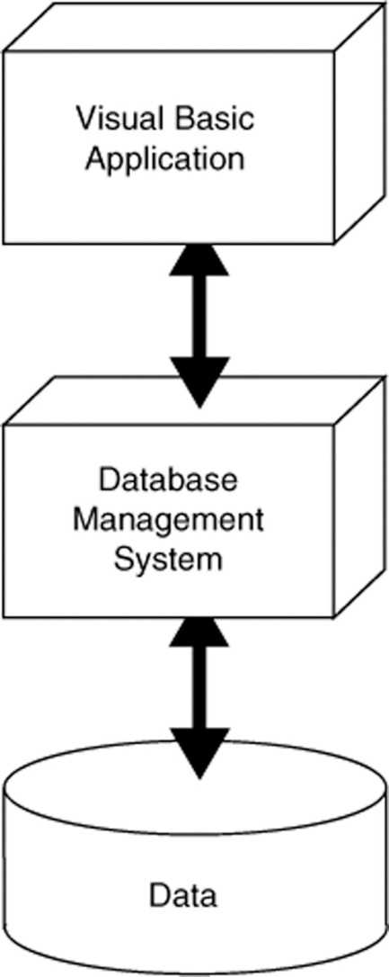
Layered Approach to Using a DBMS
Applications that work with a DBMS use a layered approach
  VB application is topmost layer
  VB sends instructions to next layer, the DBMS
  DBMS works directly with data
Programmer need not understand the physical structure of the data
  Just need to know how to interact with the database

Slide 6
Why not just use the file system?
Day8-21.txt
8,drive to work
9,teach class
10, …
Day8-22.txt
8,drive to work
9,eat donut
10, …
…
Could write programs to operate on this text file data.

Slide 7
File Storage Problems
Sharing data
Same data may be duplicated many times
Need to write custom programs to manipulate the data (e.g search, print)
As file systems become more complex, managing files gets more difficult
Making changes in existing file structures is important and difficult.
Security, data integrity (redundancy, inconsistency, anomalies) features are difficult to implement and are lacking.

Slide 8
File Storage Problems - Dependence
Structural Dependence: A change in the file’s structure requires the modification of all programs using that file.
Data Dependence: A change in any file’s data characteristics requires changes of all data access programs.

Slide 9
Solution: DBMS
Logically related data are stored in a single data repository.
The database represents a change in the way end user data are stored, accessed, and managed efficiently.
Easier to eliminate most of the file system’s data inconsistency, data anomalies, and data structural dependency problems.
Store data structures and relationships
DBMS takes care of defining all the required access paths.

Slide 10
Disadvantages of DBMS
Cost of software and implementation
Higher cost of processing routine batches
Increase magnitude of potential disaster
Lack of database technical capability

Slide 11
Relational Database Model
Introduced in the 60’s and 70’s and is the most common type of DBMS today
Data elements stored in simple tables (related)
General structure good for many problems
Easy to understand, modify, maintain
Examples: MySQL, Access, Oracle, SQL Server
We will focus on relational databases using Microsoft Access in our course

Slide 12
The Relational Model
Views entities as two-dimensional tables
  Records are rows
  Attributes (fields) are columns
Tables can be linked
Supports one-to-many, many-to-many, and one-to-one relationships

Slide 13
Terminology
Database: a collection of interrelated tables
Table: a logical grouping of related data
  A category of people, places, or things
  For example, employees or departments
  Organized into rows and columns
Field: an individual piece of data pertaining to an item, an employee name for instance
Record: the complete data about a single item such as all information about an employee
  A record is a row of a table

Slide 14
Database Table
Each table has a primary key
  Uniquely identifies that row of the table
  Emp_Id is the primary key in this example
  Serves as an index to quickly retrieve the record
Columns are also called fields or attributes
Each column has a particular data type
Emp_Id | First_Name | Last_Name | Department
001234 | Ignacio | Fleta | Accounting
002000 | Christian | Martin | Computer Support
002122 | Orville | Gibson | Human Resources
003400 | Ben | Smith | Accounting
003780 | Allison | Chong | Computer Support
Row
(Record)
Column
Field

Slide 15
VB and SQL Server Data Types
VB data types must match table data types
SQL Server and VB have similar data types
SQL Type Usage Visual Basic Type
Bit True/false values Boolean
DateTime Dates and times Date, DateTime
Decimal, Money Financial values Decimal
Float Real-number values Double
Int Integer values Integer
Smallint Integers -32,768 to 32,767 Short
Varchar(n) Variable length strings String
Text Strings more than 8000 char String

Slide 16
Choosing Column Names
Define a column for each piece of data
Allow plenty of space for text fields
Avoid using spaces in column names
For the members of an organization:
  Column Name Type Remarks
  Member_ID int Primary key
  First_Name varchar(40)
  Last_Name varchar(40)
  Phone varchar(30)
  Email varchar(50)
  Date_Joined smalldatetime Date only, no time values
  Meeings_Attended smallint
  Officer Yes/No True/False values

Slide 17
Issues with Redundant Data
Database design minimizes redundant data
In the following employee table:
ID First_Name Last_Name Department
001234 Ignacio Fleta Accounting
002000 Christian Martin Computer Support
002122 Orville Gibson Human Resources
00300 Jose Ramirez Research & Devel
003400 Ben Smith Accounting
003780 Allison Chong Computer Support
Same dept name appears multiple times
  Requires additional storage space
  Causes problems if misspelled
  What if a department needs to be renamed?

Slide 18
Eliminating Redundant Data
Create a department table
Dept_ID Dept_Name Num_Employees
1 Human Resources 10
2 Accounting 5
3 Computer Support 30
4 Research & Development 15
Reference department table in employee table
ID First_Name Last_Name Dept_ID
001234 Ignacio Fleta 2
002000 Christian Martin 3
002122 Orville Gibson 1
003000 Jose Ramirez 4
003400 Ben Smith 2
003780 Allison Chong 3

Slide 19
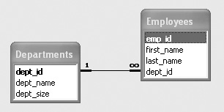
One-to-Many Relationships
The previous changes created a one-to-many relationship
  Every employee has one and only one dept
  Every department has many employees
  DeptID in department table is a primary key
  DeptID in employee table is a foreign key
One-to-many relationship
exists when primary key
of one table is specified
as a field of another table

Slide 20
Normalization
The previous example illustrated a technique used to make complex databases more efficient called Normalization
Break one large table into several smaller tables
  Eliminates all repeating groups in records
  Eliminates redundant data
Another example…

Slide 21
Redundant Data
Student
Student
Campus
Major
Phone
Course
Course
Instructor
Instructor
Instructor
Term
Grade
ID#
Name
Address
ID
Title
Name
Location
Phone
A121
Joy Egbert
100 N. State Street
MIS
555-7771
MIS 350
Intro. MIS
Van Deventer
T240C
555-2222
F'98
A
A121
Joy Egbert
100 N. State Street
MIS
555-7771
MIS 372
Database
Hann
T240F
555-2224
F'98
B
A121
Joy Egbert
100 N. State Street
MIS
555-7771
MIS 375
Elec. Comm.
Chatterjee
T240D
555-2228
F'98
B
+
A121
Joy Egbert
100 N. State Street
MIS
555-7771
MIS 448
Strategic MIS
Chatterjee
T240D
555-2228
F'98
A
−
A121
Joy Egbert
100 N. State Street
MIS
555-7771
MIS 474
Telecomm
Gilson
T240E
555-2226
F'98
C
+
A123
Larry Mueller
123 S. State Street
MIS
555-1235
MIS 350
Intro. MIS
Van Deventer
T240C
555-2222
F'98
A
A123
Larry Mueller
123 S. State Street
MIS
555-1235
MIS 372
Database
Hann
T240F
555-2224
F'98
B
−
A123
Larry Mueller
123 S. State Street
MIS
555-1235
MIS 375
Elec. Comm.
Chatterjee
T240D
555-2228
F'98
A
−
A123
Larry Mueller
123 S. State Street
MIS
555-1235
MIS 448
Strategic MIS
Chatterjee
T240D
555-2228
F'98
C
+
A124
Mike Guon
125 S. Elm
MGT
555-2214
MIS 350
Intro. MIS
Van Deventer
T240C
555-2222
F'98
A
−
A124
Mike Guon
125 S. Elm
MGT
555-2214
MIS 372
Database
Hann
T240F
555-2224
F'98
A
−
A124
Mike Guon
125 S. Elm
MGT
555-2214
MIS 375
Elec. Comm.
Chatterjee
T240D
555-2228
F'98
B
+
A124
Mike Guon
125 S. Elm
MGT
555-2214
MIS 474
Telecomm
Gilson
T240E
555-2226
F'98
B
A126
Jackie Judson
224 S. Sixth Street
MKT
555-1245
MIS 350
Intro. MIS
Van Deventer
T240C
555-2222
F'98
A
A126
Jackie Judson
224 S. Sixth Street
MKT
555-1245
MIS 372
Database
Hann
T240F
555-2224
F'98
B
+
A126
Jackie Judson
224 S. Sixth Street
MKT
555-1245
MIS 375
Elec. Comm.
Chatterjee
T240D
555-2228
F'98
B
+
A126
Jackie Judson
224 S. Sixth Street
MKT
555-1245
MIS 474
Telecomm
Gilson
T240E
555-2226
F'98
A
−
...
...
...
...
...
...
...
...
...
...
...
...

Slide 22
Normalized Data
Student Table
Student
Student
Campus
Major
Phone
Enrolled Table
ID#
Name
Address
A121
Joy Egbert
100 N. State Street
MIS
555-7771
Student
Course
Term
Grade
A123
Larry Mueller
123 S. State Street
MIS
555-1235
ID#
ID
A124
Mike Guon
125 S. Elm
MGT
555-2214
A121
MIS 350
F'98
A
A126
Jackie Judson
224 S. Sixth Street
MKT
555-1245
A121
MIS 372
F'98
B
...
...
...
...
...
A121
MIS 375
F'98
B
+
Teaching Assignment
A121
MIS 448
F'98
A
−
Course
Term
Instructor
A121
MIS 474
F'98
C
+
Class Table
ID
Name
A123
MIS 350
F'98
A
Course
Course
MIS 350
F'98
Van Deventer
A123
MIS 372
F'98
B
−
ID
Title
MIS 372
F'98
Hann
MIS 350
Intro. MIS
MIS 375
F'98
Chatterjee
A123
MIS 375
F'98
A
−
MIS 372
Database
MIS 448
F'98
Chatterjee
A123
MIS 448
F'98
C
+
MIS 375
Elec. Comm.
MIS 474
F'98
Gilson
A124
MIS 350
F'98
A
−
MIS 448
Strategic MIS
...
...
...
A124
MIS 372
F'98
A
−
MIS 474
Telecomm
Instructor Table
A124
MIS 375
F'98
B
+
...
...
Instructor
Instructor
Instructor
A124
MIS 474
F'98
B
Name
Location
Phone
A126
MIS 350
F'98
A
Chatterjee
T240D
555-2228
A126
MIS 372
F'98
B
+
Gilson
T240E
555-2226
A126
MIS 375
F'98
B
+
Hann
T240F
555-2224
Valacich
T240D
555-2223
A126
MIS 474
F'98
A
−
Van Deventer
T240C
555-2222
...
...
...
...

Slide 23
Associations
Relationships among the entities in the data structures
Three types
  One-to-one
  One-to-many
  Many-to-many
Relationships set by placing primary key from one table as foreign key in another
  Creates “acceptable” redundancy

Slide 24
Association Examples

Slide 25
Associations
Order (Order #, Order_Date, Customer)
1
Product(Prod #, Prod_Description, Qty)
1
M
M
Product_Order(Order #, Prod #, Customer)
Foreign key

Slide 26
Microsoft Access is Unique
Provides DBMS functions
  Not “industrial-strength”, designed for:
    Individuals
    Small workgroups
  External application programs work with Access
    We will use VB.NET and the Structured Query Language (SQL) later
Provides built-in tools for reporting and for application development
  Forms
  Reports
  Code modules using Visual Basic for Applications (VBA) which is similar to VB.NET but not the same
Provides flexibility
  Small, simple all-in-one environment
  Data can be easily transferred to full-fledged DBMS
Notes:
NEEDS WORK!!!!

Slide 27
Introduction to Access
Sample databases
  Northwind
    Included with every version of Access since 2.0
Demonstration of Access
  Startup
  Create tables
  Link table relationships
  Create queries/reports
  In this class you won’t have to create your own databases, but I’ll give you a database to work with

Slide 28
Access 2007 Example
Student ID Last Name First Name DOB Address
1 Mock Kenrick 4-18-1968 123 Somewhere
Ave
2 Cue Barbie 3-21-1970 567 A Street
3 Obama Barack 8-04-1961 123 Somewhere
Ave

Slide 29
Access 2007 Example
CS 111 Table
CS 201 Table
Student ID Grade
1 A
2 B
3 B
Student ID Grade
1 B
2 A
3 C

