Slide 1
Alice Methods and Classes

Slide 2
Methods and Classes
Methods
Coordinated sequence of instructions carried out when requested (e.g. move, turn to, etc.)
Class
A class defines an object, in our cases the 3D models
Classes contain
Data: e.g. position, color
Methods that pertain to the specific object
A class is a blueprint that tells Alice how to create, display, and manipulate the object
When an object is created we call this instantiation and we create an instance of the class

Slide 3
Classes vs. Objects
Bird Class
Tweety
Daffy
BigBird
To do: Add three birds to an Alice world

Slide 4
Methods
Methods must be associated with some object
Might be the world object
Should only deal with things specific to the object for which it is defined
Methods give us a way to divide a program up into small, manageable pieces that work together
Process called abstraction
Makes programs easier to write and debug than one giant code block
The process of breaking a problem into methods is called stepwise refinement
Methods may take parameters
Input data that the method should operate on, like a function

Slide 5
World Methods
For example, consider our world where we had the alien on wheels randomly try to get close to the washing machine
This is not too complex on its own, but when part of a larger script it can get messy

Slide 6
World Methods
We can create a method named “AlienSeek” that runs this code
Under “World”, click “Methods” and “Create New Method” and name it “AlienSeek”
Put code into the new method
To invoke it, we just drag out “AlienSeek” from the World methods where we want to use it
Greatly simplifies the invoking code and also gives it a name to make it more meaningful
To do: Create method in Alice

Slide 7
Another Method Example
Create a new world with three Birds
Create a World method called “RandomFly”
While true
With 50% chance
Make Bird1 turn to the left randomly up to 0.25
Otherwise
Make Bird1 turn to the right randomly up to 0.25
Go forward some random distance from 0 to 0.5

Slide 8
Problem: How about for all birds?
What if we want all birds to fly? The new method only moves Bird1 and it would be nice to avoid having to copy the method for Bird2, Bird3 when it should be the same
Solution
Make the method take a parameter that specifies which bird object to move
Bird1
Bird2
RandomFly Method: Parameter – BirdObj
( Manipulate the BirdObj)

Slide 9
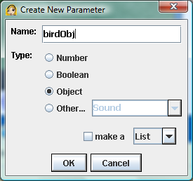
Creating a Parameter
Click “Create new Parameter” button in the method
Give it a name like birdObj
Drag birdObj in place of Bird1

Slide 10
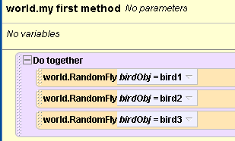
Invoking the Method
We need to specify the parameter when we invoke the method
All the birds now fly together!

Slide 11
Refinement
Maybe we want the birds to fly random lengths from 0 to 1 but at the same speed
Problem: Duration should then match the distance
We want these the same value
But if we pick another random number it may be different

Slide 12
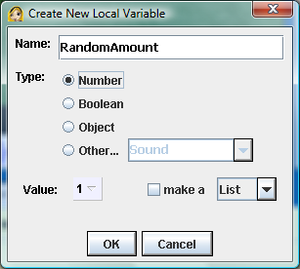
Solution: Variable
Create a variable that holds the random number, then we can reference that same variable in both places
Click “Create New Variable”, give it a name, and assign its value

Slide 13
Further Refinement: Flock
Let’s keep the birds from flying too far away from each other
Not very elegant but workable solution:
If distance to otherBirdA > 3 then
Turn to face otherBirdA
Else
If distance to otherBirdB > 3 then
Turn to face OtherBirdB
Else
Do the random direction selection
Fly forward random amount
Can do this by adding two more parameters for the other birds

Slide 14
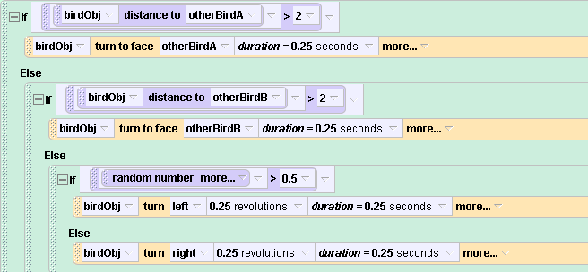
Bird Flock
More elegant solutions exist, but we will skip them here

Slide 15
Bird Sounds
What if we would like each bird to play a different sound as it flies? We can send that in as a separate parameter too.
Can record a new sound for Bird1
Create a new parameter, select Other, and pick “Sound” as the type of parameter

Slide 16
Class Methods
We can also define methods for specific classes
Such methods should ONLY apply to behaviors of the selected class / object
E.g. Select Bird1
Shouldn’t add anything relating to other birds/objects inside this method
Can add a “FlapWings” method
Set the Pose to Fly1
Set the Pose to Fly2
Notice that the new method only applies to Bird1
If you want the method for all birds, you can save Bird1 as a new object, then load the new object in and you will be creating multiple instances of the Bird1 class

Slide 17
All birds flapping
To make all the birds flap we can make a World method that takes a Bird object as input and flaps its wings

Slide 18
Exercise : Magic Act
A magician is performing a levitation illusion in which objects rise magically into the air. The magician points at a rabbit and it floats; then he points at his assistant and she floats.
Use a single method with parameters to communicate which object is to float and the distance the object is to move upward and downward.

