Slide 1
Alice
Program Design and Implementation

Slide 2
Scenarios and storyboards
The previous magician example illustrated a simple storyboard which depicts a scenario
Should come up with the scenario and come up with a design or “plan ahead” strategy to construct the program
Scenario
What story is to be told?
What objects are needed? Role vs. background?
What actions are to take place?

Slide 3
Scenario Example
Story
A robot’s first encounter with an alien on a distant moon
Objects
Robot, lunar lander, alien, rocks
Actions
Alien peeks out from behind rocks; robot turns its head and moves toward the alien; the alien hides and the robot sends a message to earth
To design this scenario we can use storyboards

Slide 4
Storyboard
Can be visual or textual
Breaks down a scenario into sequences of many short scenarios
Depicts the sequence of scenes
For an animation there many be dozens of scene sketches drawn by animation artists or generated by computer animation specialists

Slide 5
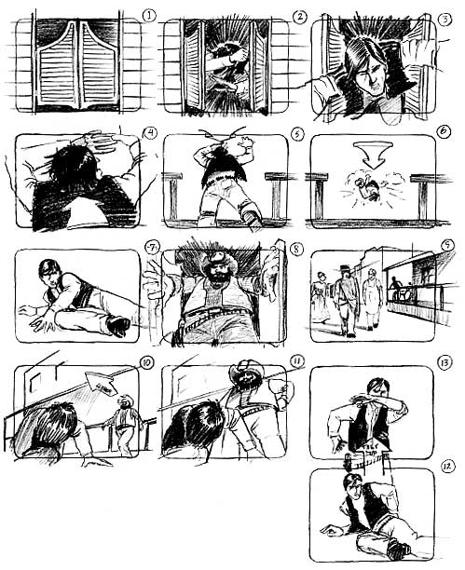
Example Visual Storyboard
For our purposes, simple stick figures, square, circles, other simple shapes will suffice
From http://accad.osu.edu/womenandtech/Storyboard%20Resource/

Slide 6
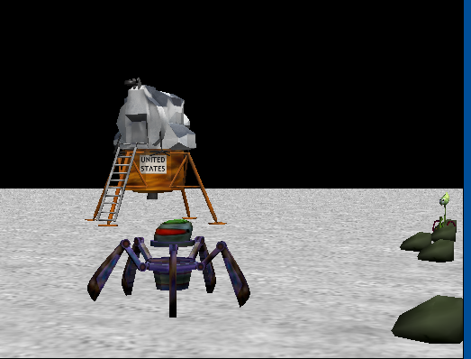
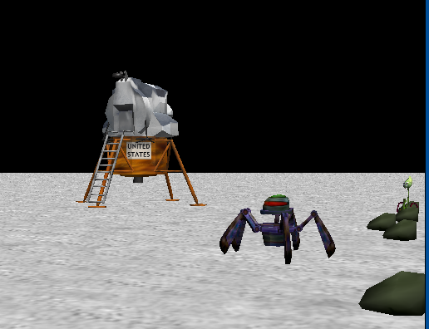
Visual Storyboard
Can plan out with screen captures from Alice and manually moving objects around
Initial scene; robot has climbed down the lander and is exploring
Alien appears and says “Slithy toves?”
Robot moves toward alien

Slide 7
Textual Storyboards
Not everyone has the patience for visual sketches; textual storyboard is a good alternative
“To-Do List” and prepares us for writing program code
Example for alien
Do the following steps in order
Alien moves up
Alien says “Slithy Toves?”
Robot’s head turns around
Robot turns toward alien
Do the following steps together
Robot moves toward the alien
Robot legs walk

Slide 8
Textual Storyboards
Evaluate and Revise – storyboard is not final
Does the action flow from scene to scene?
Do any transitions need to be added to blend one scene to the next?
Is anything missing?
Should something be changed?
Design-Modify-Create cycle

Slide 9
Creating a Program
What instructions are needed for the alien storyboard?
Do the following steps in order
Alien moves up
Alien says “Slithy Toves?”
Robot’s head turns around
Robot turns toward alien
Do the following steps together
Robot moves toward the alien
Robot legs walk
Alien moves down
Robot turns to the camera
Robot turns red
Robot says “Houston, we have a problem!”

Slide 10
To-do In Class
Program sequential actions for storyboard
Drag actions into “Do In Order”
What about moving forward while moving legs up and down? We want this to happen together
Drag the “Do Together” block where you would like things to be done together
In our case, drag inside the “Do In Order” but this could be put outside as well

Slide 11
Flowchart
backLeftLeg UpperJoint turns forward 0.1
frontRightLeg UpperJoint turns forward 0.1
Robot moves 2 meters
backLeftLeg UpperJoint turns backward 0.1
frontRightLeg UpperJoint turns backward 0.1
Can right-click the object to see what the method will do; control-Z to undo

Slide 12
First Attempt
Do together
Move robot forward
Turn backLeftLeg forward 0.1
Turn backLeftLeg backward 0.1
Turn frontRightLeg forward 0.1
Turn frontRightLeg backward 0.1

Slide 13
Second Attempt
Bug in the previous version, everything done together, including moving forward and backward at once
These should be done in order instead
Also make sure time adds up to the 2 seconds for the walking motions

Slide 14
Using a Property
You can drag the property out to the code window to change a value at some point in the program
Drag the robot’s color property and change it to Red

Slide 15
Use Comments
Drag the // to explain what the program is doing

Slide 16
Motion
Experiment with
Turn
Roll
Move To
Turn To Face
Orient To
Try putting a beach ball on top of an animal and have the two move forward together
Most likely they will not go in the same direction because we can’t tell which direction the ball is facing
Solution is to “orient to” the same direction
Vehicle Property
Makes one object belong to another so moving the “vehicle” moves the occupant as well

Slide 17
Arguments: duration, style, asSeenBy
Duration – self explanatory
Style – abrupt or gentle motion
asSeenBy – Defines the directions for forward, backward, up, down, left, right
If world, then absolute directions
If object, relative to whatever direction that object is facing
Book example: helicopter go up but banked

